Slide 1
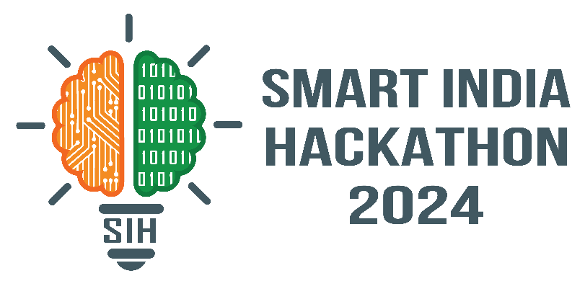

SMART INDIA HACKATHON 2024
Problem Statement ID – SIH1627
Problem Statement Title- Drug Inventory and Supply Chain Tracking System
Theme- MedTech / BioTech / HealthTech
PS Category- Software
Team ID-
Team Name - Laksh

Slide 2


Drug Inventory and Supply Chain Tracking System
Proposed Solution
The problem is being solved by a Drug Inventory and Supply Chain Tracking System which has been designed to simplify distribution.
Ecommerce platform for Distributors and Vendors.
The technology and Artificial Intelligence will assist the system in tracking, monitoring and controlling the pharmacological products in the supply chains.
The system aims to ensure that the right drugs are available in the right quantity, at the right time, place, and cost, in the right condition, and for the right people.
Innovation and Uniqueness of the Solution:
Integrated Multi-Database Approach
Real-Time Dashboard Monitoring
Focus on Data-Driven Decisions
Enhanced Security with Modern Protocols
AI based Forecasting
Ecommerce platform
How the Solution Addresses the Problem:
Ensures Drug Availability
Improves Procurement Efficiency
Monitors Drug Consumption Patterns
Reduces Costs and Waste
Improves Data Security
Enhances Regulatory Compliance

Slide 3


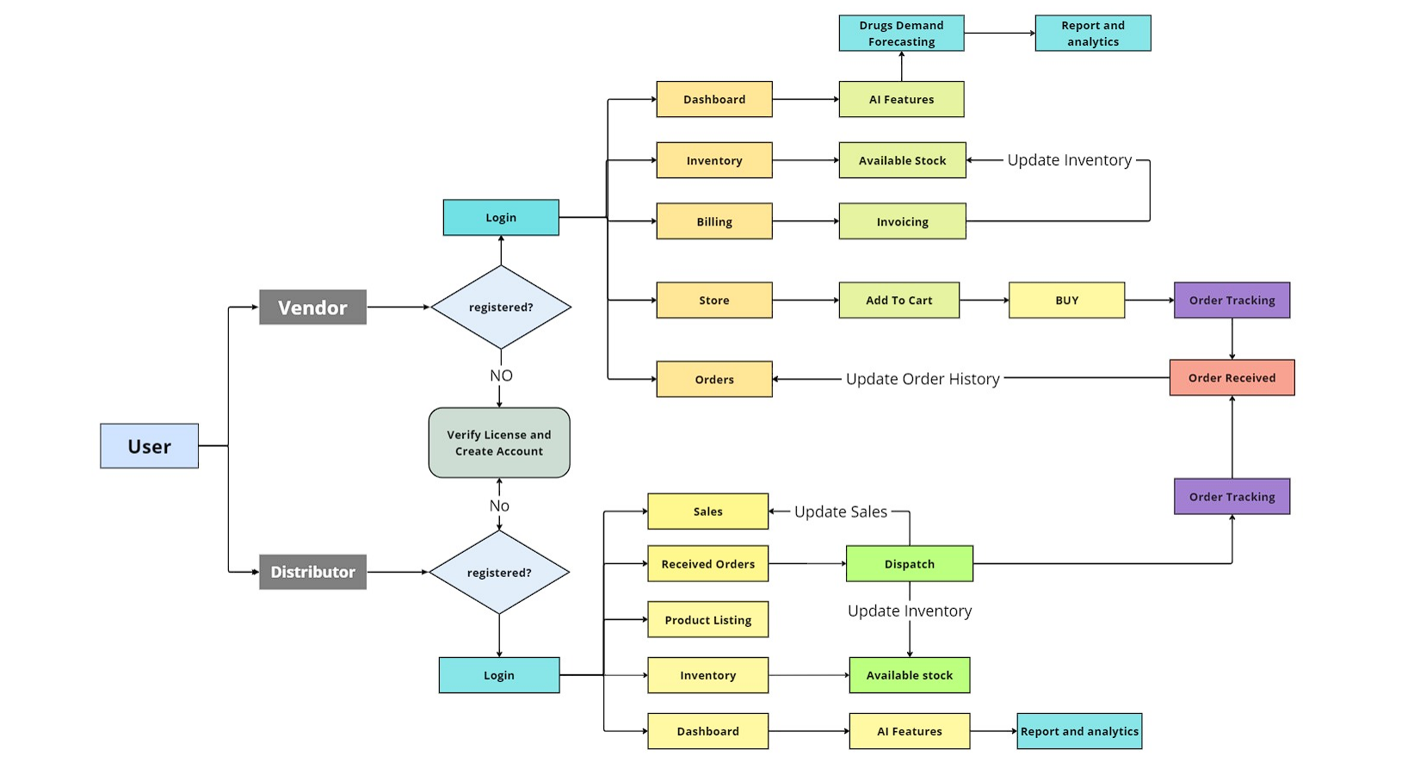



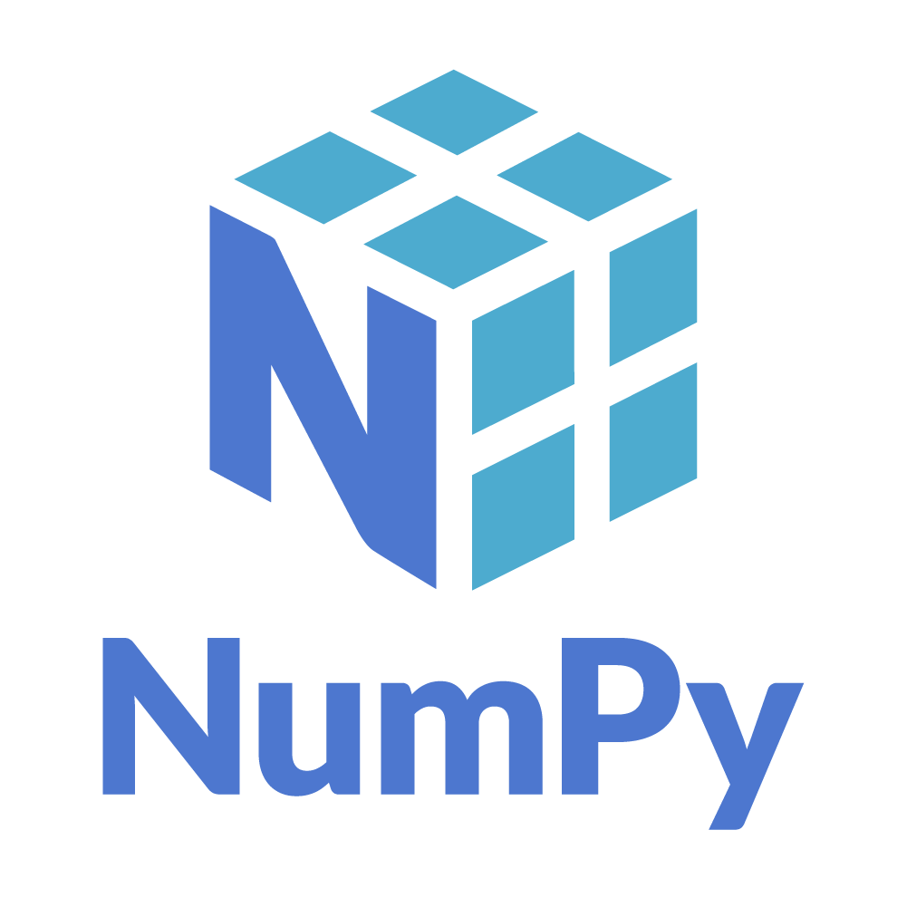








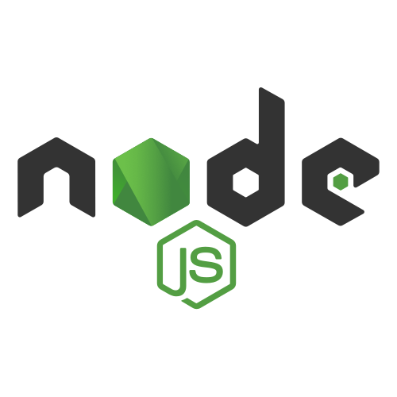
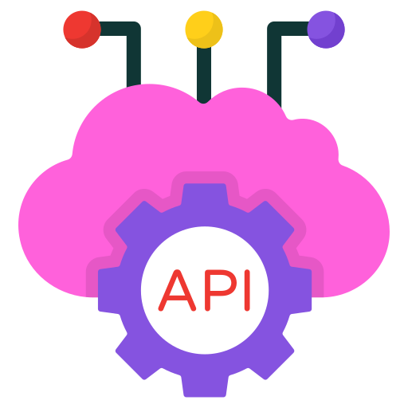


TECHNICAL APPROACH

Slide 4






FEASIBILITY AND VIABILITY
Feasibility:
1. Technical Feasibility
Technology Stack
Cloud Integration
Security
2. Operational Feasibility
Ease of Use
User Adoption
Government Guidelines
3. Financial Feasibility
Cost Considerations
Scalability
Challenges and Risks:
1. Data Accuracy and Integrity
Challenge: Ensuring data is up to date.
Risk: Errors can cause inventory issues.
2.System Integration
Challenge: Connecting with existing systems.
Risk: May loss data .
3.Cybersecurity
Challenge: Protecting sensitive data.
Risk: Breaches can cause theft and losses.
Strategies for Overcoming These Challenges:
Ensuring Data Accuracy and Integrity
Smooth Integration with Existing Systems
Enhancing Cybersecurity Measures
Managing Vendor Reliability
Ensuring Regulatory Compliance

Slide 5
IMPACT AND BENEFITS
Benefits:
Improved Drug Availability:
Ensures essential medicines are always available, reducing shortages.
Cost Reduction:
Optimizes procurement and reduces wastage, leading to cost savings for hospitals and institutions.
Real-Time Monitoring:
Enables real-time tracking of inventory, shipments, and consumption patterns through a dashboard.
Vendor Accountability:
Improves vendor performance by tracking their activities and ensuring timely deliveries.
Enhanced Decision-Making:
Provides data-driven insights into drug usage, improving procurement planning.
Impacts:
1.Social Impact:
Enhances access to medicines, improving public health.
2.Environmental Impact:
Reduces pharmaceutical waste and carbon emissions through optimized logistics.
3.Economic Impact:
Lowers healthcare costs and fosters competition, making drugs more affordable.
4.Governance and Policy Impact:
Provides data to support informed healthcare policy decisions.
5.Job Creation and Innovation:
Generates jobs in IT, supply chain management, and logistics, while promoting innovation in pharmaceutical distribution.

Slide 6
RESEARCH AND REFERENCES
“Drug Governance: IoT-based Blockchain Implementation in the Pharmaceutical Supply Chain”, Victoria Ahmadi, Sophia Benjelloun, Michel El Kik, Tanvi Sharma, Huihui Chi, Wei Zhou, 2020 Sixth International Conference on Mobile And Secure Services (MobiSecServ)
“Supply Chain Management in Pharmaceutical Industry Using IOT”, Jyothy S T and Mrinal Sarvagya, 2022 IEEE North Karnataka Subsection Flagship International Conference (NKCon)
“A Novel Framework for Pharmaceutical Supply Chain Management using Distributed Ledger and Smart Contracts”,Sandip Jangir, Ajit Muzumdar, Alok Jaiswal, Chirag N. Modi, Sheetal Chandel, C. Vyjayanthi, 2019 10th International Conference on Computing, Communication and Networking Technologies (ICCCNT)
“A Survey on Supply Chain Security: Application Areas, Security Threats, and Solution Architectures”, Vikas Hassija, Vinay Chamola, Vatsal Gupta, Sarthak Jain, Nadra Guizani, IEEE Internet of Things Journal ( Volume: 8, Issue: 8, 15 April 2021)
“Data analytics in pharmaceutical supply chains: state of the art, opportunities, and challenges”, Angie Nguyen, Samir Lamouri, Robert Pellerin, Simon Tamayo, Béranger Lekens, Received 30 Oct 2020, Accepted 16 Jun 2021, Published online: 19 Jul 2021

