Slide 1
“Polarizer”
PRESENTED BY:
BABHULGAONKAR SHASHWAT
BENDKULE PRITAM
SURYAVANSHI JAYESH
SANAP VIVEK

Slide 2
Overview
What is sentiment analysis?
Sentiment Analysis is the process of ‘computationally’ determining whether a piece of writing is positive, negative or neutral. It’s also known as opinion mining, deriving the opinion or attitude of a speaker.

Slide 3
Use Cases
Business: In marketing field companies use it to develop their strategies, to understand customers’ feelings towards products or brand, how people respond to their campaigns or product launches and why consumers don’t buy some products.
Politics: In political field, it is used to keep track of political view, to detect consistency and inconsistency between statements and actions at the government level. It can be used to predict election results as well!
Public Actions: Sentiment analysis also is used to monitor and analyse social phenomena, for the spotting of potentially dangerous situations and determining the general mood of the blogosphere.

Slide 4
Installation
Tweepy: tweepy is the python client for the official Twitter API.
Install it using following pip command:
pip install tweepy
TextBlob: textblob is the python library for processing textual data.
Install it using following pip command:
pip install textblob
Also, we need to install some NLTK corpora using following command:python -m textblob.download_corpora

Slide 5
Authentication
In order to fetch tweets through Twitter API, we register for an App through our twitter account. Below are the steps for the same:
Open this link and click the button: ‘Create New App’
Fill the application details. You can leave the callback url field empty.
Once the app is created, you will be redirected to the app page.
Open the ‘Keys and Access Tokens’ tab.
Copy ‘Consumer Key’, ‘Consumer Secret’, ‘Access token’ and ‘Access Token Secret’.

Slide 6
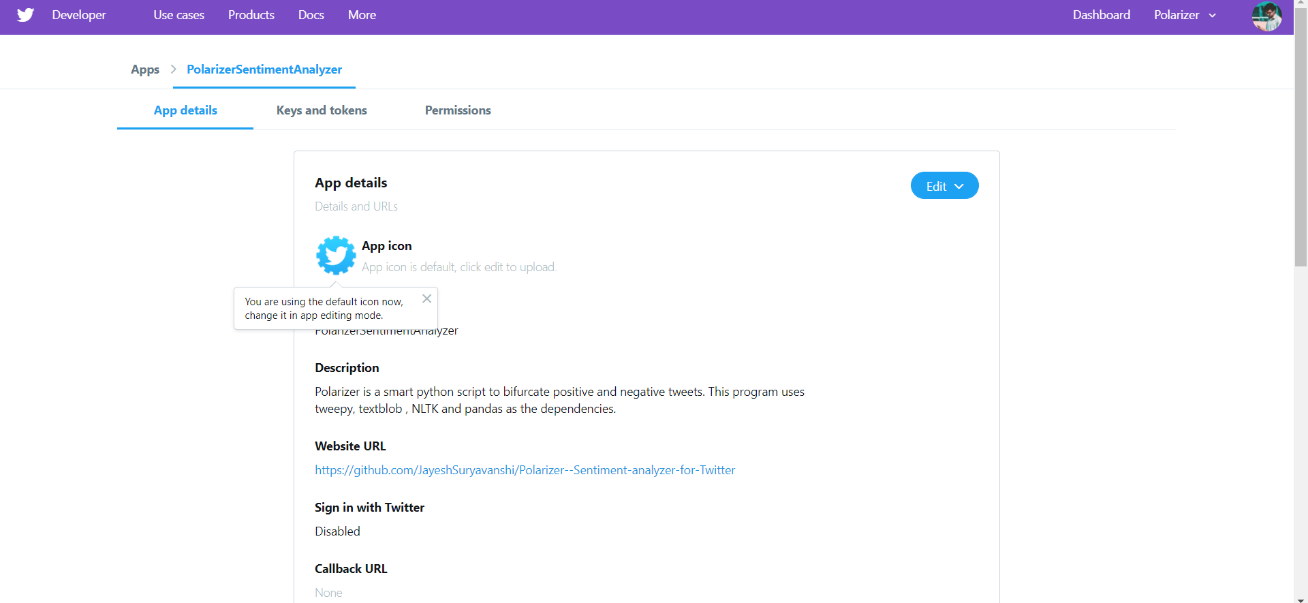
Screenshots of
Developer API’s

Slide 7
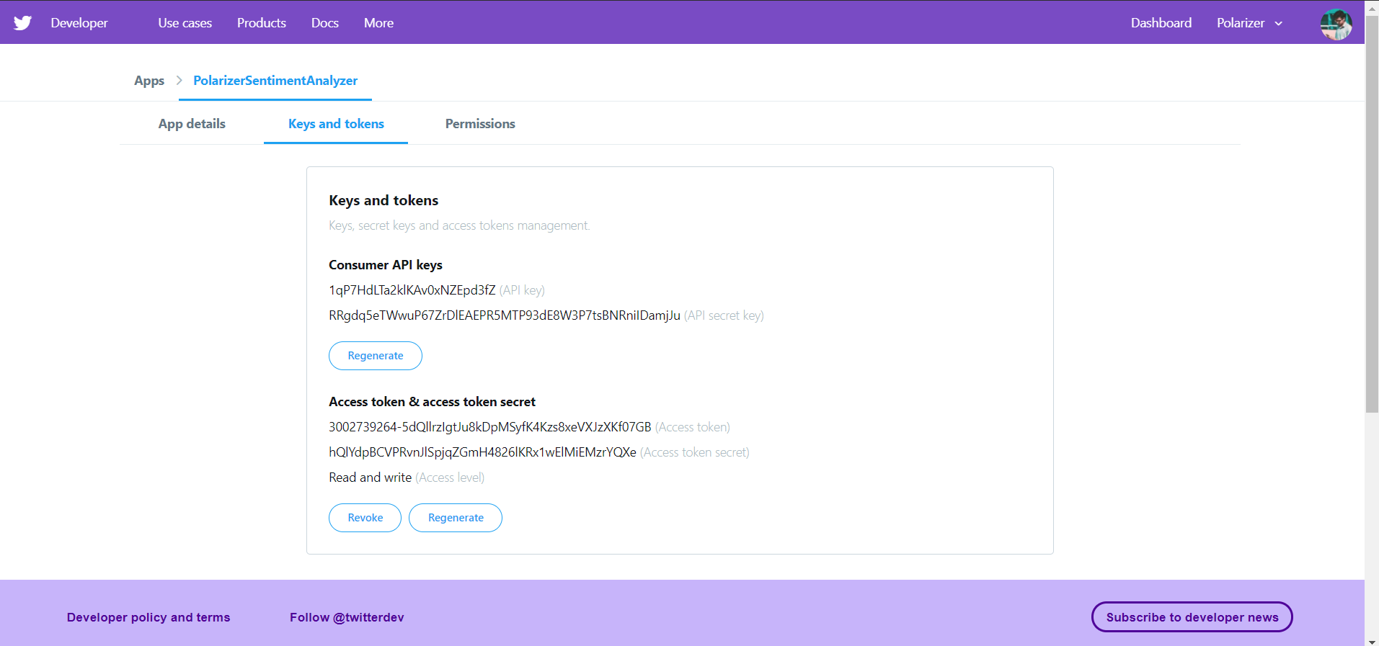
Screenshots of
Keys and tokens

Slide 8
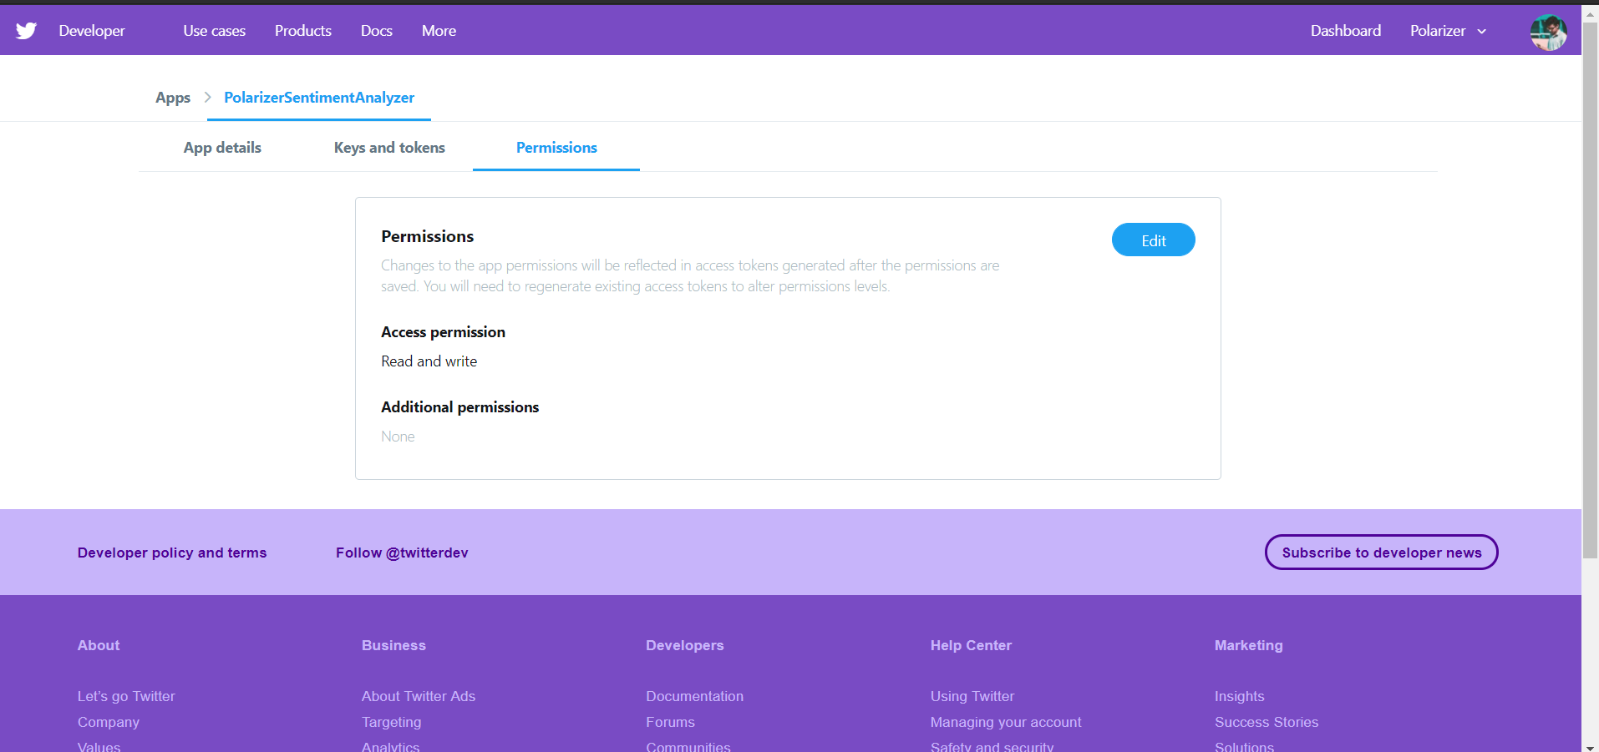
Permissions

Slide 9
Implementation & Results
Link for the project:
https://github.com/JayeshSuryavanshi/Polarizer--Sentiment-analyzer-for-Twitter
We followed these 3 major steps in our program:
Authorization: Authorize twitter API client.
Fetching: Make a GET request to Twitter API to fetch tweets for a particular query.
Parsing: Parse the tweets. Classify each tweet as positive, negative or neutral.

Slide 10
create a TwitterClient class
__init__ function to handle the authentication of API client.
In get_tweet_sentiment we use textblob module.
we use sentiment.polarity method of TextBlob class
1
2
3
4
5
get_tweets function
Twitter API to fetch tweets.
Parsing of Tweets using TextBlob library

Slide 11
Procedure:
First of all, we create a TwitterClient class. This class contains all the methods to interact with Twitter API and parsing tweets. We use __init__ function to handle the authentication of API client.
In get_tweets function, we use: fetched_tweets = self.api.search(q = query, count = count) to call the Twitter API to fetch tweets.
In get_tweet_sentiment we use textblob module. analysis = TextBlob(self.clean_tweet(tweet)) TextBlob is actually a high level library built over top of NLTK library. First we call clean_tweetmethod to remove links, special characters, etc. from the tweet using some simple regex. Then, as we pass tweet to create a TextBlob object, following processing is done over text by textblob library:

Slide 12
Procedure:
Tokenize the tweet ,i.e split words from body of text.
Remove stopwords from the tokens.(stopwords are the commonly used words which are irrelevant in text analysis like I, am, you, are, etc.)
Do POS( part of speech) tagging of the tokens and select only significant features/tokens like adjectives, adverbs, etc.
Pass the tokens to a sentiment classifier which classifies the tweet sentiment as positive, negative or neutral by assigning it a polarity between -1.0 to 1.0 .
Here is how sentiment classifier is created:
TextBlob uses a Movies Reviews dataset in which reviews have already been labelled as positive or negative.
Positive and negative features are extracted from each positive and negative review respectively.
Then, we use sentiment.polarity method of TextBlob class to get the polarity of tweet between -1 to 1.

Slide 13
Procedure:
Then, we classify polarity as: if analysis.sentiment.polarity > 0:
return 'positive'
elif analysis.sentiment.polarity == 0:
return 'neutral'
else:
return 'negative'
Finally, parsed tweets are returned. Then, we can do various type of statistical analysis on the tweets. For example, in above program, we tried to find the percentage of positive, negative and neutral tweets about a query.

Slide 14
References
http://www.ijcaonline.org/research/volume125/number3/dandrea-2015-ijca-905866.pdf
https://textblob.readthedocs.io/en/dev/quickstart.html#sentiment-analysis
textblob.readthedocs.io/en/dev/_modules/textblob/en/sentiments.html

