Slide 1

Assignment
Category and SubCategory Prediction
(Classification, NLP)
By - Jayesh Dahiwale

Slide 2


STEPS INVOLVED :
Steps that significantly contribute towards achieving the results:
Defining Problem Statement
Understanding Data
Data Cleaning
Exploratory Data Analysis
Textual Data Preprocessing
Model Building
Conclusions

Slide 3
Project Goal :
The goal of this project is to classify the transactions according to their respective Categories and SubCategories.
Problem Statement :
Freecharge is an Indian Financial services company based in Gurgaon. It allows users to pay bill such electricity, gas & telephone as well as recharge mobile,broadband, DTH & Metro Cards.
We have given a dataset consisting of around 53000 transactions. Using this data, we have to make a classification model, to predict Categories and Sub-Categories.

Slide 4
DATA PIPELINE :
Analyze Data: In this initial step we went to look for different features available and tried to understand the data. During this stage, we looked for the shape of data,data types of each feature, statistical summary etc.
Data Cleaning: Checked duplicated values present in the dataset. After that comes the null value and outlier detection and treatment. For the null values imputation we simply replace the empty string and drop some of the null rows then analyze outlier and handling.
EDA: EDA or Exploratory Data Analysis is the critical process of performing initial investigation on the data. So,through this we have observed certain trends and dependencies from the dataset that will be useful for further processing.
Textual Data Preprocessing: During this stage, cluster the data based on the attributes: director, cast, country,genre, rating and description. Data preprocessing include Remove all stop words and punctuation marks, convert all textual data to lowercase. Stemming to generate a meaningful word out of corpus of words. Tokenization of corpus and Word vectorization. We used Principal Component Analysis(PCA) to handle the curse of dimensionality.
Building Classification Model: Used K-Means and Agglomerative Hierarchical clustering algorithms to cluster the movies, obtained the optimal number of clusters using different techniques.
Build A flask API: Built an API using Flask, which will be a user friendly interface and help in providing prediction about the Category and SubCategory of the given transactions

Slide 5
DATASET SUMMARY:
ATTRIBUTE INFORMATION:
This dataset consist of transactions in the year 2021 and 2022
The dataset contained about 53000 records and 9 attributes
Features were present in both Textual and Numerical format
.
Sl. no.: Represent the serial no of transaction
Date : Represents the date of transaction
Cheque No : Represent Cheque Number of Transaction
Description: Represents the detail info about Transaction
Sub-Category: Represent sub-category of the transaction
Category: Represent Category of the transaction
Amount: represents the txn amount done by person
Category.1: Additional info about transaction
Balance : Shows the amount of balance remaining in person’s account

Slide 6
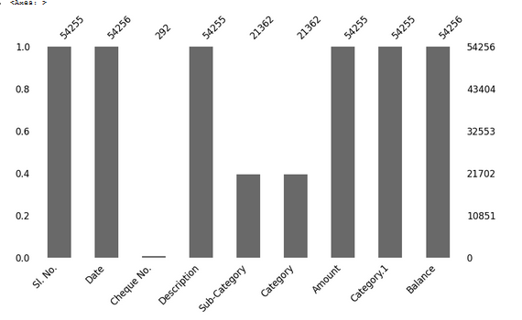
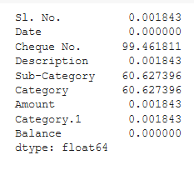
Null Values Treatment:
This bar graph showing the no of non-null values present in the dataset
Cheque No. and has lowest number non-null values present in it.
Category and SubCategory stood 2nd on the proportion of missing values present. It consist of 60% null values
Description column has 1 null value
Non Null Value Count
Percentage of missing Values

Slide 7
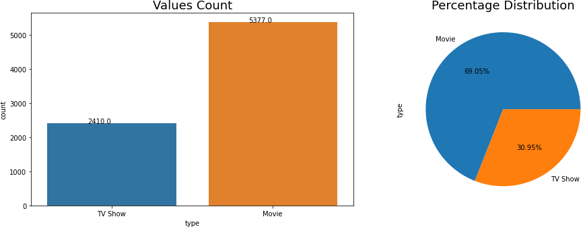
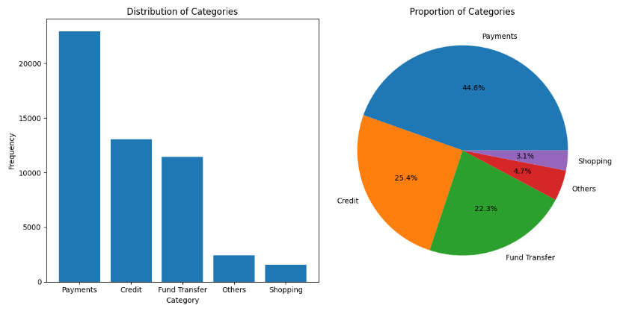
EXPLORATORY DATA ANALYSIS: (Category Column)
Among top 5 Categories, transaction with Payment Category has highest frequency.
Percentage of Payments Category take 44.6 % of txns, Shopping takes lowest 3.1% of all txns

Slide 8
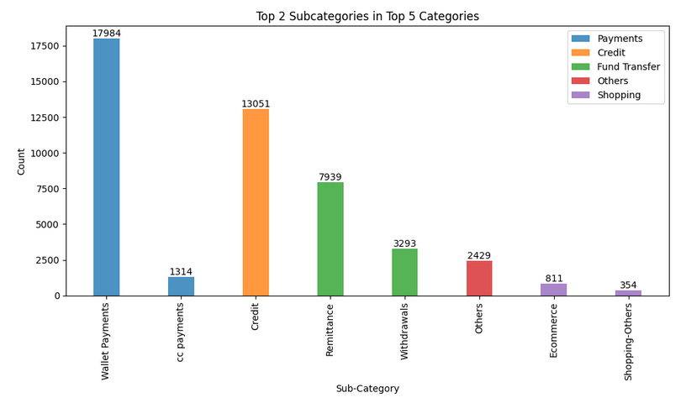
EXPLORATORY DATA ANALYSIS: (Category and SubCategory column)
Given plot shows the count of top 2 subcategories among top 5 Categories
In Payment Category, “Wallet Payment” has highest frequency
In Credit Category, there is only one subcategory “Credit”
In Shopping Category ,
“Ecommerce” and “Shopping Others” are top two categories.

Slide 9
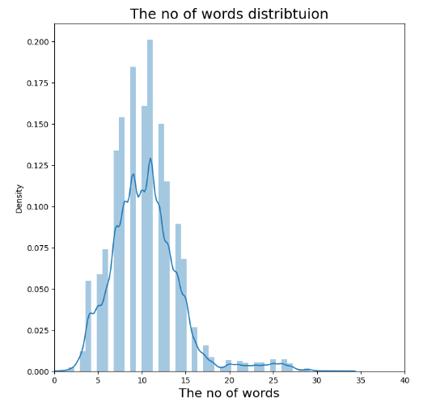
EXPLORATORY DATA ANALYSIS: (Count column)
This plot shows the distribution of length of words in ‘Description’ column of the transactions
We can see the average amount of words used in every decsritpion is close to 30.

Slide 10
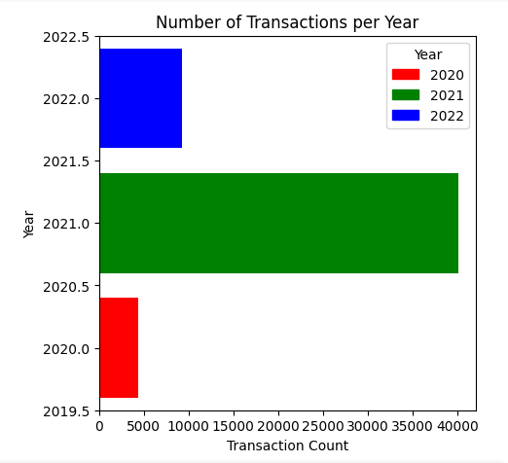
EXPLORATORY DATA ANALYSIS: (Year Column)
The highest transactions were placed in the year of 2021.
The lowest transaction were placed in year 2020.
The dataset consist of Data from year 2020 to 2022.

Slide 11
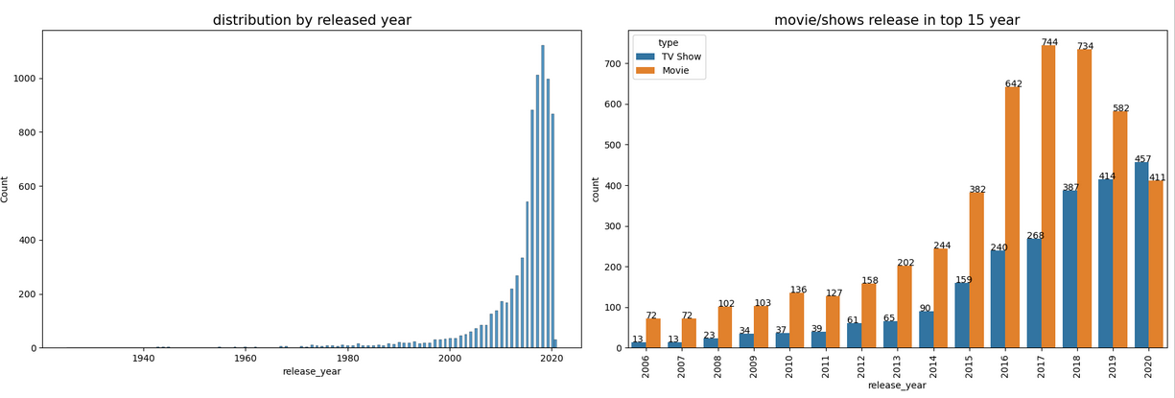
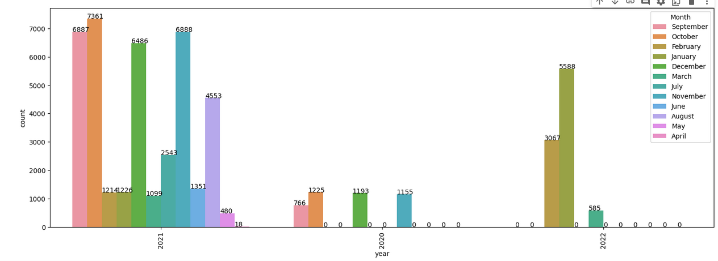
EXPLORATORY DATA ANALYSIS: (Month and Yearwise Plot)
Netflix has greater number of new movies / TV shows than the old ones.
In 2021, and 2020 October Month has highest Transactions.
In 2022, in the month of January , has the highest Transactions.

Slide 12
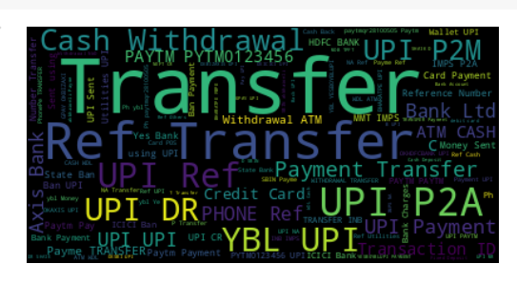
EXPLORATORY DATA ANALYSIS: (Visualising Description)
In the above word Cloud we can see that “Transfer” , “UPI” , “REF” word came a lot of times.

Slide 13
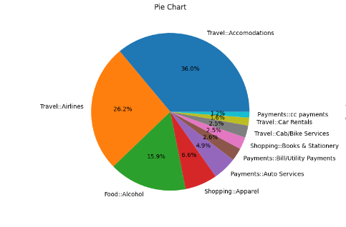
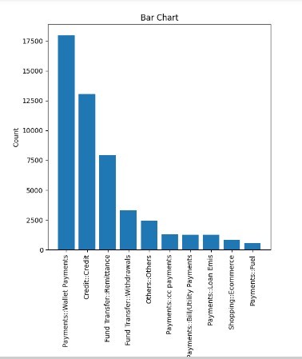
EXPLORATORY DATA ANALYSIS: (Merging Category + SubCategory= Target Variable)
We can see the Travel Accomodation has highest occurrence in case of Target Variables
Payment CC: Payments has lowest occurence

Slide 14
Modeling Approach:
Selected the attributes important for Category Classifcation
There were lot of null values in Category And SubCategory Column. Imputed them using Fuzzy Wuzzy String
Used threading and Parallel Anynchronuos Processing, to reduce the time from 15 hours to 15 mins
Text preprocessing: Remove all stop words and punctuation marks, convert all textual data to lowercase.
Stemming to generate a meaningful word out of corpus of words.
Tokenization of corpus and Word vectorization
Dimensionality reduction
Use XGBoost and Bert Algorithm, to model the data
Build A web Based user friendly API to know Category and SubCateogry of Transactions
Merging And Creating new Columns
I created
One Target column by merging Category And SubCategory features:
One “Count” columns showing the count of word in Description
Month column by fetching the month from Date
Year column by fetching the year from Date

Slide 15
Before clusters implementation we need to pre-process the data. So that we filtered data with following
steps:
Removing Stop words
Stop words are common words like “the”, “and” and “but” do not carry much meaning on their own and are
often seen as noise in the data.
Lowercasing words
Lowercasing the words can also reduce the size of the vocabulary, which can make it easier to work with larger texts or texts in languages with a high number of inflected forms.
Removing Punctuation
Punctuation marks like periods, commas, and exclamation points can add noise to the data and can sometimes be treated as separate tokens, which can affect the performance of NLP models.
Stemming
used Snowball Stemmer to generate a meaningful word out of corpus of words.
For example, the words "run," "runs," "ran," and "running" are all different inflected forms of the same word "run," and a stemmer can reduce them all to the base form "run."
Tokenization of corpus and Word vectorization – TFIDF
1. This is important in NLP tasks because most machine learning models expect numerical input and cannot work with raw text data directly. Word vectorization allows you to input the words into a machine learning model in a way that preserves the meaning and context of the words.
Dimensionality reduction – PCA
Dimensionality reduction is the process of reducing the number of features or dimensions in a dataset while preserving as much information as possible. As high-dimensional datasets can be difficult to work with and can sometimes suffer from the curse of dimensionality.

Slide 16
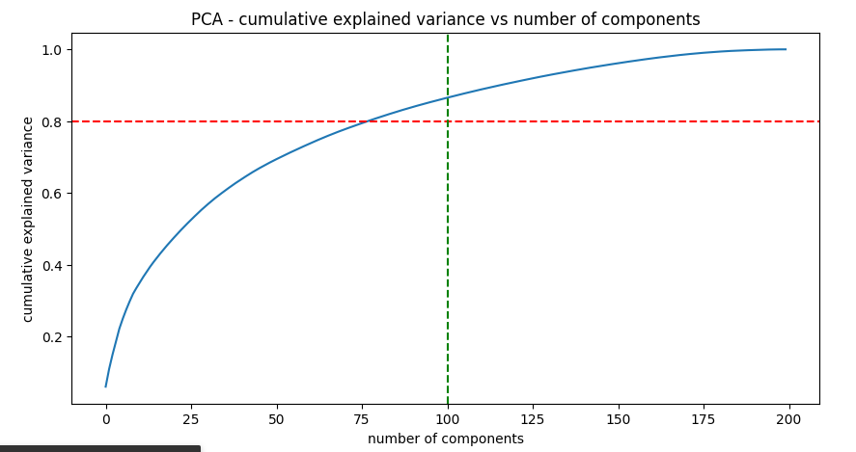
Principal Component Analysis:
As you can see that 100% of the variance is explained by about ~200 components.
Also, more than 80% of the variance is explained just by 100 components.
Hence to simplify the model, and reduce dimensionality, we take top 100 components, which will still be able to capture more than 80% of variance

Slide 17
XGBoost Classifier:
We have a build the classification model using XGBoost.
XGBoost is an optimized gradient boosting machine learning algorithm that is widely used for supervised learning tasks. It combines the advantages of gradient boosting with regularization techniques to improve prediction accuracy and handle complex datasets efficiently. XGBoost is known for its speed, scalability, and performance, making it a popular choice in various domains such as data science and machine learning competitions.
Accuracy of the model : 81%
Precision of the model : 0.87
Recall of the model : 0.81
F1-score : 0.83
As the training dataset is so huge, it take around an ½ an hour to run a single fold.
Hence Avoided HyperParameter Tuning.
Implemented another Classification model using Bert, but due to memory limitation, it was getting crashed.
Not able to tain and Evaluate BERT model

Slide 18
CONCLUSION:
In this project, we worked on a Transaction Categorisation Problem
The dataset contained about 53,000 records, and 8 attributes. We began by dealing with the dataset's missing values and doing exploratory data analysis (EDA).
It was decided to classify the data based on the attributes:Description, Category.1, Count, Amount of Transaction The values in these attributes were tokenized, preprocessed, and then vectorized using TFIDF vectorizer.
Through TFIDF Vectorization, we created a total of 200 attributes.
We used Principal Component Analysis (PCA) to handle the curse of dimensionality. 100 components were
able to capture more than 80% of variance, and hence, the number of components were restricted to 100
We built classifier using the XGBoost.
I am able to capture the accuracy of 81% and precision of 0.87 and recall of 0.81. So the f1-score was 0.83
ROC-AUC score for this classification is : 0.95

Slide 19
Thank You

