Slide 1
E-Commerce Analysis
By Jayesh kharate
May batch

Slide 2





Contents
Customer Trend
Revenue Growth
Logistics View
Dashboard

Slide 3

Problem Statement
Revenue YoY
Product Returns Impact
Product Specific Revenue Loss
Less Revenue Months
Region Wise Impact
Rating impact on Sales

Slide 4

Methodologies Used
Multiple DAX functions were used to compute the results, few of them listed below:
Related
Sum
DistinctCount
Calculate
Average
Countrows
Filter
SamePeriodLastYear

Slide 5
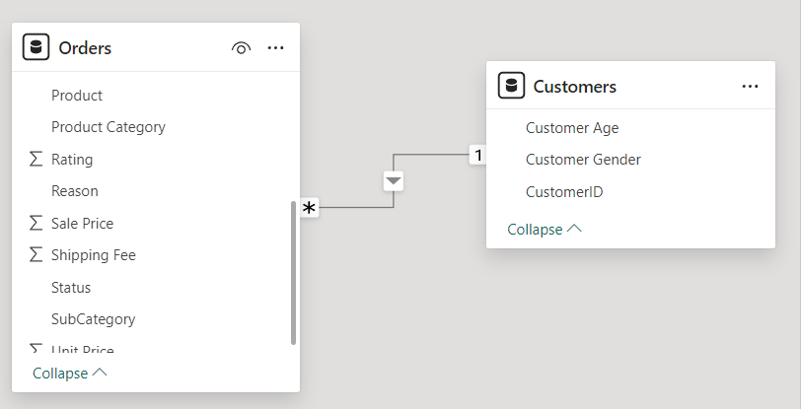
Data Overview
There are 2 tables – Orders & Customers.
For Data Cleaning – I removed Null from Location, ProductCategory & Unit Price column in Orders table

Slide 6
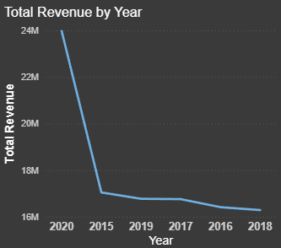
Customer’s Trend
The year 2020 recorded the highest customer count.
Customer count increased by 42% from 2015 to 2020.

Slide 7
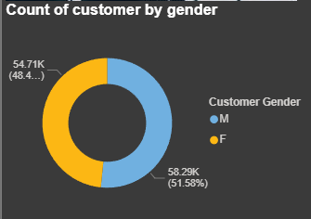
Customer Gender Donut Chart
Recommendations to Attract More Female Customers
1. Optimize Product Categories for Women
Expand product range in top-performing female categories (e.g., Fashion, Beauty, Wellness).
Introduce bundled products or curated kits tailored to women (e.g., “Self-care kits”).
2. Loyalty & Referral Programs
Launch female-focused loyalty programs (e.g., rewards for reviewing beauty/fashion items).
Incentivize referrals, especially for social sharing on Instagram, Pinterest, etc.
3 Flash Sales & Personalized Offers
Time exclusive flash sales around women-centric holidays or events (e.g., Women’s Day, Mother’s Day).
Offer personalized coupon codes based on past purchase behavior.

Slide 8
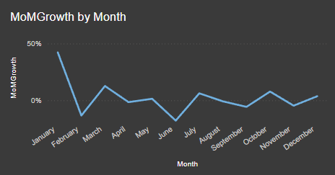
Revenue Growth
Most Revenue Growth is seen in the month of March
Least Impact seen in the month of June

Slide 9
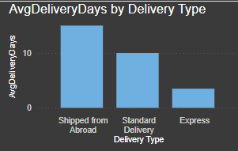
Logistics View
Most delivery time is taken for the category “Shipped from Abroad”
Least delivery time is taken by the Express

Slide 10
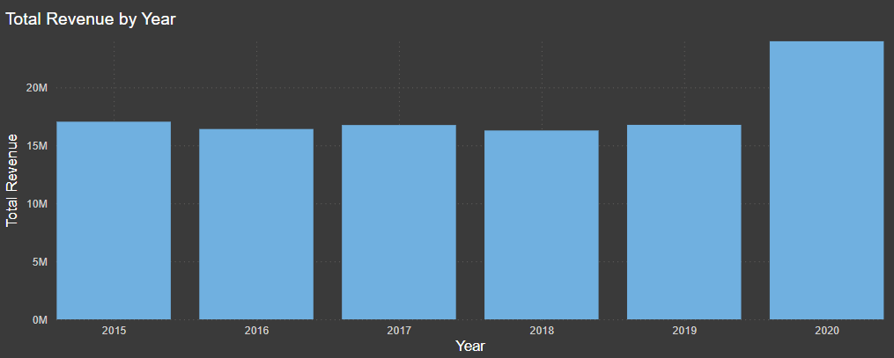
Revenue YoY
Best Revenue year has been 2020
2016 & 2018 has seen the least revenue

Slide 11
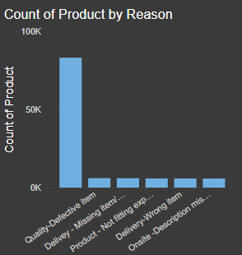
Product Return Impact
Missing, wrong, and defective items account for 18K returned products, making up 58% of total returns
By providing accurate product descriptions, returns could be reduced by 42%.

Slide 12
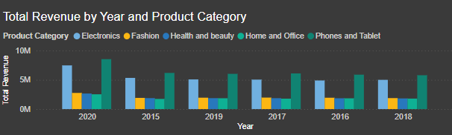
On-time vs Late Deliveries
Over 85% of Express deliveries are on time.
Shipped from Abroad has the highest number of late deliveries.
Improving international shipping logistics can reduce delays.

Slide 13
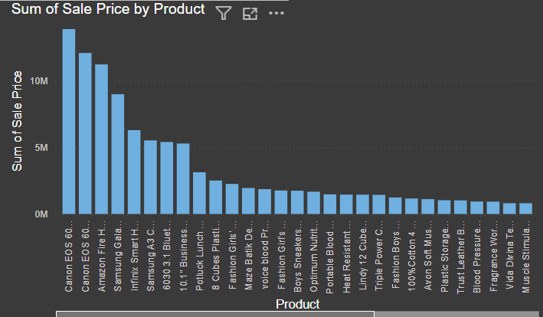
Product Specific Revenue Impact
These products have the less share in overall revenue.
To increase their sales, we will have to implement offers like Trade-in Discounts, EMI Offers, free Extended Warranties, etc

Slide 14
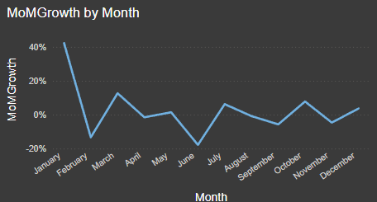
Less Revenue Months
June, September and November are the months with less revenue so we should plan promotional offers in this period

Slide 15
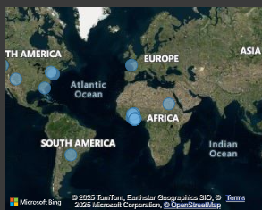
Region Wise Impact
Major business is from Africa continent – focus should be more towards Asian and European continent

Slide 16
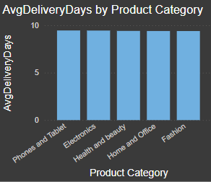
Avg Wait Time by Category
Average delivery time across all categories is around 10 days.
'Shipped from Abroad' has the longest wait time (up to 15 days).
Express category is the fastest with delivery within 4 days.

Slide 17
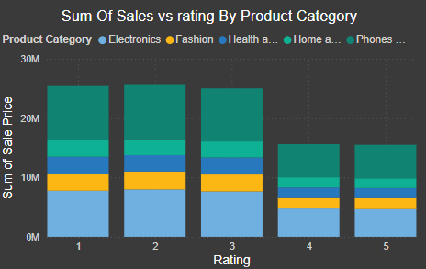
Rating Impact on Sales
Ratings have shown no direct impact on sales.
Low-rated items recorded the highest sales across all categories.

Slide 18
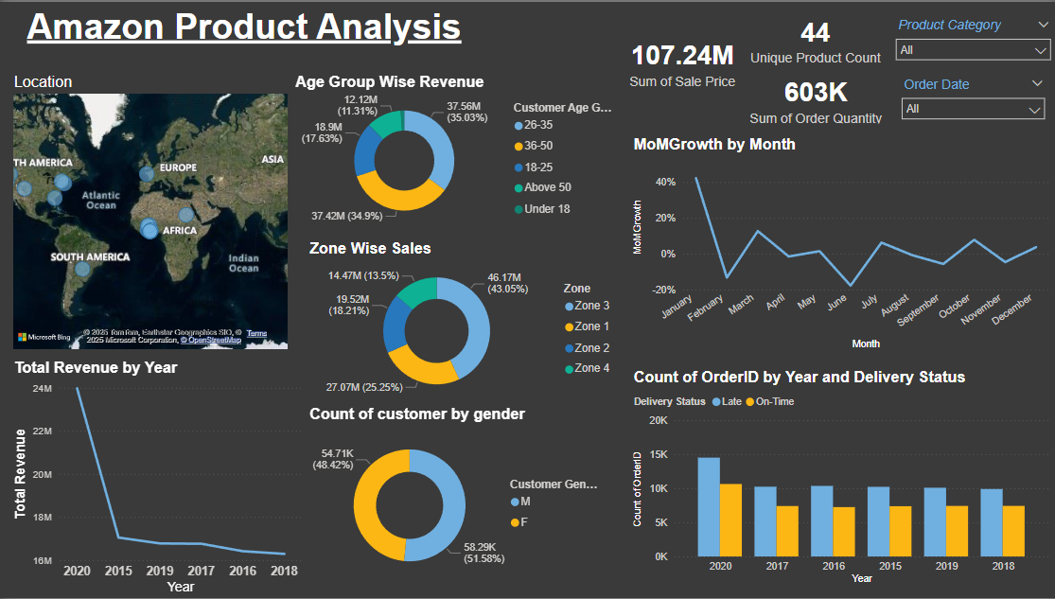

Slide 19
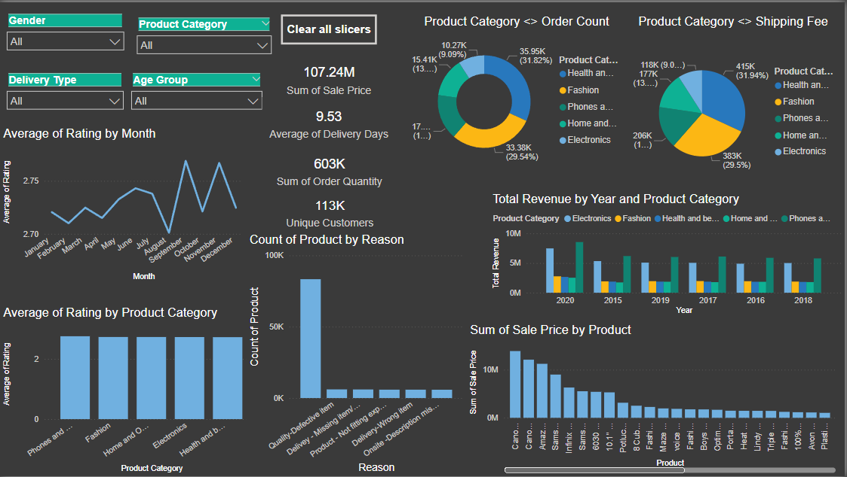

Slide 20
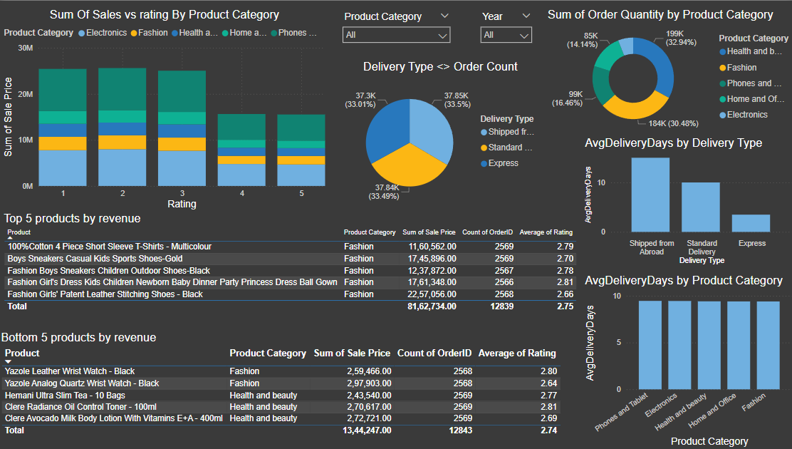

Slide 21
Final Recommendations
Launch discount campaigns for underperforming products.
Use Express delivery for time-sensitive items to ensure customer satisfaction.
Improve international shipping to reduce late deliveries.
Enhance visibility of high-rated products across platforms.
Promote female-targeted campaigns to balance customer segments.

Slide 22
Sales Focus: Target specific months like June, September, and November to boost sales.
Delivery Efficiency: Express is identified as the fastest delivery mode.
Product Targeting: Introduce new schemes for specific products to enhance overall revenue.
Return Reduction: Minimize returns by improving product quality and providing accurate product descriptions on the website.

Slide 23
THANK YOU

