Slide 1


Consumer Goods
Ad_Hoc Insights

Slide 2
Objectives
AtliqHardware is one of the major computer hardware manufacturers with a strong presence in across the globe.
The management did note that they do not have sufficient insights to make quick and data-informed decisions.
Plan to expand the data analytics team by adding junior data analysts.
Data analytics director, plans to conduct a SQL challenge to evaluate both tech and soft skills.

Slide 3
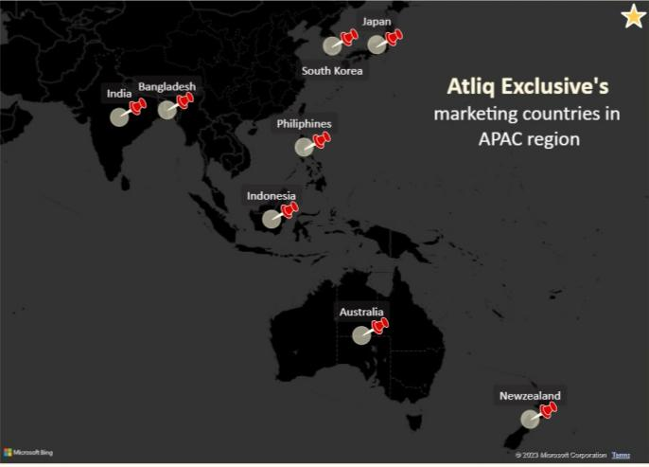
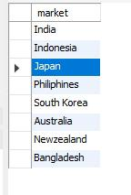
1. Provide the list of markets in which customer "Atliq Exclusive" operates its business in the APAC region
INSIGHTS:
AtliQ Hardware have presence in this list of market for AtliQ Exclusive in APAC region.
To obtain revenue, India would be the biggest Market for AtliQ Exclusive.

Slide 4
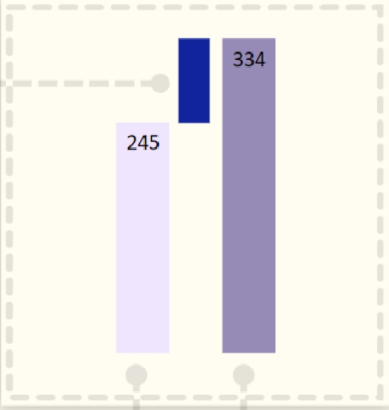

2. What is the percentage of unique product increase in 2021 vs. 2020? The final output contains these fields,
unique_products_2020
unique_products_2021
percentage_chg
Percentage change 36%
INSIGHTS:
AtliQ demand is increased with new products.
Added 36% (89) new product to production in 2021 from 2020.
Unique products 2020
Unique products 2021

Slide 5
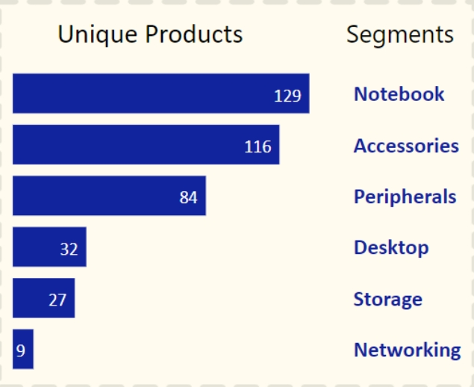
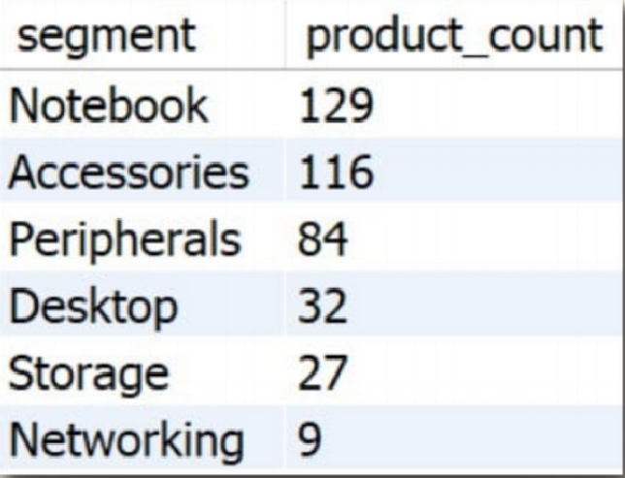
3. Provide a report with all the unique product counts for each segment and sort them in descending order of product counts. The final output contains 2 fields,
segment
product_count
INSIGHTS:
Notebook, accessories and peripherals have a strong manufacturing growth as compared to desktop, storage and networking.
Notebook, accessories and peripherals has 83% of the total manufactured products.

Slide 6
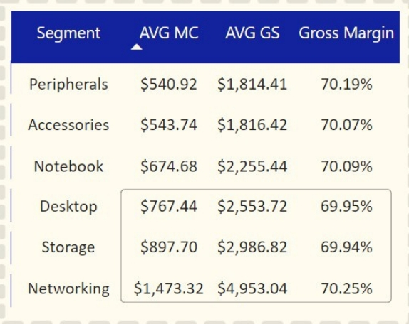
Desktop
Storage
Networking
AtliQ Suggestions:
Bulk Deal
Discounts
Customer Services
AVG MC: Average Manufacturing Cost
AVG GS: Average Gross Sales

Slide 7
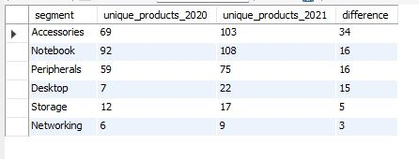
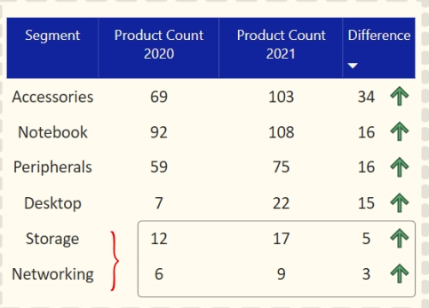
4. Which segment had the most increase in unique products in 2021 vs 2020? The final output contains these fields,
segment
product_count_2020
product_count_2021
difference
Unique products difference per segments from 2020 to 2021
INSIGHTS:
Accessories had the largest increase in production. Storage and networking are slower production growth than other segments.
Accessories, notebook, peripherals have major production than other segments.

Slide 8

5. Get the products that have the highest and lowest manufacturing costs. The final output should contain these fields,
product_code
product
manufacturing_cost
Products having highest and lowest manufacturing cost
$ 240.54
$ 0.89
AQ Home Allin1 Gen2
AQ Master wired x1 Ms
INSIGHTS:
Mouse: AQ Master wired x1 Ms has the lowest manufacturing cost.
Personal Desktop: AQ Home Allin1 Gen2 has the highest manufacturing cost.
Personal Deskop
Mouse

Slide 9
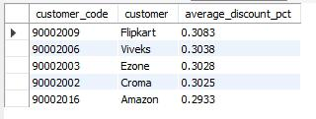
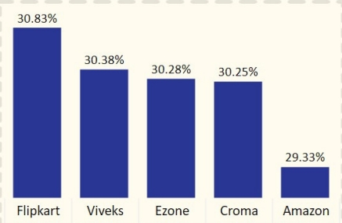
6. Generate a report which contains the top 5 customers who received an average high pre_invoice_discount_pct for the fiscal year 2021 and in the Indian market. The final output contains these fields,
customer_code
customer average_discount_percentage
Top 5 Indian customers with highest average discount percentage for 2021
INSIGHTS:
The largest average pre-invoice discount was given to Flipkart. The lowest average pre-invoice discount was given to Amazon.
Customers

Slide 10
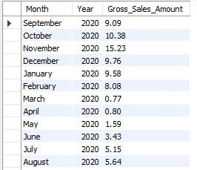
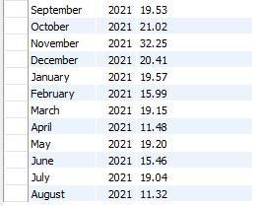
7. Get the complete report of the Gross sales amount for the customer “Atliq Exclusive" for each month. This analysis helps to get an idea of low and high-performing months and take strategic decisions. The final report contains these columns:
Month
Year
Gross sales Amount
FY 2020
79.5
INSIGHTS:
The lowest Gross sales total for both fiscal years is in March(2020) and April(2020).
The highest Gross sales total for both fiscal years is in November (2021).
73.8% of the total Gross sales figure is in FY2021.
FY 2021
224.4

Slide 11
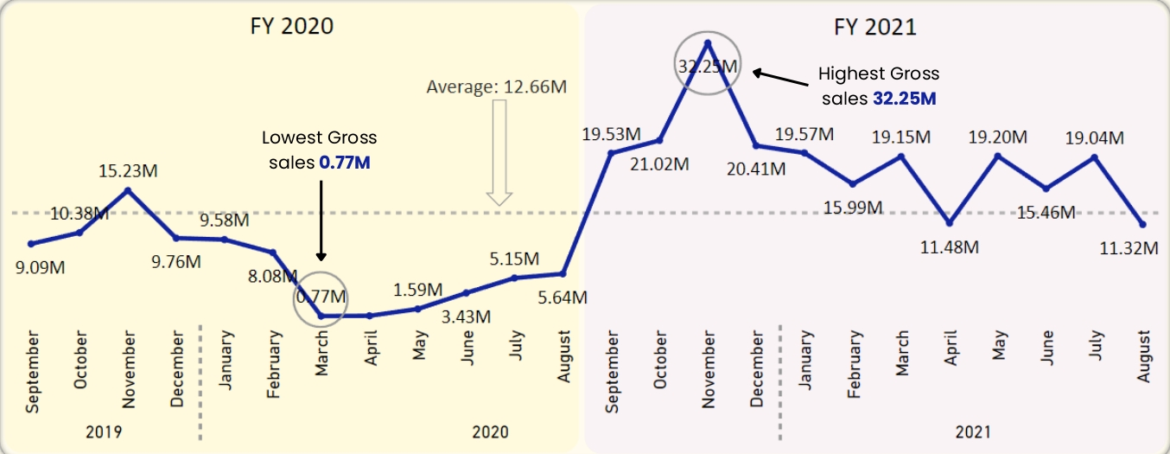
Causes:
Global chip shortage in (2020).
Covid-19

Slide 12

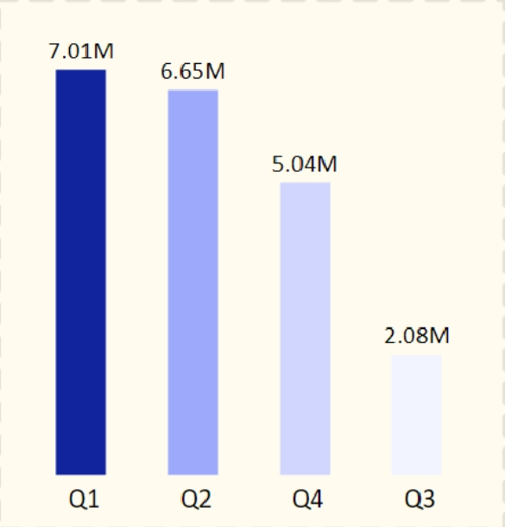
8. In which quarter of 2020, got the maximum total_sold_quantity? The final output contains these fields sorted by the total_sold_quantity, Quarter total_sold_quantity
FY 2020 by Quarter
INSIGHTS:
Quarter 1 of 2020 sold most units, while Quarter 3 sold fewest.
Quarter1 accounts for approximately 34% of the total sold quantity for FY2020.

Slide 13

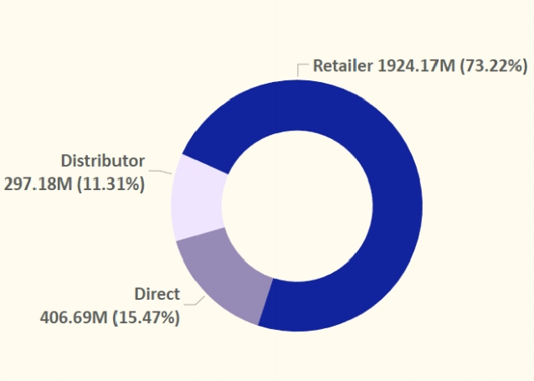
9. Which channel helped to bring more gross sales in the fiscal year 2021 and the percentage of contribution? The final output contains these fields,
channel
gross_sales_mln
percentage
Gross sales and contribution percentage by channels in 2021
INSIGHTS:
Retailer helped bring maximum sales to the company with 73.22% as the contribution percentage.
Distributor makes the minimum contribution at a percentage of 11.31%

Slide 14
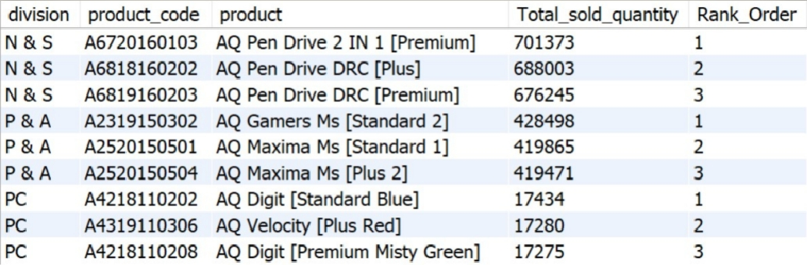
10. Get the Top 3 products in each division that have a high total_sold_quantity in the fiscal_year 2021? The final output contains these fields, division product_code product total_sold_quantity rank_order
INSIGHTS:
Every division has a product with different variants that appears twice in the top three products by division list.
Maximum sold quantity are from N & S division and minimum sold quantity from PC.

Slide 15
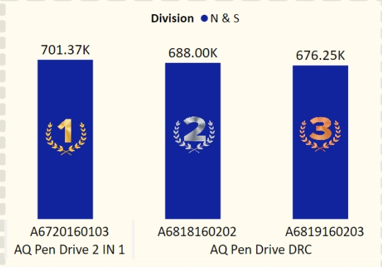
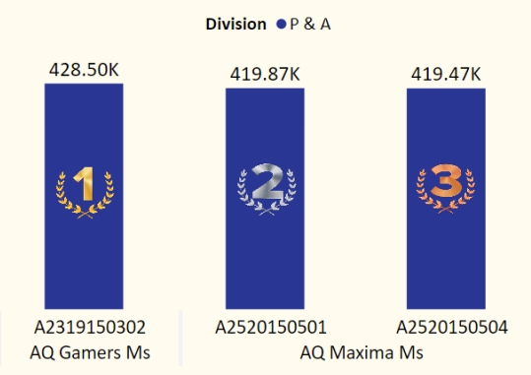
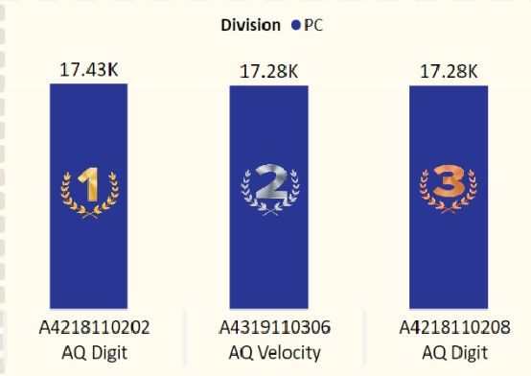
Premium
Plus
Premium
Standard 2
Standard 1
Plus 2
Standard
Blue
Plus Red
Premium
Misty Green

