Slide 1
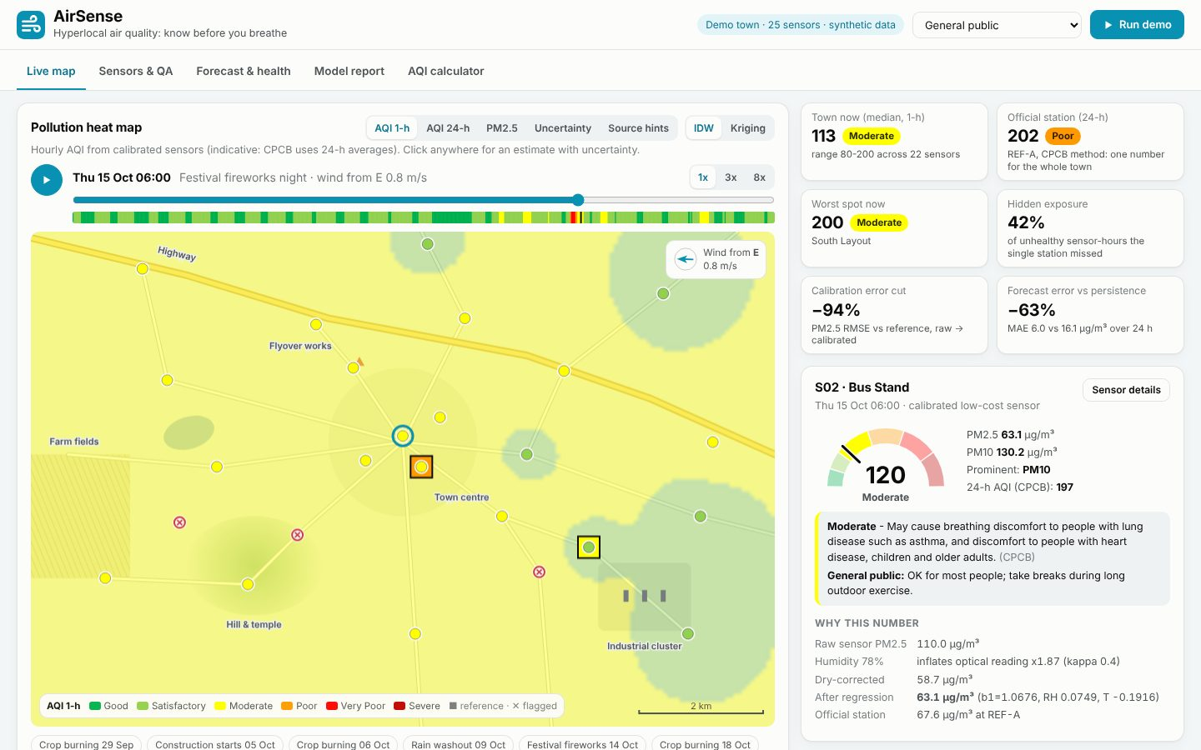
SUSTAINABILITY, CLEANTECH & GREEN ENERGY
AirSense
Hyperlocal air quality: know before you breathe
Your Team Name
QUANTIX 2K26 · 24-hour hackathon · K.S.R. College of Engineering
Notes:
Open with the one-line promise: Hyperlocal air quality: know before you breathe. Introduce the team, then go straight to the problem.

Slide 2

The problem
One official station often stands in for a whole town
Homes by highways, industry and burning fields have no local data
Cheap sensors are noisy, drift and over-read in humid air
People find out the air was bad only after breathing it
~7 million
premature deaths a year linked to air pollution (approx., WHO)
~130
Indian cities in the National Clean Air Programme (approx., NCAP)
42%
of unhealthy hours the single station missed (our demo town)
Notes:
Problem: One official station often stands in for a whole town Homes by highways, industry and burning fields have no local data Cheap sensors are noisy, drift and over-read in humid air People find out the air was bad only after breathing it Key numbers: ~7 million premature deaths a year linked to air pollution (approx., WHO); ~130 Indian cities in the National Clean Air Programme (approx., NCAP); 42% of unhealthy hours the single station missed (our demo town).

Slide 3
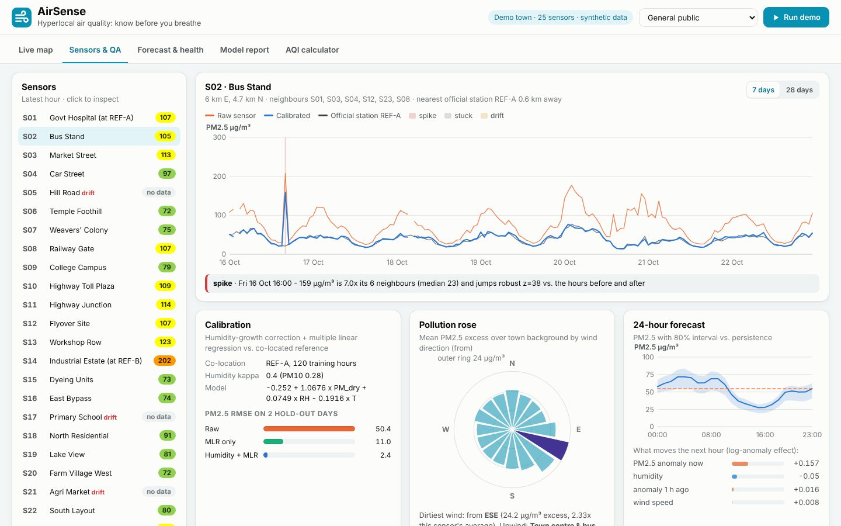

Our solution: AirSense
Calibrates every low-cost sensor against a reference station
Catches stuck, spiking and drifting sensors automatically
CPCB AQI heat map with uncertainty for any spot in town
24-hour forecast with personal alerts and the best time to run
▸ Sensors & QA
Notes:
Solution: Calibrates every low-cost sensor against a reference station Catches stuck, spiking and drifting sensors automatically CPCB AQI heat map with uncertainty for any spot in town 24-hour forecast with personal alerts and the best time to run

Slide 4






Key features
Sensor calibration
CPCB AQI engine
Live heat map
Humidity-growth fix + regression per sensor: RMSE 43.6 to 2.4 ug/m3
7 pollutants, official breakpoints, 24-h/8-h rules, 3-pollutant check
IDW + kriging; click any spot for AQI with a 90% interval
Self-checking network
Forecast & alerts
Source hints
Flags stuck, spiking and drifting sensors and says which rule fired
Next 24 h for asthma, children, outdoor workers + best hour to run
Pollution roses and upwind rays pin the industrial cluster to 0.2 km
Notes:
Features: Sensor calibration: Humidity-growth fix + regression per sensor: RMSE 43.6 to 2.4 ug/m3. CPCB AQI engine: 7 pollutants, official breakpoints, 24-h/8-h rules, 3-pollutant check. Live heat map: IDW + kriging; click any spot for AQI with a 90% interval. Self-checking network: Flags stuck, spiking and drifting sensors and says which rule fired. Forecast & alerts: Next 24 h for asthma, children, outdoor workers + best hour to run. Source hints: Pollution roses and upwind rays pin the industrial cluster to 0.2 km

Slide 5
System architecture
25 PM sensors + 2 reference stations hourly CSV
Tech stack
calibration.py kappa-Koehler humidity fix + MLR per sensor
Python 3 standard library only
http.server ThreadingHTTPServer
Vanilla HTML/CSS/JS
Canvas heat map, hand-drawn SVG charts
unittest (65 tests)
Runs fully offline
faults.py stuck, spike, drift vs neighbours' median
aqi.py CPCB sub-indices, averaging and validity rules
interpolate.py / forecast.py / sources.py map, 24 h, source hints
Runs fully offline · no installs · python app.py
app.py stdlib JSON API vanilla JS canvas map + SVG charts
Notes:
Architecture top to bottom: 25 PM sensors + 2 reference stations -> hourly CSV. calibration.py -> kappa-Koehler humidity fix + MLR per sensor. faults.py -> stuck, spike, drift vs neighbours' median. aqi.py -> CPCB sub-indices, averaging and validity rules. interpolate.py / forecast.py / sources.py -> map, 24 h, source hints. app.py stdlib JSON API -> vanilla JS canvas map + SVG charts. Stack: Python 3 standard library only, http.server ThreadingHTTPServer, Vanilla HTML/CSS/JS, Canvas heat map, hand-drawn SVG charts, unittest (65 tests), Runs fully offline.

Slide 6
Algorithms built from scratch
01
CPCB piecewise-linear sub-index
India National AQI
02
kappa-Koehler growth + multiple linear regression
calibration
03
Robust z-scores (median/MAD)
stuck, spike and drift detection
04
IDW and ordinary kriging with fitted variogram
heat map + uncertainty
05
Seasonal profile + AR + weather regression
24-hour forecast
06
Pollution rose + upwind CWT rays
likely sources
Notes:
Algorithms: CPCB piecewise-linear sub-index - India National AQI. kappa-Koehler growth + multiple linear regression - calibration. Robust z-scores (median/MAD) - stuck, spike and drift detection. IDW and ordinary kriging with fitted variogram - heat map + uncertainty. Seasonal profile + AR + weather regression - 24-hour forecast. Pollution rose + upwind CWT rays - likely sources. Stress that nothing is a black box: every decision can be explained on screen.

Slide 7



What makes it different
Turns ~Rs 5k sensors into near-reference data with explainable maths
The network checks itself: every flag names the rule that fired
Every map pixel has an uncertainty, not just a colour
Forecast-driven personal alerts before exposure, not after
Notes:
Differentiators: Turns ~Rs 5k sensors into near-reference data with explainable maths The network checks itself: every flag names the rule that fired Every map pixel has an uncertainty, not just a colour Forecast-driven personal alerts before exposure, not after

Slide 8
How we compare
 | One official station | Raw low-cost sensors | AirSense
Street-level coverage | ✗ No | ✓ Yes | ✓ Yes, heat map
Reading quality | Reference grade | Drifts, over-reads | Calibrated to ref.
Flags faulty sensors | Manual QA | ✗ No | ✓ Yes, automatic
24-h forecast + personal alerts | ✗ No | ✗ No | ✓ Yes
Explains each number | ✗ No | ✗ No | ✓ Yes
Notes:
Compare: One official station vs Raw low-cost sensors vs AirSense. Street-level coverage: No / Yes / Yes, heat map. Reading quality: Reference grade / Drifts, over-reads / Calibrated to ref.. Flags faulty sensors: Manual QA / No / Yes, automatic. 24-h forecast + personal alerts: No / No / Yes. Explains each number: No / No / Yes.

Slide 9

Measured results
-94%
95% / 100%
-63%
0.2 km
PM2.5 calibration RMSE vs reference (43.6 to 2.4 ug/m3)
fault precision / recall vs 20 injected faults
24-h forecast MAE vs persistence (6.0 vs 16.1 ug/m3)
industrial cluster located from wind data alone
Measured on held-out data generated by the project (see REPORT.md for method). Real-world performance needs field validation.
Impact Sensitive people get a warning hours before peaks, not after · Schools can move PE and assembly to the cleanest hours · Pollution boards see hotspots and likely sources to inspect
Notes:
Results: -94% PM2.5 calibration RMSE vs reference (43.6 to 2.4 ug/m3); 95% / 100% fault precision / recall vs 20 injected faults; -63% 24-h forecast MAE vs persistence (6.0 vs 16.1 ug/m3); 0.2 km industrial cluster located from wind data alone. Impact: Sensitive people get a warning hours before peaks, not after Schools can move PE and assembly to the cleanest hours Pollution boards see hotspots and likely sources to inspect

Slide 10
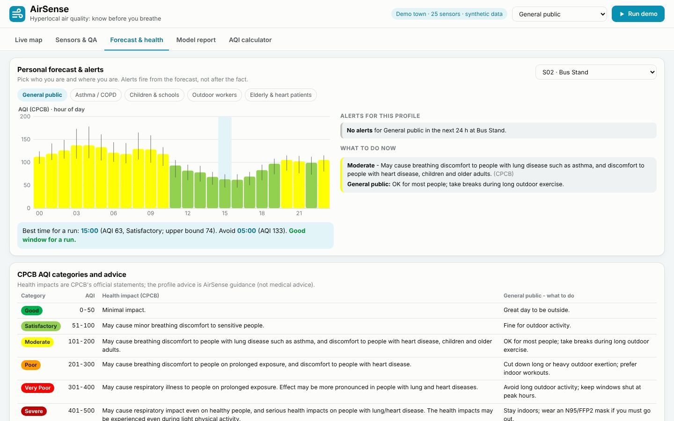
Live demo in 3 minutes
1
Click Run demo - data regenerated, all models retrained in ~2.5 s
2
Festival night playback: hourly AQI turns Severe in the town centre
3
Rain spell: raw sensors over-read, calibrated values track the reference
4
Click an empty spot: kriging AQI with a 90% interval and its 'why'
5
Sensors & QA: a drifting sensor and the rule that flagged it
6
Forecast & health: switch to Asthma, read the alert and best run time
▸ Forecast & health
python app.py → http://localhost:8015
7
Model report: calibration, faults, forecast and map accuracy
Notes:
Switch to the browser now. 1. Click Run demo - data regenerated, all models retrained in ~2.5 s 2. Festival night playback: hourly AQI turns Severe in the town centre 3. Rain spell: raw sensors over-read, calibrated values track the reference 4. Click an empty spot: kriging AQI with a 90% interval and its 'why' 5. Sensors & QA: a drifting sensor and the rule that flagged it 6. Forecast & health: switch to Asthma, read the alert and best run time 7. Model report: calibration, faults, forecast and map accuracy

Slide 11

Feasibility, business model & roadmap
Business model
Future scope
Free open-source core for colleges, RWAs and NGOs
Per-sensor subscription for municipalities: calibration, QA, alerts
Fence-line monitoring package for industrial estates
CSR-funded school networks with branded dashboards
Live ESP32 + PMS sensor firmware with MQTT upload
Gas sensors (NO2, O3) with their own calibration
WhatsApp / SMS alerts in Tamil and English
Satellite and traffic data as forecast inputs
Automatic re-calibration using the reference as a moving anchor
Notes:
Business: Free open-source core for colleges, RWAs and NGOs Per-sensor subscription for municipalities: calibration, QA, alerts Fence-line monitoring package for industrial estates CSR-funded school networks with branded dashboards Next: Live ESP32 + PMS sensor firmware with MQTT upload Gas sensors (NO2, O3) with their own calibration WhatsApp / SMS alerts in Tamil and English Satellite and traffic data as forecast inputs Automatic re-calibration using the reference as a moving anchor

Slide 12

Thank you
AirSense · Hyperlocal air quality: know before you breathe
Scan for the code
Code https://github.com/jayeskumar/a/tree/claude/confident-fermi-dpeh2g/projects/15-airsense
Run cd projects/15-airsense && python app.py
Questions?
Notes:
Close with the impact line, invite questions. Keep the demo tab open in case judges want to try it.

