Slide 1
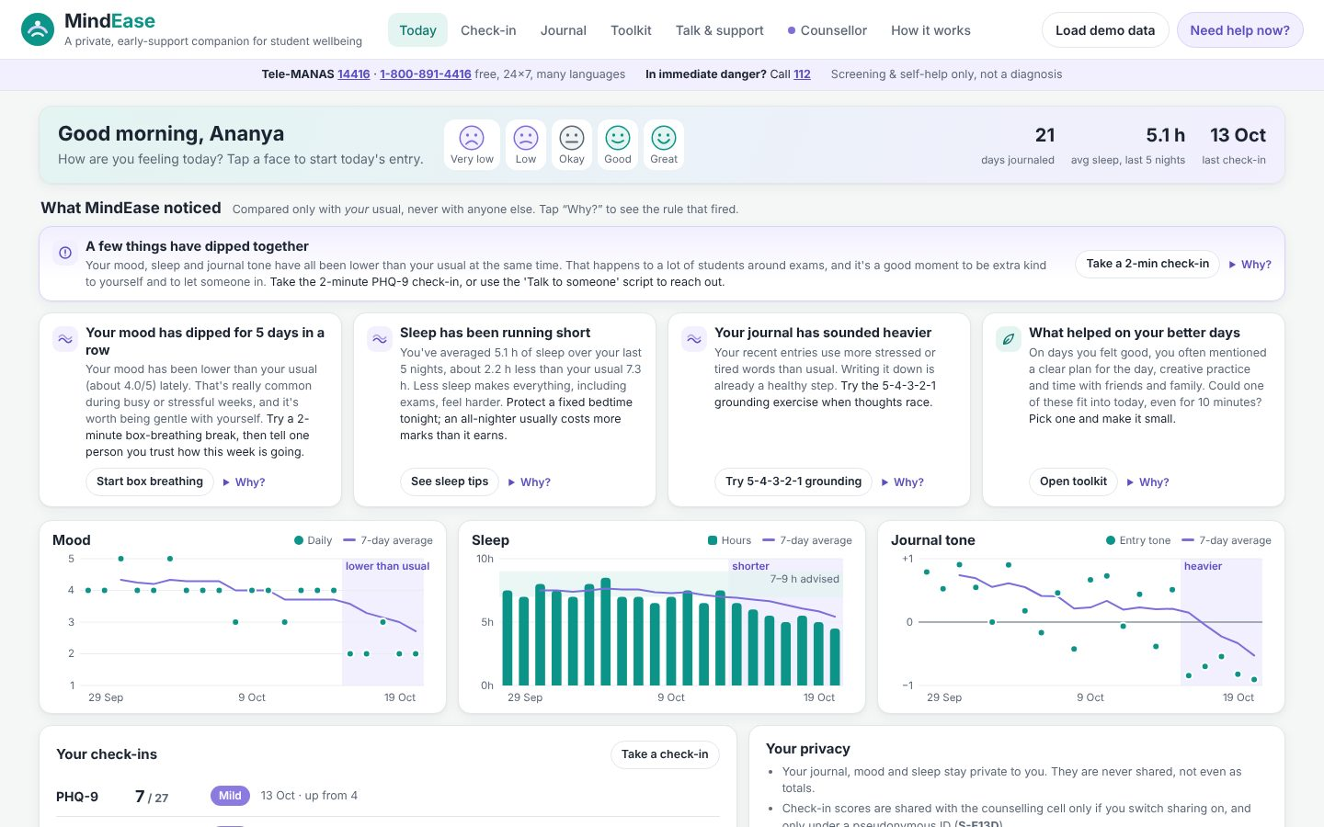
HEALTHTECH & BIOMEDICAL INNOVATION
MindEase
A private, early-support companion for student mental wellbeing
Your Team Name
QUANTIX 2K26 · 24-hour hackathon · K.S.R. College of Engineering
Notes:
Open with the one-line promise: A private, early-support companion for student mental wellbeing. Introduce the team, then go straight to the problem.

Slide 2

The problem
Exam stress, anxiety and low mood in students often go unnoticed
Stigma stops students from walking into the counselling room
Counsellors get no early signal until a crisis
Help-seeking info is hard to find at the moment it's needed
~13,000
student suicides a year in India (NCRB ADSI 2021-22, approx.)
70–92%
treatment gap for mental disorders in India (NMHS 2015-16)
1 in 2
mental health conditions begin by age 14 (WHO)
Notes:
Problem: Exam stress, anxiety and low mood in students often go unnoticed Stigma stops students from walking into the counselling room Counsellors get no early signal until a crisis Help-seeking info is hard to find at the moment it's needed Key numbers: ~13,000 student suicides a year in India (NCRB ADSI 2021-22, approx.); 70–92% treatment gap for mental disorders in India (NMHS 2015-16); 1 in 2 mental health conditions begin by age 14 (WHO).

Slide 3
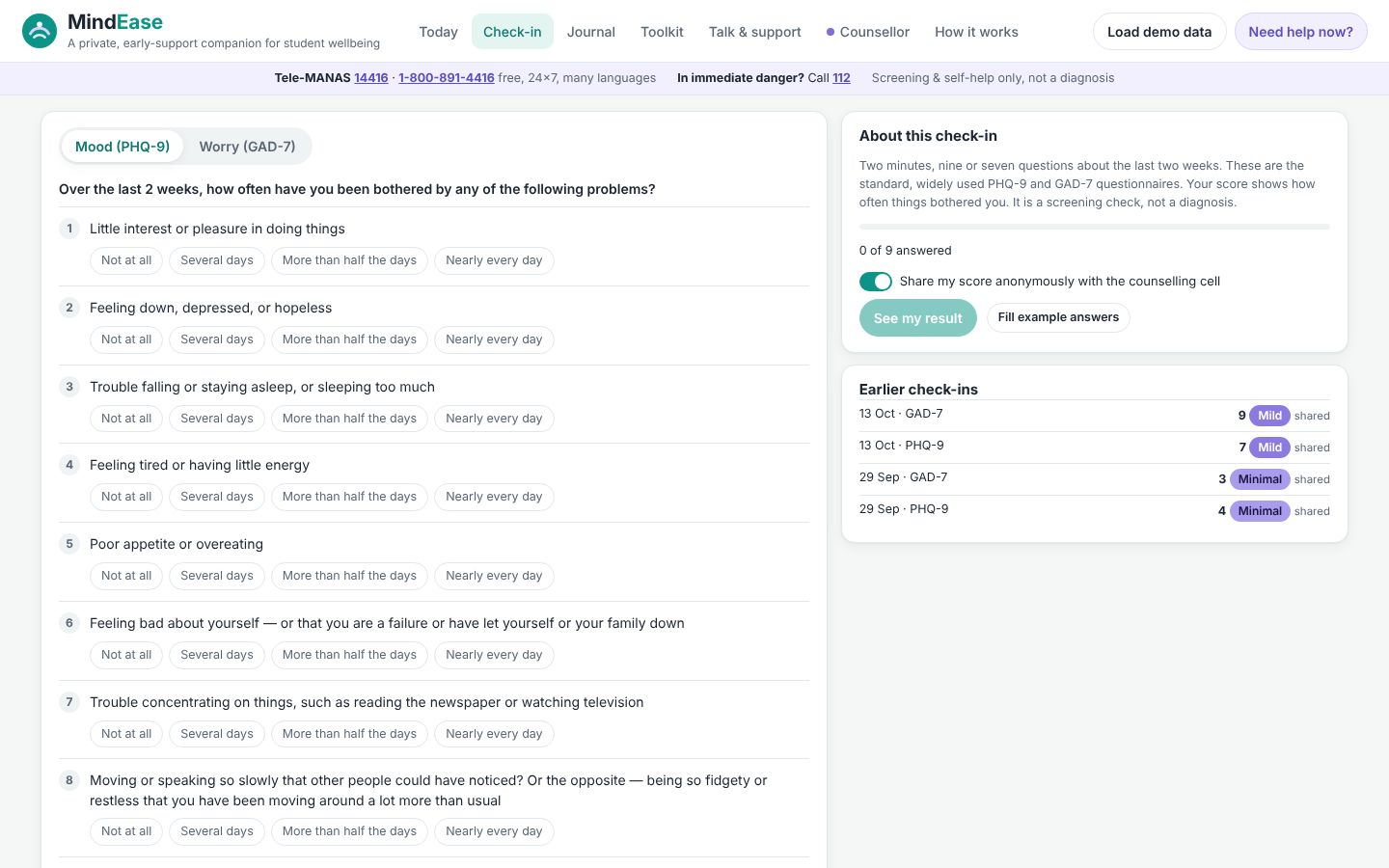

Our solution: MindEase
Private daily journal plus PHQ-9 / GAD-7 check-ins, in English and Tanglish
Explainable engine notices dips vs your own baseline, kindly
Instant support screen with Tele-MANAS 14416 and 112 when risk words appear
Counsellors see only opt-in, pseudonymous aggregates and alerts
▸ Check-in
Notes:
Solution: Private daily journal plus PHQ-9 / GAD-7 check-ins, in English and Tanglish Explainable engine notices dips vs your own baseline, kindly Instant support screen with Tele-MANAS 14416 and 112 when risk words appear Counsellors see only opt-in, pseudonymous aggregates and alerts

Slide 4






Key features
PHQ-9 & GAD-7
Explainable journal
Personal trends
Standard wording and bands; item 9 > 0 opens a support screen at once
Lexicon sentiment with negation, emoji, Tanglish; shows why, never diagnoses
CUSUM + dip run vs your usual: 'your mood has dipped for 5 days'
Offline toolkit
Prepare to talk
Counsellor view
Box breathing, 5-4-3-2-1 grounding, Pomodoro exam planner, sleep tips
Turns a few taps into words to say to a friend, parent or counsellor
Opt-in pseudonymous aggregates, small-cell suppression, alert follow-up
Notes:
Features: PHQ-9 & GAD-7: Standard wording and bands; item 9 > 0 opens a support screen at once. Explainable journal: Lexicon sentiment with negation, emoji, Tanglish; shows why, never diagnoses. Personal trends: CUSUM + dip run vs your usual: 'your mood has dipped for 5 days'. Offline toolkit: Box breathing, 5-4-3-2-1 grounding, Pomodoro exam planner, sleep tips. Prepare to talk: Turns a few taps into words to say to a friend, parent or counsellor. Counsellor view: Opt-in pseudonymous aggregates, small-cell suppression, alert follow-up

Slide 5
System architecture
Browser UI (vanilla JS, inline SVG) student and counsellor views
Tech stack
app.py ThreadingHTTPServer JSON API, demo PIN role check
Python 3 stdlib
http.server
Vanilla HTML/CSS/JS
Inline SVG charts
unittest (100 tests)
questionnaires.py PHQ-9 / GAD-7 scoring, bands, item-9 rule
sentiment.py + safety.py tone, emotions, concerning phrases
trends.py rolling means, CUSUM, dip run, OLS slope
Runs fully offline · no installs · python app.py
store.py consent-aware state in data/state.json
Notes:
Architecture top to bottom: Browser UI (vanilla JS, inline SVG) -> student and counsellor views. app.py ThreadingHTTPServer -> JSON API, demo PIN role check. questionnaires.py -> PHQ-9 / GAD-7 scoring, bands, item-9 rule. sentiment.py + safety.py -> tone, emotions, concerning phrases. trends.py -> rolling means, CUSUM, dip run, OLS slope. store.py -> consent-aware state in data/state.json. Stack: Python 3 stdlib, http.server, Vanilla HTML/CSS/JS, Inline SVG charts, unittest (100 tests).

Slide 6
Algorithms built from scratch
01
PHQ-9 / GAD-7
published 0-3 scoring and severity bands
02
Lexicon sentiment
valence, negation, intensifiers, 'but', emoji
03
Safety net
41 phrase rules + first-person co-occurrence layer
04
One-sided CUSUM
small persistent dips vs personal baseline
05
OLS slope t-test
supporting trend evidence
06
Greedy Pomodoro allocation
need x urgency, sleep protected
Notes:
Algorithms: PHQ-9 / GAD-7 – published 0-3 scoring and severity bands. Lexicon sentiment – valence, negation, intensifiers, 'but', emoji. Safety net – 41 phrase rules + first-person co-occurrence layer. One-sided CUSUM – small persistent dips vs personal baseline. OLS slope t-test – supporting trend evidence. Greedy Pomodoro allocation – need x urgency, sleep protected. Stress that nothing is a black box: every decision can be explained on screen.

Slide 7



What makes it different
Safety-first: crisis help one tap away on every screen
Explainable, offline, no cloud: journal never leaves the laptop
Understands Tanglish and emoji the way students actually write
Early signal for counsellors without surveillance
Notes:
Differentiators: Safety-first: crisis help one tap away on every screen Explainable, offline, no cloud: journal never leaves the laptop Understands Tanglish and emoji the way students actually write Early signal for counsellors without surveillance

Slide 8
How we compare
 | Walk-in counselling | Generic wellness apps | MindEase
Early signal before a crisis | ✗ No | ◐ Partial | ✓ Yes, opt-in
Private, no cloud needed | ✓ Yes | Often cloud | ✓ Yes, local only
Explains each flag | Human judgement | ◐ Partial | ✓ Yes, rule shown
Helpline one tap away | Office hours | ◐ Partial | ✓ Yes, every screen
Clinical diagnosis | ✓ Yes, by experts | ✗ No | ✗ No, screening only
Notes:
Compare: Walk-in counselling vs Generic wellness apps vs MindEase. Early signal before a crisis: No / Partial / Yes, opt-in. Private, no cloud needed: Yes / Often cloud / Yes, local only. Explains each flag: Human judgement / Partial / Yes, rule shown. Helpline one tap away: Office hours / Partial / Yes, every screen. Clinical diagnosis: Yes, by experts / No / No, screening only.

Slide 9

Measured results
78%
24/24
90% · 3%
0.1 ms
sentiment accuracy, 50 untuned sentences (word count: 70%)
direct risk phrases caught, 0/22 false alarms; 8/10 indirect
sim. mood dips flagged · false alarms per stable week
to analyse one journal entry (pure Python)
Measured on held-out data generated by the project (see REPORT.md for method). Real-world performance needs field validation.
Impact Earlier, stigma-free first step towards help · Counsellors spot exam-time spikes and plan outreach · Crisis numbers always visible, never buried
Notes:
Results: 78% sentiment accuracy, 50 untuned sentences (word count: 70%); 24/24 direct risk phrases caught, 0/22 false alarms; 8/10 indirect; 90% · 3% sim. mood dips flagged · false alarms per stable week; 0.1 ms to analyse one journal entry (pure Python). Impact: Earlier, stigma-free first step towards help Counsellors spot exam-time spikes and plan outreach Crisis numbers always visible, never buried

Slide 10
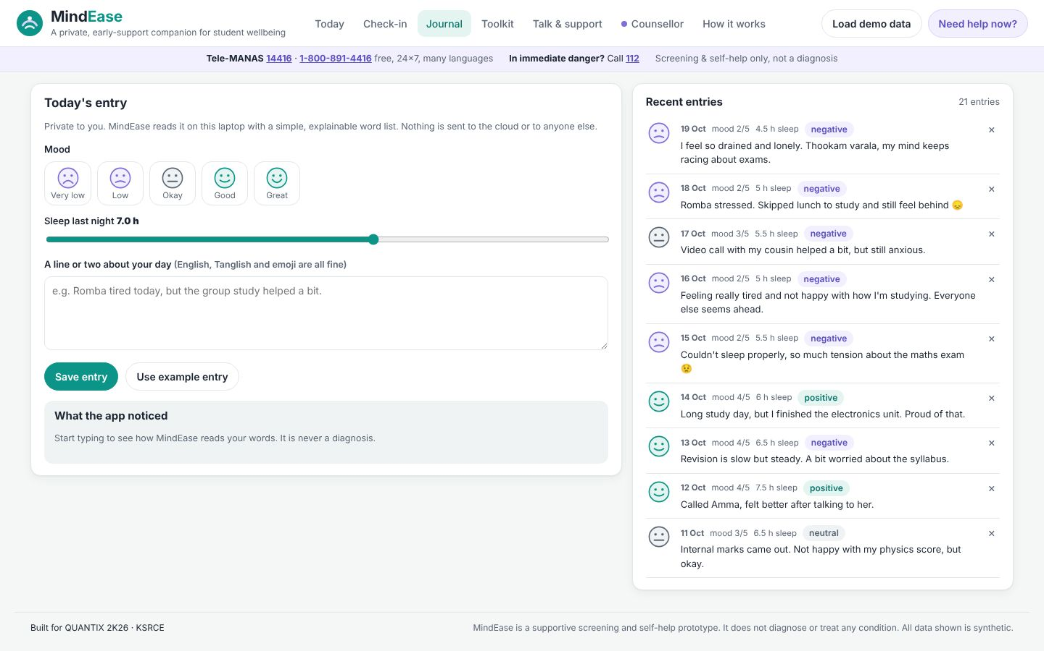
Live demo in 3 minutes
1
Load demo data: Ananya's 3-week journal, 60-student cohort
2
Today: 'mood dipped for 5 days', tap Why? to see CUSUM
3
Journal example: 'killing me' ignored, hopeless phrase noticed
4
Gentle support screen: Tele-MANAS 14416, 112, counsellor
5
Check-in: item 9 answer opens support instantly
6
Toolkit: box breathing and Pomodoro exam plan
▸ Journal
python app.py → http://localhost:8016
7
Counsellor (PIN 2468): exam spike, acknowledge alert
Notes:
Switch to the browser now. 1. Load demo data: Ananya's 3-week journal, 60-student cohort 2. Today: 'mood dipped for 5 days', tap Why? to see CUSUM 3. Journal example: 'killing me' ignored, hopeless phrase noticed 4. Gentle support screen: Tele-MANAS 14416, 112, counsellor 5. Check-in: item 9 answer opens support instantly 6. Toolkit: box breathing and Pomodoro exam plan 7. Counsellor (PIN 2468): exam spike, acknowledge alert

Slide 11

Feasibility, business model & roadmap
Business model
Future scope
Free for students, always
College licence for the counsellor dashboard
Deploy via student-welfare and NSS/CSR programmes
Paid add-ons: SSO, multi-campus reports, local languages
Validate with the counselling cell under ethics approval
Official Tamil/Hindi PHQ-9 and GAD-7 translations
Larger, multi-rater Tanglish lexicon
Encrypted on-device storage as a mobile PWA
Trained peer-listener matching
Notes:
Business: Free for students, always College licence for the counsellor dashboard Deploy via student-welfare and NSS/CSR programmes Paid add-ons: SSO, multi-campus reports, local languages Next: Validate with the counselling cell under ethics approval Official Tamil/Hindi PHQ-9 and GAD-7 translations Larger, multi-rater Tanglish lexicon Encrypted on-device storage as a mobile PWA Trained peer-listener matching

Slide 12

Thank you
MindEase · A private, early-support companion for student mental wellbeing
Scan for the code
Code https://github.com/jayeskumar/a/tree/claude/confident-fermi-dpeh2g/projects/16-mindease
Run cd projects/16-mindease && python app.py
Questions?
Notes:
Close with the impact line, invite questions. Keep the demo tab open in case judges want to try it.

