Slide 1
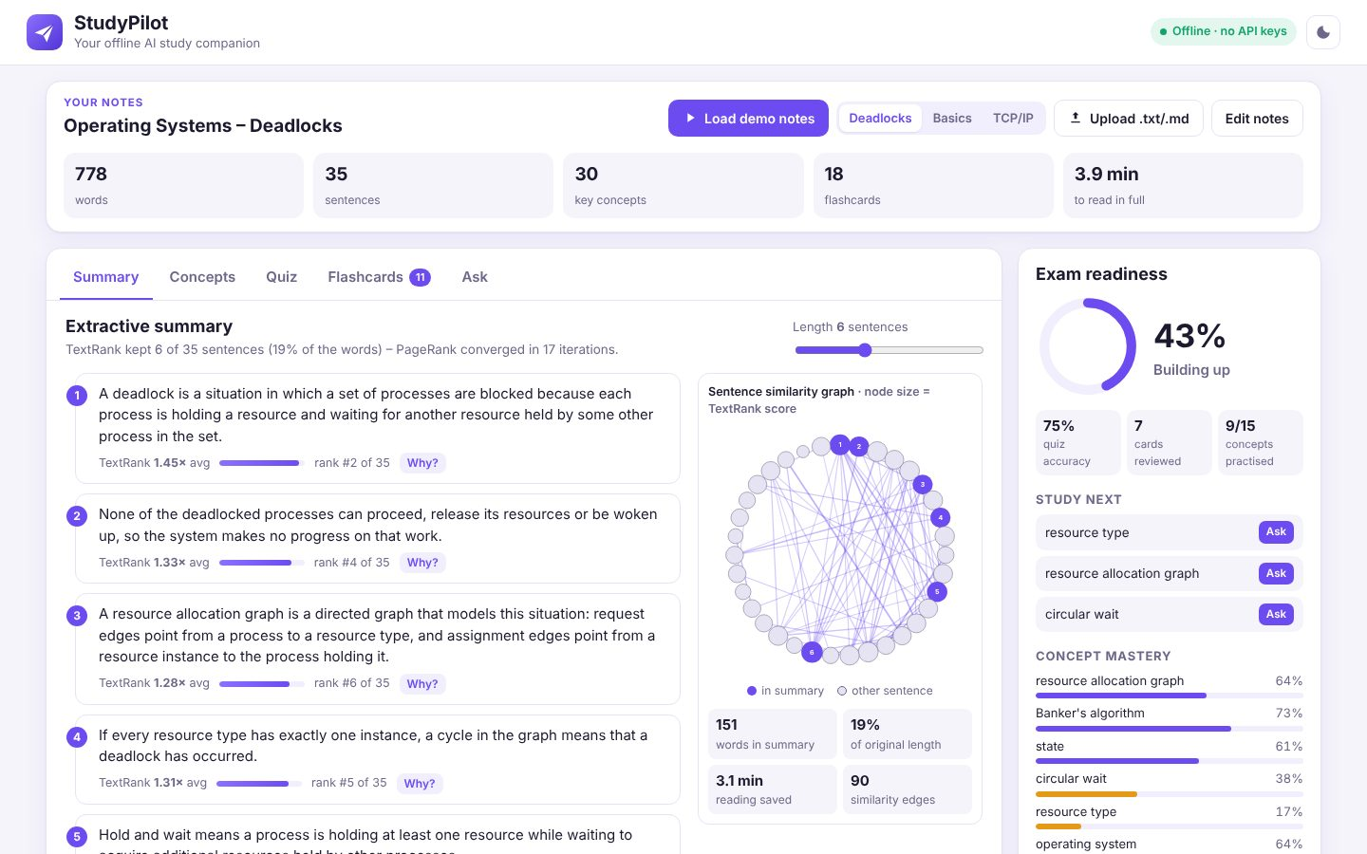
ARTIFICIAL INTELLIGENCE & MACHINE LEARNING
StudyPilot
Your offline AI study companion
Your Team Name
QUANTIX 2K26 · 24-hour hackathon · K.S.R. College of Engineering
Notes:
Open with the one-line promise: Your offline AI study companion. Introduce the team, then go straight to the problem.

Slide 2

The problem
Students drown in pages of notes before exams
Re-reading is slow; without review, material fades in days
AI chatbots need internet and paid keys, and can hallucinate
Tier-2/3 colleges often have weak Wi-Fi and costly mobile data
~4.3 crore
students in Indian higher education (AISHE 2021-22, approx.)
Days
for unreviewed material to fade (Ebbinghaus forgetting curve, approx.)
₹0
StudyPilot cost per query: no API key, no data plan
Notes:
Problem: Students drown in pages of notes before exams Re-reading is slow; without review, material fades in days AI chatbots need internet and paid keys, and can hallucinate Tier-2/3 colleges often have weak Wi-Fi and costly mobile data Key numbers: ~4.3 crore students in Indian higher education (AISHE 2021-22, approx.); Days for unreviewed material to fade (Ebbinghaus forgetting curve, approx.); ₹0 StudyPilot cost per query: no API key, no data plan.

Slide 3

Our solution: StudyPilot
Paste or upload notes and get a full revision kit in ~6 ms
Summary, concepts, quiz, flashcards and Q&A from your own notes
Everything extractive and explained, so nothing is made up
Pure Python on any laptop, 100% offline and private
Notes:
Solution: Paste or upload notes and get a full revision kit in ~6 ms Summary, concepts, quiz, flashcards and Q&A from your own notes Everything extractive and explained, so nothing is made up Pure Python on any laptop, 100% offline and private

Slide 4






Key features
TextRank summary
Key concepts
Auto quiz
Adjustable length, per-sentence scores and a similarity graph
RAKE keyphrases as weighted chips with highlighted evidence
Cloze and MCQ with similar-type distractors and typo-tolerant grading
SM-2 flashcards
Ask your notes
Exam readiness
Auto-made cards, Again/Hard/Good/Easy, schedule saved locally
BM25 answers with highlights, confidence and term breakdown
Mastery per concept from quiz and card history, plus study-next
Notes:
Features: TextRank summary: Adjustable length, per-sentence scores and a similarity graph. Key concepts: RAKE keyphrases as weighted chips with highlighted evidence. Auto quiz: Cloze and MCQ with similar-type distractors and typo-tolerant grading. SM-2 flashcards: Auto-made cards, Again/Hard/Good/Easy, schedule saved locally. Ask your notes: BM25 answers with highlights, confidence and term breakdown. Exam readiness: Mastery per concept from quiz and card history, plus study-next

Slide 5
System architecture
Browser UI (vanilla JS + SVG) tabs, readiness sidebar
Tech stack
app.py ThreadingHTTPServer JSON API, validation, cache
Python 3 stdlib only (http.server, re, math, json)
Vanilla HTML/CSS/JS, inline SVG, no CDN
JSON file persistence with atomic writes
unittest: 34 tests
text.py tokenizer, sentence splitter, stop words, stemmer
textrank / keyphrases / bm25 summary, concepts, retrieval
quiz / flashcards / srs cloze, MCQ, SM-2 scheduling
Runs fully offline · no installs · python app.py
mastery + store readiness score, data/state.json
Notes:
Architecture top to bottom: Browser UI (vanilla JS + SVG) -> tabs, readiness sidebar. app.py ThreadingHTTPServer -> JSON API, validation, cache. text.py -> tokenizer, sentence splitter, stop words, stemmer. textrank / keyphrases / bm25 -> summary, concepts, retrieval. quiz / flashcards / srs -> cloze, MCQ, SM-2 scheduling. mastery + store -> readiness score, data/state.json. Stack: Python 3 stdlib only (http.server, re, math, json), Vanilla HTML/CSS/JS, inline SVG, no CDN, JSON file persistence with atomic writes, unittest: 34 tests.

Slide 6
Algorithms built from scratch
01
TextRank (PageRank power iteration)
extractive summary
02
RAKE + occurrence boost
key-concept extraction
03
Type-similarity ranking
MCQ distractor selection
04
Okapi BM25 + definition bonus
question answering
05
SM-2
spaced-repetition scheduling
06
Laplace-smoothed mastery
exam-readiness score
Notes:
Algorithms: TextRank (PageRank power iteration) – extractive summary. RAKE + occurrence boost – key-concept extraction. Type-similarity ranking – MCQ distractor selection. Okapi BM25 + definition bonus – question answering. SM-2 – spaced-repetition scheduling. Laplace-smoothed mastery – exam-readiness score. Stress that nothing is a black box: every decision can be explained on screen.

Slide 7



What makes it different
Hallucination-free: every output is a sentence from your notes
Explains every decision: scores, links, distractors, SM-2 changes
Closed loop: summary to recall to spaced review to readiness
Runs on a ₹15k laptop with Wi-Fi off
Notes:
Differentiators: Hallucination-free: every output is a sentence from your notes Explains every decision: scores, links, distractors, SM-2 changes Closed loop: summary to recall to spaced review to readiness Runs on a ₹15k laptop with Wi-Fi off

Slide 8

Measured results
0.526
100%
~6 ms
~1 ms
ROUGE-1 F1 vs reference (Lead-6: 0.465)
QA top-3 hit rate on 31 questions (top-1 80.6%)
full analysis of a 780-word note set
Ask-your-notes HTTP round trip
Measured on held-out data generated by the project (see REPORT.md for method). Real-world performance needs field validation.
Impact AI study help for students with poor connectivity · No subscription, no API cost, no mobile data · Notes and progress never leave the device
Notes:
Results: 0.526 ROUGE-1 F1 vs reference (Lead-6: 0.465); 100% QA top-3 hit rate on 31 questions (top-1 80.6%); ~6 ms full analysis of a 780-word note set; ~1 ms Ask-your-notes HTTP round trip. Impact: AI study help for students with poor connectivity No subscription, no API cost, no mobile data Notes and progress never leave the device

Slide 9
Live demo in 3 minutes
1
Turn Wi-Fi off and click Load demo notes
2
Summary: drag length slider, click Why? and graph nodes
3
Concepts: click a chip to see its evidence
4
Quiz: answer with a typo, check answers, see readiness rise
5
Flashcards: flip, rate Good and Again, see the SM-2 schedule
python app.py → http://localhost:8001
6
Ask: question with highlights and confidence, then an off-topic one
Notes:
Switch to the browser now. 1. Turn Wi-Fi off and click Load demo notes 2. Summary: drag length slider, click Why? and graph nodes 3. Concepts: click a chip to see its evidence 4. Quiz: answer with a typo, check answers, see readiness rise 5. Flashcards: flip, rate Good and Again, see the SM-2 schedule 6. Ask: question with highlights and confidence, then an off-topic one

Slide 10

Feasibility, business model & roadmap
Business model
Future scope
Free core app for every student
College licence: LAN server and class readiness dashboards
White-label quiz generation for ed-tech and coaching
Premium packs: Tamil/Hindi support, PDF import
PDF and offline OCR import
Tamil and Hindi tokenisers and stemmers
Synonym-aware query expansion
FSRS scheduler and exam-date planner
Faculty mode with class-level weak-concept view
Notes:
Business: Free core app for every student College licence: LAN server and class readiness dashboards White-label quiz generation for ed-tech and coaching Premium packs: Tamil/Hindi support, PDF import Next: PDF and offline OCR import Tamil and Hindi tokenisers and stemmers Synonym-aware query expansion FSRS scheduler and exam-date planner Faculty mode with class-level weak-concept view

Slide 11

Thank you
StudyPilot · Your offline AI study companion
Scan for the code
Code https://github.com/jayeskumar/a/tree/claude/confident-fermi-dpeh2g/projects/01-studypilot
Run cd projects/01-studypilot && python app.py
Questions?
Notes:
Close with the impact line, invite questions. Keep the demo tab open in case judges want to try it.

