Slide 1
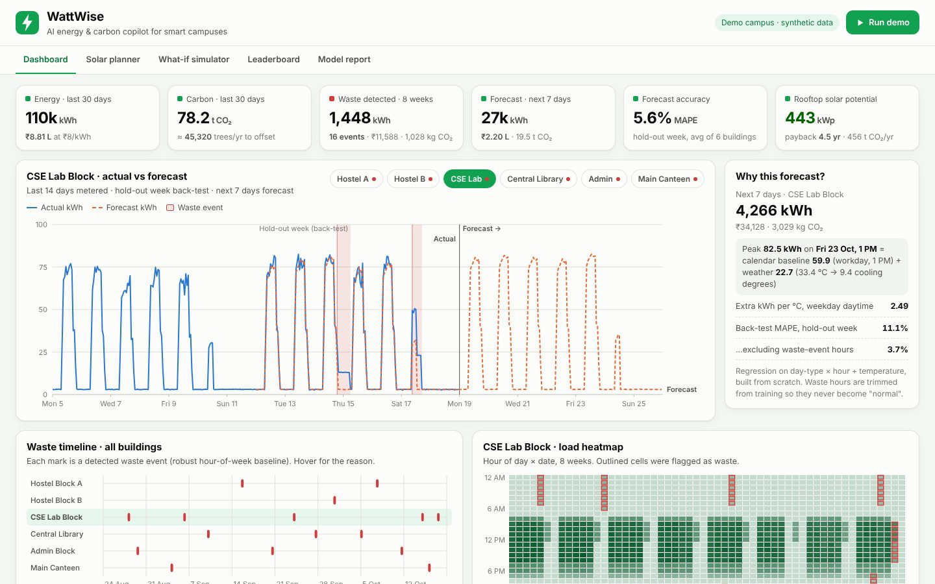
SUSTAINABILITY, CLEANTECH & GREEN ENERGY
WattWise
AI energy & carbon copilot for smart campuses
Your Team Name
QUANTIX 2K26 · 24-hour hackathon · K.S.R. College of Engineering
Notes:
Open with the one-line promise: AI energy & carbon copilot for smart campuses. Introduce the team, then go straight to the problem.

Slide 2

The problem
Labs, ACs and lights run all night and on weekends
The only feedback is a monthly bill, weeks late
No one knows if rooftop solar would really pay off
Green drives fade because savings are never measured
~0.7 kg
CO2 per kWh on India's grid (approx., CEA)
~1/3
of India's electricity is used by buildings (approx., BEE)
1.34 GWh
yearly use of our 6-building demo campus (synthetic)
Notes:
Problem: Labs, ACs and lights run all night and on weekends The only feedback is a monthly bill, weeks late No one knows if rooftop solar would really pay off Green drives fade because savings are never measured Key numbers: ~0.7 kg CO2 per kWh on India's grid (approx., CEA); ~1/3 of India's electricity is used by buildings (approx., BEE); 1.34 GWh yearly use of our 6-building demo campus (synthetic).

Slide 3

Our solution: WattWise
Reads hourly meter data for every campus building
Forecasts next week and flags waste with a plain reason
Converts every kWh to rupees, CO2 and trees
Plans rooftop solar and simulates savings before you spend
Notes:
Solution: Reads hourly meter data for every campus building Forecasts next week and flags waste with a plain reason Converts every kWh to rupees, CO2 and trees Plans rooftop solar and simulates savings before you spend

Slide 4






Key features
7-day forecast
Waste detective
Carbon ledger
Hourly per building, split into calendar baseline + weather effect
Robust z-score alerts: '18 kW at 3 AM Sun vs 3 kW typical'
kWh to rupees to kg CO2 to trees, with named, editable factors
Solar planner
What-if levers
Green leaderboard
kWp, payback, 25-year cash flow and CO2 avoided for any roof
AC setpoint, auto-off, LED and BLDC - live savings, no double count
Weather-normalised savings vs own baseline; Green Champion badge
Notes:
Features: 7-day forecast: Hourly per building, split into calendar baseline + weather effect. Waste detective: Robust z-score alerts: '18 kW at 3 AM Sun vs 3 kW typical'. Carbon ledger: kWh to rupees to kg CO2 to trees, with named, editable factors. Solar planner: kWp, payback, 25-year cash flow and CO2 avoided for any roof. What-if levers: AC setpoint, auto-off, LED and BLDC - live savings, no double count. Green leaderboard: Weather-normalised savings vs own baseline; Green Champion badge

Slide 5
System architecture
Meters / CSV hourly kWh + temperature per building
Tech stack
dataset.py deterministic synthetic campus with ground truth
Python 3 standard library only
http.server ThreadingHTTPServer
Vanilla HTML/CSS/JS
Hand-drawn inline SVG charts
unittest (30 tests)
Runs fully offline
forecast.py robust weighted regression, Holt-Winters baseline
anomaly.py median + MAD per hour-of-week, rule-based causes
solar.py / whatif.py / leaderboard.py decisions in rupees and CO2
Runs fully offline · no installs · python app.py
app.py stdlib HTTP JSON API; static/ – vanilla JS + SVG dashboard
Notes:
Architecture top to bottom: Meters / CSV -> hourly kWh + temperature per building. dataset.py -> deterministic synthetic campus with ground truth. forecast.py -> robust weighted regression, Holt-Winters baseline. anomaly.py -> median + MAD per hour-of-week, rule-based causes. solar.py / whatif.py / leaderboard.py -> decisions in rupees and CO2. app.py -> stdlib HTTP JSON API; static/ -> vanilla JS + SVG dashboard. Stack: Python 3 standard library only, http.server ThreadingHTTPServer, Vanilla HTML/CSS/JS, Hand-drawn inline SVG charts, unittest (30 tests), Runs fully offline.

Slide 6
Algorithms built from scratch
01
Weighted ridge regression (Gaussian elimination)
hourly load forecast
02
Robust trimming from category medians
waste never becomes 'normal'
03
Modified z-score (median + MAD)
waste event detection
04
Holt-Winters triple smoothing
benchmark forecaster
05
Degraded cash-flow model
solar payback and 25-year savings
06
Weather-normalised baseline (IPMVP-style)
fair leaderboard
Notes:
Algorithms: Weighted ridge regression (Gaussian elimination) - hourly load forecast. Robust trimming from category medians - waste never becomes 'normal'. Modified z-score (median + MAD) - waste event detection. Holt-Winters triple smoothing - benchmark forecaster. Degraded cash-flow model - solar payback and 25-year savings. Weather-normalised baseline (IPMVP-style) - fair leaderboard. Stress that nothing is a black box: every decision can be explained on screen.

Slide 7



What makes it different
Every forecast and alert explains itself - no black box
Buildings compete with their own weather-adjusted past
Detection to rupees to fix to solar, all in one offline tool
Zero dependencies: runs on a Rs 15k laptop with no internet
Notes:
Differentiators: Every forecast and alert explains itself - no black box Buildings compete with their own weather-adjusted past Detection to rupees to fix to solar, all in one offline tool Zero dependencies: runs on a Rs 15k laptop with no internet

Slide 8

Measured results
5.6%
100% / 89%
10%
300 ms
forecast MAPE on hold-out week (Holt-Winters 27.7%)
waste-event precision / recall vs injected truth
monthly saving from 4 cheap levers (Rs 10.7 L/yr, demo)
full pipeline for 6 buildings x 8 weeks
Measured on held-out data generated by the project (see REPORT.md for method). Real-world performance needs field validation.
Impact ~10% lower bills from operational levers (demo estimate) · ~95 t CO2/yr avoided by levers, ~456 t/yr by rooftop solar · Students see their building's footprint and compete to cut it
Notes:
Results: 5.6% forecast MAPE on hold-out week (Holt-Winters 27.7%); 100% / 89% waste-event precision / recall vs injected truth; 10% monthly saving from 4 cheap levers (Rs 10.7 L/yr, demo); 300 ms full pipeline for 6 buildings x 8 weeks. Impact: ~10% lower bills from operational levers (demo estimate) ~95 t CO2/yr avoided by levers, ~456 t/yr by rooftop solar Students see their building's footprint and compete to cut it

Slide 9
Live demo in 3 minutes
1
Click Run demo - models retrain offline in ~300 ms
2
Read KPI tiles: kWh, rupees, CO2, waste, next-week forecast
3
Hover the CSE Lab night-time waste band for its reason
4
Open Why this forecast: baseline + weather split
5
Solar planner: all roofs, 442 kWp, 4.5-year payback
6
What-if: drag AC and LED sliders, watch savings update
python app.py → http://localhost:8002
7
Leaderboard and Model report: champion and live accuracy
Notes:
Switch to the browser now. 1. Click Run demo - models retrain offline in ~300 ms 2. Read KPI tiles: kWh, rupees, CO2, waste, next-week forecast 3. Hover the CSE Lab night-time waste band for its reason 4. Open Why this forecast: baseline + weather split 5. Solar planner: all roofs, 442 kWp, 4.5-year payback 6. What-if: drag AC and LED sliders, watch savings update 7. Leaderboard and Model report: champion and live accuracy

Slide 10

Feasibility, business model & roadmap
Business model
Future scope
Free open-source core for colleges via eco-clubs
Pro tier per building: alerts, meter connectors, NAAC reports
Referral fee from solar EPC vendors
Shared-savings contracts verified by the same baseline
Live Modbus/MQTT meters and WhatsApp alerts
Academic calendar and humidity as forecast inputs
Time-of-day tariff and peak-demand optimisation
Battery dispatch and carbon-aware scheduling
NILM to learn end-use shares automatically
Notes:
Business: Free open-source core for colleges via eco-clubs Pro tier per building: alerts, meter connectors, NAAC reports Referral fee from solar EPC vendors Shared-savings contracts verified by the same baseline Next: Live Modbus/MQTT meters and WhatsApp alerts Academic calendar and humidity as forecast inputs Time-of-day tariff and peak-demand optimisation Battery dispatch and carbon-aware scheduling NILM to learn end-use shares automatically

Slide 11

Thank you
WattWise · AI energy & carbon copilot for smart campuses
Scan for the code
Code https://github.com/jayeskumar/a/tree/claude/confident-fermi-dpeh2g/projects/02-wattwise
Run cd projects/02-wattwise && python app.py
Questions?
Notes:
Close with the impact line, invite questions. Keep the demo tab open in case judges want to try it.

