Slide 1
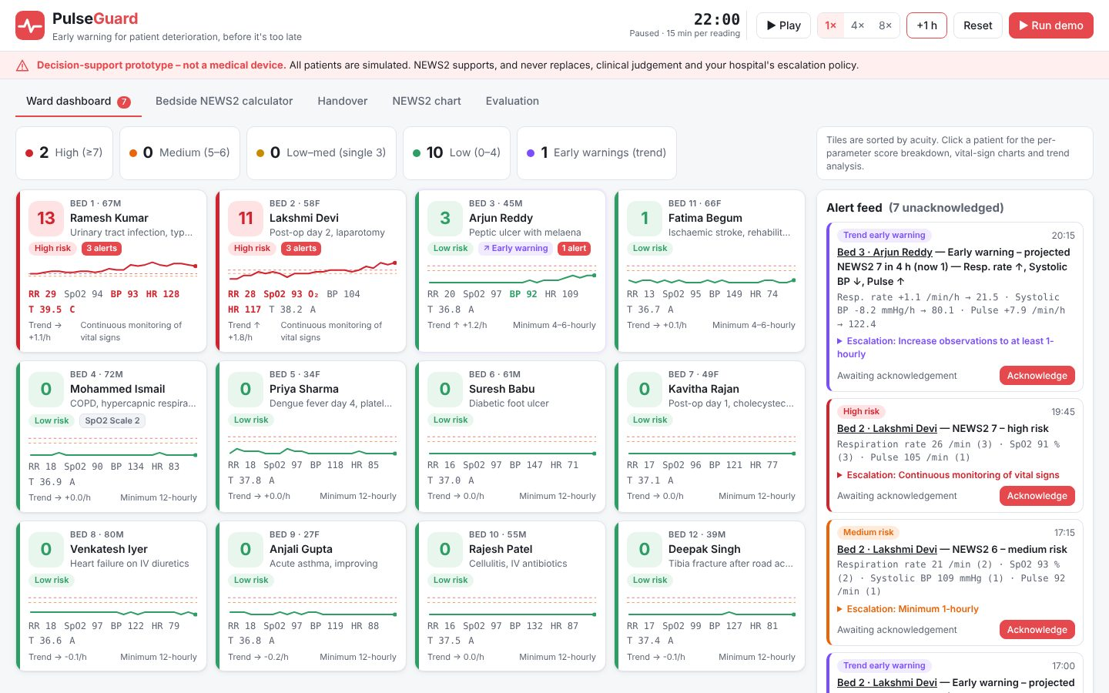
HEALTHTECH & BIOMEDICAL INNOVATION
PulseGuard
Early warning for patient deterioration, before it's too late
Your Team Name
QUANTIX 2K26 · 24-hour hackathon · K.S.R. College of Engineering
Notes:
Open with the one-line promise: Early warning for patient deterioration, before it's too late. Introduce the team, then go straight to the problem.

Slide 2

The problem
Ward patients deteriorate silently between manual observation rounds
Understaffed district hospitals: one nurse, many beds, paper charts
Paper NEWS2 is a snapshot; nobody plots the trend
Threshold alarms fire only after the patient has crossed the line
~8 in 10
in-hospital arrests showed deterioration in prior 8 h (Schein 1990, approx.)
4–6 h
NEWS2 minimum obs interval for scores 1–4 (RCP 2017)
Notes:
Problem: Ward patients deteriorate silently between manual observation rounds Understaffed district hospitals: one nurse, many beds, paper charts Paper NEWS2 is a snapshot; nobody plots the trend Threshold alarms fire only after the patient has crossed the line Key numbers: ~8 in 10 in-hospital arrests showed deterioration in prior 8 h (Schein 1990, approx.); 4–6 h NEWS2 minimum obs interval for scores 1–4 (RCP 2017).

Slide 3

Our solution: PulseGuard
Exact NEWS2 scoring of every reading, incl. SpO2 Scale 2 for COPD
From-scratch trend detector projects NEWS2 4 h ahead
Acuity-sorted ward dashboard with alert feed and escalation steps
Explainable breakdown, bedside calculator and auto handover
Notes:
Solution: Exact NEWS2 scoring of every reading, incl. SpO2 Scale 2 for COPD From-scratch trend detector projects NEWS2 4 h ahead Acuity-sorted ward dashboard with alert feed and escalation steps Explainable breakdown, bedside calculator and auto handover

Slide 4






Key features
NEWS2 engine
Trend early warning
Live ward simulator
All 7 parameters, Scale 1/2, red-3 rule, 4 bands, RCP responses
OLS slopes + R² gating flag rising risk before thresholds
12 seeded patients, server clock, play/pause/speed/reset
Explainability
Bedside calculator
Auto handover
Per-parameter points, zone-shaded charts, rule that fired
Validated entry, instant score, save to patient chart
Printable per-patient summary: score, trend, last change
Notes:
Features: NEWS2 engine: All 7 parameters, Scale 1/2, red-3 rule, 4 bands, RCP responses. Trend early warning: OLS slopes + R² gating flag rising risk before thresholds. Live ward simulator: 12 seeded patients, server clock, play/pause/speed/reset. Explainability: Per-parameter points, zone-shaded charts, rule that fired. Bedside calculator: Validated entry, instant score, save to patient chart. Auto handover: Printable per-patient summary: score, trend, last change

Slide 5
System architecture
Ward simulator / nurse entry validated vital-sign readings
Tech stack
news2.py RCP 2017 tables, bands, escalation response
Python 3 stdlib
http.server
Vanilla HTML/CSS/JS
Inline SVG charts
unittest (75 tests)
trend.py least-squares slope, R², 4 h projection
alerts.py hysteresis, debounce, cooldown
app.py ThreadingHTTPServer JSON API
Runs fully offline · no installs · python app.py
Vanilla JS + inline SVG dashboard, polls every second
Notes:
Architecture top to bottom: Ward simulator / nurse entry -> validated vital-sign readings. news2.py -> RCP 2017 tables, bands, escalation response. trend.py -> least-squares slope, R², 4 h projection. alerts.py -> hysteresis, debounce, cooldown. app.py ThreadingHTTPServer -> JSON API. Vanilla JS + inline SVG dashboard, polls every second. Stack: Python 3 stdlib, http.server, Vanilla HTML/CSS/JS, Inline SVG charts, unittest (75 tests).

Slide 6
Algorithms built from scratch
01
NEWS2 (RCP 2017)
aggregate risk score and clinical response
02
Ordinary least squares
per-vital slope and R² over 3 h
03
Trend projection
score projected vitals with NEWS2
04
Hysteresis state machine
alert without flicker spam
05
AR(1) physiological simulator
seeded deterministic vitals
Notes:
Algorithms: NEWS2 (RCP 2017) – aggregate risk score and clinical response. Ordinary least squares – per-vital slope and R² over 3 h. Trend projection – score projected vitals with NEWS2. Hysteresis state machine – alert without flicker spam. AR(1) physiological simulator – seeded deterministic vitals. Stress that nothing is a black box: every decision can be explained on screen.

Slide 7



What makes it different
Warns on the trajectory, not just the threshold
Early warning stated in NEWS2 terms nurses already use
Scale 2 prevents constant false red alerts in COPD
Fully offline, explainable, runs on a ₹15k laptop
Notes:
Differentiators: Warns on the trajectory, not just the threshold Early warning stated in NEWS2 terms nurses already use Scale 2 prevents constant false red alerts in COPD Fully offline, explainable, runs on a ₹15k laptop

Slide 8

Measured results
1.0 h
3.25 h
3 / 270
≈6 µs
median extra warning vs NEWS2≥5 alert (held-out sim)
median earlier than 4-hourly paper rounds (held-out sim)
false trend alerts per stable patient-days (held-out)
NEWS2 scoring latency per reading
Measured on held-out data generated by the project (see REPORT.md for method). Real-world performance needs field validation.
Impact More time for antibiotics, fluids or ICU transfer · Points scarce nursing attention at the beds that need it · No licence, cloud or new hardware needed to start
Notes:
Results: 1.0 h median extra warning vs NEWS2≥5 alert (held-out sim); 3.25 h median earlier than 4-hourly paper rounds (held-out sim); 3 / 270 false trend alerts per stable patient-days (held-out); ≈6 µs NEWS2 scoring latency per reading. Impact: More time for antibiotics, fluids or ICU transfer Points scarce nursing attention at the beds that need it No licence, cloud or new hardware needed to start

Slide 9
Live demo in 3 minutes
1
Click Run demo: 12-bed ward plays from 08:00
2
Bed 1 gets a purple early warning while NEWS2 is still low
3
Open patient: per-parameter breakdown, shaded charts, slopes
4
Threshold fires 1 h 45 min later; acknowledge alert
5
COPD bed: Scale 2 vs Scale 1 comparison
6
Bedside calculator: Early sepsis example scores 7
python app.py → http://localhost:8003
7
Handover tab: print the auto-generated summary
Notes:
Switch to the browser now. 1. Click Run demo: 12-bed ward plays from 08:00 2. Bed 1 gets a purple early warning while NEWS2 is still low 3. Open patient: per-parameter breakdown, shaded charts, slopes 4. Threshold fires 1 h 45 min later; acknowledge alert 5. COPD bed: Scale 2 vs Scale 1 comparison 6. Bedside calculator: Early sepsis example scores 7 7. Handover tab: print the auto-generated summary

Slide 10

Feasibility, business model & roadmap
Business model
Future scope
Free bedside calculator to drive adoption
Per-bed monthly subscription for ward dashboard
Bundle with low-cost wearables via state health missions/CSR
Analytics add-on: escalation compliance for quality teams
Validate on real de-identified vitals, then silent ward pilot
HL7/FHIR and BLE wearable ingestion
SMS/WhatsApp escalation with acknowledgement timing
Patient-specific baselines and calibrated risk
Tamil/Hindi UI and voice entry
Notes:
Business: Free bedside calculator to drive adoption Per-bed monthly subscription for ward dashboard Bundle with low-cost wearables via state health missions/CSR Analytics add-on: escalation compliance for quality teams Next: Validate on real de-identified vitals, then silent ward pilot HL7/FHIR and BLE wearable ingestion SMS/WhatsApp escalation with acknowledgement timing Patient-specific baselines and calibrated risk Tamil/Hindi UI and voice entry

Slide 11

Thank you
PulseGuard · Early warning for patient deterioration, before it's too late
Scan for the code
Code https://github.com/jayeskumar/a/tree/claude/confident-fermi-dpeh2g/projects/03-pulseguard
Run cd projects/03-pulseguard && python app.py
Questions?
Notes:
Close with the impact line, invite questions. Keep the demo tab open in case judges want to try it.

