Slide 1
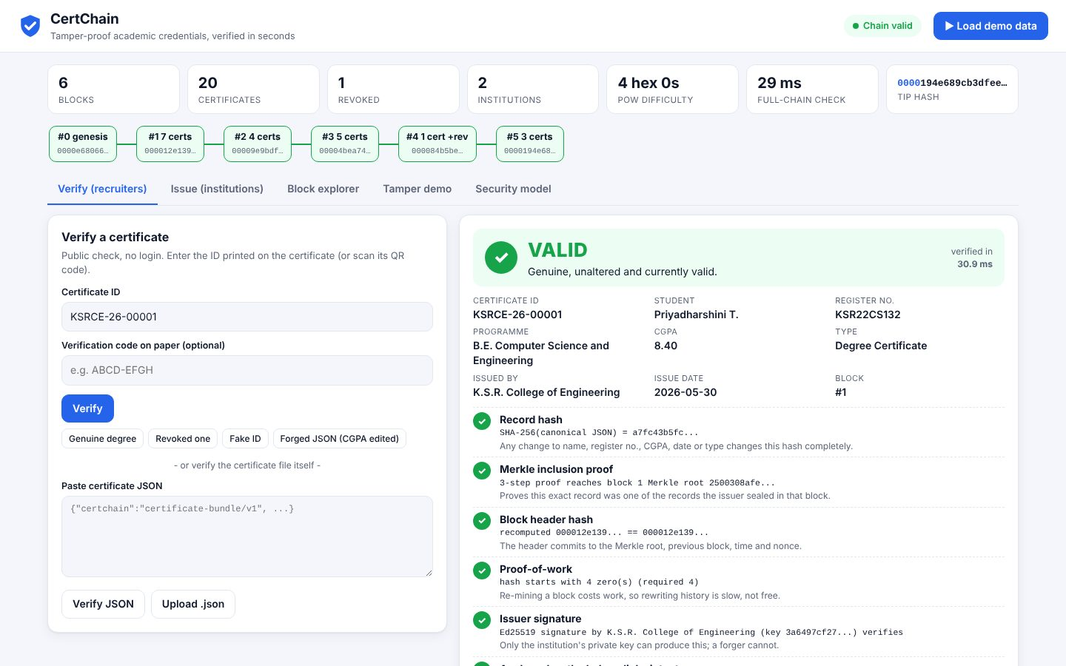
CYBERSECURITY & BLOCKCHAIN TECHNOLOGY
CertChain
Tamper-proof academic credentials, verified in seconds
Your Team Name
QUANTIX 2K26 · 24-hour hackathon · K.S.R. College of Engineering
Notes:
Open with the one-line promise: Tamper-proof academic credentials, verified in seconds. Introduce the team, then go straight to the problem.

Slide 2

The problem
Fake degree, marksheet and internship certificates keep fooling recruiters
A doctored PDF takes minutes; manual college verification takes days to weeks
Phone/email checks leave no audit trail and can be socially engineered
Central databases must be trusted blindly - insider edits are invisible
Days-weeks
manual verification turnaround via the college (approx.)
Minutes
to doctor a certificate PDF with free tools (approx.)
0
cryptographic checks on a typical paper certificate
Notes:
Problem: Fake degree, marksheet and internship certificates keep fooling recruiters A doctored PDF takes minutes; manual college verification takes days to weeks Phone/email checks leave no audit trail and can be socially engineered Central databases must be trusted blindly - insider edits are invisible Key numbers: Days-weeks manual verification turnaround via the college (approx.); Minutes to doctor a certificate PDF with free tools (approx.); 0 cryptographic checks on a typical paper certificate.

Slide 3

Our solution: CertChain
Each college signs certificates with its own Ed25519 key
Records are Merkle-sealed into a hash-linked, PoW-mined permissioned chain
Recruiters scan a QR code: VALID / REVOKED / INVALID with 7 explained checks
Signed on-chain revocations; tampering pinpoints the exact broken block
Notes:
Solution: Each college signs certificates with its own Ed25519 key Records are Merkle-sealed into a hash-linked, PoW-mined permissioned chain Recruiters scan a QR code: VALID / REVOKED / INVALID with 7 explained checks Signed on-chain revocations; tampering pinpoints the exact broken block

Slide 4






Key features
Issue & bulk CSV
Printable cert + QR
Explainable verify
Form or CSV batch -> one mined, signed block per batch
QR code from our own pure-Python encoder, ID and 8-char verify code
Hash, Merkle proof, block hash, PoW, signature, anchoring, revocation
Revocation registry
Tamper demo
Block explorer
Issuer-signed revocations recorded on-chain; only the issuer can revoke
Edit a CGPA in chain.json and watch the exact block and link break
Linked block cards with hashes, nonces, signatures and check status
Notes:
Features: Issue & bulk CSV: Form or CSV batch -> one mined, signed block per batch. Printable cert + QR: QR code from our own pure-Python encoder, ID and 8-char verify code. Explainable verify: Hash, Merkle proof, block hash, PoW, signature, anchoring, revocation. Revocation registry: Issuer-signed revocations recorded on-chain; only the issuer can revoke. Tamper demo: Edit a CGPA in chain.json and watch the exact block and link break. Block explorer: Linked block cards with hashes, nonces, signatures and check status

Slide 5
System architecture
Browser SPA (vanilla JS) verify, issue, explorer, tamper, security
Tech stack
app.py ThreadingHTTPServer JSON API under /api
Python 3 stdlib only (hashlib, http.server, json, csv)
Vanilla HTML/CSS/JS, inline SVG, no CDN
JSON file ledger, atomic writes
Runs fully offline on any laptop
service.py issue, bulk, revoke, verify, tamper, restore
chain.py blocks, PoW, full-chain validation, explainable verify
ed25519.py + merkle.py + qr.py crypto from scratch on hashlib
Runs fully offline · no installs · python app.py
data/chain.json + keys.json atomic JSON persistence
Notes:
Architecture top to bottom: Browser SPA (vanilla JS) -> verify, issue, explorer, tamper, security. app.py ThreadingHTTPServer -> JSON API under /api. service.py -> issue, bulk, revoke, verify, tamper, restore. chain.py -> blocks, PoW, full-chain validation, explainable verify. ed25519.py + merkle.py + qr.py -> crypto from scratch on hashlib. data/chain.json + keys.json -> atomic JSON persistence. Stack: Python 3 stdlib only (hashlib, http.server, json, csv), Vanilla HTML/CSS/JS, inline SVG, no CDN, JSON file ledger, atomic writes, Runs fully offline on any laptop.

Slide 6
Algorithms built from scratch
01
Ed25519 (RFC 8032)
issuer signatures on blocks and revocations
02
SHA-256 canonical-JSON hashing with 128-bit salt
record fingerprint
03
Merkle tree + inclusion proofs
verify one cert against a header
04
Proof-of-work (4 hex zeros)
cost to rewrite history
05
Full-chain validation
links, PoW, roots, signatures, rules
06
QR encoding with Reed-Solomon GF(256)
scannable verify link
Notes:
Algorithms: Ed25519 (RFC 8032) – issuer signatures on blocks and revocations. SHA-256 canonical-JSON hashing with 128-bit salt – record fingerprint. Merkle tree + inclusion proofs – verify one cert against a header. Proof-of-work (4 hex zeros) – cost to rewrite history. Full-chain validation – links, PoW, roots, signatures, rules. QR encoding with Reed-Solomon GF(256) – scannable verify link. Stress that nothing is a black box: every decision can be explained on screen.

Slide 7



What makes it different
All crypto hand-built and checked against RFC 8032 test vectors
Verification explains which guarantee failed and why it matters
Self-contained certificate bundle: Merkle proof + signed header
Two-level attacker demo shows why each security layer exists
Notes:
Differentiators: All crypto hand-built and checked against RFC 8032 test vectors Verification explains which guarantee failed and why it matters Self-contained certificate bundle: Merkle proof + signed header Two-level attacker demo shows why each security layer exists

Slide 8

Measured results
33 ms
3.4 / 3.8 ms
4 / 4
8 / 8
end-to-end certificate verification (median)
Ed25519 sign / verify, pure Python
RFC 8032 test vectors matched
tamper scenarios detected in tests
Measured on held-out data generated by the project (see REPORT.md for method). Real-world performance needs field validation.
Impact Honest graduates no longer undercut by forged credentials · Colleges stop answering verification emails one by one · Recruiters verify instantly and offline, for free
Notes:
Results: 33 ms end-to-end certificate verification (median); 3.4 / 3.8 ms Ed25519 sign / verify, pure Python; 4 / 4 RFC 8032 test vectors matched; 8 / 8 tamper scenarios detected in tests. Impact: Honest graduates no longer undercut by forged credentials Colleges stop answering verification emails one by one Recruiters verify instantly and offline, for free

Slide 9
Live demo in 3 minutes
1
Load demo data -> verify a genuine KSRCE degree: VALID, 7 ticks
2
Forged JSON (CGPA edited) -> INVALID at Merkle proof; fake ID -> NOT FOUND
3
Issue a certificate -> mined + signed -> printable page with QR
4
Bulk issue 5 certificates from CSV in one block
5
Tamper: edit CGPA in chain.json -> block 1 Merkle root breaks
6
Re-mine attack -> signature + block 2 link break; restore
python app.py → http://localhost:8004
7
Close on the threat model: forgery, tampering, insider, key theft
Notes:
Switch to the browser now. 1. Load demo data -> verify a genuine KSRCE degree: VALID, 7 ticks 2. Forged JSON (CGPA edited) -> INVALID at Merkle proof; fake ID -> NOT FOUND 3. Issue a certificate -> mined + signed -> printable page with QR 4. Bulk issue 5 certificates from CSV in one block 5. Tamper: edit CGPA in chain.json -> block 1 Merkle root breaks 6. Re-mine attack -> signature + block 2 link break; restore 7. Close on the threat model: forgery, tampering, insider, key theft

Slide 10

Feasibility, business model & roadmap
Business model
Future scope
Free public verification for recruiters drives adoption
Annual issuance licence per institution, with ERP/CSV integration
Paid bulk-verification API for job portals and BGV firms
White-label for skill and bootcamp certificate issuers
Multi-node replication and BFT consensus across a consortium
Key rotation, HSM signing and on-chain key-compromise records
Selective disclosure: prove the degree without revealing CGPA
W3C Verifiable Credentials and DigiLocker export
Mobile offline verifier app
Notes:
Business: Free public verification for recruiters drives adoption Annual issuance licence per institution, with ERP/CSV integration Paid bulk-verification API for job portals and BGV firms White-label for skill and bootcamp certificate issuers Next: Multi-node replication and BFT consensus across a consortium Key rotation, HSM signing and on-chain key-compromise records Selective disclosure: prove the degree without revealing CGPA W3C Verifiable Credentials and DigiLocker export Mobile offline verifier app

Slide 11
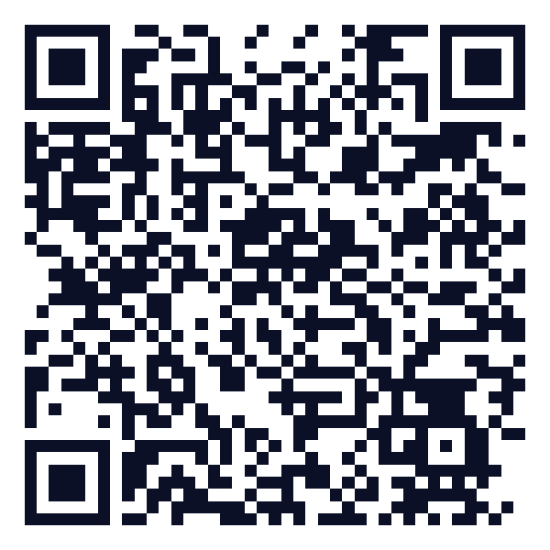
Thank you
CertChain · Tamper-proof academic credentials, verified in seconds
Scan for the code
Code https://github.com/jayeskumar/a/tree/claude/confident-fermi-dpeh2g/projects/04-certchain
Run cd projects/04-certchain && python app.py
Questions?
Notes:
Close with the impact line, invite questions. Keep the demo tab open in case judges want to try it.

