Slide 1
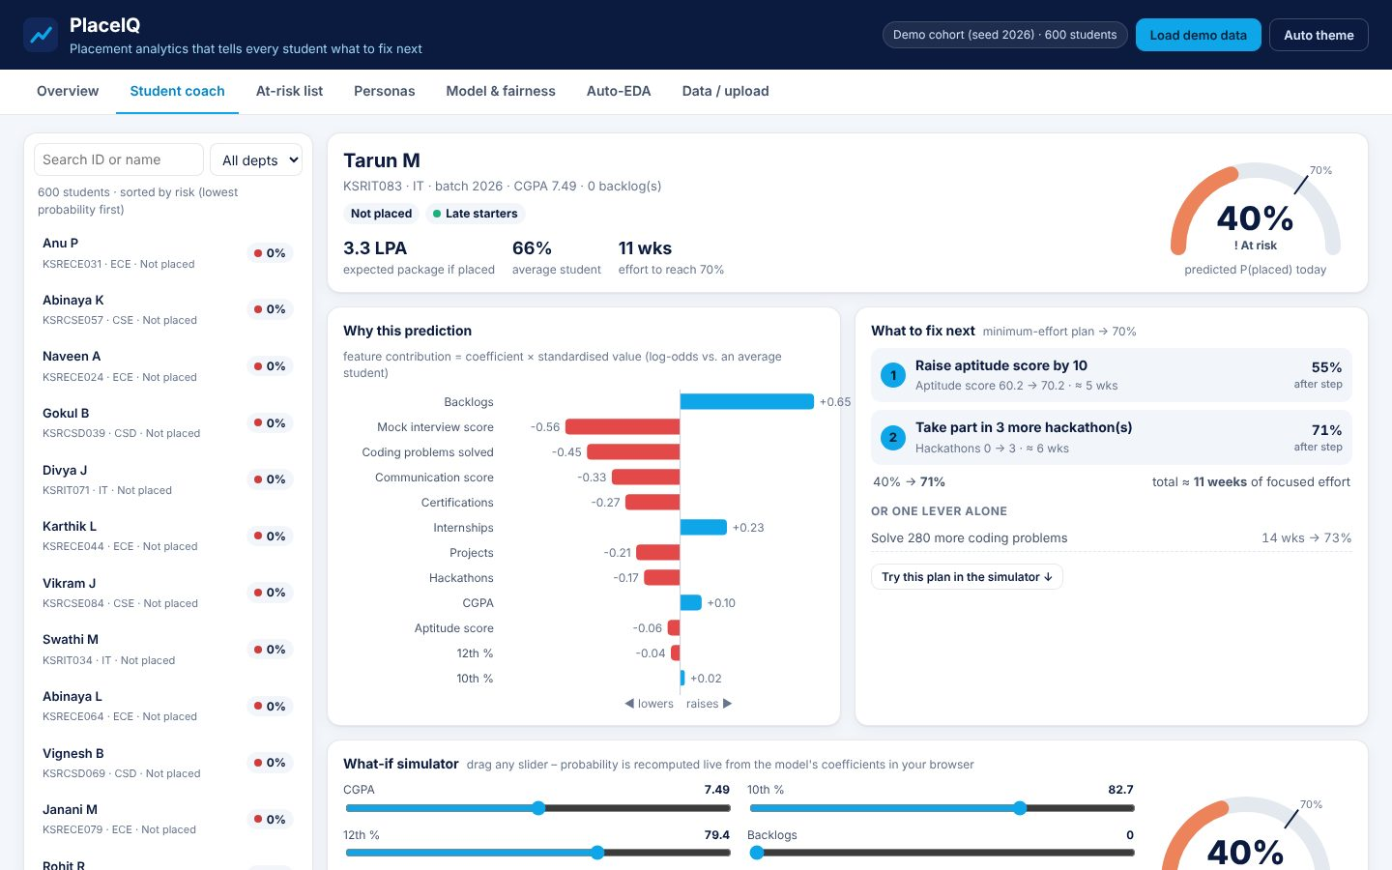
DATA SCIENCE & ANALYTICS
PlaceIQ
Placement analytics that tells every student what to fix next
Your Team Name
QUANTIX 2K26 · 24-hour hackathon · K.S.R. College of Engineering
Notes:
Open with the one-line promise: Placement analytics that tells every student what to fix next. Introduce the team, then go straight to the problem.

Slide 2

The problem
Placement cells track hundreds of students in spreadsheets
They learn who got placed only after the drive is over
Students don't know which skill gap matters most
Departments can't see weak trends early enough to act
10 lakh+
engineering seats a year in India (AICTE intake, approx.)
~50%
graduate employability in industry surveys (approx., varies)
Notes:
Problem: Placement cells track hundreds of students in spreadsheets They learn who got placed only after the drive is over Students don't know which skill gap matters most Departments can't see weak trends early enough to act Key numbers: 10 lakh+ engineering seats a year in India (AICTE intake, approx.); ~50% graduate employability in industry surveys (approx., varies).

Slide 3

Our solution: PlaceIQ
Upload the placement sheet (or load demo) and get instant auto-EDA
Explainable model predicts each student's placement chance
Optimiser finds the least-effort plan that lifts them above 70%
At-risk call list, personas and a fairness audit for the cell
Notes:
Solution: Upload the placement sheet (or load demo) and get instant auto-EDA Explainable model predicts each student's placement chance Optimiser finds the least-effort plan that lifts them above 70% At-risk call list, personas and a fairness audit for the cell

Slide 4






Key features
What to fix next
Why this prediction
What-if simulator
Exact minimum-effort counterfactual plan per student, ranked by effort
Coefficient x standardised value bars that add up to the score
12 sliders with a live probability gauge and re-planning
At-risk list
Student personas
Fairness check
Threshold slider, top gap per student, one-click CSV export
k-means++ clusters such as Coding stars and Toppers lacking projects
Per-department FPR, FNR and calibration gap on out-of-fold predictions
Notes:
Features: What to fix next: Exact minimum-effort counterfactual plan per student, ranked by effort. Why this prediction: Coefficient x standardised value bars that add up to the score. What-if simulator: 12 sliders with a live probability gauge and re-planning. At-risk list: Threshold slider, top gap per student, one-click CSV export. Student personas: k-means++ clusters such as Coding stars and Toppers lacking projects. Fairness check: Per-department FPR, FNR and calibration gap on out-of-fold predictions

Slide 5
System architecture
Browser UI vanilla JS, hand-drawn SVG charts, live simulator
Tech stack
app.py stdlib ThreadingHTTPServer, JSON API, input validation
Python 3 stdlib only
Vanilla HTML/CSS/JS
Inline SVG charts
No CDN, fully offline
unittest (46 tests)
data.py latent-model cohort generator + CSV row validation
models.py / metrics.py LogReg GD+L2, ridge, AUC, ROC, F1, R2
explain.py contributions + dynamic-programming planner
Runs fully offline · no installs · python app.py
cluster.py / engine.py k-means++ personas, fairness, dashboards
Notes:
Architecture top to bottom: Browser UI -> vanilla JS, hand-drawn SVG charts, live simulator. app.py -> stdlib ThreadingHTTPServer, JSON API, input validation. data.py -> latent-model cohort generator + CSV row validation. models.py / metrics.py -> LogReg GD+L2, ridge, AUC, ROC, F1, R2. explain.py -> contributions + dynamic-programming planner. cluster.py / engine.py -> k-means++ personas, fairness, dashboards. Stack: Python 3 stdlib only, Vanilla HTML/CSS/JS, Inline SVG charts, No CDN, fully offline, unittest (46 tests).

Slide 6
Algorithms built from scratch
01
Logistic regression (gradient descent, L2)
placement probability
02
Ridge linear regression (normal equations)
expected package
03
Bounded knapsack DP
minimum-effort counterfactual plan
04
k-means++
student personas
05
Rank-based ROC-AUC, Pearson correlation
evaluation and EDA
Notes:
Algorithms: Logistic regression (gradient descent, L2) - placement probability. Ridge linear regression (normal equations) - expected package. Bounded knapsack DP - minimum-effort counterfactual plan. k-means++ - student personas. Rank-based ROC-AUC, Pearson correlation - evaluation and EDA. Stress that nothing is a black box: every decision can be explained on screen.

Slide 7



What makes it different
Prescribes the cheapest realistic fix, not just a probability
Glass-box: chart, simulator and plan use one exact model
Effort costs and caps are editable named assumptions
Department excluded from the model, then audited for fairness
Notes:
Differentiators: Prescribes the cheapest realistic fix, not just a probability Glass-box: chart, simulator and plan use one exact model Effort costs and caps are editable named assumptions Department excluded from the model, then audited for fairness

Slide 8

Measured results
0.935
86.0%
0.588
2.7 s
ROC-AUC on 150 held-out students
hold-out accuracy (baseline 58.0%)
package R2, MAE 1.17 LPA
cold start: data + 9 models, pure Python
Measured on held-out data generated by the project (see REPORT.md for method). Real-world performance needs field validation.
Impact Students get a ranked to-do list, not 'improve your profile' · ~200 at-risk students found before drives, not after · Personas turn into targeted workshops per batch
Notes:
Results: 0.935 ROC-AUC on 150 held-out students; 86.0% hold-out accuracy (baseline 58.0%); 0.588 package R2, MAE 1.17 LPA; 2.7 s cold start: data + 9 models, pure Python. Impact: Students get a ranked to-do list, not 'improve your profile' ~200 at-risk students found before drives, not after Personas turn into targeted workshops per batch

Slide 9
Live demo in 3 minutes
1
Overview: KPIs, MECH lagging, who to call first
2
Student coach: Tarun M at 40% and why
3
What to fix next: +10 aptitude, +3 hackathons -> 71%
4
Simulator: drag backlogs, watch the gauge move
5
At-risk list: set threshold, export the call sheet
6
Model & fairness: AUC 0.935, MECH over-predicted 8 pts
python app.py → http://localhost:8006
7
Upload a file with errors: 8 bad rows reported
Notes:
Switch to the browser now. 1. Overview: KPIs, MECH lagging, who to call first 2. Student coach: Tarun M at 40% and why 3. What to fix next: +10 aptitude, +3 hackathons -> 71% 4. Simulator: drag backlogs, watch the gauge move 5. At-risk list: set threshold, export the call sheet 6. Model & fairness: AUC 0.935, MECH over-predicted 8 pts 7. Upload a file with errors: 8 bad rows reported

Slide 10

Feasibility, business model & roadmap
Business model
Future scope
Free open-source edition for single colleges
Paid multi-campus edition with history and role logins
Opt-in readiness-verified talent pipeline for hiring firms
Implementation workshops for placement officers
Semester-long progress tracking per student
Company-specific models and package bands
Effort costs learned from students who improved
WhatsApp/email weekly next-fix nudges
Tamil/English interface
Notes:
Business: Free open-source edition for single colleges Paid multi-campus edition with history and role logins Opt-in readiness-verified talent pipeline for hiring firms Implementation workshops for placement officers Next: Semester-long progress tracking per student Company-specific models and package bands Effort costs learned from students who improved WhatsApp/email weekly next-fix nudges Tamil/English interface

Slide 11

Thank you
PlaceIQ · Placement analytics that tells every student what to fix next
Scan for the code
Code https://github.com/jayeskumar/a/tree/claude/confident-fermi-dpeh2g/projects/06-placeiq
Run cd projects/06-placeiq && python app.py
Questions?
Notes:
Close with the impact line, invite questions. Keep the demo tab open in case judges want to try it.

