Slide 1
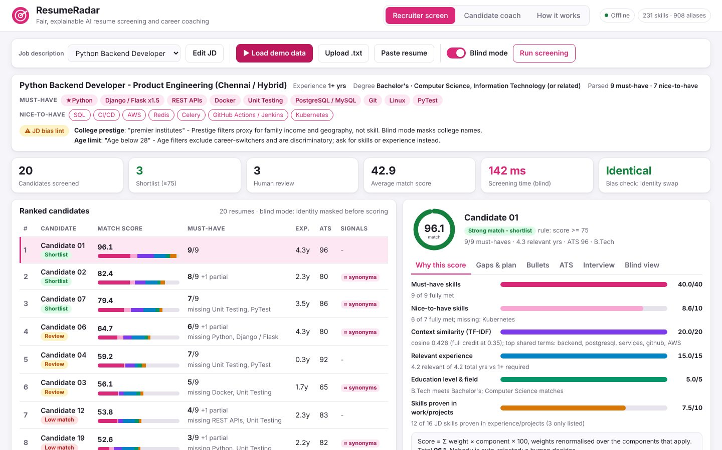
ARTIFICIAL INTELLIGENCE & MACHINE LEARNING
ResumeRadar
Fair, explainable AI resume screening and career coaching
Your Team Name
QUANTIX 2K26 · 24-hour hackathon · K.S.R. College of Engineering
Notes:
Open with the one-line promise: Fair, explainable AI resume screening and career coaching. Introduce the team, then go straight to the problem.

Slide 2

The problem
Recruiters skim hundreds of resumes in seconds per profile
Keyword ATS tools reject good candidates for their wording
Name, gender and college bias creep into screening
Rejected students never learn why or what to fix
~7 s
first human scan of a resume (Ladders eye-tracking study 2018, approx.)
~50%
more callbacks for identical resumes, name changed (Bertrand & Mullainathan 2004, approx.)
#11 → #2
strong 'ReactJS, JS, TS' resume: keyword ATS vs ResumeRadar (our demo)
Notes:
Problem: Recruiters skim hundreds of resumes in seconds per profile Keyword ATS tools reject good candidates for their wording Name, gender and college bias creep into screening Rejected students never learn why or what to fix Key numbers: ~7 s first human scan of a resume (Ladders eye-tracking study 2018, approx.); ~50% more callbacks for identical resumes, name changed (Bertrand & Mullainathan 2004, approx.); #11 → #2 strong 'ReactJS, JS, TS' resume: keyword ATS vs ResumeRadar (our demo).

Slide 3

Our solution: ResumeRadar
Rank resumes against a JD with a transparent weighted score
231-skill ontology understands synonyms: JS = JavaScript, k8s = Kubernetes
Blind mode masks identity; a bias check proves the ranking is unchanged
Students get gaps, a learning plan, bullet rewrites and interview prep
Notes:
Solution: Rank resumes against a JD with a transparent weighted score 231-skill ontology understands synonyms: JS = JavaScript, k8s = Kubernetes Blind mode masks identity; a bias check proves the ranking is unchanged Students get gaps, a learning plan, bullet rewrites and interview prep

Slide 4






Key features
Explainable match score
Blind mode + bias check
JD bias lint
Must/nice skills, TF-IDF context, experience, evidence: every point shown
Identity deleted or swapped: blind score change is exactly 0.00
Flags 'IIT/NIT preferred', age limits and gendered wording
Learning path
Bullet coach + ATS check
Interview prep
Missing skills plus prerequisites ordered by topological sort
Weak bullets rewritten; 9 ATS rules with points and fixes
115 questions on claimed skills, gaps and your projects
Notes:
Features: Explainable match score: Must/nice skills, TF-IDF context, experience, evidence: every point shown. Blind mode + bias check: Identity deleted or swapped: blind score change is exactly 0.00. JD bias lint: Flags 'IIT/NIT preferred', age limits and gendered wording. Learning path: Missing skills plus prerequisites ordered by topological sort. Bullet coach + ATS check: Weak bullets rewritten; 9 ATS rules with points and fixes. Interview prep: 115 questions on claimed skills, gaps and your projects

Slide 5
System architecture
Browser UI (vanilla JS + SVG) recruiter screen, coach, how it works
Tech stack
app.py ThreadingHTTPServer 14 JSON endpoints, validation
Python 3 stdlib only (http.server, re, math, heapq)
Vanilla HTML/CSS/JS, inline SVG, no CDN
Fully offline, no API keys, no data leaves the laptop
unittest: 77 tests
blind.py mask / strip / swap identity spans
extract.py + jd.py + ontology.py skills, roles, requirements
tfidf.py + scoring.py weighted, explained match score
Runs fully offline · no installs · python app.py
gaps.py / ats.py / interview.py coaching outputs
Notes:
Architecture top to bottom: Browser UI (vanilla JS + SVG) -> recruiter screen, coach, how it works. app.py ThreadingHTTPServer -> 14 JSON endpoints, validation. blind.py -> mask / strip / swap identity spans. extract.py + jd.py + ontology.py -> skills, roles, requirements. tfidf.py + scoring.py -> weighted, explained match score. gaps.py / ats.py / interview.py -> coaching outputs. Stack: Python 3 stdlib only (http.server, re, math, heapq), Vanilla HTML/CSS/JS, inline SVG, no CDN, Fully offline, no API keys, no data leaves the laptop, unittest: 77 tests.

Slide 6
Algorithms built from scratch
01
Longest-match alias dictionary with case rules
skill extraction
02
Sublinear TF-IDF + cosine with skill tokens
context similarity
03
Weighted linear score with implied/related credit
ranking
04
Interval union of dated roles
relevant experience
05
Counterfactual identity swap + Spearman rho
bias check
06
Kahn topological sort
prerequisite-ordered learning path
Notes:
Algorithms: Longest-match alias dictionary with case rules – skill extraction. Sublinear TF-IDF + cosine with skill tokens – context similarity. Weighted linear score with implied/related credit – ranking. Interval union of dated roles – relevant experience. Counterfactual identity swap + Spearman rho – bias check. Kahn topological sort – prerequisite-ordered learning path. Stress that nothing is a black box: every decision can be explained on screen.

Slide 7



What makes it different
Fairness verified on every batch, not just claimed
Skill-aware matching: synonyms, implied and related skills
Proven-in-work evidence beats keyword stuffing
One model serves recruiters and coaches students
Notes:
Differentiators: Fairness verified on every batch, not just claimed Skill-aware matching: synonyms, implied and related skills Proven-in-work evidence beats keyword stuffing One model serves recruiters and coaches students

Slide 8

Measured results
0.00
0.84
0.99
3.8 ms
blind-mode score change after identity swap (standard mode: up to 1.7)
mean Spearman vs hand labels (keyword ATS 0.82)
skill-extraction F1 on 28 tricky snippets (keyword 0.76)
full report per resume; 100 resumes in 0.38 s
Measured on held-out data generated by the project (see REPORT.md for method). Real-world performance needs field validation.
Impact Skills, not college brand or gender, decide the shortlist · Every rejected student gets a concrete learning plan · Placement cells can pre-check every resume for every drive
Notes:
Results: 0.00 blind-mode score change after identity swap (standard mode: up to 1.7); 0.84 mean Spearman vs hand labels (keyword ATS 0.82); 0.99 skill-extraction F1 on 28 tricky snippets (keyword 0.76); 3.8 ms full report per resume; 100 resumes in 0.38 s. Impact: Skills, not college brand or gender, decide the shortlist Every rejected student gets a concrete learning plan Placement cells can pre-check every resume for every drive

Slide 9
Live demo in 3 minutes
1
Wi-Fi off, click Load demo data: 20 resumes ranked in ~90 ms
2
Show JD bias lint: 'IIT/NIT preferred', 'age below 28'
3
Open a score breakdown; show synonym and stuffing signals
4
Blind view and bias check: 0.00 vs 1.1 pts drift
5
Candidate coach: gaps, learning path, bullet rewrites
python app.py → http://localhost:8008
6
How it works: run the live evaluation
Notes:
Switch to the browser now. 1. Wi-Fi off, click Load demo data: 20 resumes ranked in ~90 ms 2. Show JD bias lint: 'IIT/NIT preferred', 'age below 28' 3. Open a score breakdown; show synonym and stuffing signals 4. Blind view and bias check: 0.00 vs 1.1 pts drift 5. Candidate coach: gaps, learning path, bullet rewrites 6. How it works: run the live evaluation

Slide 10

Feasibility, business model & roadmap
Business model
Future scope
Free candidate coach for students and colleges
Recruiter licence per seat or per hiring drive
On-premise edition for firms that cannot use SaaS
Paid domain ontology packs and ATS integrations
Offline PDF/DOCX import
Weights learned from recruiter decisions, still explainable
Tamil and Hindi resume support
Exportable fairness audit per hiring drive
Optional embeddings, checked by the same bias test
Notes:
Business: Free candidate coach for students and colleges Recruiter licence per seat or per hiring drive On-premise edition for firms that cannot use SaaS Paid domain ontology packs and ATS integrations Next: Offline PDF/DOCX import Weights learned from recruiter decisions, still explainable Tamil and Hindi resume support Exportable fairness audit per hiring drive Optional embeddings, checked by the same bias test

Slide 11

Thank you
ResumeRadar · Fair, explainable AI resume screening and career coaching
Scan for the code
Code https://github.com/jayeskumar/a/tree/claude/confident-fermi-dpeh2g/projects/08-resumeradar
Run cd projects/08-resumeradar && python app.py
Questions?
Notes:
Close with the impact line, invite questions. Keep the demo tab open in case judges want to try it.

