Slide 1
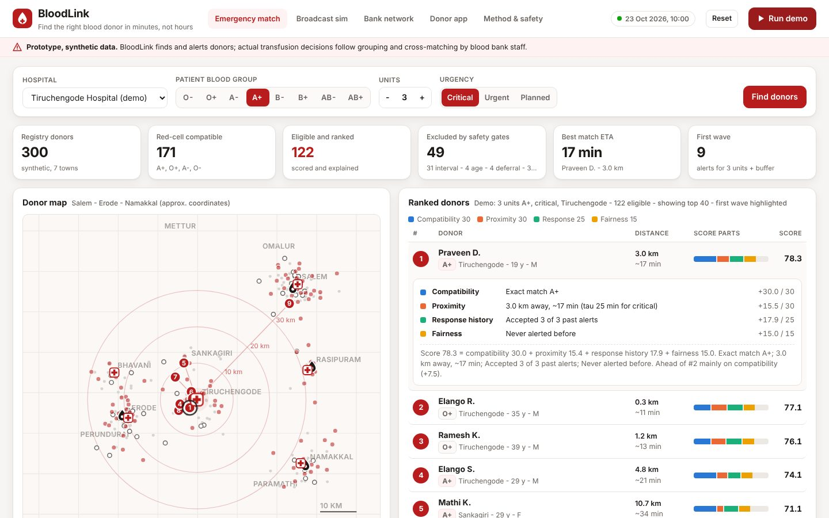
HEALTHTECH & BIOMEDICAL INNOVATION
BloodLink
Find the right blood donor in minutes, not hours
Your Team Name
QUANTIX 2K26 · 24-hour hackathon · K.S.R. College of Engineering
Notes:
Open with the one-line promise: Find the right blood donor in minutes, not hours. Introduce the team, then go straight to the problem.

Slide 2

The problem
Families forward WhatsApp pleas to everyone and wait for hours
Nobody knows who is eligible: recent donors reply and travel for nothing
Scarce groups (O-, Rh-negative) get used when a common group would do
One bank's units expire while a bank 40 km away is short
35-42 days
red-cell shelf life (CPDA-1 / SAGM)
~5%
of Indians are Rh-negative (approx.)
up to 3
patients helped per donation (commonly cited)
Notes:
Problem: Families forward WhatsApp pleas to everyone and wait for hours Nobody knows who is eligible: recent donors reply and travel for nothing Scarce groups (O-, Rh-negative) get used when a common group would do One bank's units expire while a bank 40 km away is short Key numbers: 35-42 days red-cell shelf life (CPDA-1 / SAGM); ~5% of Indians are Rh-negative (approx.); up to 3 patients helped per donation (commonly cited).

Slide 3

Our solution: BloodLink
Rank only eligible, compatible donors with a transparent score
Alert in small waves; stand donors down once units are drawn
Balance stock across blood banks before units expire
Donor app: self-check, next eligible date, badges
Notes:
Solution: Rank only eligible, compatible donors with a transparent score Alert in small waves; stand donors down once units are drawn Balance stock across blood banks before units expire Donor app: self-check, next eligible date, badges

Slide 4






Key features
Correct compatibility
Safety gates
Explainable ranking
ABO/Rh red-cell + plasma rules from antigens, all 64 pairs tested
90/120-day interval, age, weight, deferral - reason and next date shown
Compatibility + travel time + response + fairness, every point shown
Live wave timeline
Bank network
Offline map
Simulated alerts vs broadcast-all and phone list on the same dice
FEFO, moving-average forecast, expiry risk, greedy transfers
SVG map of donors, hospitals and banks - no tiles, no internet
Notes:
Features: Correct compatibility: ABO/Rh red-cell + plasma rules from antigens, all 64 pairs tested. Safety gates: 90/120-day interval, age, weight, deferral - reason and next date shown. Explainable ranking: Compatibility + travel time + response + fairness, every point shown. Live wave timeline: Simulated alerts vs broadcast-all and phone list on the same dice. Bank network: FEFO, moving-average forecast, expiry risk, greedy transfers. Offline map: SVG map of donors, hospitals and banks - no tiles, no internet

Slide 5
System architecture
Browser UI vanilla JS tabs, SVG maps and charts
Tech stack
app.py stdlib ThreadingHTTPServer, JSON API, validation
Python 3 stdlib only
http.server + JSON API
Vanilla HTML/CSS/JS
Hand-drawn SVG maps and charts
unittest (91 tests)
Runs offline on any laptop
ranking.py gates + weighted, explained donor score
simulation.py event-driven wave vs baseline simulator
inventory.py FEFO, forecast, transfers, month simulation
Runs fully offline · no installs · python app.py
dataset.py seeded synthetic donors and 5-bank network
Notes:
Architecture top to bottom: Browser UI -> vanilla JS tabs, SVG maps and charts. app.py -> stdlib ThreadingHTTPServer, JSON API, validation. ranking.py -> gates + weighted, explained donor score. simulation.py -> event-driven wave vs baseline simulator. inventory.py -> FEFO, forecast, transfers, month simulation. dataset.py -> seeded synthetic donors and 5-bank network. Stack: Python 3 stdlib only, http.server + JSON API, Vanilla HTML/CSS/JS, Hand-drawn SVG maps and charts, unittest (91 tests), Runs offline on any laptop.

Slide 6
Algorithms built from scratch
01
Antigen-subset ABO/Rh rule
red-cell and plasma compatibility
02
Haversine + circuity factor
distance and travel time
03
Weighted score with Beta(2,2) prior
explainable ranking
04
Discrete-event simulation
wave broadcast vs baselines
05
FEFO + moving average
issue order and demand forecast
06
Greedy expiry-risk matching
inter-bank transfers
Notes:
Algorithms: Antigen-subset ABO/Rh rule – red-cell and plasma compatibility. Haversine + circuity factor – distance and travel time. Weighted score with Beta(2,2) prior – explainable ranking. Discrete-event simulation – wave broadcast vs baselines. FEFO + moving average – issue order and demand forecast. Greedy expiry-risk matching – inter-bank transfers. Stress that nothing is a black box: every decision can be explained on screen.

Slide 7



What makes it different
Nobody ineligible is ever alerted
Every rank, exclusion and transfer is explained
Fairness term spreads load across donors
One engine for donors and blood bank stock
Notes:
Differentiators: Nobody ineligible is ever alerted Every rank, exclusion and transfer is explained Fairness term spreads load across donors One engine for donors and blood bank stock

Slide 8

Measured results
58 vs 96 min
6x fewer
-85%
-91%
median time to fulfil vs broadcast (sim, 300 requests)
alerts than broadcast-to-everyone (12 vs 76)
expired units per month with transfers (sim, 20 months)
unmet demand with transfers (sim)
Measured on held-out data generated by the project (see REPORT.md for method). Real-world performance needs field validation.
Impact Families get donors faster: 88% within 2 h in simulation · No wasted trips by ineligible donors · Fewer expired units and fewer local shortages
Notes:
Results: 58 vs 96 min median time to fulfil vs broadcast (sim, 300 requests); 6x fewer alerts than broadcast-to-everyone (12 vs 76); -85% expired units per month with transfers (sim, 20 months); -91% unmet demand with transfers (sim). Impact: Families get donors faster: 88% within 2 h in simulation No wasted trips by ineligible donors Fewer expired units and fewer local shortages

Slide 9
Live demo in 3 minutes
1
Run demo: 3 units A+ critical at Tiruchengode
2
Show safety gates and excluded donors with reasons
3
Open donor #1 score breakdown and the map
4
Play the live wave timeline vs baselines
5
Send wave plan: fairness and interval update
6
Bank network: apply transfers, month result
python app.py → http://localhost:8010
7
Donor app self-check and compatibility matrix
Notes:
Switch to the browser now. 1. Run demo: 3 units A+ critical at Tiruchengode 2. Show safety gates and excluded donors with reasons 3. Open donor #1 score breakdown and the map 4. Play the live wave timeline vs baselines 5. Send wave plan: fairness and interval update 6. Bank network: apply transfers, month result 7. Donor app self-check and compatibility matrix

Slide 10

Feasibility, business model & roadmap
Business model
Future scope
Free for donors and families
SaaS for private hospital and blood bank networks
CSR / public-health funding for government banks
District pilot with college donor registries
Learn weights from real accept/decline outcomes
Min-cost-flow transfers with vehicle capacity
Platelet and plasma component inventory
Seasonal demand forecast and camp planning
SMS/IVR alerts in Tamil and English
Notes:
Business: Free for donors and families SaaS for private hospital and blood bank networks CSR / public-health funding for government banks District pilot with college donor registries Next: Learn weights from real accept/decline outcomes Min-cost-flow transfers with vehicle capacity Platelet and plasma component inventory Seasonal demand forecast and camp planning SMS/IVR alerts in Tamil and English

Slide 11
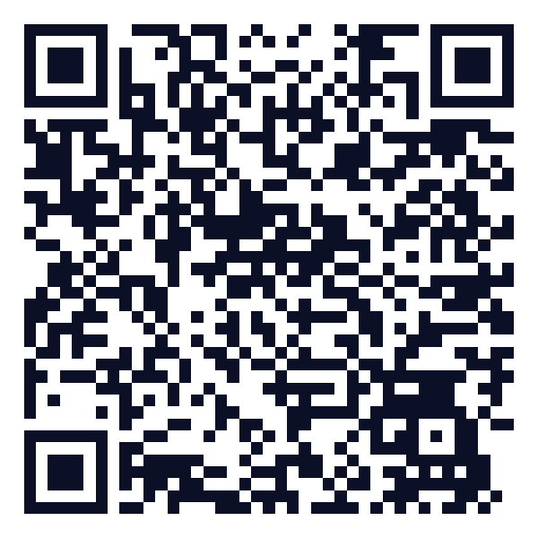
Thank you
BloodLink · Find the right blood donor in minutes, not hours
Scan for the code
Code https://github.com/jayeskumar/a/tree/claude/confident-fermi-dpeh2g/projects/10-bloodlink
Run cd projects/10-bloodlink && python app.py
Questions?
Notes:
Close with the impact line, invite questions. Keep the demo tab open in case judges want to try it.

