Slide 1
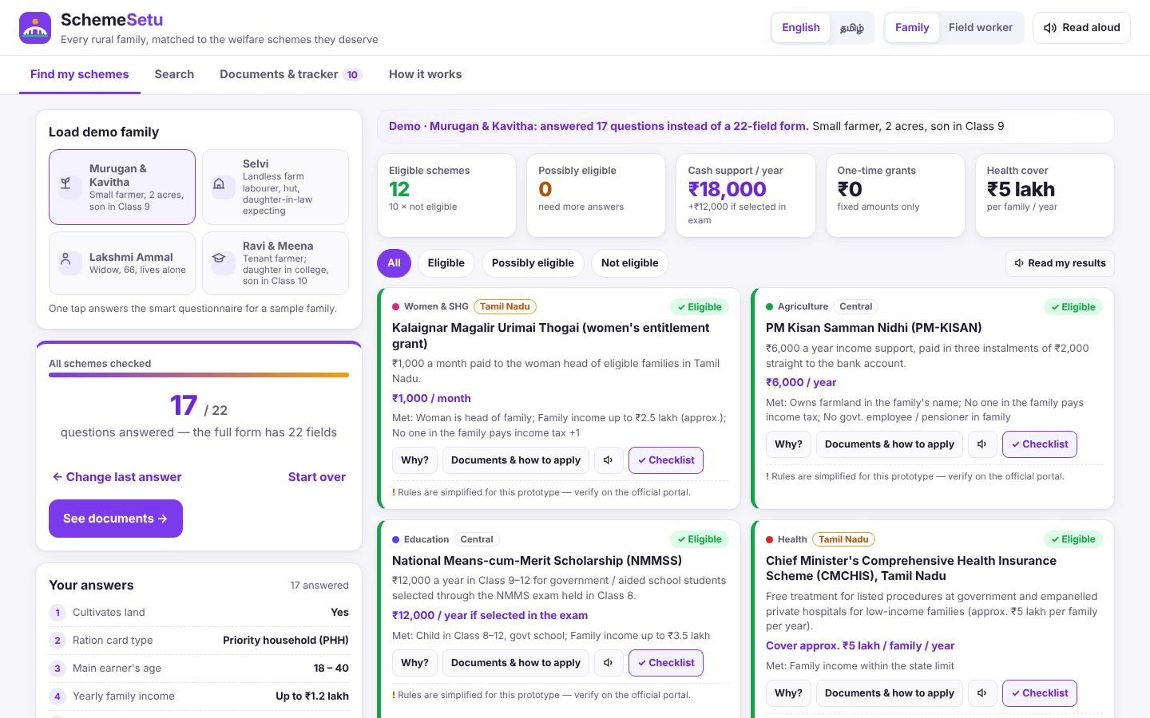
SMART AGRICULTURE & RURAL DEVELOPMENT (AGRITECH)
SchemeSetu
Every rural family, matched to the welfare schemes they deserve
Your Team Name
QUANTIX 2K26 · 24-hour hackathon · K.S.R. College of Engineering
Notes:
Open with the one-line promise: Every rural family, matched to the welfare schemes they deserve. Introduce the team, then go straight to the problem.

Slide 2

The problem
Rural families miss crop insurance, pensions, housing, scholarships
Eligibility rules are complex, scattered and mostly online
Offices are far away; middlemen charge fees to find and fill schemes
Field workers can't see which eligible families haven't applied
~69%
Indians living in rural areas (Census 2011)
~86%
farm holdings small / marginal (Agri Census 2015-16, approx.)
54
fields to check our 22 schemes one by one (measured)
Notes:
Problem: Rural families miss crop insurance, pensions, housing, scholarships Eligibility rules are complex, scattered and mostly online Offices are far away; middlemen charge fees to find and fill schemes Field workers can't see which eligible families haven't applied Key numbers: ~69% Indians living in rural areas (Census 2011); ~86% farm holdings small / marginal (Agri Census 2015-16, approx.); 54 fields to check our 22 schemes one by one (measured).

Slide 3

Our solution: SchemeSetu
Adaptive Tamil / English questionnaire with big buttons
Explainable rules: eligible / possibly / not, per condition
One deduplicated document checklist + application tracker
Village dashboard of eligible-but-unclaimed benefits
Notes:
Solution: Adaptive Tamil / English questionnaire with big buttons Explainable rules: eligible / possibly / not, per condition One deduplicated document checklist + application tracker Village dashboard of eligible-but-unclaimed benefits

Slide 4






Key features
Explainable eligibility
Smart questionnaire
Benefit estimator
JSON rule trees with 3-valued logic; pass / fail / unknown per condition
Greedy information gain: 15 questions vs a 22-field form, same decisions
Adds fixed ₹ amounts only; insurance cover and loans shown separately
Document checklist
Bilingual search
Field-worker mode
Union of required documents, deduplicated, printable, tracked
TF-IDF + concept map: 'பயிர் காப்பீடு' finds crop insurance
Register households; see unclaimed benefits per scheme and family
Notes:
Features: Explainable eligibility: JSON rule trees with 3-valued logic; pass / fail / unknown per condition. Smart questionnaire: Greedy information gain: 15 questions vs a 22-field form, same decisions. Benefit estimator: Adds fixed ₹ amounts only; insurance cover and loans shown separately. Document checklist: Union of required documents, deduplicated, printable, tracked. Bilingual search: TF-IDF + concept map: 'பயிர் காப்பீடு' finds crop insurance. Field-worker mode: Register households; see unclaimed benefits per scheme and family

Slide 5
System architecture
Browser UI (vanilla JS, EN/TA, SVG) JSON API
Tech stack
app.py ThreadingHTTPServer validation + routes
Python 3 stdlib
Vanilla JS + inline SVG
JSON rules & storage
Web Speech API (optional)
rules.py 3-valued rule engine with full trace
questionnaire.py information-gain question choice
search.py Tamil-aware TF-IDF + concept map
Runs fully offline · no installs · python app.py
store.py households + tracker in data/state.json
Notes:
Architecture top to bottom: Browser UI (vanilla JS, EN/TA, SVG) -> JSON API. app.py ThreadingHTTPServer -> validation + routes. rules.py -> 3-valued rule engine with full trace. questionnaire.py -> information-gain question choice. search.py -> Tamil-aware TF-IDF + concept map. store.py -> households + tracker in data/state.json. Stack: Python 3 stdlib, Vanilla JS + inline SVG, JSON rules & storage, Web Speech API (optional).

Slide 6
Algorithms built from scratch
01
Kleene 3-valued logic
eligible / possibly / not, with reasons
02
Expected information gain
picks the next best question
03
TF-IDF + bilingual concept map
Tamil / English search
04
Alias normalisation
document checklist deduplication
Notes:
Algorithms: Kleene 3-valued logic – eligible / possibly / not, with reasons. Expected information gain – picks the next best question. TF-IDF + bilingual concept map – Tamil / English search. Alias normalisation – document checklist deduplication. Stress that nothing is a black box: every decision can be explained on screen.

Slide 7



What makes it different
Says 'possibly eligible – need X' instead of silently rejecting
Explains why each question is asked (bits of information)
Rules are data: officers edit JSON, not code
Offline last-mile tool with a village unclaimed-benefit view
Notes:
Differentiators: Says 'possibly eligible – need X' instead of silently rejecting Explains why each question is asked (bits of information) Rules are data: officers edit JSON, not code Offline last-mile tool with a village unclaimed-benefit view

Slide 8

Measured results
15.2
100%
70%
1.4 ms
avg questions vs 22-field form (304 households)
decisions identical to the full form
eligible schemes confirmed after 8 questions
to choose the next question
Measured on held-out data generated by the project (see REPORT.md for method). Real-world performance needs field validation.
Impact Entitlements found in ~5 minutes, in Tamil, no middleman · Demo village: ₹1.57 lakh/yr unclaimed cash surfaced (synthetic) · One checklist: 43 document mentions -> 10 documents
Notes:
Results: 15.2 avg questions vs 22-field form (304 households); 100% decisions identical to the full form; 70% eligible schemes confirmed after 8 questions; 1.4 ms to choose the next question. Impact: Entitlements found in ~5 minutes, in Tamil, no middleman Demo village: ₹1.57 lakh/yr unclaimed cash surfaced (synthetic) One checklist: 43 document mentions -> 10 documents

Slide 9
Live demo in 3 minutes
1
Load demo farmer: 17 questions, 12 schemes, ₹18,000/yr
2
Open 'Why?' on PM-KISAN to show the condition tree
3
Answer live; tap 'Don't know' -> possibly eligible
4
Switch to Tamil; search 'பயிர் காப்பீடு'
5
Print the checklist; mark an application Applied
python app.py → http://localhost:8011
6
Field worker: village dashboard of unclaimed benefits
Notes:
Switch to the browser now. 1. Load demo farmer: 17 questions, 12 schemes, ₹18,000/yr 2. Open 'Why?' on PM-KISAN to show the condition tree 3. Answer live; tap 'Don't know' -> possibly eligible 4. Switch to Tamil; search 'பயிர் காப்பீடு' 5. Print the checklist; mark an application Applied 6. Field worker: village dashboard of unclaimed benefits

Slide 10

Feasibility, business model & roadmap
Business model
Future scope
Free for families, always
Deployment for CSCs, Panchayats and SHG federations
CSR / NGO programmes measuring benefit uptake
Offline companion for state welfare departments
Sync field-worker devices to a block server
Offline Tamil voice input for low-literacy users
Import official scheme data; per-district rules
OCR of ration card / patta to pre-fill answers
SMS reminders for deadlines such as PMFBY cut-offs
Notes:
Business: Free for families, always Deployment for CSCs, Panchayats and SHG federations CSR / NGO programmes measuring benefit uptake Offline companion for state welfare departments Next: Sync field-worker devices to a block server Offline Tamil voice input for low-literacy users Import official scheme data; per-district rules OCR of ration card / patta to pre-fill answers SMS reminders for deadlines such as PMFBY cut-offs

Slide 11
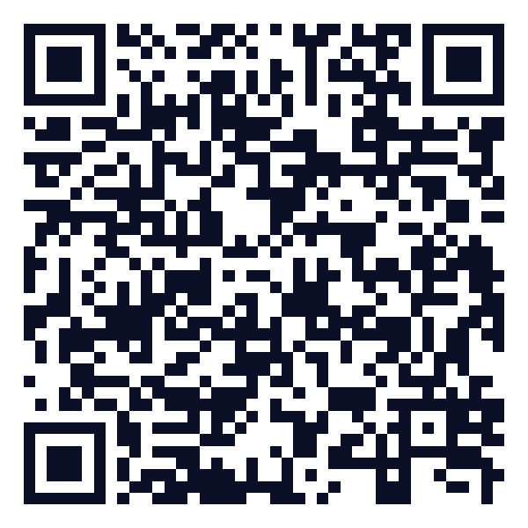
Thank you
SchemeSetu · Every rural family, matched to the welfare schemes they deserve
Scan for the code
Code https://github.com/jayeskumar/a/tree/claude/confident-fermi-dpeh2g/projects/11-schemesetu
Run cd projects/11-schemesetu && python app.py
Questions?
Notes:
Close with the impact line, invite questions. Keep the demo tab open in case judges want to try it.

