Slide 1
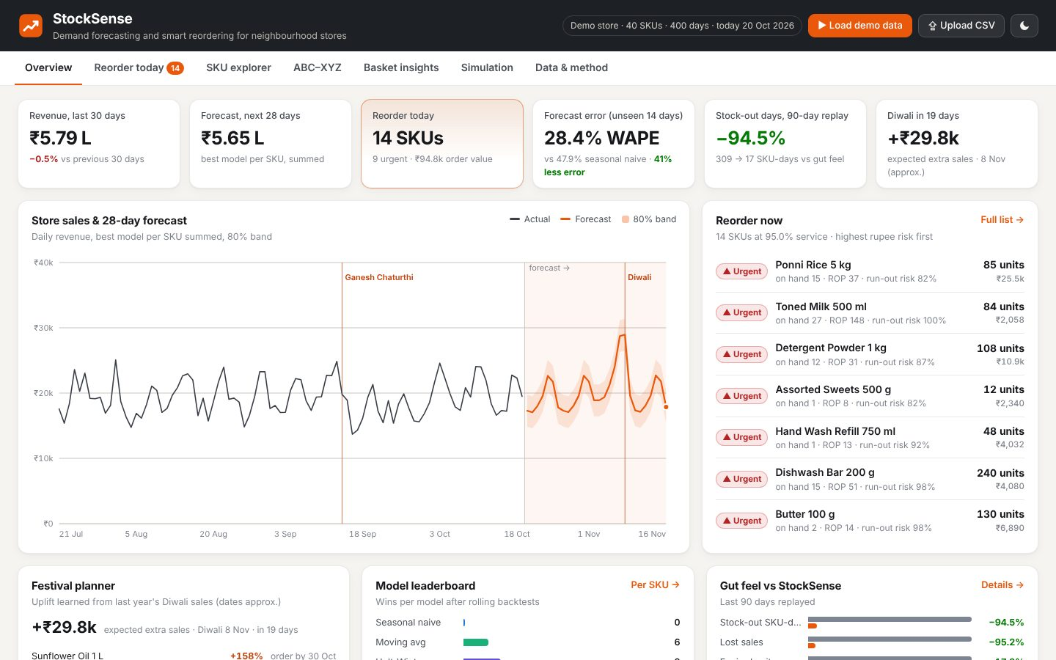
DATA SCIENCE & ANALYTICS
StockSense
Demand forecasting and smart reordering for neighbourhood stores
Your Team Name
QUANTIX 2K26 · 24-hour hackathon · K.S.R. College of Engineering
Notes:
Open with the one-line promise: Demand forecasting and smart reordering for neighbourhood stores. Introduce the team, then go straight to the problem.

Slide 2

The problem
Kiranas, pharmacies and canteens reorder by gut feel
Fast movers run out; customers walk to the next shop
Perishables expire; festival spikes are missed
Enterprise forecasting tools are costly, complex, online-only
1 crore+
kirana stores in India (approx., widely cited estimate)
~15%
demand lost to empty shelves under gut feel (demo replay)
5-6x
Diwali-week sweets demand vs a normal day (demo data)
Notes:
Problem: Kiranas, pharmacies and canteens reorder by gut feel Fast movers run out; customers walk to the next shop Perishables expire; festival spikes are missed Enterprise forecasting tools are costly, complex, online-only Key numbers: 1 crore+ kirana stores in India (approx., widely cited estimate); ~15% demand lost to empty shelves under gut feel (demo replay); 5-6x Diwali-week sweets demand vs a normal day (demo data).

Slide 3

Our solution: StockSense
Upload date, sku, qty - get a morning reorder list
4 models backtested per SKU; the best one wins
Safety stock, reorder point, EOQ with shelf-life caps
Every order explained with risk and rupees at stake
Notes:
Solution: Upload date, sku, qty - get a morning reorder list 4 models backtested per SKU; the best one wins Safety stock, reorder point, EOQ with shelf-life caps Every order explained with risk and rupees at stake

Slide 4






Key features
Auto model selection
Festival-aware
Smart reorder list
Naive, moving avg, Holt-Winters, regression; rolling backtests pick the best
Learns last Diwali/Pongal uplift per SKU and plans pre-orders
Qty, run-out risk, sales at risk and the maths behind each line
What-if service level
ABC-XYZ + basket rules
90-day simulation
Slider shows holding cost vs lost margin and the optimum
Pareto x variability matrix and Apriori shelf/bundle advice
Replays real demand: gut feel vs StockSense, side by side
Notes:
Features: Auto model selection: Naive, moving avg, Holt-Winters, regression; rolling backtests pick the best. Festival-aware: Learns last Diwali/Pongal uplift per SKU and plans pre-orders. Smart reorder list: Qty, run-out risk, sales at risk and the maths behind each line. What-if service level: Slider shows holding cost vs lost margin and the optimum. ABC-XYZ + basket rules: Pareto x variability matrix and Apriori shelf/bundle advice. 90-day simulation: Replays real demand: gut feel vs StockSense, side by side

Slide 5
System architecture
CSV / demo generator validate, detect + impute stock-outs
Tech stack
Festival layer learn uplift, de-festival, re-apply
Python 3 stdlib only
http.server JSON API
Vanilla HTML/CSS/JS
Hand-drawn SVG charts
Runs fully offline
4 forecasting models rolling-origin backtest – best per SKU + sigma
Inventory engine safety stock, ROP, EOQ, perishable cap, risk in Rs
Simulator + ABC-XYZ + Apriori JSON API (stdlib http.server)
Runs fully offline · no installs · python app.py
Vanilla JS dashboard hand-drawn SVG charts, light/dark, mobile
Notes:
Architecture top to bottom: CSV / demo generator -> validate, detect + impute stock-outs. Festival layer -> learn uplift, de-festival, re-apply. 4 forecasting models -> rolling-origin backtest -> best per SKU + sigma. Inventory engine -> safety stock, ROP, EOQ, perishable cap, risk in Rs. Simulator + ABC-XYZ + Apriori -> JSON API (stdlib http.server). Vanilla JS dashboard -> hand-drawn SVG charts, light/dark, mobile. Stack: Python 3 stdlib only, http.server JSON API, Vanilla HTML/CSS/JS, Hand-drawn SVG charts, Runs fully offline.

Slide 6
Algorithms built from scratch
01
Holt-Winters (additive, weekly, damped)
level, trend, weekday pattern
02
Ridge regression via Gaussian elimination
weekday, festival, promo effects
03
Rolling-origin backtesting
leak-free sMAPE/MAPE model selection
04
Acklam inverse normal
z-score for any service level
05
Safety stock z*sigma, ROP, EOQ sqrt(2DS/H)
reorder policy
06
Normal loss function G(z)
expected lost sales in rupees
Notes:
Algorithms: Holt-Winters (additive, weekly, damped) - level, trend, weekday pattern. Ridge regression via Gaussian elimination - weekday, festival, promo effects. Rolling-origin backtesting - leak-free sMAPE/MAPE model selection. Acklam inverse normal - z-score for any service level. Safety stock z*sigma, ROP, EOQ sqrt(2DS/H) - reorder policy. Normal loss function G(z) - expected lost sales in rupees. Stress that nothing is a black box: every decision can be explained on screen.

Slide 7



What makes it different
Explainable: every order traces to forecast, sigma, z and EOQ
Honest evaluation: nested hold-out and leak-free simulation
Indian retail realism: festivals, case packs, perishables, stock-outs
Zero install, zero cloud: runs on a Rs 15k laptop
Notes:
Differentiators: Explainable: every order traces to forecast, sigma, z and EOQ Honest evaluation: nested hold-out and leak-free simulation Indian retail realism: festivals, case packs, perishables, stock-outs Zero install, zero cloud: runs on a Rs 15k laptop

Slide 8

Measured results
-41%
309 -> 17
-49.5%
1.5 s
forecast error vs seasonal naive (WAPE 28.4% vs 47.9%, hold-out)
stock-out SKU-days in 90-day replay vs gut feel
total inventory cost (holding+ordering+waste+lost margin)
full analysis of 40 SKUs x 400 days on a laptop
Measured on held-out data generated by the project (see REPORT.md for method). Real-world performance needs field validation.
Impact Fewer empty shelves: fill rate 84.9% -> 99.6% (demo replay) · Less food waste: 17% fewer expired units, fewer orders · Small shops compete with quick-commerce without big software
Notes:
Results: -41% forecast error vs seasonal naive (WAPE 28.4% vs 47.9%, hold-out); 309 -> 17 stock-out SKU-days in 90-day replay vs gut feel; -49.5% total inventory cost (holding+ordering+waste+lost margin); 1.5 s full analysis of 40 SKUs x 400 days on a laptop. Impact: Fewer empty shelves: fill rate 84.9% -> 99.6% (demo replay) Less food waste: 17% fewer expired units, fewer orders Small shops compete with quick-commerce without big software

Slide 9
Live demo in 3 minutes
1
Load demo data: 40 SKUs, 13 months, Diwali in 19 days
2
Trend chart: forecast band with learned Diwali spike
3
Reorder today: urgent items, row explains ROP and EOQ
4
Drag service-level slider: cost trade-off and optimum
5
SKU explorer (Sweets): leaderboard, +577% Diwali uplift
6
Simulation: 309 -> 17 stock-out days, cost halved
python app.py → http://localhost:8012
7
ABC-XYZ and basket rules; upload your own CSV
Notes:
Switch to the browser now. 1. Load demo data: 40 SKUs, 13 months, Diwali in 19 days 2. Trend chart: forecast band with learned Diwali spike 3. Reorder today: urgent items, row explains ROP and EOQ 4. Drag service-level slider: cost trade-off and optimum 5. SKU explorer (Sweets): leaderboard, +577% Diwali uplift 6. Simulation: 309 -> 17 stock-out days, cost halved 7. ABC-XYZ and basket rules; upload your own CSV

Slide 10

Feasibility, business model & roadmap
Business model
Future scope
Free offline single-store edition
Rs 199-499/month (indicative) multi-store + WhatsApp orders
White-label module for billing and distributor apps
Pilot with campus canteens and FMCG distributors
Direct billing-app and barcode integration
WhatsApp purchase orders per supplier with MOQs
Batch-level expiry tracking with markdown advice
Weather, exam and local-event demand features
Regional festival calendars and Tamil/Hindi UI
Notes:
Business: Free offline single-store edition Rs 199-499/month (indicative) multi-store + WhatsApp orders White-label module for billing and distributor apps Pilot with campus canteens and FMCG distributors Next: Direct billing-app and barcode integration WhatsApp purchase orders per supplier with MOQs Batch-level expiry tracking with markdown advice Weather, exam and local-event demand features Regional festival calendars and Tamil/Hindi UI

Slide 11

Thank you
StockSense · Demand forecasting and smart reordering for neighbourhood stores
Scan for the code
Code https://github.com/jayeskumar/a/tree/claude/confident-fermi-dpeh2g/projects/12-stocksense
Run cd projects/12-stocksense && python app.py
Questions?
Notes:
Close with the impact line, invite questions. Keep the demo tab open in case judges want to try it.

