Slide 1
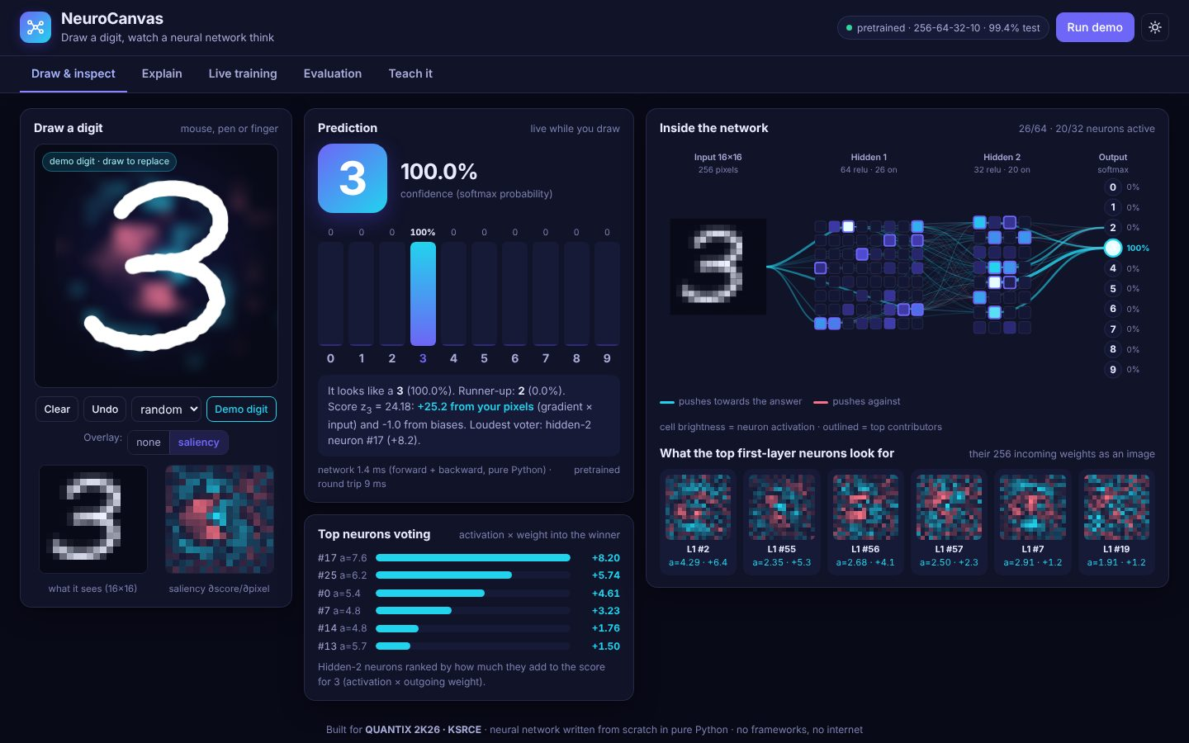
ARTIFICIAL INTELLIGENCE & MACHINE LEARNING
NeuroCanvas
Draw a digit, watch a neural network think
Your Team Name
QUANTIX 2K26 · 24-hour hackathon · K.S.R. College of Engineering
Notes:
Open with the one-line promise: Draw a digit, watch a neural network think. Introduce the team, then go straight to the problem.

Slide 2

The problem
Students meet neural networks as model.fit(): a black box
Backprop, activations and failure modes stay invisible
Deep-learning tutorials assume GPUs, cloud notebooks and internet
Labs with weak Wi-Fi cannot run AI-literacy sessions at all
~4.3 crore
students in Indian higher education (AISHE 2021-22, approx.)
0
GPUs, installs or internet NeuroCanvas needs
18,858
weights you can watch, every one written in plain Python
Notes:
Problem: Students meet neural networks as model.fit(): a black box Backprop, activations and failure modes stay invisible Deep-learning tutorials assume GPUs, cloud notebooks and internet Labs with weak Wi-Fi cannot run AI-literacy sessions at all Key numbers: ~4.3 crore students in Indian higher education (AISHE 2021-22, approx.); 0 GPUs, installs or internet NeuroCanvas needs; 18,858 weights you can watch, every one written in plain Python.

Slide 3

Our solution: NeuroCanvas
Draw a digit: probabilities, neurons and saliency update live
Explain mode walks forward pass and backprop with your numbers
Train a fresh network live; teach it your own handwriting
Pure-Python MLP, hand-derived backprop, runs offline on any laptop
Notes:
Solution: Draw a digit: probabilities, neurons and saliency update live Explain mode walks forward pass and backprop with your numbers Train a fresh network live; teach it your own handwriting Pure-Python MLP, hand-derived backprop, runs offline on any laptop

Slide 4






Key features
Live prediction
Inside the network
Saliency overlay
10-class bars update as you draw, about 2 ms per forward + backward pass
Every neuron's activation, strongest connections, top voters, weight images
Gradient of the winning score per pixel, glowing on your own strokes
Explain mode
Live training lab
Teach it
11 steps from pixels to softmax to backprop to one SGD step, real numbers
Tune lr, neurons, layers, data; watch loss curves and filters evolve
Label your drawings, fine-tune with replay, measure fixes vs forgetting
Notes:
Features: Live prediction: 10-class bars update as you draw, about 2 ms per forward + backward pass. Inside the network: Every neuron's activation, strongest connections, top voters, weight images. Saliency overlay: Gradient of the winning score per pixel, glowing on your own strokes. Explain mode: 11 steps from pixels to softmax to backprop to one SGD step, real numbers. Live training lab: Tune lr, neurons, layers, data; watch loss curves and filters evolve. Teach it: Label your drawings, fine-tune with replay, measure fixes vs forgetting

Slide 5
System architecture
Browser (vanilla JS + SVG/canvas) drawing pad, MNIST-style preprocessing
Tech stack
app.py ThreadingHTTPServer JSON API, validation, static files
Python 3 stdlib only (http.server, math, random, gzip, json)
Vanilla HTML/CSS/JS, inline SVG and canvas, no CDN
6,000-image dataset in 0.8 MB, trained weights in 160 KB
unittest: 50 tests incl. finite-difference gradient check
render + templates deterministic synthetic digit generator
mlp + train MLP, backprop, SGD with momentum, L2
explain saliency, contributions, step-by-step text
Runs fully offline · no installs · python app.py
live + teach background trainer, fine-tuning with replay
Notes:
Architecture top to bottom: Browser (vanilla JS + SVG/canvas) -> drawing pad, MNIST-style preprocessing. app.py ThreadingHTTPServer -> JSON API, validation, static files. render + templates -> deterministic synthetic digit generator. mlp + train -> MLP, backprop, SGD with momentum, L2. explain -> saliency, contributions, step-by-step text. live + teach -> background trainer, fine-tuning with replay. Stack: Python 3 stdlib only (http.server, math, random, gzip, json), Vanilla HTML/CSS/JS, inline SVG and canvas, no CDN, 6,000-image dataset in 0.8 MB, trained weights in 160 KB, unittest: 50 tests incl. finite-difference gradient check.

Slide 6
Algorithms built from scratch
01
Stroke templates + elastic warp + affine
synthetic handwriting
02
Bounding-box fit + centre-of-mass shift
MNIST-style preprocessing
03
MLP 256-64-32-10, ReLU, softmax + cross-entropy
classifier
04
Backpropagation + mini-batch SGD with momentum, He init, L2
05
Gradient saliency and gradient x activation
explanations
06
Replay fine-tuning
learn new styles without forgetting
Notes:
Algorithms: Stroke templates + elastic warp + affine – synthetic handwriting. Bounding-box fit + centre-of-mass shift – MNIST-style preprocessing. MLP 256-64-32-10, ReLU, softmax + cross-entropy – classifier. Backpropagation + mini-batch SGD with momentum, He init, L2. Gradient saliency and gradient x activation – explanations. Replay fine-tuning – learn new styles without forgetting. Stress that nothing is a black box: every decision can be explained on screen.

Slide 7



What makes it different
Every number is inspectable: no framework hides the maths
Explanations use the actual activations of your drawing
Shows failure honestly: confident mistakes, forgetting, divergence
Starts in 0.1 s on a cheap laptop with Wi-Fi off
Notes:
Differentiators: Every number is inspectable: no framework hides the maths Explanations use the actual activations of your drawing Shows failure honestly: confident mistakes, forgetting, divergence Starts in 0.1 s on a cheap laptop with Wi-Fi off

Slide 8

Measured results
99.4%
57/60
0.4 ms
60→83%
test accuracy, 1,000 held-out synthetic digits
mouse-drawn digits in a real browser; 60/60 after teaching 3
forward pass per image, pure Python (1.8 ms with saliency)
unseen LCD-style digits after teaching 20 examples (2.6 s)
Measured on held-out data generated by the project (see REPORT.md for method). Real-world performance needs field validation.
Impact AI literacy for any college lab, even without internet · Students see why models fail, not just that they work · Teachers get a ready demo for backprop, overfitting, forgetting
Notes:
Results: 99.4% test accuracy, 1,000 held-out synthetic digits; 57/60 mouse-drawn digits in a real browser; 60/60 after teaching 3; 0.4 ms forward pass per image, pure Python (1.8 ms with saliency); 60→83% unseen LCD-style digits after teaching 20 examples (2.6 s). Impact: AI literacy for any college lab, even without internet Students see why models fail, not just that they work Teachers get a ready demo for backprop, overfitting, forgetting

Slide 9
Live demo in 3 minutes
1
Open the app: a demo 3 draws itself, bars and neurons light up
2
Draw a 7 by hand: show saliency glow and top voting neurons
3
Explain tab: pick label 1 and watch backprop push hard
4
Live training: run 'lr too high' then defaults, compare curves
5
Evaluation: confusion matrix, click a cell to see mistakes
python app.py → http://localhost:8014
6
Teach it: load LCD lesson, fine-tune, show fixes and forgetting
Notes:
Switch to the browser now. 1. Open the app: a demo 3 draws itself, bars and neurons light up 2. Draw a 7 by hand: show saliency glow and top voting neurons 3. Explain tab: pick label 1 and watch backprop push hard 4. Live training: run 'lr too high' then defaults, compare curves 5. Evaluation: confusion matrix, click a cell to see mistakes 6. Teach it: load LCD lesson, fine-tune, show fixes and forgetting

Slide 10

Feasibility, business model & roadmap
Business model
Future scope
Free and open for students; offline by design
Paid workshop kits for colleges and school ATL labs
Teacher edition: lesson plans and auto-graded exercises
Extend to letters, Tamil script and other datasets
Convolutional layer view, to compare with the MLP
Tamil and Devanagari character sets
Class mode: students' drawings pooled into one dataset
Real MNIST import when a copy is available offline
Step-through backprop animation, one neuron at a time
Notes:
Business: Free and open for students; offline by design Paid workshop kits for colleges and school ATL labs Teacher edition: lesson plans and auto-graded exercises Extend to letters, Tamil script and other datasets Next: Convolutional layer view, to compare with the MLP Tamil and Devanagari character sets Class mode: students' drawings pooled into one dataset Real MNIST import when a copy is available offline Step-through backprop animation, one neuron at a time

Slide 11

Thank you
NeuroCanvas · Draw a digit, watch a neural network think
Scan for the code
Code https://github.com/jayeskumar/a/tree/claude/confident-fermi-dpeh2g/projects/14-neurocanvas
Run cd projects/14-neurocanvas && python app.py
Questions?
Notes:
Close with the impact line, invite questions. Keep the demo tab open in case judges want to try it.

