Slide 1
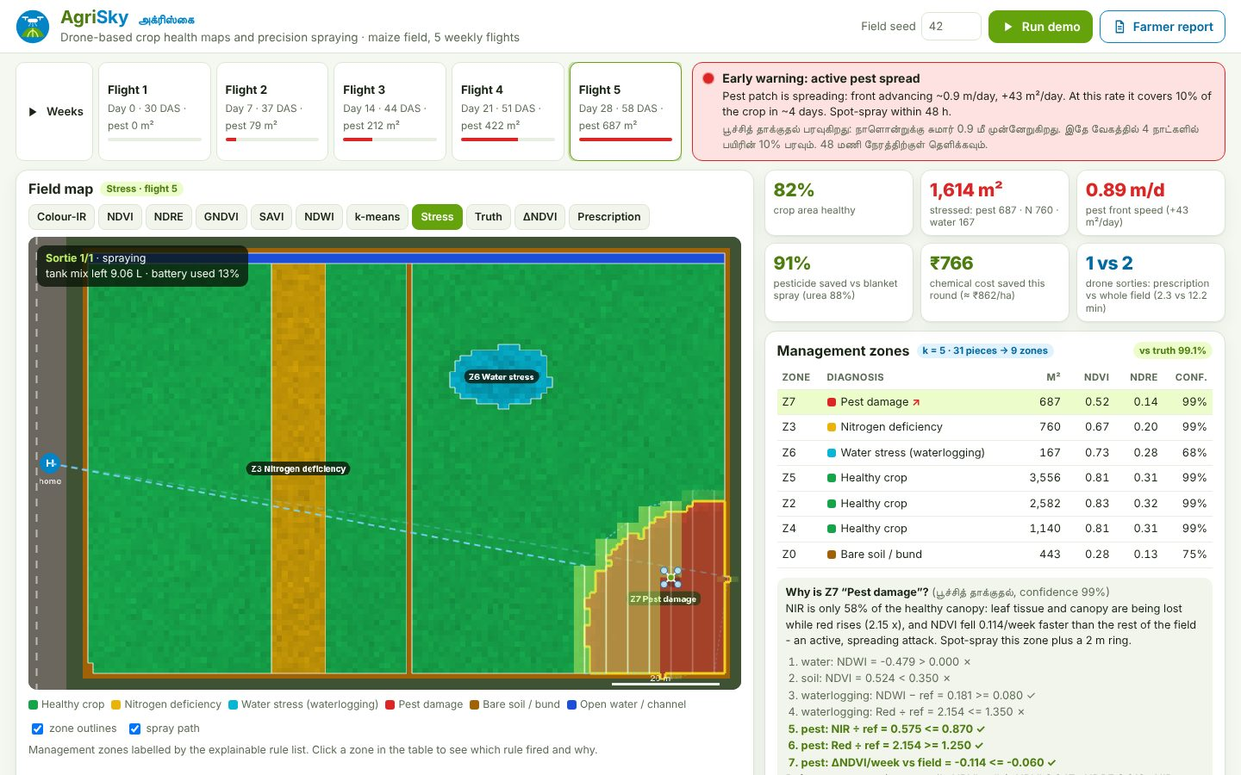
SMART AGRICULTURE & RURAL DEVELOPMENT (AGRITECH)
AgriSky
Drone crop-health maps and spray only where the crop needs it
Your Team Name
QUANTIX 2K26 · 24-hour hackathon · K.S.R. College of Engineering
Notes:
Open with the one-line promise: Drone crop-health maps and spray only where the crop needs it. Introduce the team, then go straight to the problem.

Slide 2

The problem
Pesticide and urea are sprayed over the whole field, though stress is patchy
Wasted chemical costs money and harms soil, water and the sprayer's health
Stress shows from above days before the eye sees it
Imagery analytics tools are costly, online-only black boxes
~86%
Indian farm holdings small/marginal (Agri Census 2015-16, approx.)
₹266.50
MRP of a 45-kg bag of subsidised urea (approx.)
10 L
typical agri-drone tank class (approx.)
Notes:
Problem: Pesticide and urea are sprayed over the whole field, though stress is patchy Wasted chemical costs money and harms soil, water and the sprayer's health Stress shows from above days before the eye sees it Imagery analytics tools are costly, online-only black boxes Key numbers: ~86% Indian farm holdings small/marginal (Agri Census 2015-16, approx.); ₹266.50 MRP of a 45-kg bag of subsidised urea (approx.); 10 L typical agri-drone tank class (approx.).

Slide 3

Our solution: AgriSky
Multispectral flights → NDVI/NDRE/NDWI maps and management zones
Explainable rules diagnose water stress, nitrogen deficiency or pest
Change detection warns when a pest patch starts spreading
Prescription + drone mission sprays only the zones that need it
Notes:
Solution: Multispectral flights → NDVI/NDRE/NDWI maps and management zones Explainable rules diagnose water stress, nitrogen deficiency or pest Change detection warns when a pest patch starts spreading Prescription + drone mission sprays only the zones that need it

Slide 4






Key features
Crop-health maps
Zones + diagnosis
Early warning
NDVI, NDRE, GNDVI, SAVI, NDWI, colour-IR and ΔNDVI heat maps
k-means zones, rule trace per zone, 98.6% accuracy on unseen fields
Pest front speed, √area trend and days until it covers 10% of crop
Variable-rate Rx
Spray mission
Farmer report
Spot spray + urea by NDRE deficit: ~89% pesticide saved, ₹ shown
Boustrophedon lanes, fewest turns, tank/battery sorties, animated
Printable English + Tamil report, CSV and GeoJSON export
Notes:
Features: Crop-health maps: NDVI, NDRE, GNDVI, SAVI, NDWI, colour-IR and ΔNDVI heat maps. Zones + diagnosis: k-means zones, rule trace per zone, 98.6% accuracy on unseen fields. Early warning: Pest front speed, √area trend and days until it covers 10% of crop. Variable-rate Rx: Spot spray + urea by NDRE deficit: ~89% pesticide saved, ₹ shown. Spray mission: Boustrophedon lanes, fewest turns, tank/battery sorties, animated. Farmer report: Printable English + Tamil report, CSV and GeoJSON export

Slide 5
System architecture
Browser UI vanilla JS, canvas maps, SVG charts, path animation
Tech stack
app.py stdlib ThreadingHTTPServer, JSON API, validation
Python 3 stdlib only
Vanilla HTML/CSS/JS
Canvas + inline SVG
No CDN, no internet
unittest (77 tests)
field.py seeded 4-band field generator with ground truth
analysis indices, masks, k-means, mode filter, components
classify / change rule list, ΔNDVI, spread trend, alert
Runs fully offline · no installs · python app.py
prescription / planner VRA doses, coverage path, sorties
Notes:
Architecture top to bottom: Browser UI -> vanilla JS, canvas maps, SVG charts, path animation. app.py -> stdlib ThreadingHTTPServer, JSON API, validation. field.py -> seeded 4-band field generator with ground truth. analysis -> indices, masks, k-means, mode filter, components. classify / change -> rule list, ΔNDVI, spread trend, alert. prescription / planner -> VRA doses, coverage path, sorties. Stack: Python 3 stdlib only, Vanilla HTML/CSS/JS, Canvas + inline SVG, No CDN, no internet, unittest (77 tests).

Slide 6
Algorithms built from scratch
01
NDVI / GNDVI / NDRE / SAVI / NDWI
vegetation and water indices
02
k-means++ with restarts
management zones on crop cells
03
Mode filter + connected components
clean, contiguous zones
04
Ordered rule list vs reference canopy
explainable diagnosis
05
ΔNDVI + p90 front advance + OLS on √area
spread rate, warning
06
Boustrophedon coverage + orientation search
fewest turns, sorties
Notes:
Algorithms: NDVI / GNDVI / NDRE / SAVI / NDWI – vegetation and water indices. k-means++ with restarts – management zones on crop cells. Mode filter + connected components – clean, contiguous zones. Ordered rule list vs reference canopy – explainable diagnosis. ΔNDVI + p90 front advance + OLS on √area – spread rate, warning. Boustrophedon coverage + orientation search – fewest turns, sorties. Stress that nothing is a black box: every decision can be explained on screen.

Slide 7



What makes it different
Diagnosis explains itself: every rule, value and threshold shown
Plans the drone path from the prescription, not just a map
Warns on spread speed, not only on today's damage
Fully offline on a ₹15k laptop, Tamil farmer report
Notes:
Differentiators: Diagnosis explains itself: every rule, value and threshold shown Plans the drone path from the prescription, not just a map Warns on spread speed, not only on today's damage Fully offline on a ₹15k laptop, Tamil farmer report

Slide 8

Measured results
98.6%
89%
100%
6.9%
zone accuracy vs truth, 20 unseen fields × 5 flights
pesticide saved vs blanket spray (urea 86%)
target cells sprayed exactly once, every field
error of pest front-speed estimate
Measured on held-out data generated by the project (see REPORT.md for method). Real-world performance needs field validation.
Impact Less pesticide and urea per spray round lowers input cost · Less chemical reaching soil, channels and groundwater · Less operator exposure: drone sprays only small patches
Notes:
Results: 98.6% zone accuracy vs truth, 20 unseen fields × 5 flights; 89% pesticide saved vs blanket spray (urea 86%); 100% target cells sprayed exactly once, every field; 6.9% error of pest front-speed estimate. Impact: Less pesticide and urea per spray round lowers input cost Less chemical reaching soil, channels and groundwater Less operator exposure: drone sprays only small patches

Slide 9
Live demo in 3 minutes
1
Open dashboard on phone + projector, Wi-Fi off
2
Play Weeks: pest patch grows from the corner
3
Flight 5: red early warning, 0.9 m/day, 10% in ~4 days
4
Click the pest zone: read the rule trace
5
Prescription: 91% less pesticide, ₹766 saved
6
Run demo: drone flies 1 sortie vs 2 for whole field
python app.py → http://localhost:8018
7
Print the English + Tamil farmer report
Notes:
Switch to the browser now. 1. Open dashboard on phone + projector, Wi-Fi off 2. Play Weeks: pest patch grows from the corner 3. Flight 5: red early warning, 0.9 m/day, 10% in ~4 days 4. Click the pest zone: read the rule trace 5. Prescription: 91% less pesticide, ₹766 saved 6. Run demo: drone flies 1 sortie vs 2 for whole field 7. Print the English + Tamil farmer report

Slide 10

Feasibility, business model & roadmap
Business model
Future scope
Per-acre service for drone operators and custom hiring centres
SaaS for FPOs / agri-input dealers to plan spray rounds
B2G: crop-health monitoring for KVKs and agriculture departments
Add-on prescription export for drone and sprayer makers
Real multispectral imagery (orthomosaic import, calibration panels)
Train the rules / a Naive Bayes on field-scouted labels
Nozzle-section control to cut edge overspray
Weather-aware spray windows (wind, rain) and drift buffers
Export to drone-controller mission formats
Notes:
Business: Per-acre service for drone operators and custom hiring centres SaaS for FPOs / agri-input dealers to plan spray rounds B2G: crop-health monitoring for KVKs and agriculture departments Add-on prescription export for drone and sprayer makers Next: Real multispectral imagery (orthomosaic import, calibration panels) Train the rules / a Naive Bayes on field-scouted labels Nozzle-section control to cut edge overspray Weather-aware spray windows (wind, rain) and drift buffers Export to drone-controller mission formats

Slide 11

Thank you
AgriSky · Drone crop-health maps and spray only where the crop needs it
Scan for the code
Code https://github.com/jayeskumar/a/tree/claude/confident-fermi-dpeh2g/projects/18-agrisky
Run cd projects/18-agrisky && python app.py
Questions?
Notes:
Close with the impact line, invite questions. Keep the demo tab open in case judges want to try it.

