Slide 1
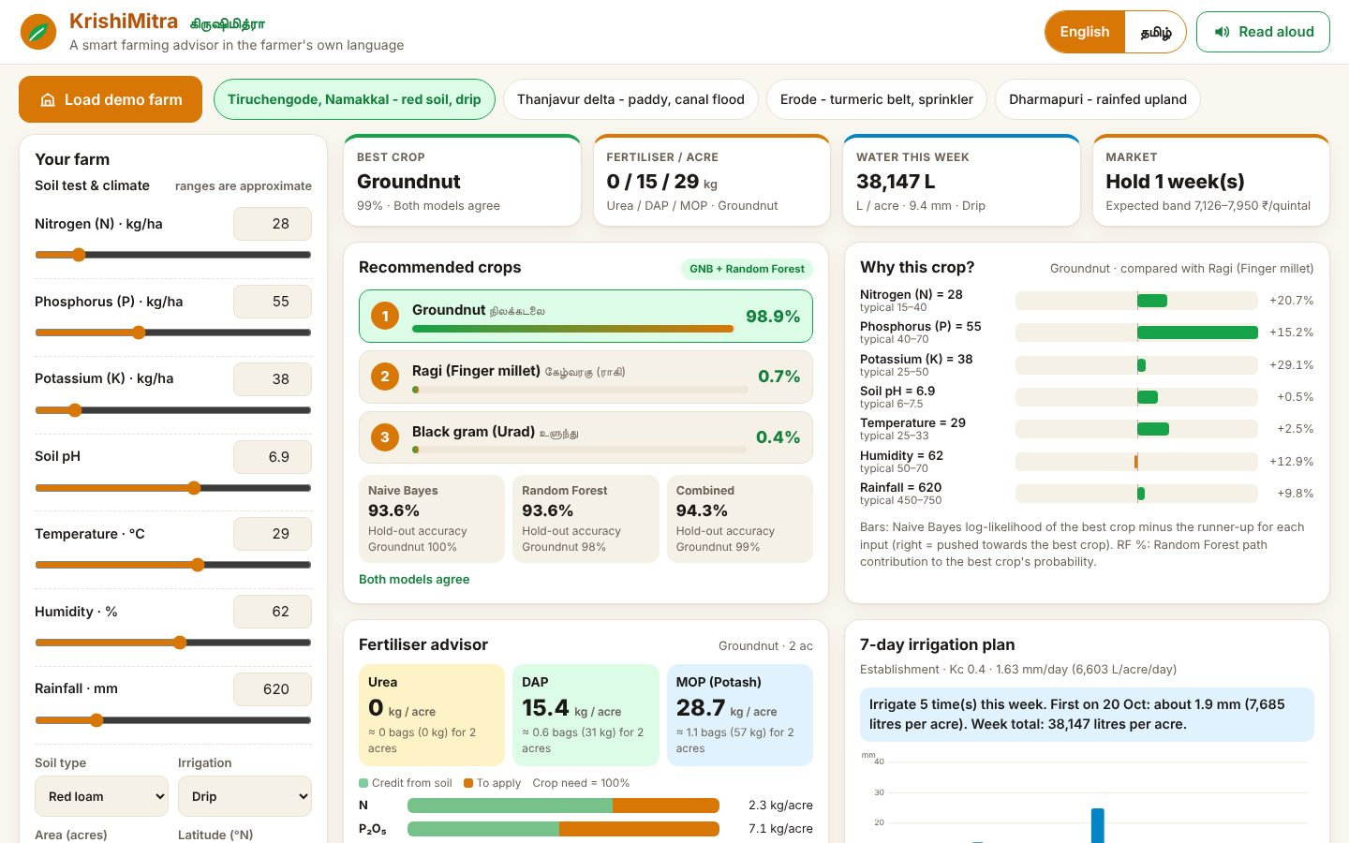
SMART AGRICULTURE & RURAL DEVELOPMENT (AGRITECH)
KrishiMitra
A smart farming advisor in the farmer's own language
Your Team Name
QUANTIX 2K26 · 24-hour hackathon · K.S.R. College of Engineering
Notes:
Open with the one-line promise: A smart farming advisor in the farmer's own language. Introduce the team, then go straight to the problem.

Slide 2

The problem
Crops chosen by habit, not by soil and season
Urea over-used, P and K neglected; money and soil wasted
Irrigation by guesswork; produce sold at the harvest-glut low
Advisory apps are English-first, online-only black boxes
~86%
Indian farm holdings small/marginal (Agri Census 2015-16, approx.)
~80%
India's freshwater used by agriculture (approx.)
4:2:1
target N:P:K ratio; actual use is N-heavy (approx.)
Notes:
Problem: Crops chosen by habit, not by soil and season Urea over-used, P and K neglected; money and soil wasted Irrigation by guesswork; produce sold at the harvest-glut low Advisory apps are English-first, online-only black boxes Key numbers: ~86% Indian farm holdings small/marginal (Agri Census 2015-16, approx.); ~80% India's freshwater used by agriculture (approx.); 4:2:1 target N:P:K ratio; actual use is N-heavy (approx.).

Slide 3

Our solution: KrishiMitra
Soil test in, four decisions out: crop, fertiliser, water, sell
Two from-scratch ML models with per-input explanations
Full Tamil / English UI with read-aloud voice
Runs offline on one laptop; phones join over local Wi-Fi
Notes:
Solution: Soil test in, four decisions out: crop, fertiliser, water, sell Two from-scratch ML models with per-input explanations Full Tamil / English UI with read-aloud voice Runs offline on one laptop; phones join over local Wi-Fi

Slide 4






Key features
Crop recommender
Fertiliser advisor
Irrigation planner
Top-3 of 14 TN crops from Naive Bayes + Random Forest, with why-bars
NPK deficit to Urea / DAP / MOP kg per acre, bags, organic options
FAO-56 Ra + Hargreaves ET0 x Kc: 7-day plan in mm and litres/acre
Market timing
Crop calendar
Tamil + voice
Seasonal index + trend: sell now or hold N weeks, with price band
Visual timeline from land prep to harvest with key operations
Every label and advice in Tamil script; speechSynthesis read-aloud
Notes:
Features: Crop recommender: Top-3 of 14 TN crops from Naive Bayes + Random Forest, with why-bars. Fertiliser advisor: NPK deficit to Urea / DAP / MOP kg per acre, bags, organic options. Irrigation planner: FAO-56 Ra + Hargreaves ET0 x Kc: 7-day plan in mm and litres/acre. Market timing: Seasonal index + trend: sell now or hold N weeks, with price band. Crop calendar: Visual timeline from land prep to harvest with key operations. Tamil + voice: Every label and advice in Tamil script; speechSynthesis read-aloud

Slide 5
System architecture
Browser UI vanilla JS, SVG charts, EN/TA, speech
Tech stack
app.py stdlib ThreadingHTTPServer, JSON API, validation
Python 3 stdlib only
Vanilla HTML/CSS/JS
Inline SVG charts
Web Speech API
No CDN, no internet
advisor one call runs every module for the chosen crop
recommender GNB + RF trained on seeded synthetic data
fertiliser / irrigation / market / calendar pure Python
Runs fully offline · no installs · python app.py
config.py every assumption, labelled approx.
Notes:
Architecture top to bottom: Browser UI -> vanilla JS, SVG charts, EN/TA, speech. app.py -> stdlib ThreadingHTTPServer, JSON API, validation. advisor -> one call runs every module for the chosen crop. recommender -> GNB + RF trained on seeded synthetic data. fertiliser / irrigation / market / calendar -> pure Python. config.py -> every assumption, labelled approx.. Stack: Python 3 stdlib only, Vanilla HTML/CSS/JS, Inline SVG charts, Web Speech API, No CDN, no internet.

Slide 6
Algorithms built from scratch
01
Gaussian Naive Bayes
crop probabilities + log-odds per input
02
CART + Random Forest
bootstrap, feature bagging, OOB, Saabas
03
FAO-56 Ra + Hargreaves ET0
reference water demand
04
Kc stage curve + soil bucket
7-day irrigation schedule
05
Ratio-to-moving-average seasonal index + OLS trend
sell/hold
Notes:
Algorithms: Gaussian Naive Bayes – crop probabilities + log-odds per input. CART + Random Forest – bootstrap, feature bagging, OOB, Saabas. FAO-56 Ra + Hargreaves ET0 – reference water demand. Kc stage curve + soil bucket – 7-day irrigation schedule. Ratio-to-moving-average seasonal index + OLS trend – sell/hold. Stress that nothing is a black box: every decision can be explained on screen.

Slide 7



What makes it different
One plan: crop choice drives dose, Kc, prices and calendar
Explainable ML written from scratch, two models side by side
Tamil-first advice text and voice, not just translated labels
Fully offline on a ₹15k laptop, ~3 ms per request
Notes:
Differentiators: One plan: crop choice drives dose, Kc, prices and calendar Explainable ML written from scratch, two models side by side Tamil-first advice text and voice, not just translated labels Fully offline on a ₹15k laptop, ~3 ms per request

Slide 8

Measured results
94.3%
93.6%
2.9 ms
32.2
hold-out accuracy, GNB+RF blend (synthetic, 14 crops)
GNB and RF each, on the same hold-out
median HTTP latency, full advisory
Ra MJ/m²/day: matches FAO-56 Example 8
Measured on held-out data generated by the project (see REPORT.md for method). Real-world performance needs field validation.
Impact Right-sized fertiliser cuts input cost and nitrate pollution · ET-based irrigation saves water and pumping power · Tamil voice advice reaches low-literacy and older farmers
Notes:
Results: 94.3% hold-out accuracy, GNB+RF blend (synthetic, 14 crops); 93.6% GNB and RF each, on the same hold-out; 2.9 ms median HTTP latency, full advisory; 32.2 Ra MJ/m²/day: matches FAO-56 Example 8. Impact: Right-sized fertiliser cuts input cost and nitrate pollution ET-based irrigation saves water and pumping power Tamil voice advice reaches low-literacy and older farmers

Slide 9
Live demo in 3 minutes
1
Open on phone + projector, Wi-Fi off
2
Tiruchengode farm: groundnut 99%, read the why-bars
3
Toggle Tamil and tap Read aloud
4
Fertiliser: 0 urea, 15 kg DAP, 29 kg MOP per acre
5
Delta paddy: irrigate once, 3.5 lakh L/acre
6
Market: sell now vs Erode turmeric hold
python app.py → http://localhost:8005
7
Switch crop: every card updates
Notes:
Switch to the browser now. 1. Open on phone + projector, Wi-Fi off 2. Tiruchengode farm: groundnut 99%, read the why-bars 3. Toggle Tamil and tap Read aloud 4. Fertiliser: 0 urea, 15 kg DAP, 29 kg MOP per acre 5. Delta paddy: irrigate once, 3.5 lakh L/acre 6. Market: sell now vs Erode turmeric hold 7. Switch crop: every card updates

Slide 10

Feasibility, business model & roadmap
Business model
Future scope
B2G: explain-your-Soil-Health-Card layer for KVKs / state
B2B: white-label advisories for FPOs and input dealers
Freemium: free app, paid SMS/IVR voice advisories
Consented, anonymised data for agronomic research
Train on real Soil Health Card + yield data
Live IMD weather and Agmarknet prices, cached offline
More Indian languages and voice input
Pest and disease alerts from weather
Android PWA and SMS/IVR for feature phones
Notes:
Business: B2G: explain-your-Soil-Health-Card layer for KVKs / state B2B: white-label advisories for FPOs and input dealers Freemium: free app, paid SMS/IVR voice advisories Consented, anonymised data for agronomic research Next: Train on real Soil Health Card + yield data Live IMD weather and Agmarknet prices, cached offline More Indian languages and voice input Pest and disease alerts from weather Android PWA and SMS/IVR for feature phones

Slide 11
Thank you
KrishiMitra · A smart farming advisor in the farmer's own language
Code https://github.com/jayeskumar/a/tree/claude/confident-fermi-dpeh2g/projects/05-krishimitra
Run cd projects/05-krishimitra && python app.py
Questions?
Notes:
Close with the impact line, invite questions. Keep the demo tab open in case judges want to try it.

