Slide 1
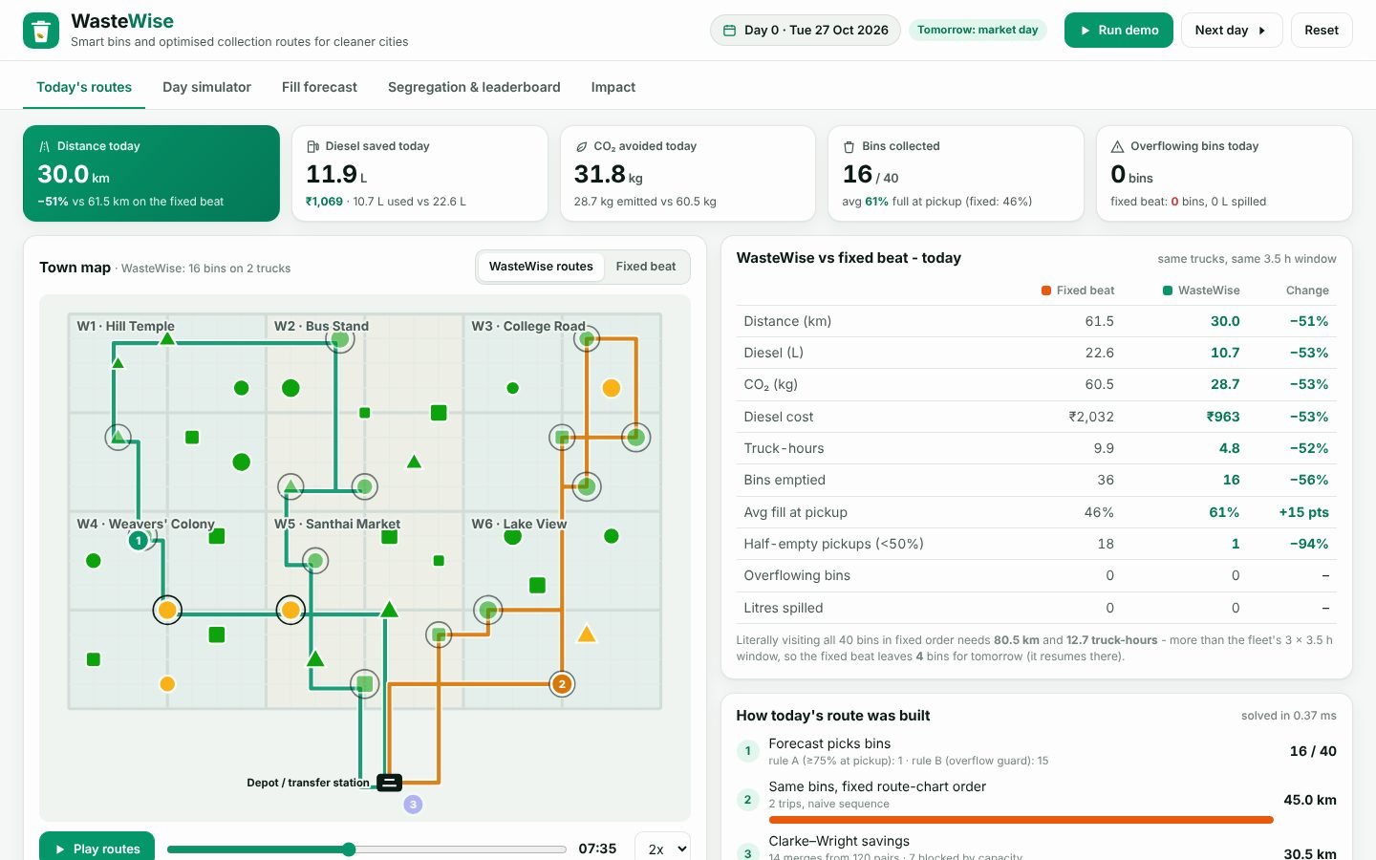
SUSTAINABILITY, CLEANTECH & GREEN ENERGY
WasteWise
Smart bins and optimised collection routes for cleaner cities
Your Team Name
QUANTIX 2K26 · 24-hour hackathon · K.S.R. College of Engineering
Notes:
Open with the one-line promise: Smart bins and optimised collection routes for cleaner cities. Introduce the team, then go straight to the problem.

Slide 2

The problem
Trucks follow fixed beats, whatever the bins hold
Half-full bins get emptied while market bins overflow
Wasted diesel, crew hours and CO2 every single day
Citizens unsure which bin an item goes in
1.5 lakh+ t/day
urban solid waste generated in India (CPCB, approx.)
3 streams
wet / dry / hazardous segregation required by SWM Rules 2016
40%
avg bin fill at pickup on a fixed beat (our simulation)
Notes:
Problem: Trucks follow fixed beats, whatever the bins hold Half-full bins get emptied while market bins overflow Wasted diesel, crew hours and CO2 every single day Citizens unsure which bin an item goes in Key numbers: 1.5 lakh+ t/day urban solid waste generated in India (CPCB, approx.); 3 streams wet / dry / hazardous segregation required by SWM Rules 2016; 40% avg bin fill at pickup on a fixed beat (our simulation).

Slide 3

Our solution: WasteWise
Forecast every bin's fill and time-to-full
Collect only bins that need it, with a stated reason
Clarke-Wright + 2-opt routes for 3 capacity-limited trucks
Bilingual bin guide and green-points ward leaderboard
Notes:
Solution: Forecast every bin's fill and time-to-full Collect only bins that need it, with a stated reason Clarke-Wright + 2-opt routes for 3 capacity-limited trucks Bilingual bin guide and green-points ward leaderboard

Slide 4






Key features
Fill forecaster
Explainable pickups
Route optimiser
Seasonal smoothing learns weekday and market-day spikes; hours to full
Rule A: >=75% at pickup. Rule B: overflow guard with +1 sigma margin
Clarke-Wright savings, 2-opt and truck packing in under 1 ms
Live map playback
Day simulator
Which bin? EN/TA
Animated trucks, bins coloured by fill, fixed beat toggle
Same waste, two policies: km, diesel, CO2 and overflows side by side
Naive Bayes on English, Tamil and Tanglish names; green points
Notes:
Features: Fill forecaster: Seasonal smoothing learns weekday and market-day spikes; hours to full. Explainable pickups: Rule A: >=75% at pickup. Rule B: overflow guard with +1 sigma margin. Route optimiser: Clarke-Wright savings, 2-opt and truck packing in under 1 ms. Live map playback: Animated trucks, bins coloured by fill, fixed beat toggle. Day simulator: Same waste, two policies: km, diesel, CO2 and overflows side by side. Which bin? EN/TA: Naive Bayes on English, Tamil and Tanglish names; green points

Slide 5
System architecture
Smart bin sensors (simulated) daily fill readings
Tech stack
Forecaster predicted fill at pickup and tomorrow
Python 3 standard library only
http.server JSON API
Vanilla HTML/CSS/JS
Hand-drawn SVG map and charts
unittest (45 tests)
Runs fully offline
Planner rules A/B today's bins with reasons
Clarke-Wright + 2-opt + LPT truck trips in shift
Simulator fixed beat vs WasteWise on same waste
Runs fully offline · no installs · python app.py
Python stdlib API vanilla JS + SVG dashboard
Notes:
Architecture top to bottom: Smart bin sensors (simulated) -> daily fill readings. Forecaster -> predicted fill at pickup and tomorrow. Planner rules A/B -> today's bins with reasons. Clarke-Wright + 2-opt + LPT -> truck trips in shift. Simulator -> fixed beat vs WasteWise on same waste. Python stdlib API -> vanilla JS + SVG dashboard. Stack: Python 3 standard library only, http.server JSON API, Vanilla HTML/CSS/JS, Hand-drawn SVG map and charts, unittest (45 tests), Runs fully offline.

Slide 6
Algorithms built from scratch
01
Seasonal exponential smoothing
per-bin daily fill forecast
02
OLS + weekday dummies (Gaussian elimination)
backtest rival
03
Clarke-Wright savings
capacitated route construction
04
2-opt
uncross each route, never longer
05
Longest-trip-first packing
trips onto trucks in shift
06
Multinomial Naive Bayes + char 3-grams
EN/TA bin guide
Notes:
Algorithms: Seasonal exponential smoothing - per-bin daily fill forecast. OLS + weekday dummies (Gaussian elimination) - backtest rival. Clarke-Wright savings - capacitated route construction. 2-opt - uncross each route, never longer. Longest-trip-first packing - trips onto trucks in shift. Multinomial Naive Bayes + char 3-grams - EN/TA bin guide. Stress that nothing is a black box: every decision can be explained on screen.

Slide 7



What makes it different
Predicts overflow before it happens, not after
Fair baseline: same trucks, window and waste
Every pickup, route and answer explained
Tamil + Tanglish item names out of the box
Notes:
Differentiators: Predicts overflow before it happens, not after Fair baseline: same trucks, window and waste Every pickup, route and answer explained Tamil + Tanglish item names out of the box

Slide 8

Measured results
-43%
12 -> 1
0.4 ms
78%
truck km and diesel vs fixed beat (30-day sim)
overflowing bin-days in the month
daily planning time, CW + 2-opt
bin-guide accuracy on unseen item names
Measured on held-out data generated by the project (see REPORT.md for method). Real-world performance needs field validation.
Impact ~3,650 L diesel and ~9.8 t CO2 a year per 40 bins (sim) · ~Rs 3.3 lakh diesel a year per 40 bins at Rs 90/L · Fewer overflowing bins near markets and bus stands
Notes:
Results: -43% truck km and diesel vs fixed beat (30-day sim); 12 -> 1 overflowing bin-days in the month; 0.4 ms daily planning time, CW + 2-opt; 78% bin-guide accuracy on unseen item names. Impact: ~3,650 L diesel and ~9.8 t CO2 a year per 40 bins (sim) ~Rs 3.3 lakh diesel a year per 40 bins at Rs 90/L Fewer overflowing bins near markets and bus stands

Slide 9
Live demo in 3 minutes
1
Run demo: trucks animate, 30 km vs 61.5 km today
2
Toggle fixed beat: 36 half-full pickups, 4 bins left
3
Route card: fixed order 45 -> CW 30.5 -> 2-opt 30 km
4
Click market bin: Wednesday spike, rule B fires
5
Next day: fixed beat overflows, WasteWise none
6
Run to day 30: -43% km, overflows 12 -> 1
python app.py → http://localhost:8009
7
Ask Tamil 'thengai odu', earn green points, see Impact
Notes:
Switch to the browser now. 1. Run demo: trucks animate, 30 km vs 61.5 km today 2. Toggle fixed beat: 36 half-full pickups, 4 bins left 3. Route card: fixed order 45 -> CW 30.5 -> 2-opt 30 km 4. Click market bin: Wednesday spike, rule B fires 5. Next day: fixed beat overflows, WasteWise none 6. Run to day 30: -43% km, overflows 12 -> 1 7. Ask Tamil 'thengai odu', earn green points, see Impact

Slide 10

Feasibility, business model & roadmap
Business model
Future scope
SaaS per bin per month for municipalities
Sensor + software bundle via local integrators
Segregation analytics for compost and recyclers
Free campus tier as a showcase
Real road network distances and time windows
Multi-depot, mixed fleet, inter-route moves
Festival and rain effects in the forecaster
Driver phone app and Tamil WhatsApp reporting bot
Photo-based contamination check at the bin
Notes:
Business: SaaS per bin per month for municipalities Sensor + software bundle via local integrators Segregation analytics for compost and recyclers Free campus tier as a showcase Next: Real road network distances and time windows Multi-depot, mixed fleet, inter-route moves Festival and rain effects in the forecaster Driver phone app and Tamil WhatsApp reporting bot Photo-based contamination check at the bin

Slide 11
Thank you
WasteWise · Smart bins and optimised collection routes for cleaner cities
Code https://github.com/jayeskumar/a/tree/claude/confident-fermi-dpeh2g/projects/09-wastewise
Run cd projects/09-wastewise && python app.py
Questions?
Notes:
Close with the impact line, invite questions. Keep the demo tab open in case judges want to try it.

