Slide 1
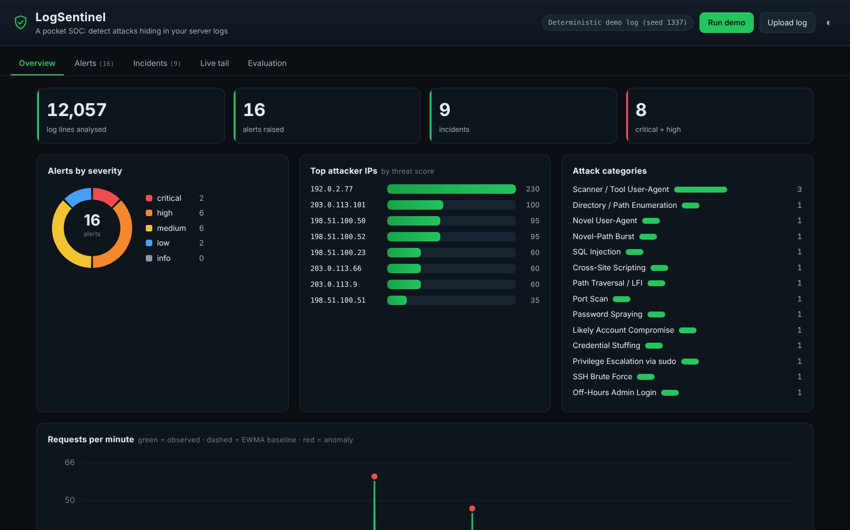
CYBERSECURITY & BLOCKCHAIN TECHNOLOGY
LogSentinel
A pocket SOC: detect attacks hiding in your server logs
Your Team Name
QUANTIX 2K26 · 24-hour hackathon · K.S.R. College of Engineering
Notes:
Open with the one-line promise: A pocket SOC: detect attacks hiding in your server logs. Introduce the team, then go straight to the problem.

Slide 2

The problem
Colleges and small businesses run web + SSH servers with zero security monitoring.
Commercial SIEMs are costly, cloud-tied and complex to operate.
Brute force, SQLi and scans sit in logs that nobody ever reads.
By the time a breach is noticed, the attacker is already inside.
0
false positives on a benign-only log (measured)
100%
attacks detected in the demo (11/11, measured)
~89k
log lines/sec parsed on a laptop (approx.)
Notes:
Problem: Colleges and small businesses run web + SSH servers with zero security monitoring. Commercial SIEMs are costly, cloud-tied and complex to operate. Brute force, SQLi and scans sit in logs that nobody ever reads. By the time a breach is noticed, the attacker is already inside. Key numbers: 0 false positives on a benign-only log (measured); 100% attacks detected in the demo (11/11, measured); ~89k log lines/sec parsed on a laptop (approx.).

Slide 3

Our solution: LogSentinel
Auto-detects Apache/Nginx, auth.log and firewall logs; robust to bad lines.
Signatures + sliding-window correlation + statistical anomaly detection.
Every alert: evidence, MITRE ATT&CK mapping and a response playbook.
Groups alerts into incidents with a kill-chain timeline; exports a blocklist.
Notes:
Solution: Auto-detects Apache/Nginx, auth.log and firewall logs; robust to bad lines. Signatures + sliding-window correlation + statistical anomaly detection. Every alert: evidence, MITRE ATT&CK mapping and a response playbook. Groups alerts into incidents with a kill-chain timeline; exports a blocklist.

Slide 4






Key features
Three-layer engine
MITRE ATT&CK
Incident timelines
Signatures, stateful correlation and EWMA anomaly - all from scratch
Each alert maps to a technique ID with a why-it-fired note
Alerts from one IP merged into a kill-chain story
Live tail replay
Bring your own log
Actionable export
Streams the log at speed, lighting up attacks as they land
Paste or upload a real log; format auto-detected per line
iptables / fail2ban blocklist + Markdown/HTML report
Notes:
Features: Three-layer engine: Signatures, stateful correlation and EWMA anomaly - all from scratch. MITRE ATT&CK: Each alert maps to a technique ID with a why-it-fired note. Incident timelines: Alerts from one IP merged into a kill-chain story. Live tail replay: Streams the log at speed, lighting up attacks as they land. Bring your own log: Paste or upload a real log; format auto-detected per line. Actionable export: iptables / fail2ban blocklist + Markdown/HTML report

Slide 5
System architecture
Parsers normalize web/SSH/firewall lines into one event type
Tech stack
Signatures URL-decode then regex for SQLi/XSS/traversal/scanners
Python 3 standard library (http.server, re, urllib, datetime)
Vanilla HTML/CSS/JS, hand-drawn inline-SVG charts
No pip, no CDN, no network - runs offline on a cheap laptop
Deterministic log generator with ground-truth labels for evaluation
Correlation sliding windows – brute force, spraying, compromise, scans
Anomaly per-IP EWMA + z-score on request rate, UA/path novelty
Incidents group by IP+time into a kill-chain timeline
Runs fully offline · no installs · python app.py
stdlib http.server JSON API + vanilla JS console dashboard
Notes:
Architecture top to bottom: Parsers -> normalize web/SSH/firewall lines into one event type. Signatures -> URL-decode then regex for SQLi/XSS/traversal/scanners. Correlation -> sliding windows: brute force, spraying, compromise, scans. Anomaly -> per-IP EWMA + z-score on request rate, UA/path novelty. Incidents -> group by IP+time into a kill-chain timeline. stdlib http.server -> JSON API + vanilla JS console dashboard. Stack: Python 3 standard library (http.server, re, urllib, datetime), Vanilla HTML/CSS/JS, hand-drawn inline-SVG charts, No pip, no CDN, no network - runs offline on a cheap laptop, Deterministic log generator with ground-truth labels for evaluation.

Slide 6
Algorithms built from scratch
01
URL-decoding signature matching
defeats percent/double-encoding evasion
02
Sliding-window correlation
N events in T seconds, distinct-key counts
03
EWMA mean + variance with z-score
per-IP request-rate anomalies
04
Credential-stuffing vs spraying
invalid-user ratio splits the two
05
Kill-chain incident grouping
phase-ordered timeline per source IP
Notes:
Algorithms: URL-decoding signature matching - defeats percent/double-encoding evasion. Sliding-window correlation - N events in T seconds, distinct-key counts. EWMA mean + variance with z-score - per-IP request-rate anomalies. Credential-stuffing vs spraying - invalid-user ratio splits the two. Kill-chain incident grouping - phase-ordered timeline per source IP. Stress that nothing is a black box: every decision can be explained on screen.

Slide 7



What makes it different
Explainable by design - every alert shows evidence + the rule + MITRE why.
Three complementary detectors catch known AND novel attacks.
Ships its own labelled attack dataset, so accuracy is measured, not claimed.
Never touches your firewall - it hands you a blocklist to review and apply.
Notes:
Differentiators: Explainable by design - every alert shows evidence + the rule + MITRE why. Three complementary detectors catch known AND novel attacks. Ships its own labelled attack dataset, so accuracy is measured, not claimed. Never touches your firewall - it hands you a blocklist to review and apply.

Slide 8

Measured results
100%
100%
0
~89k/s
recall across 11 labelled attack types
detection precision (IP-level, 0 false alerts)
false positives on 11.9k benign lines
parse throughput, lines/sec (approx.)
Measured on held-out data generated by the project (see REPORT.md for method). Real-world performance needs field validation.
Impact Free, offline security monitoring for orgs that can afford none. · Turns ignored logs into an early-warning system before a breach spreads. · Teaches SOC concepts (MITRE, kill-chain) - a learning tool for students.
Notes:
Results: 100% recall across 11 labelled attack types; 100% detection precision (IP-level, 0 false alerts); 0 false positives on 11.9k benign lines; ~89k/s parse throughput, lines/sec (approx.). Impact: Free, offline security monitoring for orgs that can afford none. Turns ignored logs into an early-warning system before a breach spreads. Teaches SOC concepts (MITRE, kill-chain) - a learning tool for students.

Slide 9
Live demo in 3 minutes
1
Open the dashboard - demo log is already analysed (12k lines, 16 alerts).
2
Overview: severity donut, top attacker IPs, requests/min with red anomaly markers.
3
Incidents: open INC for 192.0.2.77 - see stuffing -> compromise -> sudo kill-chain.
4
Alerts: filter to SQL Injection, open one, read decoded payload + MITRE + fix.
5
Live tail: hit Play - watch attacks light up in the streaming console.
6
Evaluation tab: 100% recall / precision, 0 benign FPs, throughput.
python app.py → http://localhost:8013
7
Export a blocklist, then Upload log to analyse a judge's own file.
Notes:
Switch to the browser now. 1. Open the dashboard - demo log is already analysed (12k lines, 16 alerts). 2. Overview: severity donut, top attacker IPs, requests/min with red anomaly markers. 3. Incidents: open INC for 192.0.2.77 - see stuffing -> compromise -> sudo kill-chain. 4. Alerts: filter to SQL Injection, open one, read decoded payload + MITRE + fix. 5. Live tail: hit Play - watch attacks light up in the streaming console. 6. Evaluation tab: 100% recall / precision, 0 benign FPs, throughput. 7. Export a blocklist, then Upload log to analyse a judge's own file.

Slide 10

Feasibility, business model & roadmap
Business model
Future scope
Open-core: free self-hosted tool; paid support + managed rules for SMBs.
Campus/MSP tier: one install watches many hosts via shipped logs.
Rule packs and MITRE-aligned reports as a subscription add-on.
Near-zero running cost - stdlib Python, no infra to rent.
Live log tailing from files/journald instead of replay.
GeoIP and ASN enrichment for attacker context (offline DB).
Optional fail2ban/iptables apply with human approval.
More sources: IIS, Postfix, Windows Event Log, Kubernetes audit.
Tunable rule editor and alert suppression lists in the UI.
Notes:
Business: Open-core: free self-hosted tool; paid support + managed rules for SMBs. Campus/MSP tier: one install watches many hosts via shipped logs. Rule packs and MITRE-aligned reports as a subscription add-on. Near-zero running cost - stdlib Python, no infra to rent. Next: Live log tailing from files/journald instead of replay. GeoIP and ASN enrichment for attacker context (offline DB). Optional fail2ban/iptables apply with human approval. More sources: IIS, Postfix, Windows Event Log, Kubernetes audit. Tunable rule editor and alert suppression lists in the UI.

Slide 11
Thank you
LogSentinel · A pocket SOC: detect attacks hiding in your server logs
Code https://github.com/jayeskumar/a/tree/claude/confident-fermi-dpeh2g/projects/13-logsentinel
Run cd projects/13-logsentinel && python app.py
Questions?
Notes:
Close with the impact line, invite questions. Keep the demo tab open in case judges want to try it.

