Slide 1
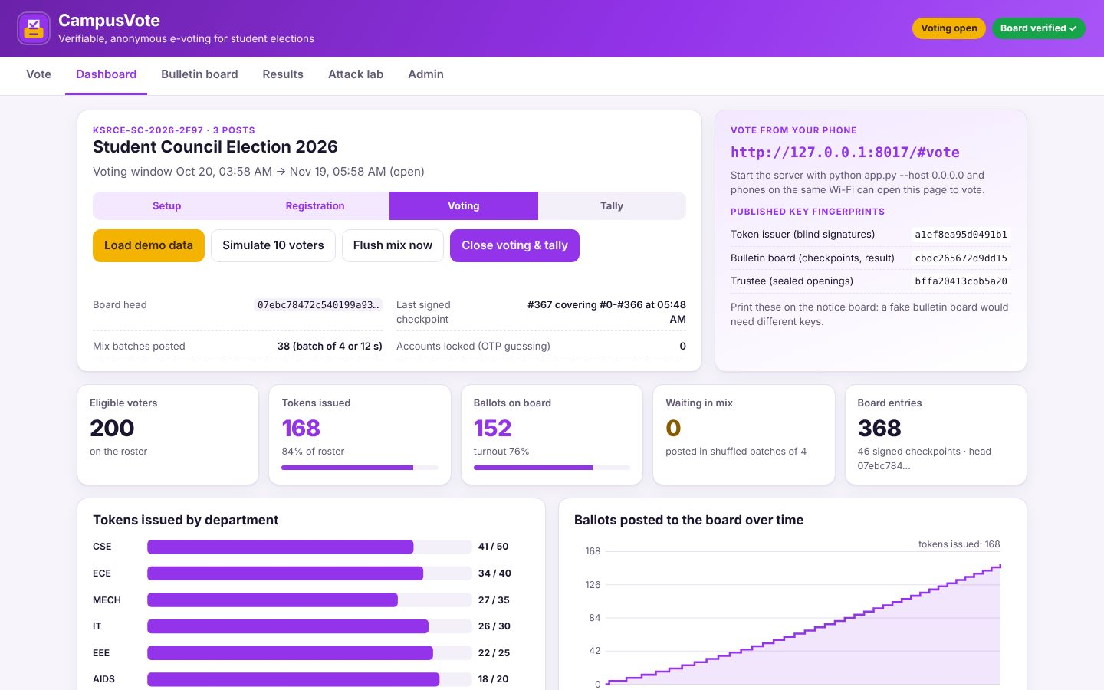
CYBERSECURITY & BLOCKCHAIN TECHNOLOGY
CampusVote
Verifiable, anonymous e-voting for student elections
Your Team Name
QUANTIX 2K26 · 24-hour hackathon · K.S.R. College of Engineering
Notes:
Open with the one-line promise: Verifiable, anonymous e-voting for student elections. Introduce the team, then go straight to the problem.

Slide 2

The problem
Paper ballots: hours of manual counting, disputed recounts
Google Forms: admins see who voted what and can edit rows
Shared form links and proxy logins allow double voting
Losing candidates have no way to check the result
0
ways for a voter to check a Google Forms tally
Hours
to hand-count a few thousand paper ballots (approx.)
1 admin
can silently edit a spreadsheet of votes
Notes:
Problem: Paper ballots: hours of manual counting, disputed recounts Google Forms: admins see who voted what and can edit rows Shared form links and proxy logins allow double voting Losing candidates have no way to check the result Key numbers: 0 ways for a voter to check a Google Forms tally; Hours to hand-count a few thousand paper ballots (approx.); 1 admin can silently edit a spreadsheet of votes.

Slide 3

Our solution: CampusVote
Chaum blind signatures: eligible, yet unlinkable to the voter
SHA-256 commitments hide choices until voting closes
Hash-chained public bulletin board with signed checkpoints
Receipts + full recount by anyone, even in the browser
Notes:
Solution: Chaum blind signatures: eligible, yet unlinkable to the voter SHA-256 commitments hide choices until voting closes Hash-chained public bulletin board with signed checkpoints Receipts + full recount by anyone, even in the browser

Slide 4






Key features
Phone voting
Blind-signed tokens
Public bulletin board
Mobile-first ballot over campus Wi-Fi, large buttons, no app
Authority signs a token it never sees; one per register number
Hash chain + RSA-signed checkpoints, download and verify anywhere
Voter receipts
Attack lab
Explained audit
Check on your own phone that your ballot was counted as cast
12 live attacks: double vote, forgery, replay, tampering, stuffing
10-step verification report with the reason each check matters
Notes:
Features: Phone voting: Mobile-first ballot over campus Wi-Fi, large buttons, no app. Blind-signed tokens: Authority signs a token it never sees; one per register number. Public bulletin board: Hash chain + RSA-signed checkpoints, download and verify anywhere. Voter receipts: Check on your own phone that your ballot was counted as cast. Attack lab: 12 live attacks: double vote, forgery, replay, tampering, stuffing. Explained audit: 10-step verification report with the reason each check matters

Slide 5
System architecture
Phone/browser (vanilla JS) SHA-256, RSA blinding, sealing, audit
Tech stack
app.py ThreadingHTTPServer JSON API, no IPs logged on cast
Python 3 stdlib only (hashlib, hmac, secrets, http.server)
Vanilla HTML/CSS/JS with BigInt crypto, inline SVG charts
JSON files with atomic writes
Fully offline: one laptop + campus Wi-Fi
election.py roster, OTP login, issuance, mix pool, phases, tally
blind.py + rsa.py + numtheory.py Miller-Rabin, RSA-FDH, Chaum
board.py + audit.py hash chain, checkpoints, universal recount
Runs fully offline · no installs · python app.py
data/board.json the only file an auditor needs
Notes:
Architecture top to bottom: Phone/browser (vanilla JS) -> SHA-256, RSA blinding, sealing, audit. app.py ThreadingHTTPServer -> JSON API, no IPs logged on cast. election.py -> roster, OTP login, issuance, mix pool, phases, tally. blind.py + rsa.py + numtheory.py -> Miller-Rabin, RSA-FDH, Chaum. board.py + audit.py -> hash chain, checkpoints, universal recount. data/board.json -> the only file an auditor needs. Stack: Python 3 stdlib only (hashlib, hmac, secrets, http.server), Vanilla HTML/CSS/JS with BigInt crypto, inline SVG charts, JSON files with atomic writes, Fully offline: one laptop + campus Wi-Fi.

Slide 6
Algorithms built from scratch
01
Miller-Rabin (40 rounds)
2048-bit RSA key generation
02
RSA-FDH + CRT
signatures with Bellcore fault check
03
Chaum blind signatures
eligibility without identity
04
SHA-256 hash commitments
hiding and binding ballots
05
RSA-KEM + SHA-256 CTR + HMAC
sealed openings for the trustee
06
Hash chain + signed checkpoints
tamper-evident board
Notes:
Algorithms: Miller-Rabin (40 rounds) - 2048-bit RSA key generation. RSA-FDH + CRT - signatures with Bellcore fault check. Chaum blind signatures - eligibility without identity. SHA-256 hash commitments - hiding and binding ballots. RSA-KEM + SHA-256 CTR + HMAC - sealed openings for the trustee. Hash chain + signed checkpoints - tamper-evident board. Stress that nothing is a black box: every decision can be explained on screen.

Slide 7



What makes it different
Admin can run the election but cannot see, link or alter votes
Browser re-verifies the whole board: no trust in our server
Perfect unlinkability shown live: every pairing is consistent
Honest threat model, incl. coercion and stuffing limits
Notes:
Differentiators: Admin can run the election but cannot see, link or alter votes Browser re-verifies the whole board: no trust in our server Perfect unlinkability shown live: every pairing is consistent Honest threat model, incl. coercion and stuffing limits

Slide 8

Measured results
~9 ms
0.2 ms
<2 s
12 / 12
blind signature per voter, 2048-bit, pure Python
ballot signature verification
independent recount of 2,000 ballots
attack demos rejected or detected
Measured on held-out data generated by the project (see REPORT.md for method). Real-world performance needs field validation.
Impact Results in minutes, not an evening of counting · Disputes settled by recounting a public file · Students can vote from hostels and labs on their phones
Notes:
Results: ~9 ms blind signature per voter, 2048-bit, pure Python; 0.2 ms ballot signature verification; <2 s independent recount of 2,000 ballots; 12 / 12 attack demos rejected or detected. Impact: Results in minutes, not an evening of counting Disputes settled by recounting a public file Students can vote from hostels and labs on their phones

Slide 9
Live demo in 3 minutes
1
Phone: demo voter signs in, gets a blind-signed token
2
Choose candidates, cast anonymously, get a receipt
3
Attack lab: double vote, forgery, replay all rejected
4
Edit board.json: chain breaks at the exact entry; restore
5
Close voting: trustee opens ballots, signed result posted
6
Results + 10-step audit; browser recount matches
python app.py → http://localhost:8017
7
Phone re-checks receipt: counted exactly as cast
Notes:
Switch to the browser now. 1. Phone: demo voter signs in, gets a blind-signed token 2. Choose candidates, cast anonymously, get a receipt 3. Attack lab: double vote, forgery, replay all rejected 4. Edit board.json: chain breaks at the exact entry; restore 5. Close voting: trustee opens ballots, signed result posted 6. Results + 10-step audit; browser recount matches 7. Phone re-checks receipt: counted exactly as cast

Slide 10

Feasibility, business model & roadmap
Business model
Future scope
Free for student clubs on one laptop
Annual college licence: council, hostel, club and alumni polls
Paid audit/observer support for university-wide elections
Extend to RWAs, cooperatives and union ballots
Split trustee and signing keys across 3 faculty (threshold RSA)
Real mix-net / separate relay so the server never sees ballot IPs
Homomorphic ElGamal tally with zero-knowledge ballot proofs
Anchor checkpoint hashes on a public chain or notice board QR
Ranked-choice and multi-seat posts
Notes:
Business: Free for student clubs on one laptop Annual college licence: council, hostel, club and alumni polls Paid audit/observer support for university-wide elections Extend to RWAs, cooperatives and union ballots Next: Split trustee and signing keys across 3 faculty (threshold RSA) Real mix-net / separate relay so the server never sees ballot IPs Homomorphic ElGamal tally with zero-knowledge ballot proofs Anchor checkpoint hashes on a public chain or notice board QR Ranked-choice and multi-seat posts

Slide 11
Thank you
CampusVote · Verifiable, anonymous e-voting for student elections
Code https://github.com/jayeskumar/a/tree/claude/confident-fermi-dpeh2g/projects/17-campusvote
Run cd projects/17-campusvote && python app.py
Questions?
Notes:
Close with the impact line, invite questions. Keep the demo tab open in case judges want to try it.

