Slide 1
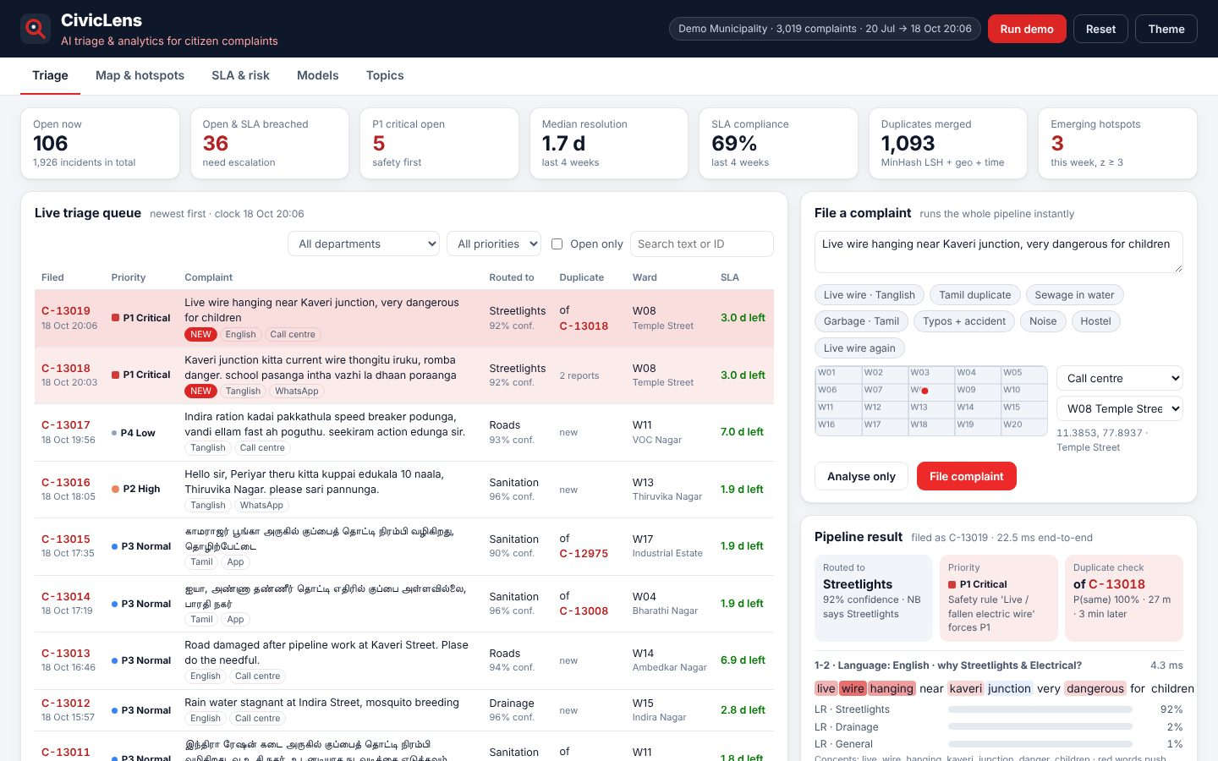
DATA SCIENCE & ANALYTICS
CivicLens
AI triage and analytics for citizen complaints
Your Team Name
QUANTIX 2K26 · 24-hour hackathon · K.S.R. College of Engineering
Notes:
Open with the one-line promise: AI triage and analytics for citizen complaints. Introduce the team, then go straight to the problem.

Slide 2

The problem
Towns and campuses get thousands of complaints via apps, calls and social media
Clerks route them by hand, in English, Tamil and Tanglish
Duplicates pile up while a live wire waits behind a parking complaint
Hotspots and SLA breaches stay invisible until there is a crisis
~48%
of Tamil Nadu's people live in urban areas (Census 2011, approx.)
1 in 3
complaints repeat an open issue (our synthetic stream; varies)
Notes:
Problem: Towns and campuses get thousands of complaints via apps, calls and social media Clerks route them by hand, in English, Tamil and Tanglish Duplicates pile up while a live wire waits behind a parking complaint Hotspots and SLA breaches stay invisible until there is a crisis Key numbers: ~48% of Tamil Nadu's people live in urban areas (Census 2011, approx.); 1 in 3 complaints repeat an open issue (our synthetic stream; varies).

Slide 3

Our solution: CivicLens
Every new complaint is routed, prioritised and de-duplicated in ~3 ms
Safety rules plus an ML model set P1-P4 and say why
DBSCAN and Poisson tests flag hotspots and wards that are suddenly worse
Survival curves and a breach model warn before the SLA is missed
Notes:
Solution: Every new complaint is routed, prioritised and de-duplicated in ~3 ms Safety rules plus an ML model set P1-P4 and say why DBSCAN and Poisson tests flag hotspots and wards that are suddenly worse Survival curves and a breach model warn before the SLA is missed

Slide 4






Key features
Tamil-aware routing
Explainable priority
Duplicate merging
TF-IDF logistic regression vs Naive Bayes on words, letters and concepts
Safety rules force P1; the model weighs school, elderly, days pending
MinHash LSH + distance + time links reports across languages
Hotspots & surges
SLA risk queue
Topic discovery
DBSCAN on incidents plus weekly Poisson z-test per ward
Kaplan-Meier curves and breach probability with reasons
k-means finds themes like noise or encroachment in Other
Notes:
Features: Tamil-aware routing: TF-IDF logistic regression vs Naive Bayes on words, letters and concepts. Explainable priority: Safety rules force P1; the model weighs school, elderly, days pending. Duplicate merging: MinHash LSH + distance + time links reports across languages. Hotspots & surges: DBSCAN on incidents plus weekly Poisson z-test per ward. SLA risk queue: Kaplan-Meier curves and breach probability with reasons. Topic discovery: k-means finds themes like noise or encroachment in Other

Slide 5
System architecture
Browser UI vanilla JS, SVG/canvas charts, live queue and map
Tech stack
app.py stdlib ThreadingHTTPServer, JSON API, input validation
Python 3 stdlib only
Vanilla HTML/CSS/JS
Hand-drawn SVG + canvas
No CDN, fully offline
unittest (70 tests)
text + lexicon Tamil-safe tokens, graphemes, bilingual concepts
models NB, OvR logistic regression, urgency rules + model
dedup + hotspot MinHash LSH, haversine, DBSCAN, Poisson test
Runs fully offline · no installs · python app.py
sla + topics Kaplan-Meier, breach LR, spherical k-means
Notes:
Architecture top to bottom: Browser UI -> vanilla JS, SVG/canvas charts, live queue and map. app.py -> stdlib ThreadingHTTPServer, JSON API, input validation. text + lexicon -> Tamil-safe tokens, graphemes, bilingual concepts. models -> NB, OvR logistic regression, urgency rules + model. dedup + hotspot -> MinHash LSH, haversine, DBSCAN, Poisson test. sla + topics -> Kaplan-Meier, breach LR, spherical k-means. Stack: Python 3 stdlib only, Vanilla HTML/CSS/JS, Hand-drawn SVG + canvas, No CDN, fully offline, unittest (70 tests).

Slide 6
Algorithms built from scratch
01
Multinomial Naive Bayes
department routing baseline
02
TF-IDF logistic regression (OvR, SGD)
routing + urgency
03
MinHash + LSH banding + haversine
duplicate incidents
04
DBSCAN (grid index)
spatial hotspots per department
05
Poisson z-test
emerging ward hotspots vs 4-week baseline
06
Kaplan-Meier + logistic regression
SLA curves and breach risk
Notes:
Algorithms: Multinomial Naive Bayes - department routing baseline. TF-IDF logistic regression (OvR, SGD) - routing + urgency. MinHash + LSH banding + haversine - duplicate incidents. DBSCAN (grid index) - spatial hotspots per department. Poisson z-test - emerging ward hotspots vs 4-week baseline. Kaplan-Meier + logistic regression - SLA curves and breach risk. Stress that nothing is a black box: every decision can be explained on screen.

Slide 7



What makes it different
Tamil grapheme tokenizer + bilingual concepts: one model, three scripts
Duplicates matched across languages using text, place and time
Safety rules never wait for a model; the model never hides why
Every metric measured against planted ground truth
Notes:
Differentiators: Tamil grapheme tokenizer + bilingual concepts: one model, three scripts Duplicates matched across languages using text, place and time Safety rules never wait for a model; the model never hides why Every metric measured against planted ground truth

Slide 8

Measured results
95.3%
0.82
6 / 6
2.6 ms
routing accuracy, 615 held-out (94.2% on unseen phrasing)
duplicate-pair F1 (text-only baseline 0.47)
planted hotspots found, zero false hotspots
full pipeline per complaint (p50, pure Python)
Measured on held-out data generated by the project (see REPORT.md for method). Real-world performance needs field validation.
Impact Urgent safety hazards jump the queue within seconds · ~36% fewer tickets once duplicate reports are merged (demo data) · Ward officers see hotspots and slow wards weekly, not yearly
Notes:
Results: 95.3% routing accuracy, 615 held-out (94.2% on unseen phrasing); 0.82 duplicate-pair F1 (text-only baseline 0.47); 6 / 6 planted hotspots found, zero false hotspots; 2.6 ms full pipeline per complaint (p50, pure Python). Impact: Urgent safety hazards jump the queue within seconds ~36% fewer tickets once duplicate reports are merged (demo data) Ward officers see hotspots and slow wards weekly, not yearly

Slide 9
Live demo in 3 minutes
1
Triage: KPIs, live queue with priority and duplicate links
2
Run demo: Tanglish live wire becomes P1 by safety rule
3
Tamil duplicate merged with an English report
4
Map: 6 DBSCAN hotspots match the planted ones
5
Heat grid: W11 garbage surge, z = 15
6
SLA: survival curve, at-risk queue with reasons
python app.py → http://localhost:8019
7
Models: LR 94% vs NB 61% on unseen phrasing
Notes:
Switch to the browser now. 1. Triage: KPIs, live queue with priority and duplicate links 2. Run demo: Tanglish live wire becomes P1 by safety rule 3. Tamil duplicate merged with an English report 4. Map: 6 DBSCAN hotspots match the planted ones 5. Heat grid: W11 garbage surge, z = 15 6. SLA: survival curve, at-risk queue with reasons 7. Models: LR 94% vs NB 61% on unseen phrasing

Slide 10

Feasibility, business model & roadmap
Business model
Future scope
Free open-source edition for colleges and small towns
Paid hosted edition for municipal corporations with integrations
Setup and lexicon tuning for each district's own language
Plugs into existing CPGRAMS-style portals and WhatsApp lines
Learn from officers' re-routing corrections (active learning)
Speech-to-text for call-centre and voice notes
Photo evidence: pothole and garbage image checks
Crew routing for clustered incidents
Public status page for citizens
Notes:
Business: Free open-source edition for colleges and small towns Paid hosted edition for municipal corporations with integrations Setup and lexicon tuning for each district's own language Plugs into existing CPGRAMS-style portals and WhatsApp lines Next: Learn from officers' re-routing corrections (active learning) Speech-to-text for call-centre and voice notes Photo evidence: pothole and garbage image checks Crew routing for clustered incidents Public status page for citizens

Slide 11
Thank you
CivicLens · AI triage and analytics for citizen complaints
Code https://github.com/jayeskumar/a/tree/claude/confident-fermi-dpeh2g/projects/19-civiclens
Run cd projects/19-civiclens && python app.py
Questions?
Notes:
Close with the impact line, invite questions. Keep the demo tab open in case judges want to try it.

