Slide 1
Group1
Implement Gradient boosting Tree on Titanic Dataset

Slide 2
The problems we solved
Implement gradientboost classifier ourselves just 0.02 less accurate than sklearn when submit result in Kaggle
Tunning hyper perametres by both cross-validation and empirical
result in previous paper
Fill in important missing data in dataset using gradientboost regressor
Use gradientboost classifier to predict whether people survive in titanic and give coresponding interpretation using relative importance plot and partial dependence plots
Analyze algorithm performance with ROC curve and confusion matrix

Slide 3
Gradient Boosting Tree Algorithm
Set hyper perametre and choose loss function and set aside a validation set in order to use early stopping
Start iteration:
1.Calculate derivative of current loss function with respect to f(Xi) (0<i<=n)
2.Stochastically choose half of the training set to fit a regression tree
use negative gradient as target (Friedman, 1999)
3. Update f(X) by adding the fitted tree with the weight of learning rate to current f(X)
4. Calculate improvement after updating in validation set
5. Stop iterate if improvement on validation set is smaller than given threshold(early stopping)
Output f(X)

Slide 4
Hyper-perameter
Subsampling
With stochastic gradient boosting (Friedman, 1999), at each iteration we sample a fraction η of the training observations (without replacement), and grow the next tree using that subsample. The rest of the algorithm is identical. A typical value for η can be 0.5, although for large N, η can be substantially smaller than 0.5.
Max depth
Although in many applications J = 2 will be insuﬃcient, it is unlikely that J > 10 will be required. Experience so far indicates that 4 ≤ J ≤ 8 works well in the context of boosting, with results being fairly insensitive to particular choices in this range. One can ﬁne-tune the value for J by trying several diﬀerent values and choosing the one that produces the lowest risk on a validation sample. However, this seldom provides signiﬁcant improvement over using J ≃ 6.

Slide 5
Hyper-perameter
Learning rate and estimators number
Empirically it has been found (Friedman, 2001) that smaller values of ν favor better test error, and require correspondingly larger values of M. In fact, the best strategy appears to be to set ν to be very small (ν < 0.1) and then choose M by early stopping. This yields dramatic improvements (over no shrinkage ν = 1) for regression and for probability estimation.
Use early stopping to terminate training when validation score is not improving. So we do not need to tune estimators number(just set it as large as possible) as the training will automatically stop using validation

Slide 6
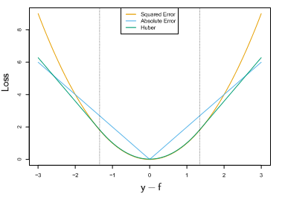
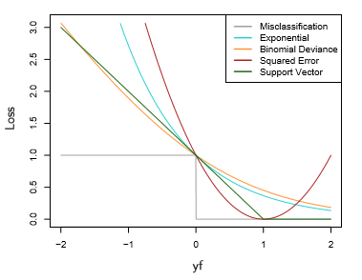
Loss function choosing
For Regression
Huber(Huber,1964)
MSE
MAE
For classification
Deviance
exponential

Slide 7
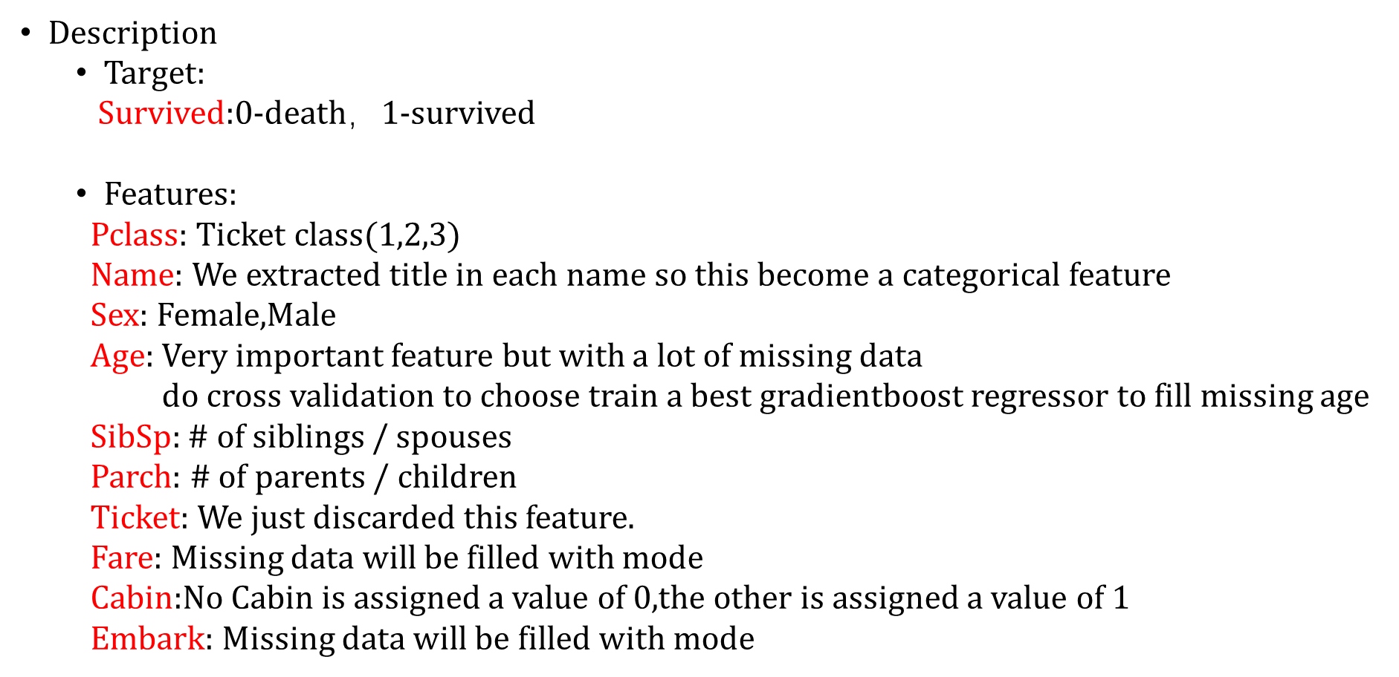
Dataset
Our goal
Deal with missing data of important feature carefully
Achieve high accuracy rate
Give resononable interpretation with visualization:
Relative Importance of Predictor Variables Plot
Partial Dependence Plots

Slide 8
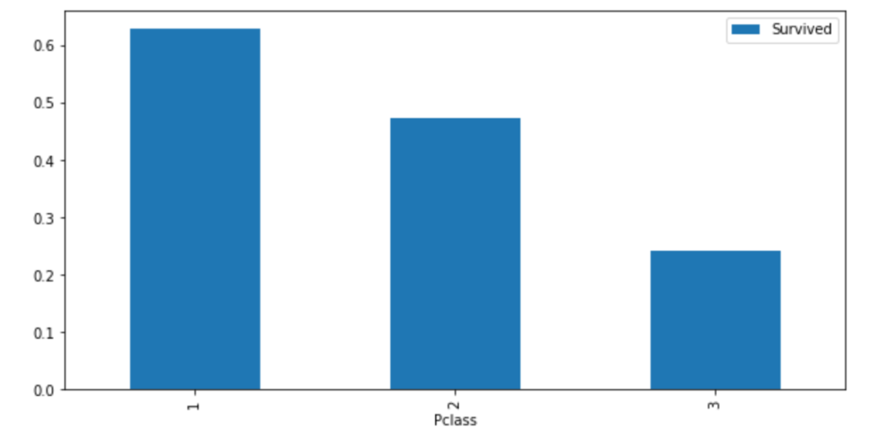
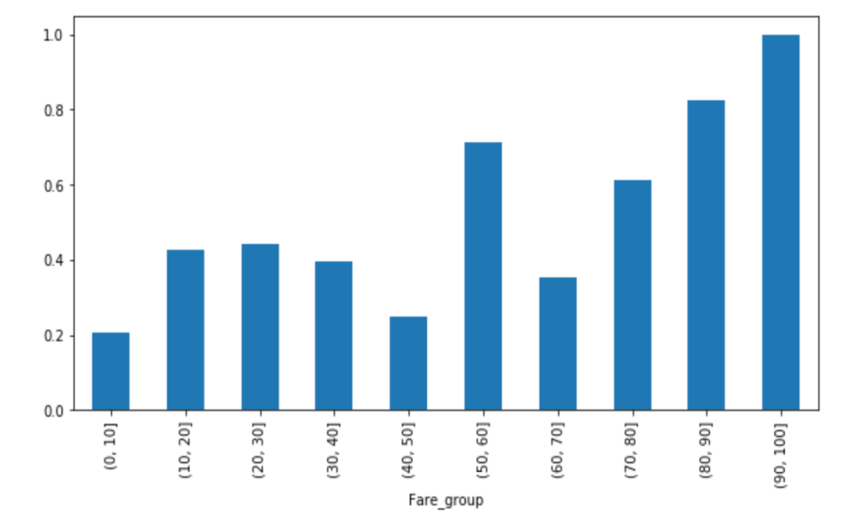
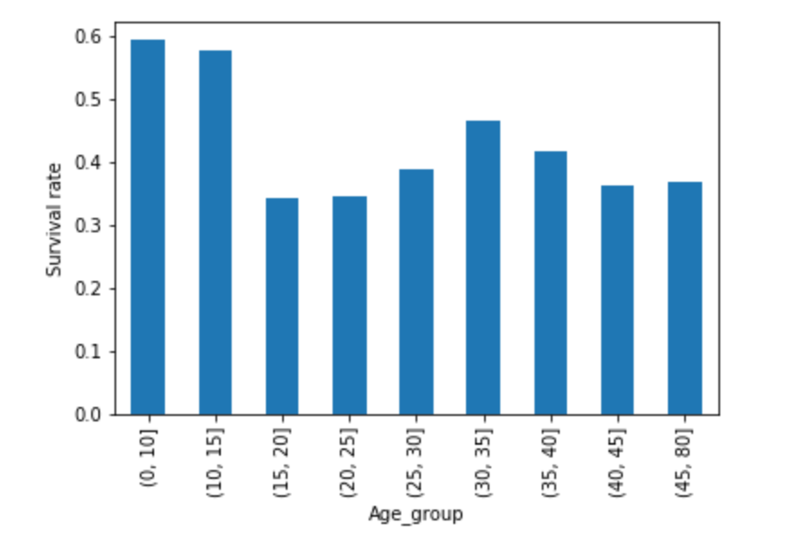
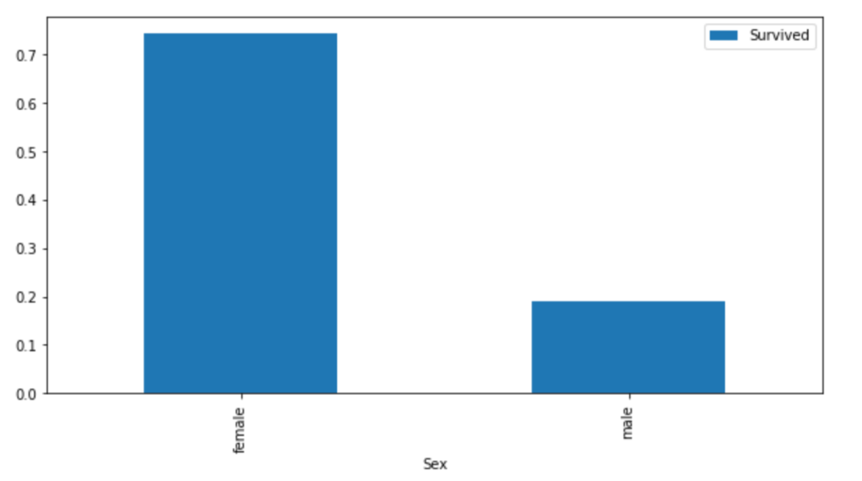
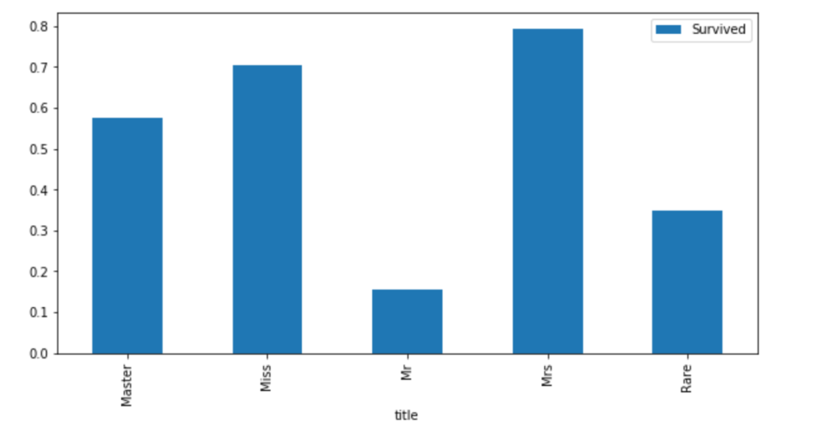
Exploratory data analysis

Slide 9
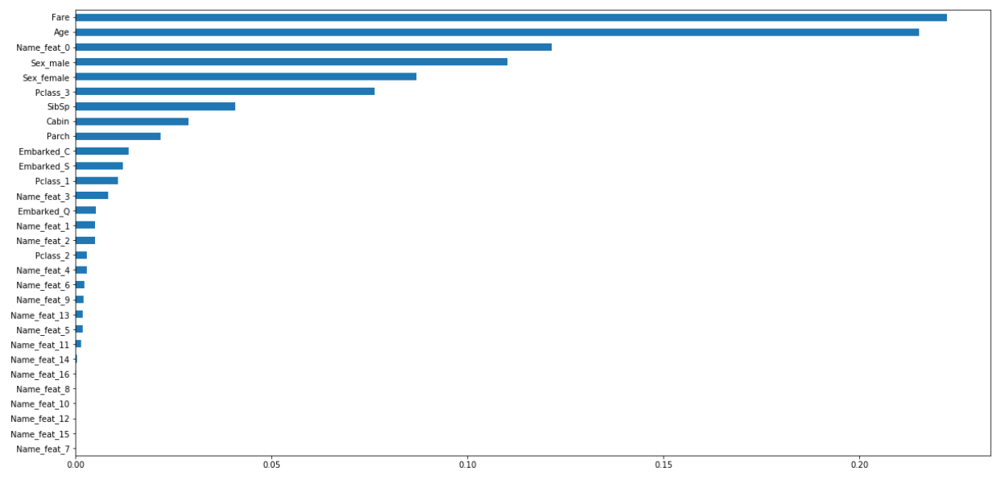


Relative Importance of Predictor Variables

Slide 10


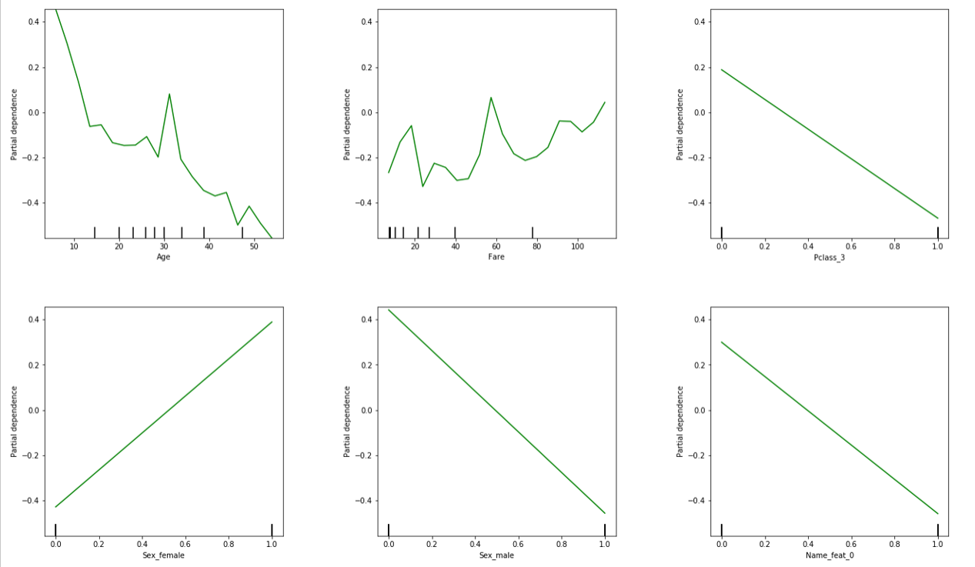
Partial Dependence Plots

Slide 11
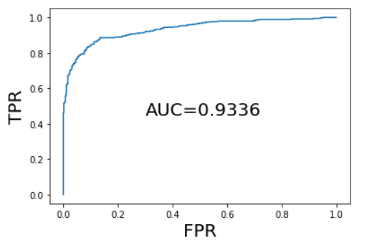
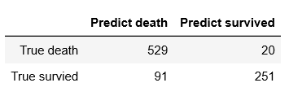
Accuracy rate and Future improvements
Test accuracy rate is about 0.03 smaller than mean validation accuracy rate
In order to improve our rank, maybe we should do more feature engineering or simply use other ensemble method like stacking because we have done all we can in choosing hyper-perameter and loss function

