Slide 1
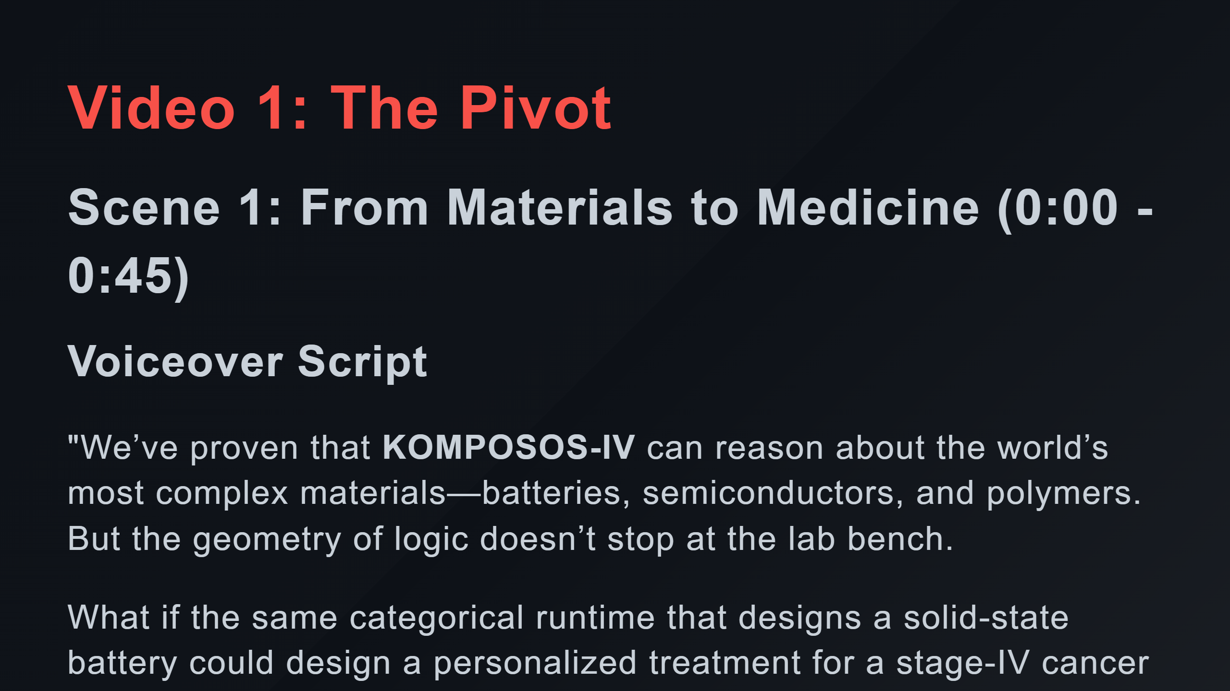

Slide 2
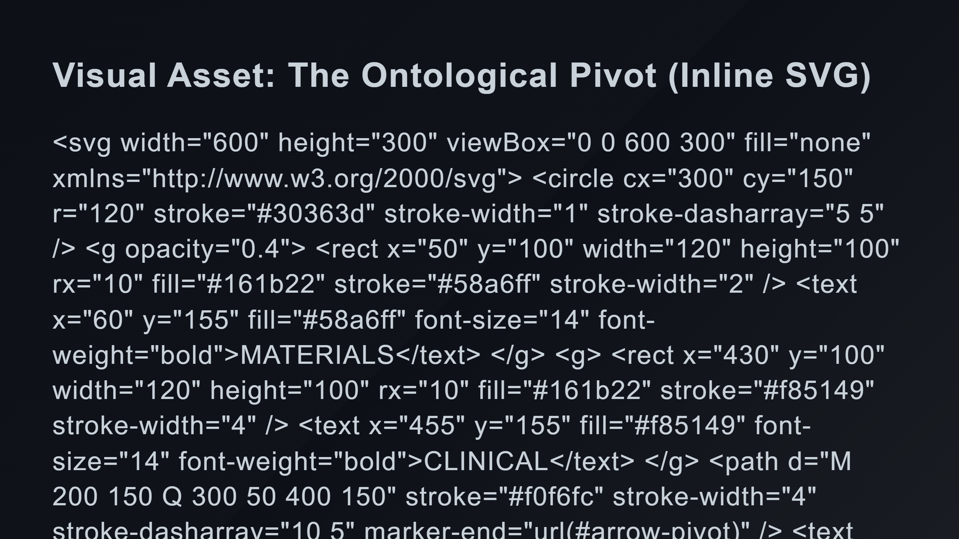
Notes:
Left Side: Materials (Ghosted/Transitioning) Right Side: Clinical (Active/Bright) The Pivot Arrow Central Symbol

Slide 3
