Slide 1
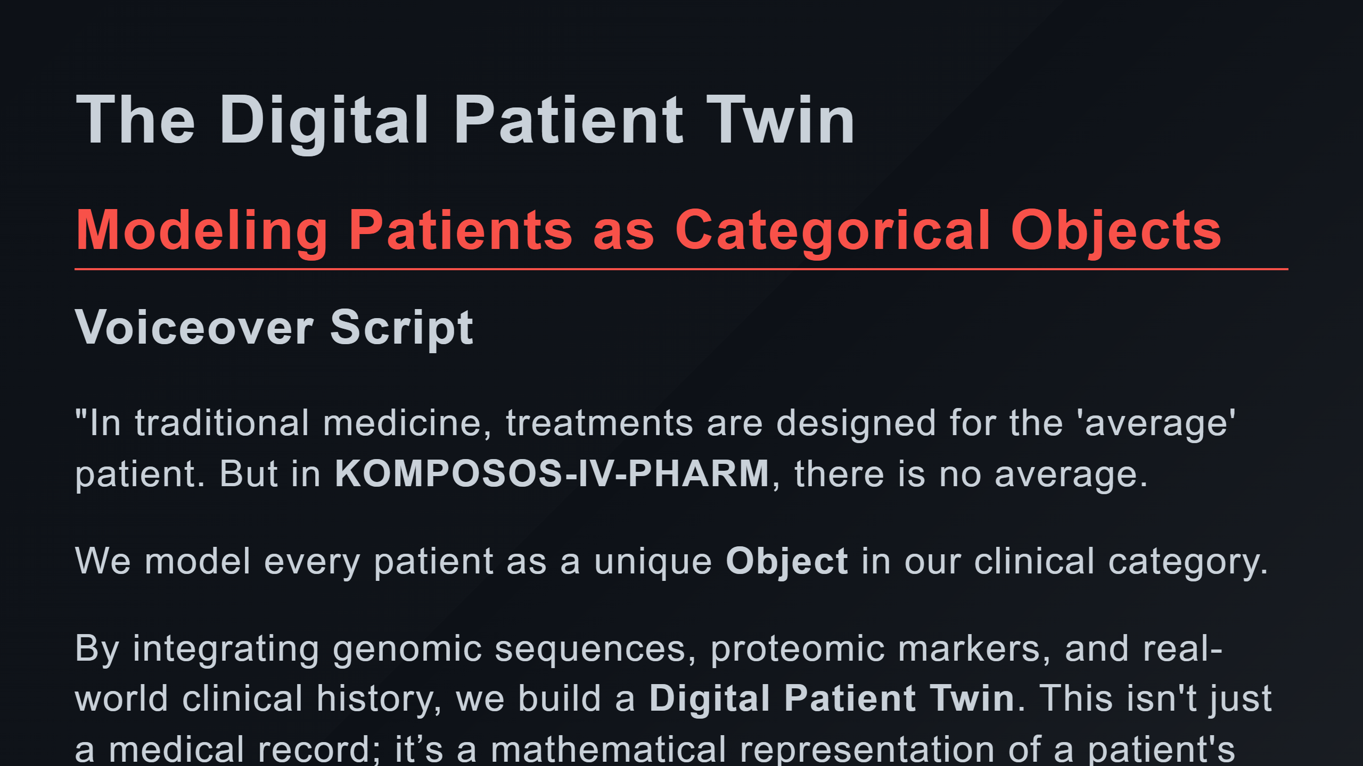

Slide 2
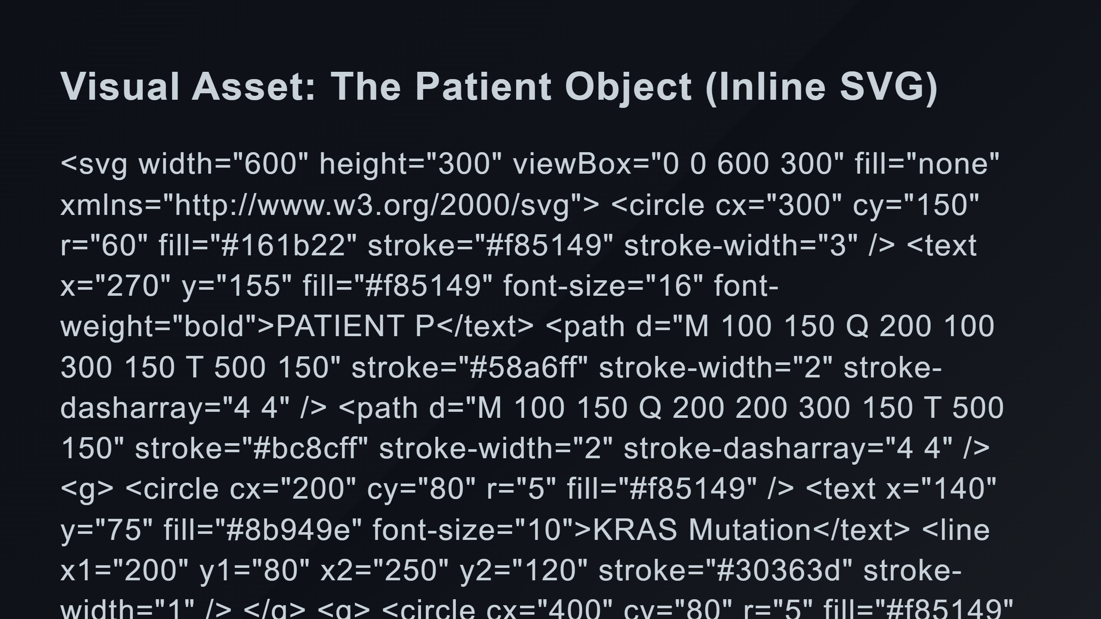
Notes:
Data Strands (DNA-like) Specific Markers

Slide 3
