Slide 1
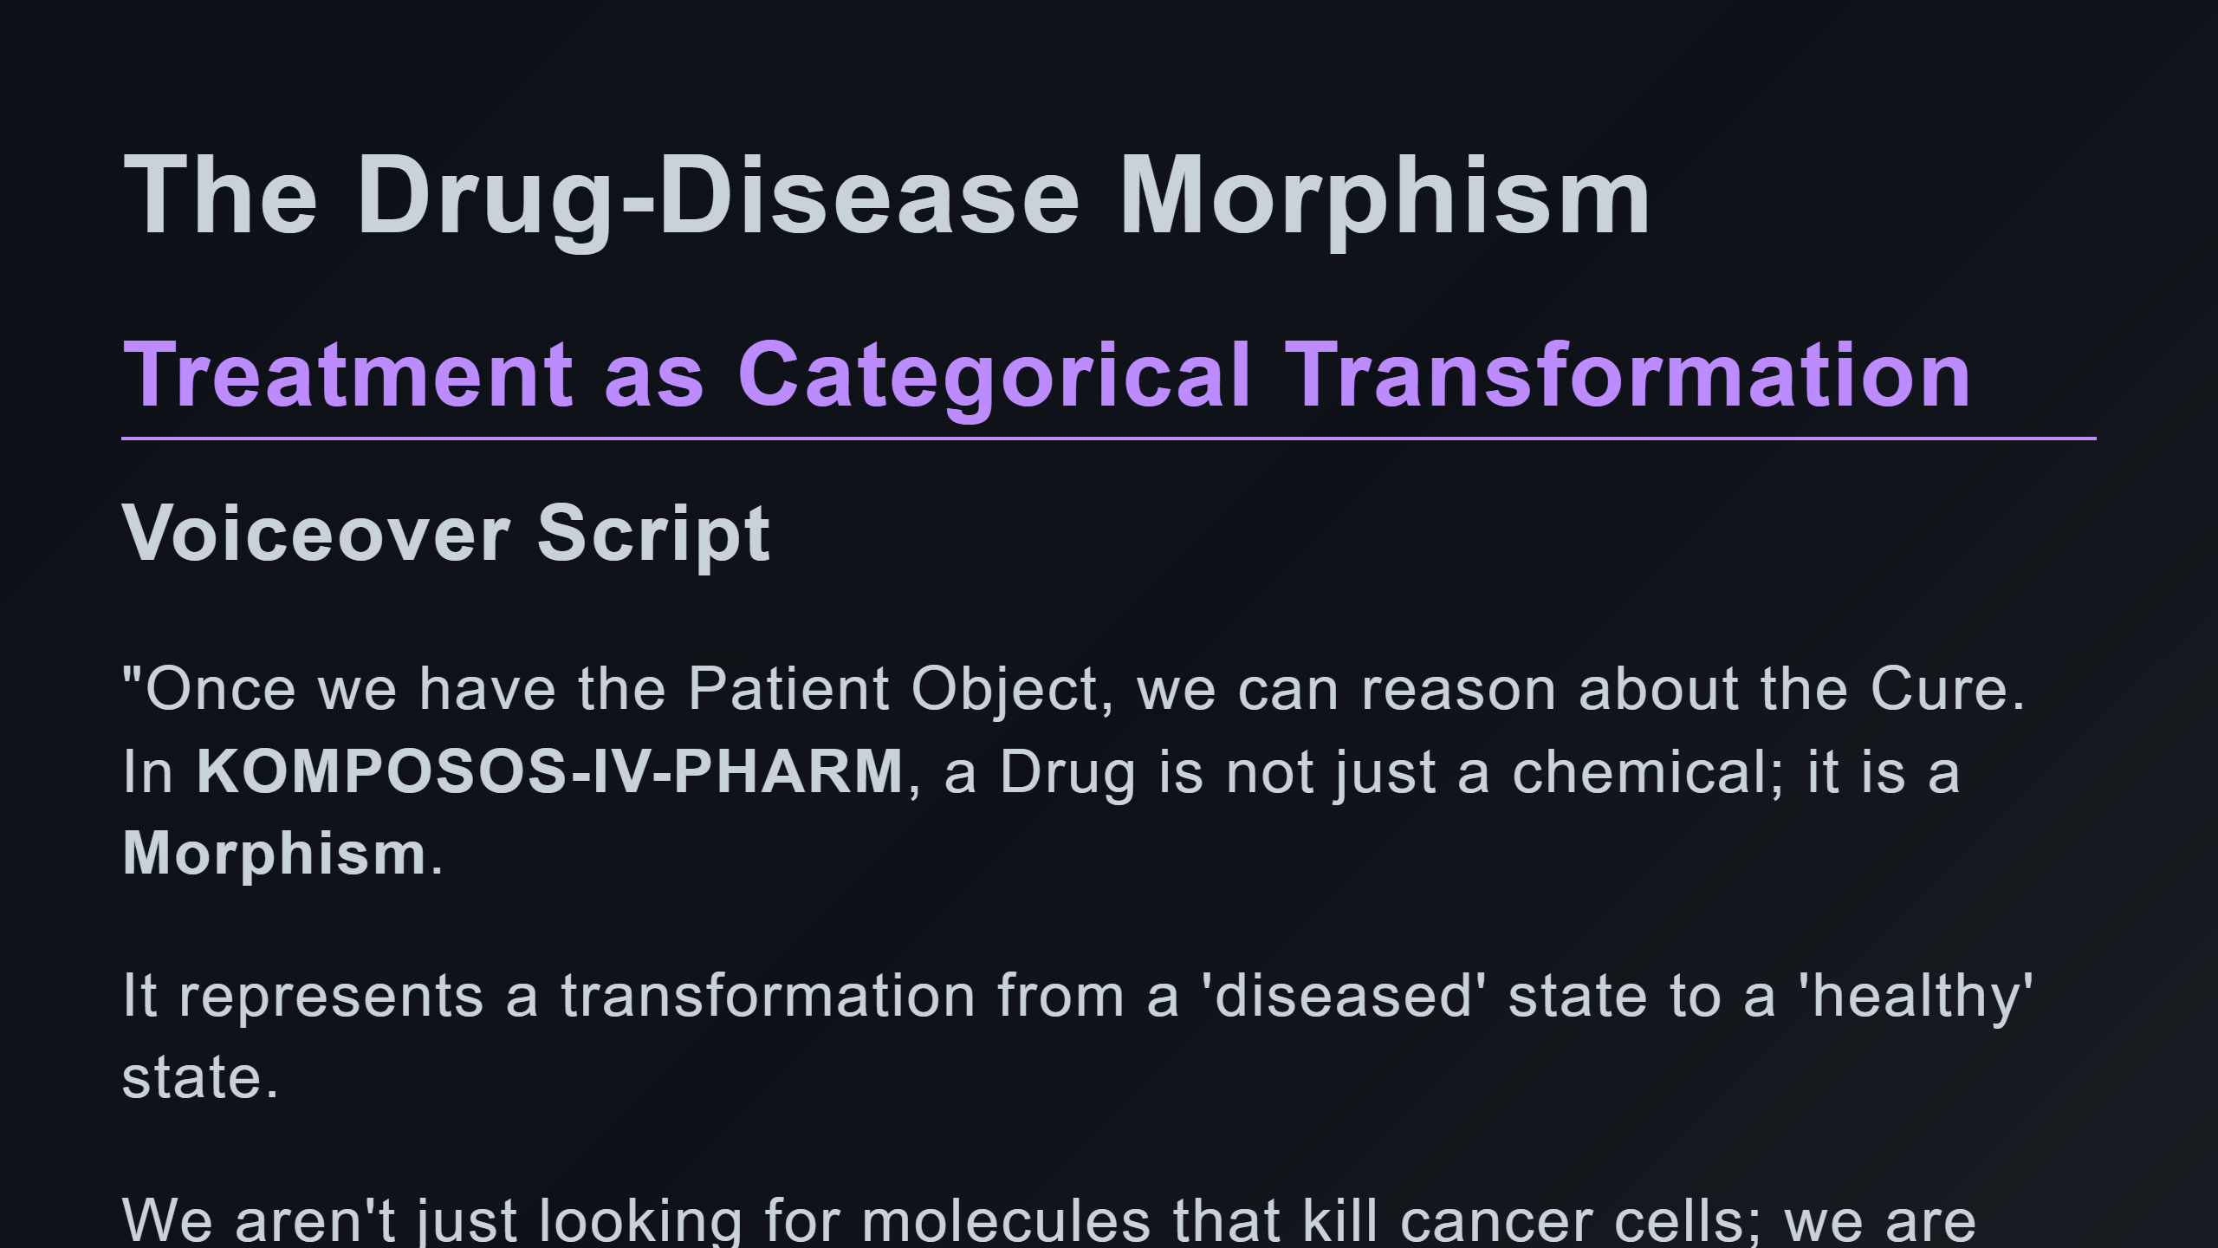

Slide 2
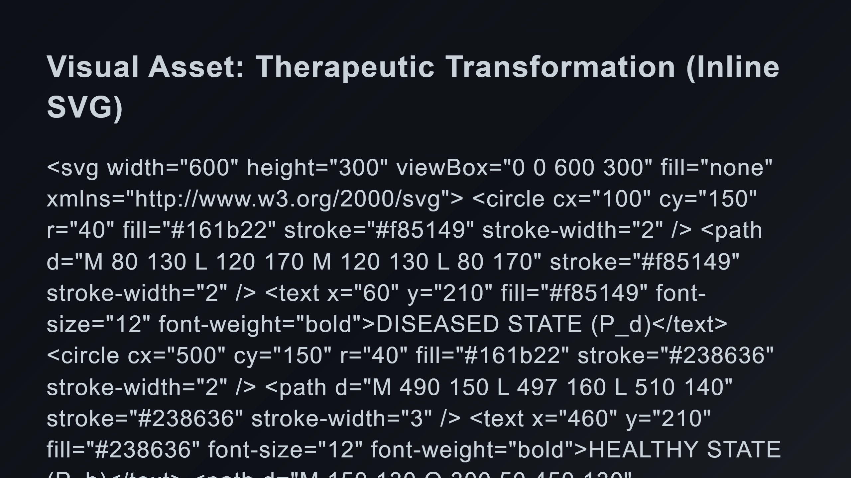
Notes:
Healthy State Drug Morphism f Combination Path (Drug A -> Intermediate -> Drug B)

Slide 3
