Slide 1
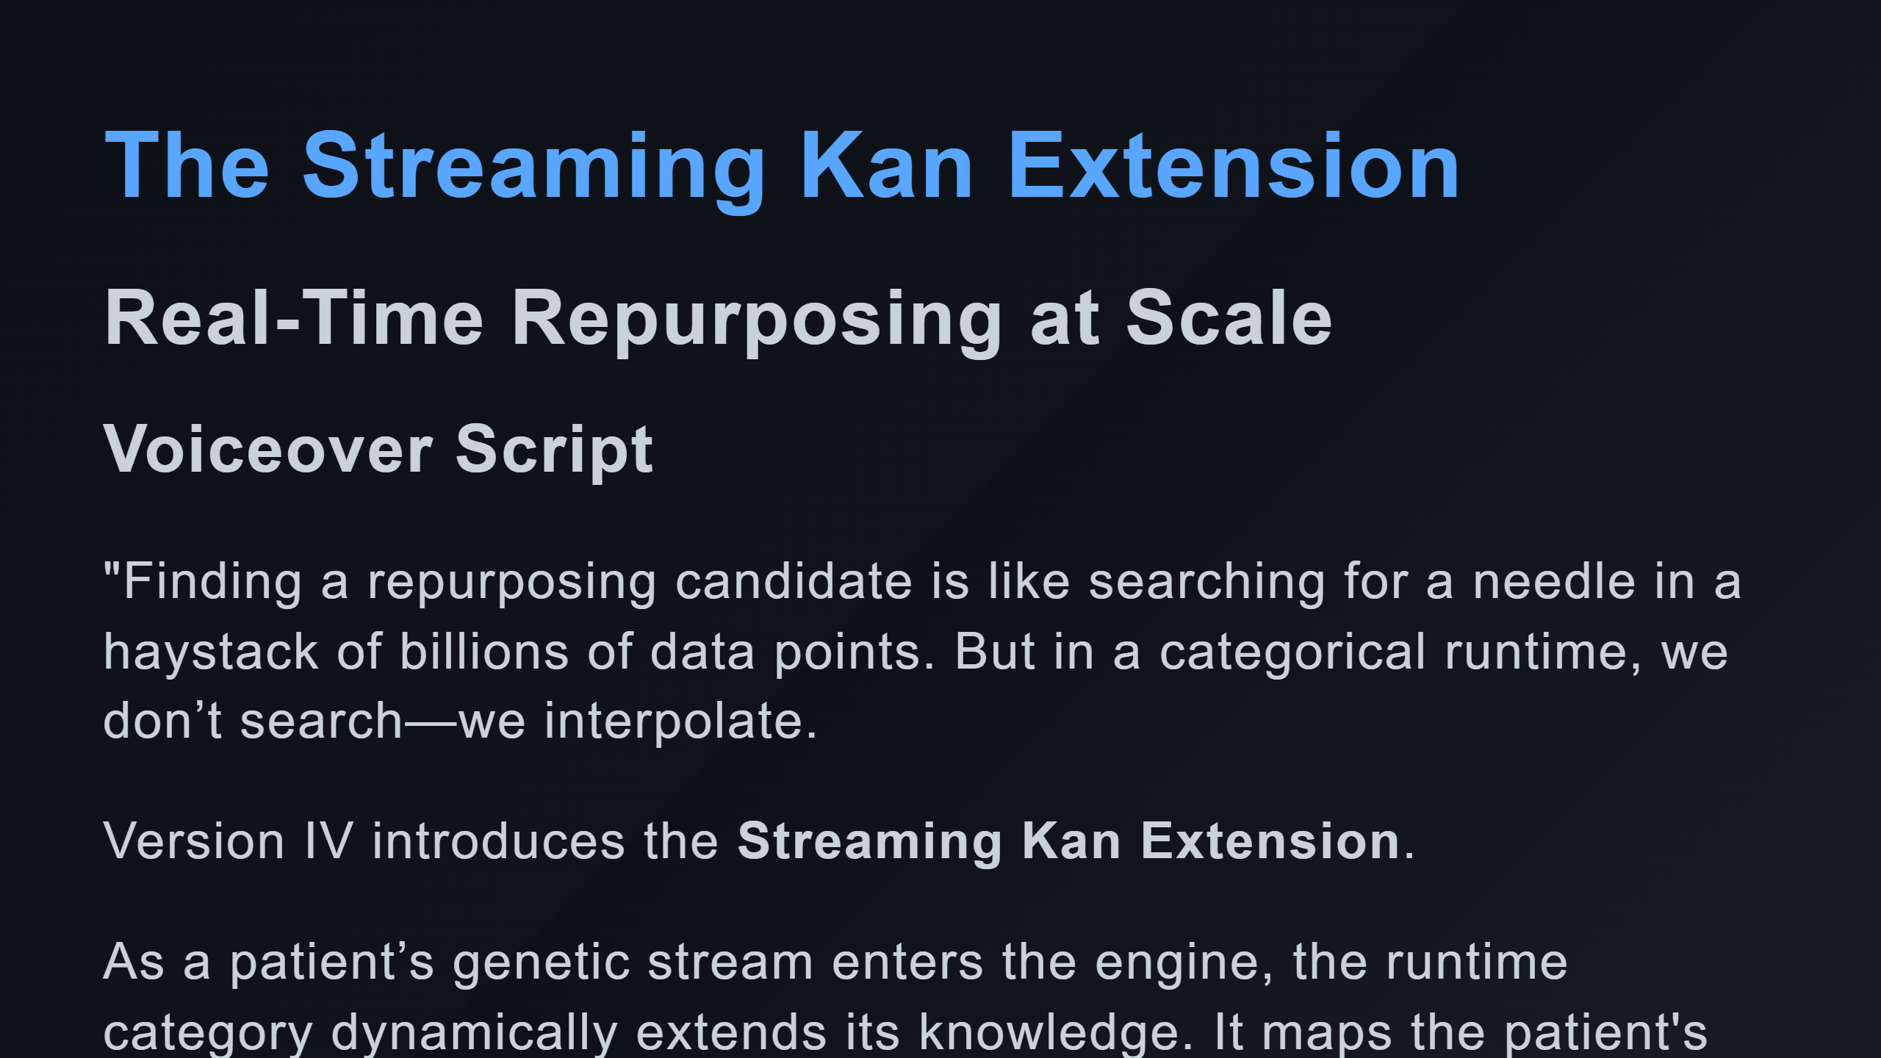

Slide 2
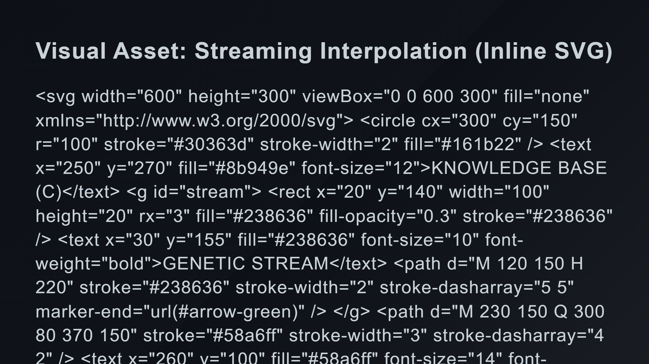
Notes:
Incoming Stream Kan Extension Mapping Discovered Candidate Animation Elements (Simulated)

Slide 3
