Slide 1
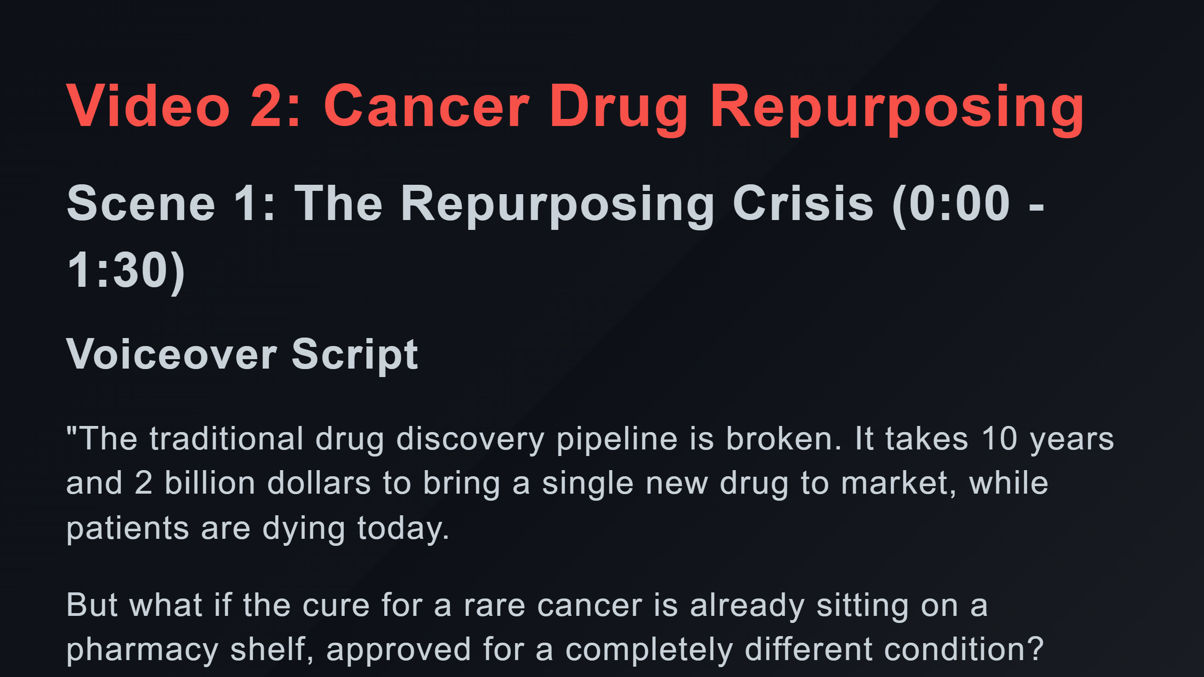

Slide 2
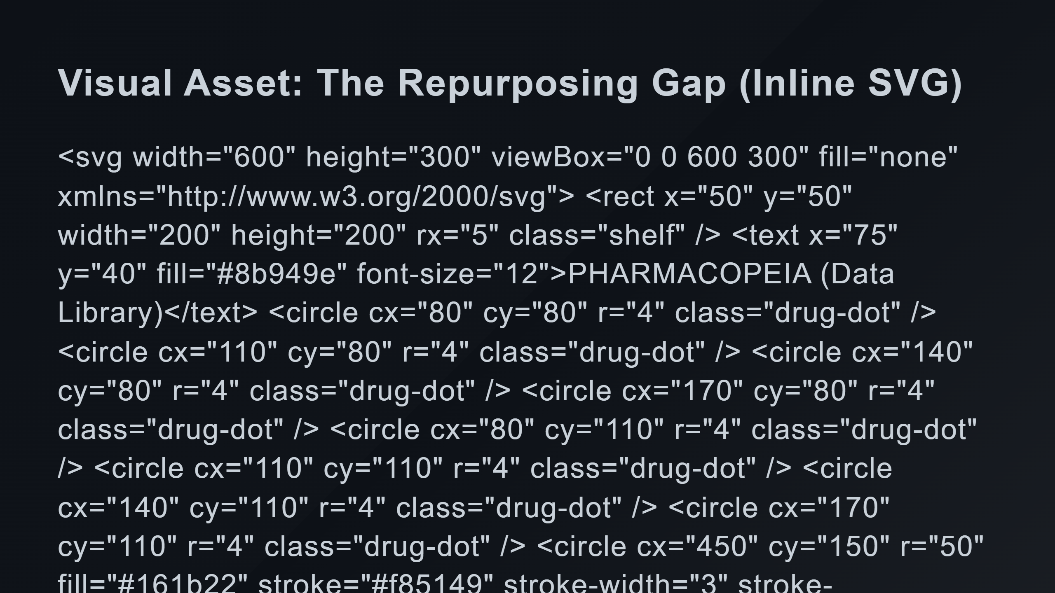
Notes:
Drug Dots (Grid) Unsolved Patient The Gap (Disconnected paths) The Hidden Morphism (Activating)

Slide 3
