Slide 1
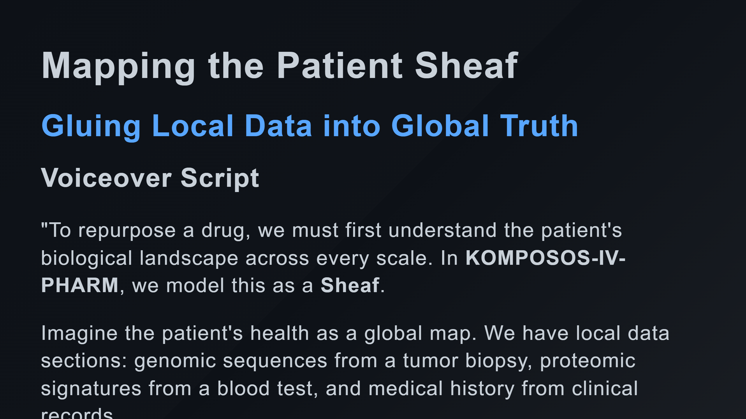

Slide 2
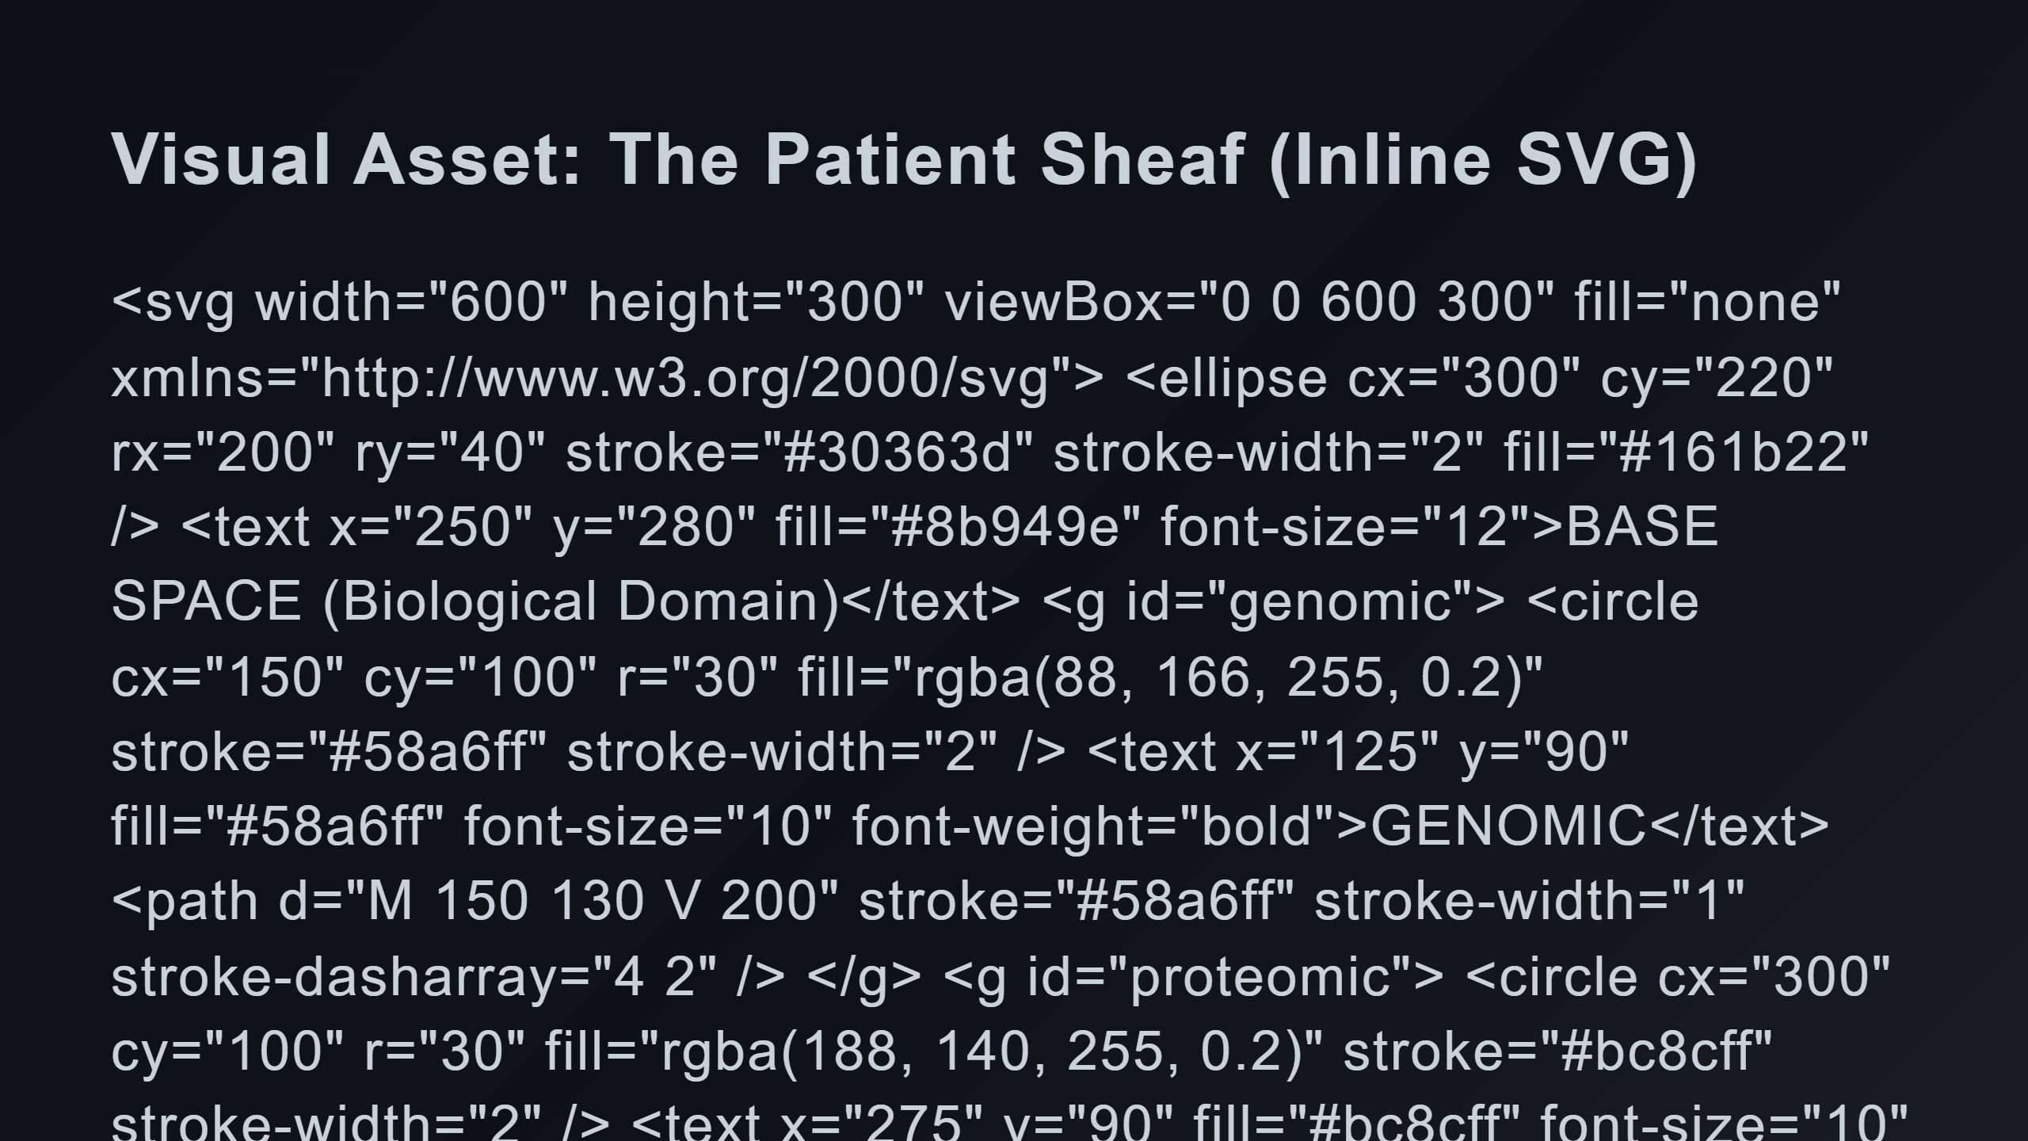
Notes:
Local Sections (Genomic, Proteomic, Clinical) Gluing/Coherence Arrows

Slide 3
