Slide 1
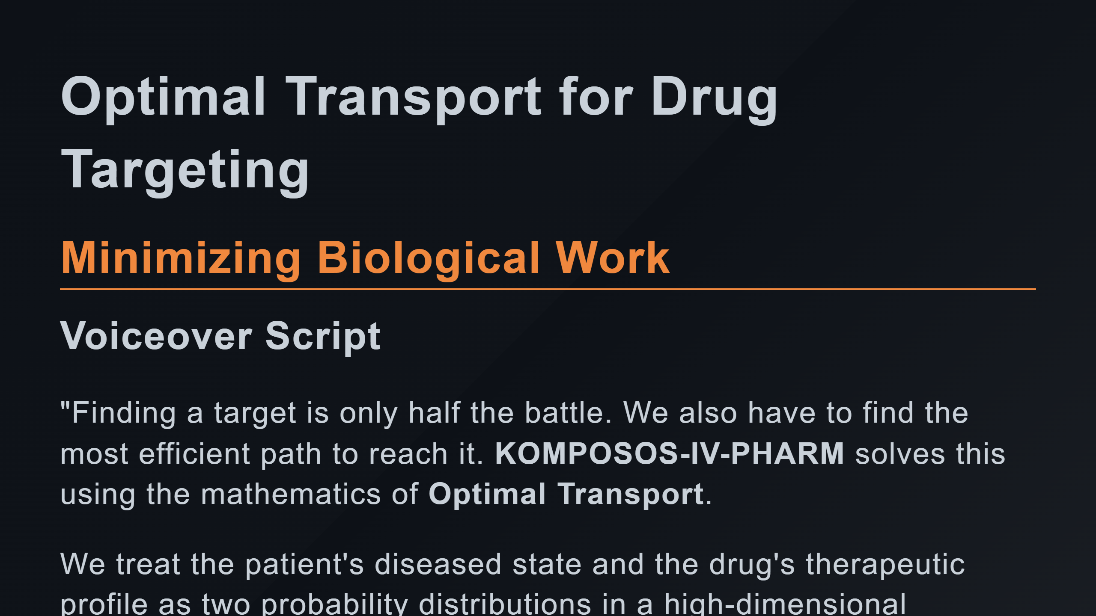

Slide 2
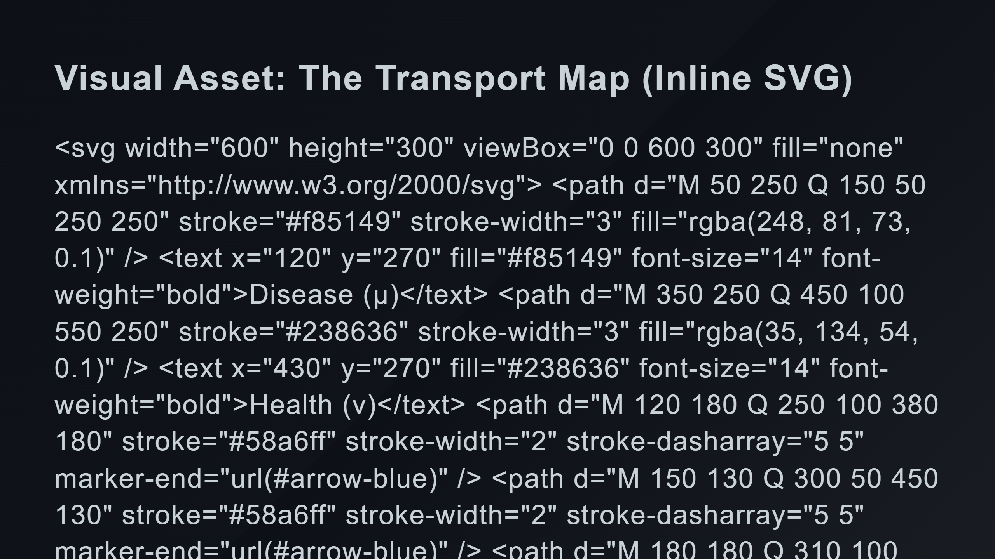
Notes:
Distribution 2: Health (Nu) Transport Map (Arrows)

Slide 3
