Slide 1
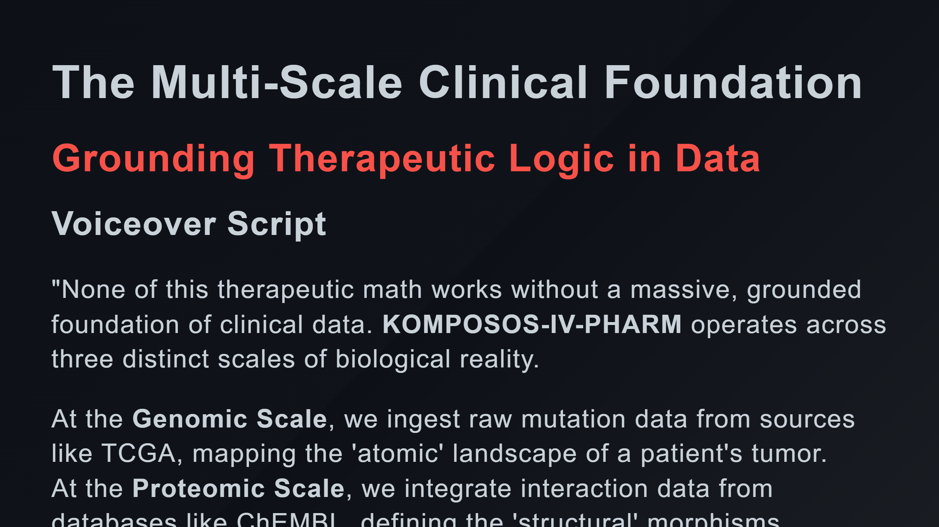

Slide 2
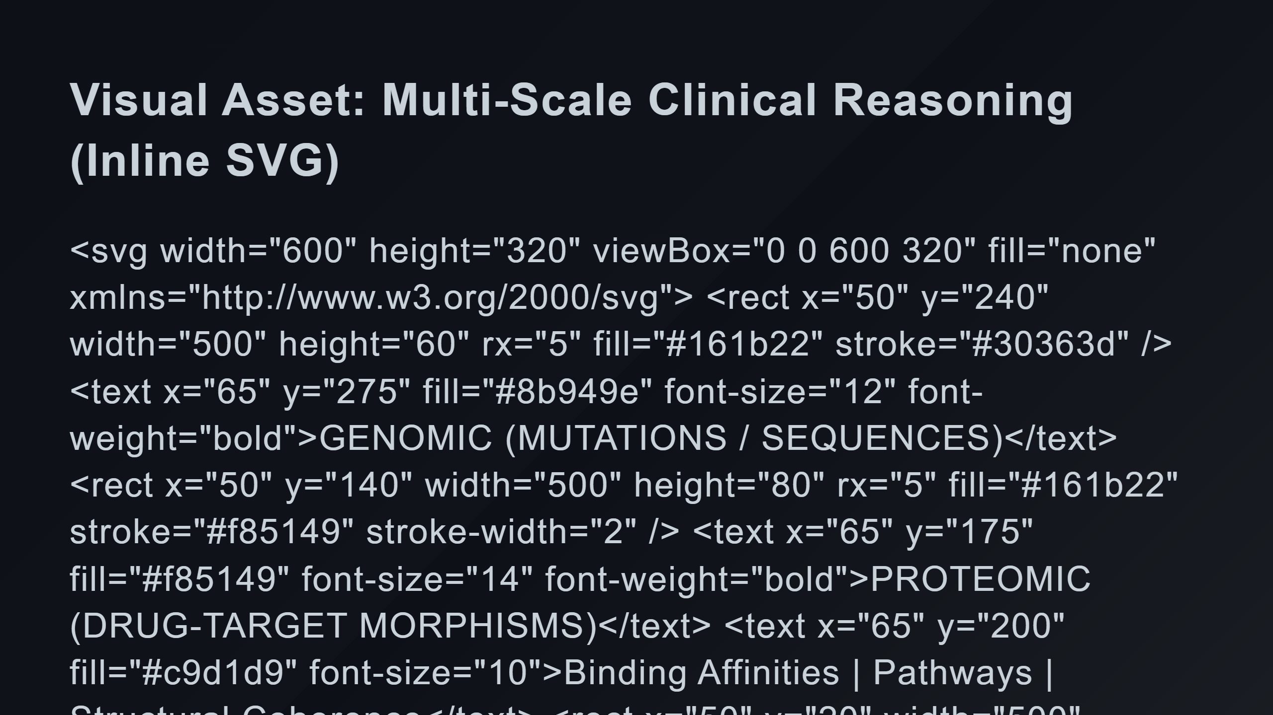
Notes:
Scale 2: Proteomic Scale 3: Clinical Relationships

Slide 3
