Slide 1
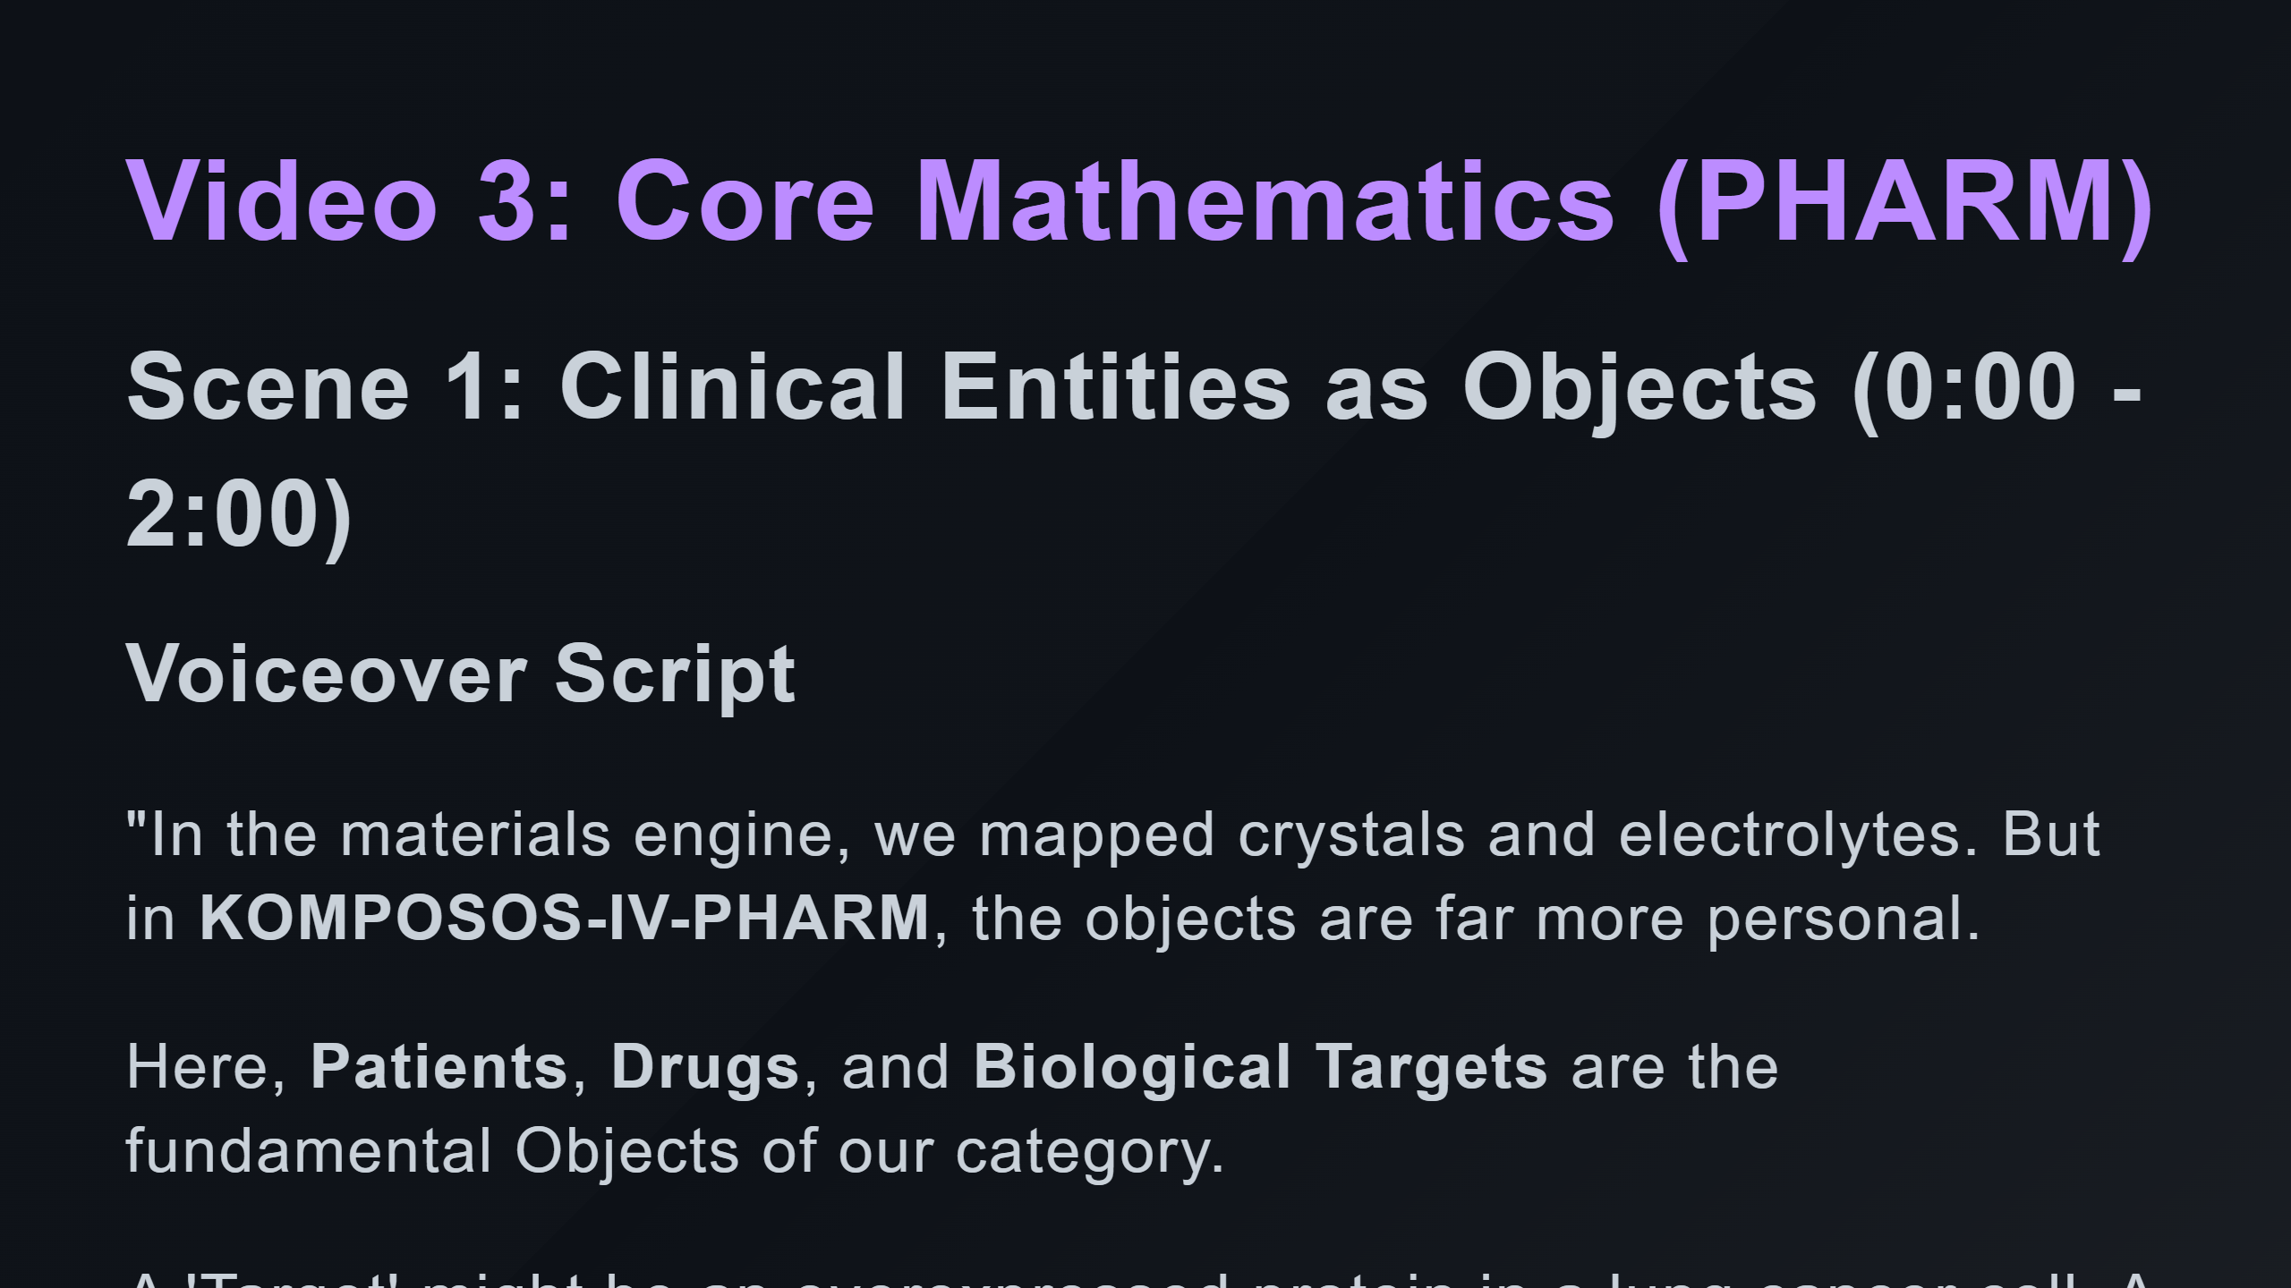

Slide 2
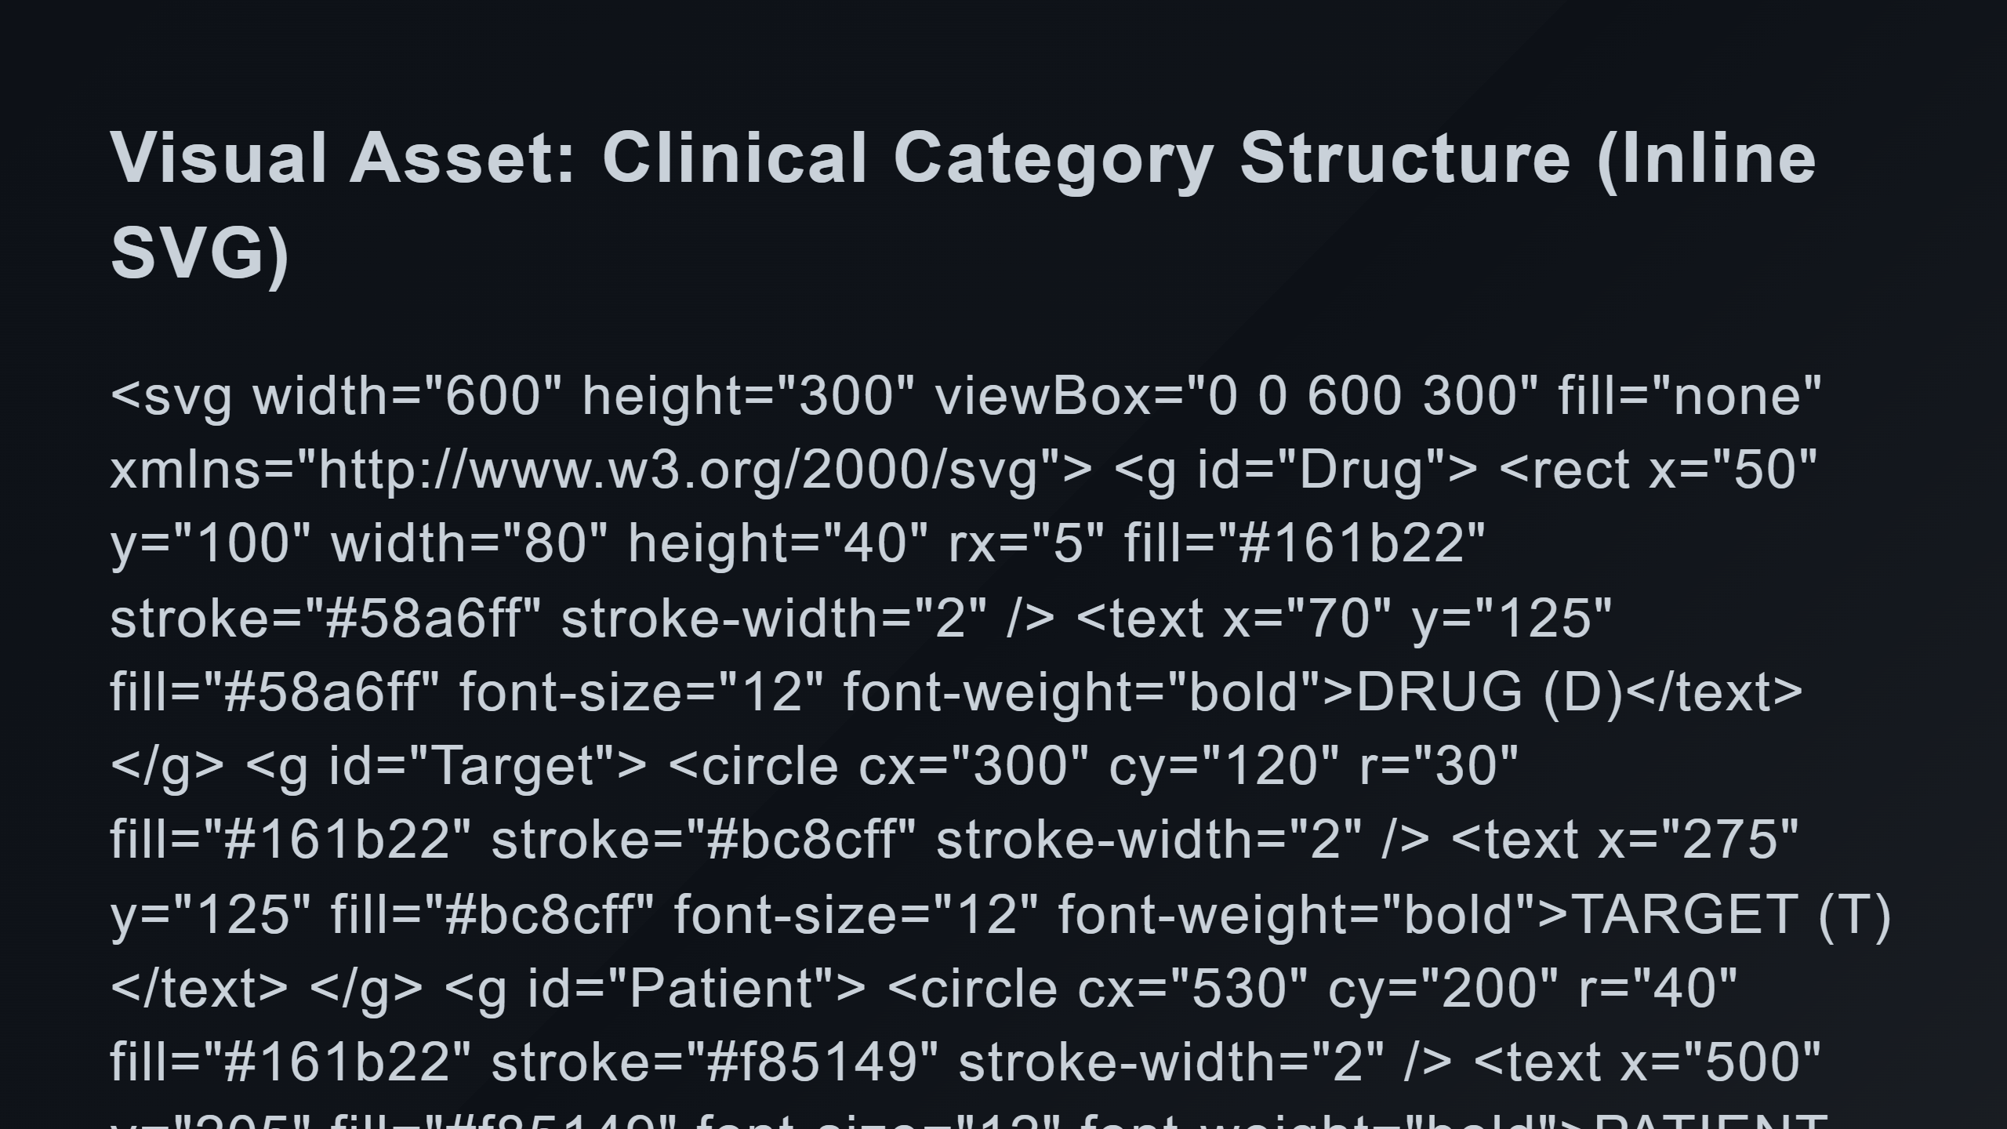
Notes:
Morphism f: Binding Morphism g: Efficacy Composition g ∘ f: Predicted Outcome

Slide 3
