Slide 1
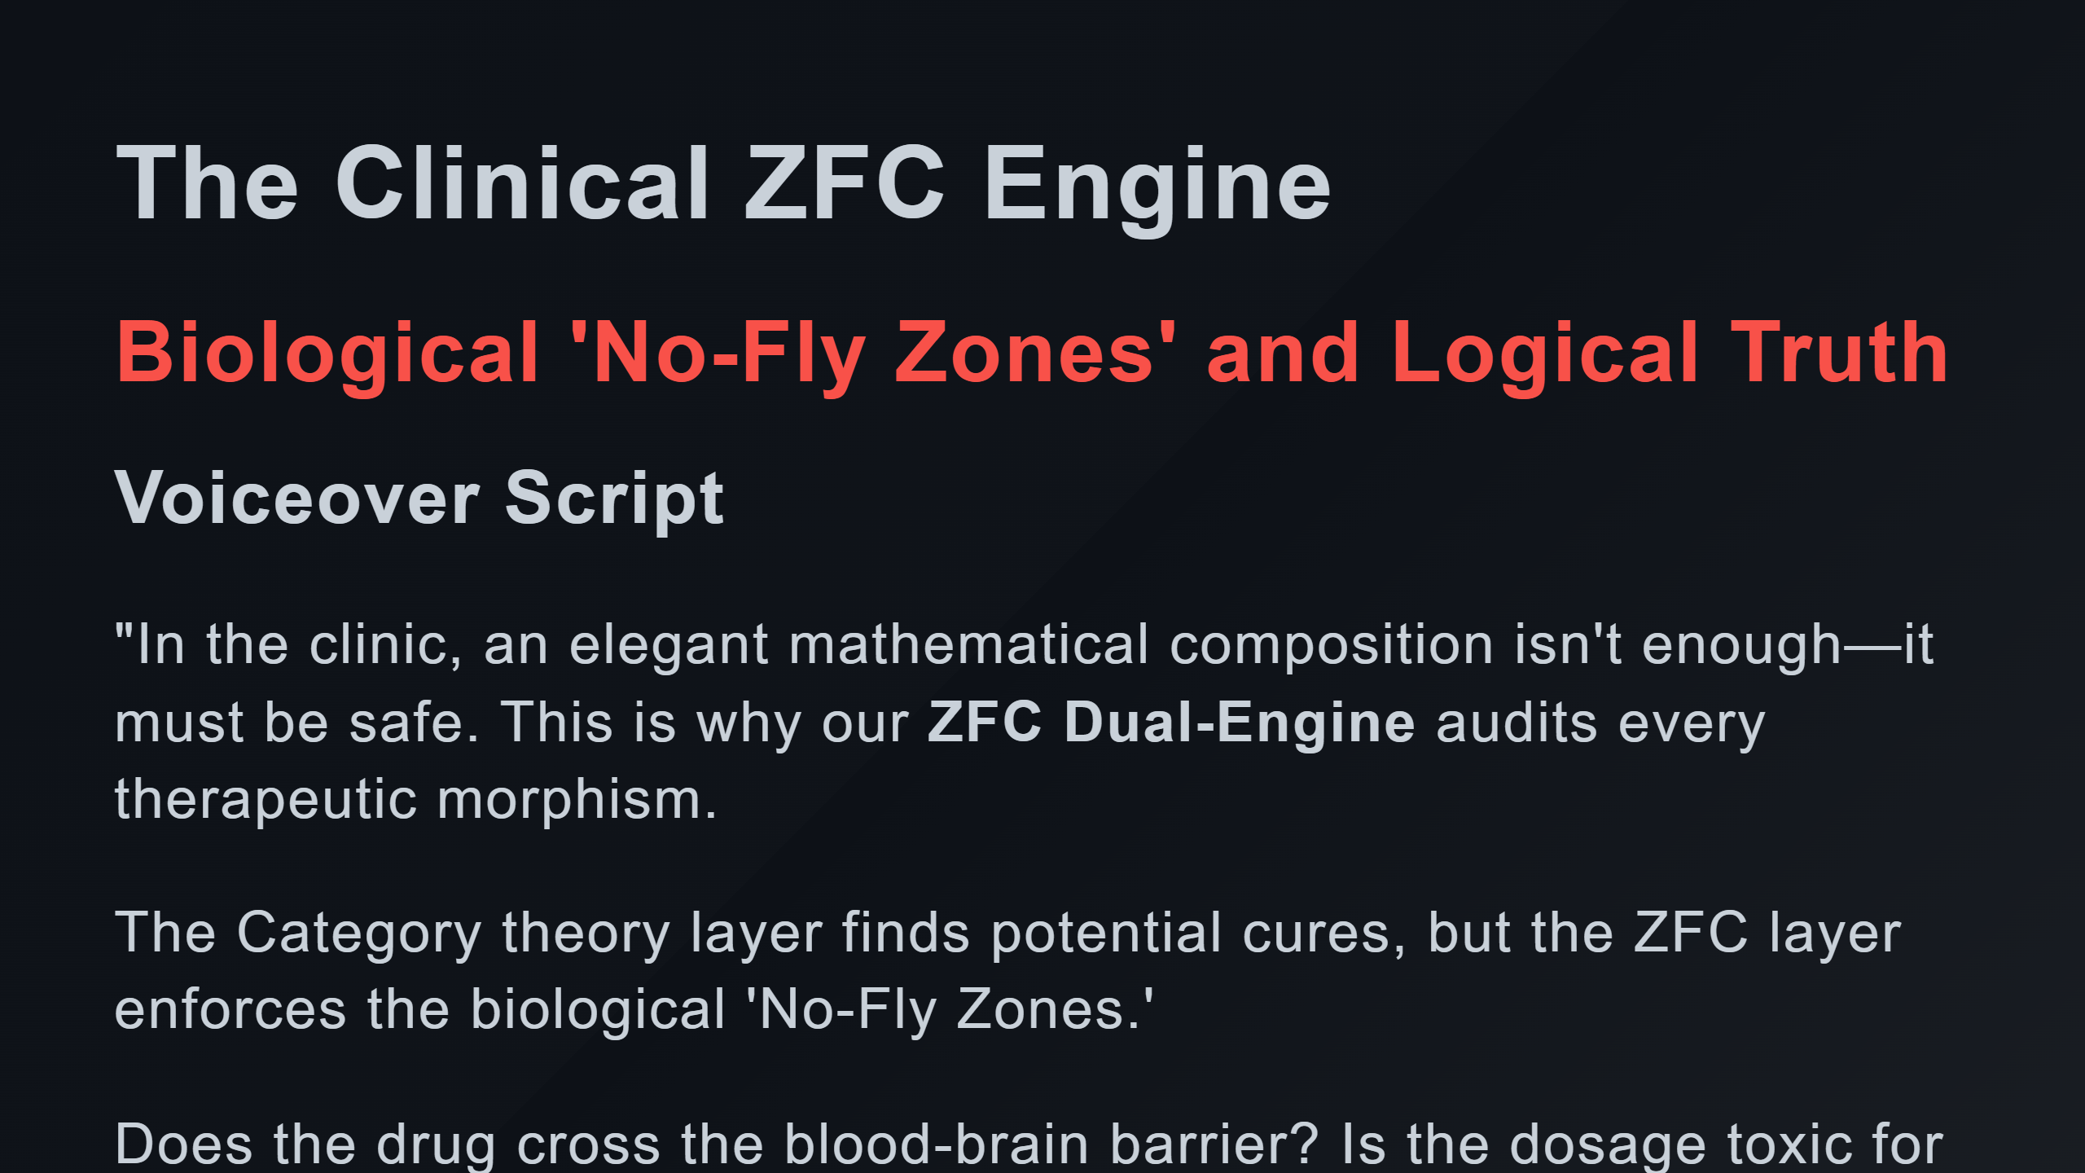

Slide 2
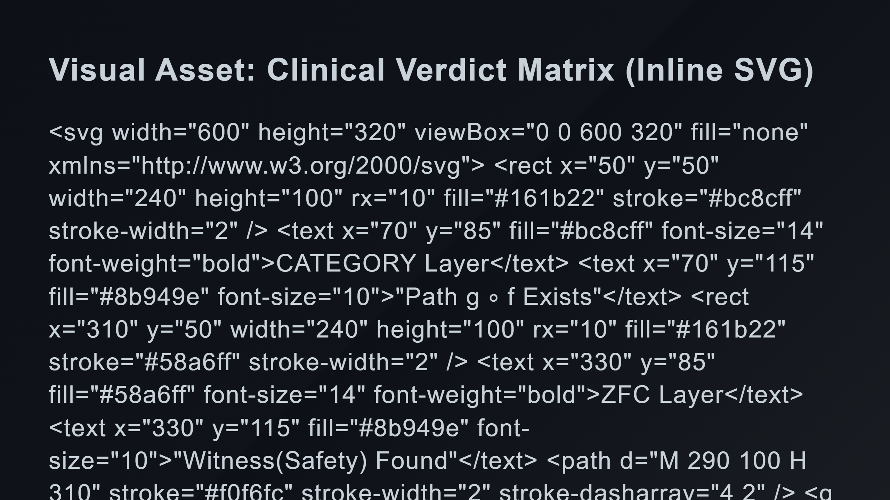
Notes:
Connection / Comparison The Veto (Hollow State)

Slide 3
