Slide 1
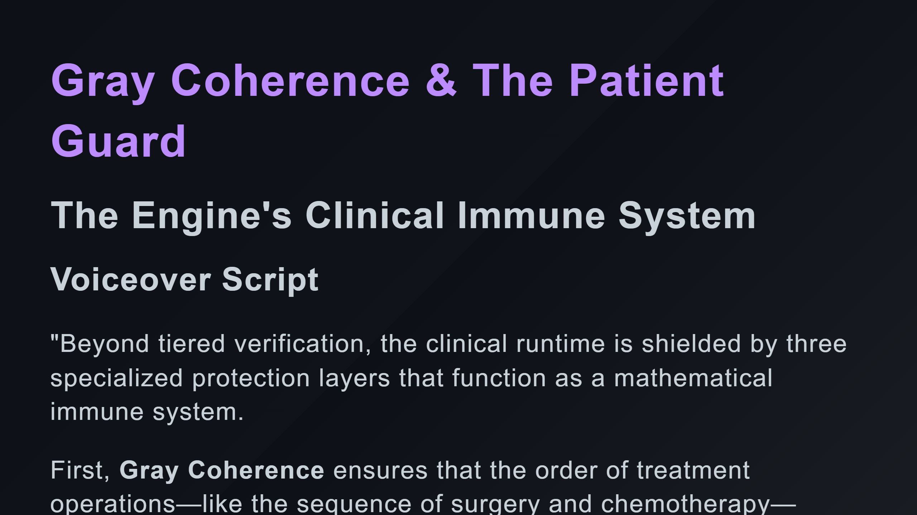

Slide 2
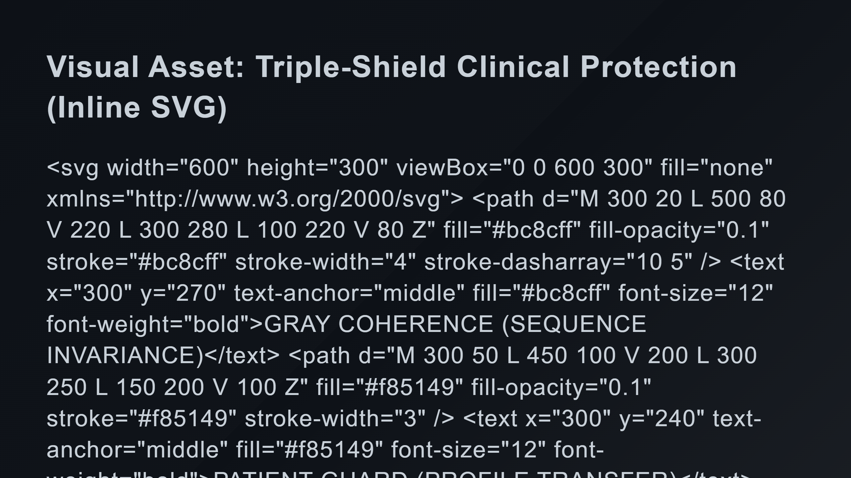
Notes:
Middle Shield: Patient Guard Inner Core: Failure Memory Clinical Data Flow

Slide 3
