Slide 1


Slide 2
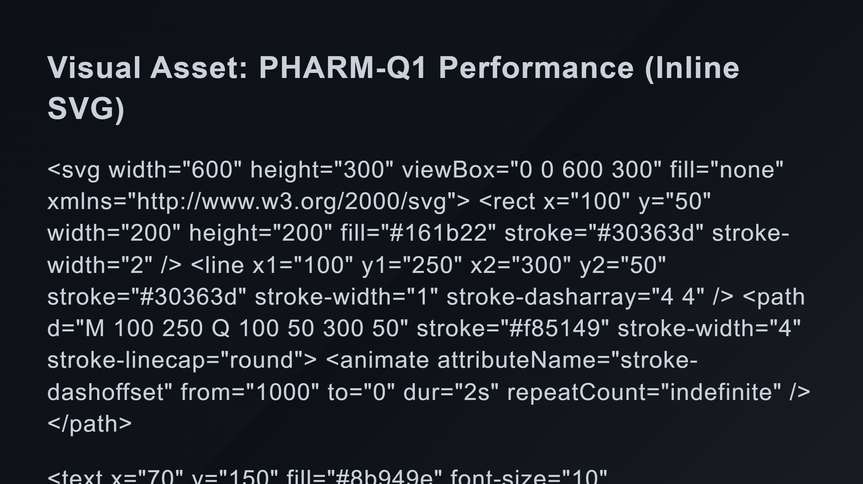
Notes:
The Curve (High AUROC) Axis Labels Big Numbers Status Badge

Slide 3
