Slide 1
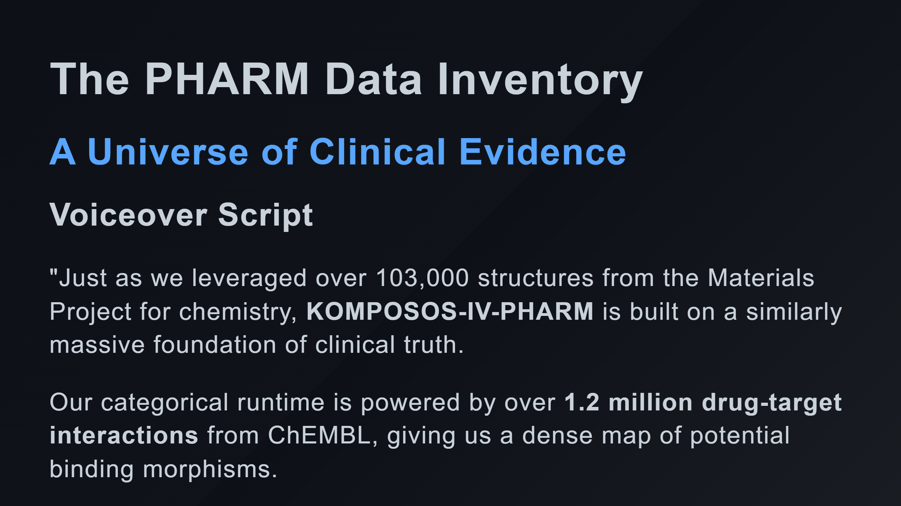

Slide 2
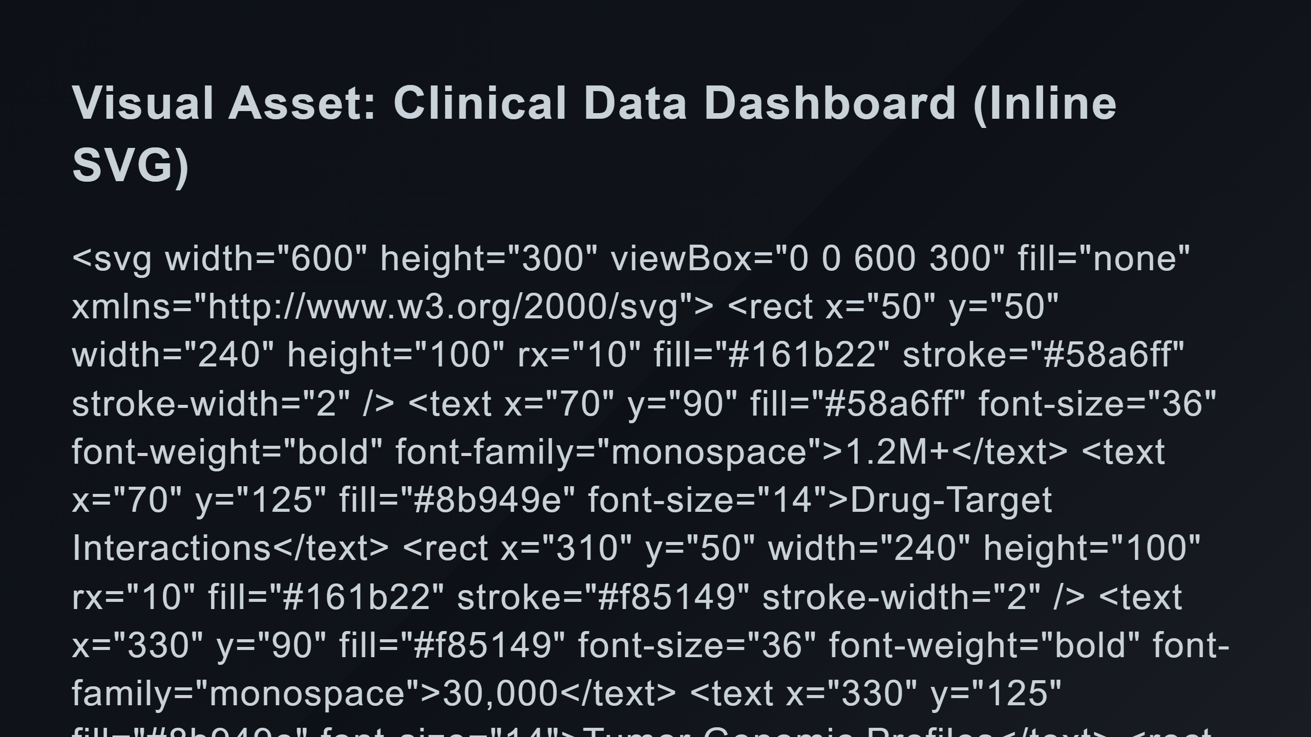
Notes:
Genomic Block Small Blocks

Slide 3
