Slide 1
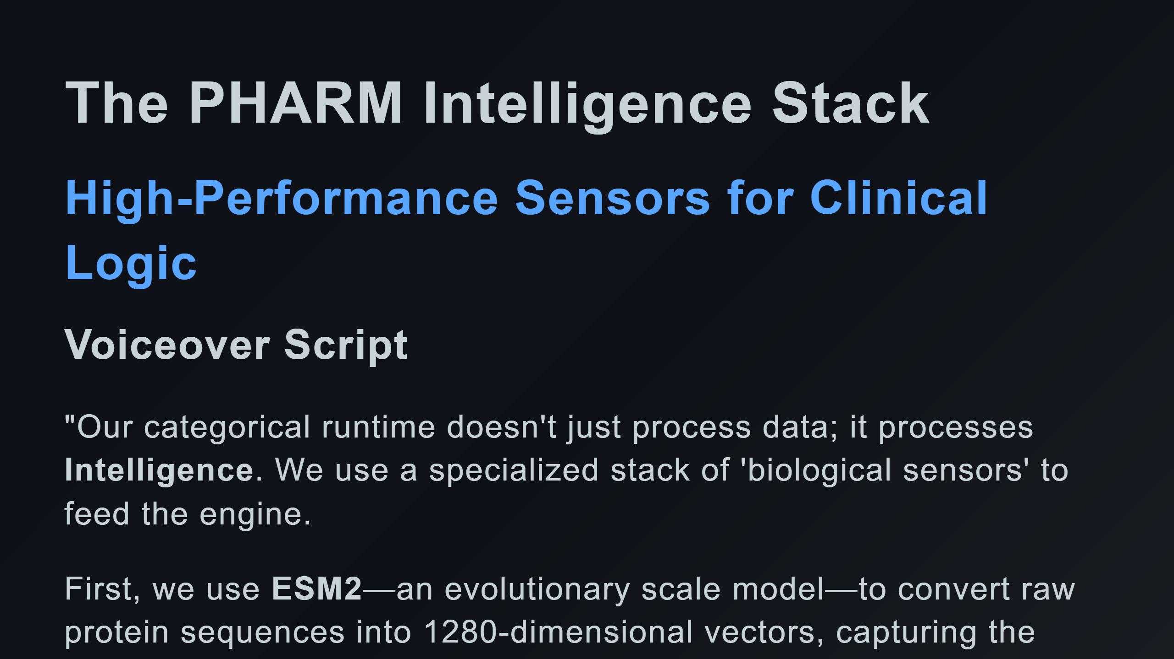

Slide 2
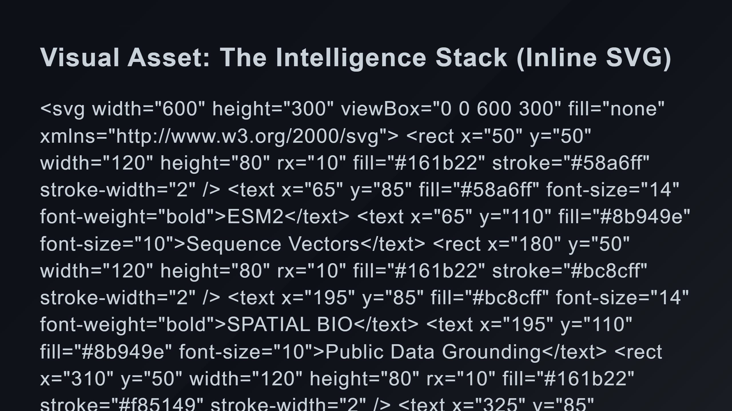
Notes:
Sensor 2: Spatial Bio (Formerly labeled Noetik) Sensor 3: ChEMBL Sensor 4: Boltz2 Unified Out

Slide 3
