Slide 1
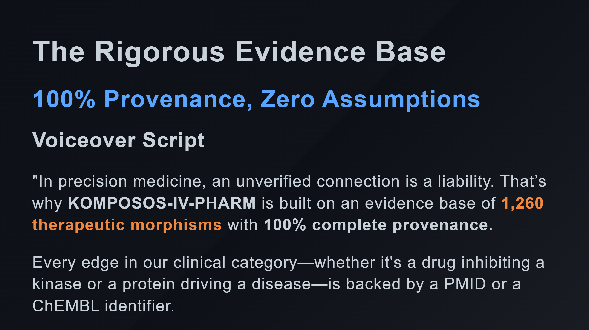

Slide 2
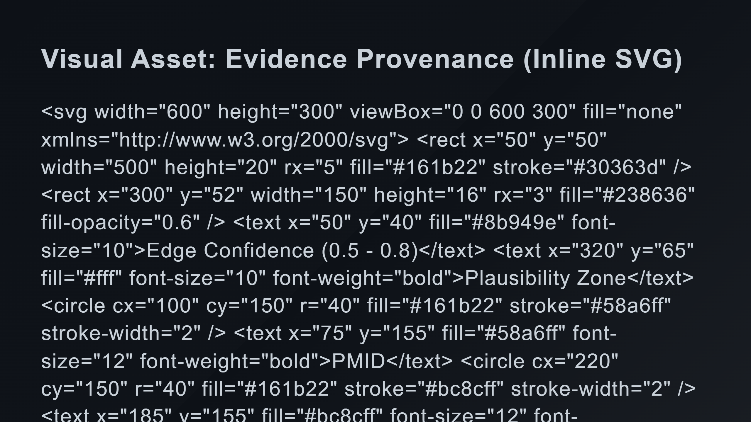
Notes:
Provenance Bubbles Total Count Inter-scale connections

Slide 3
