Slide 1
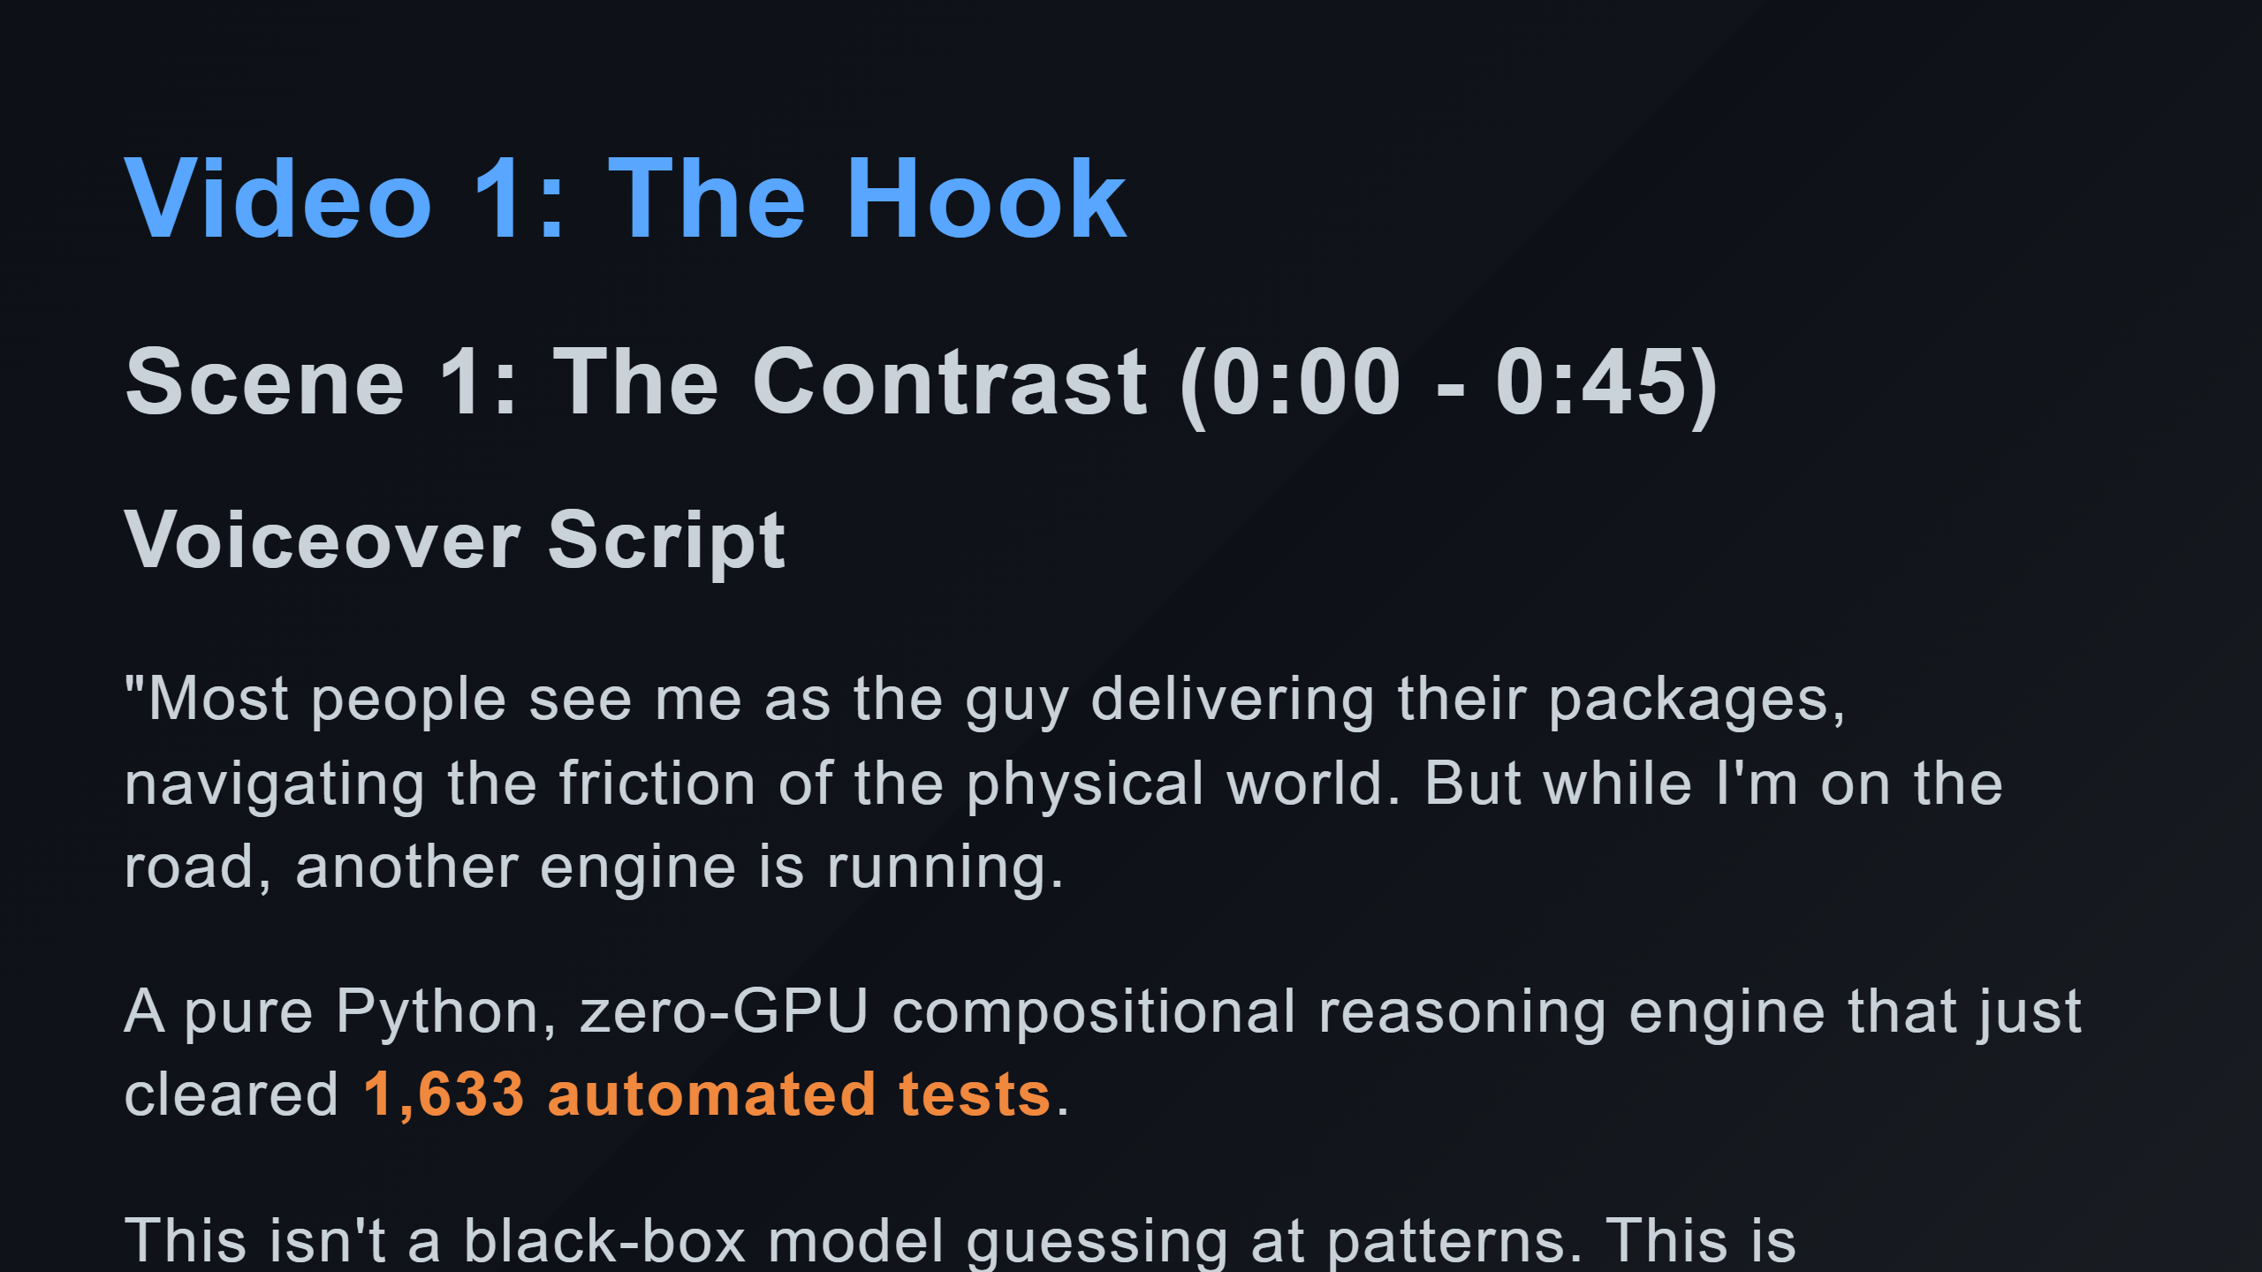

Slide 2
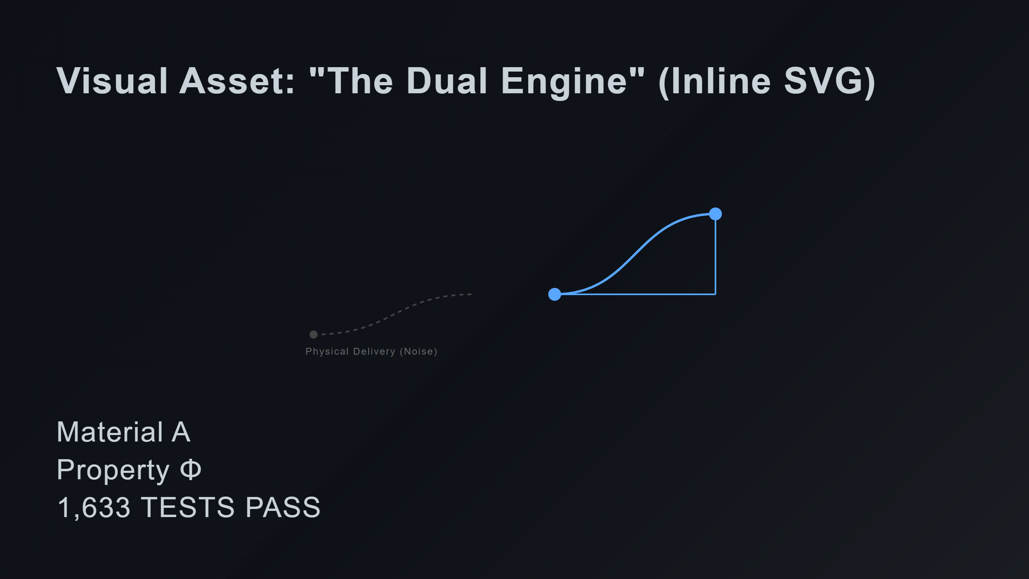
Notes:
Categorical Path (Engine) Commutative Square Elements Definitions

Slide 3
