Slide 1
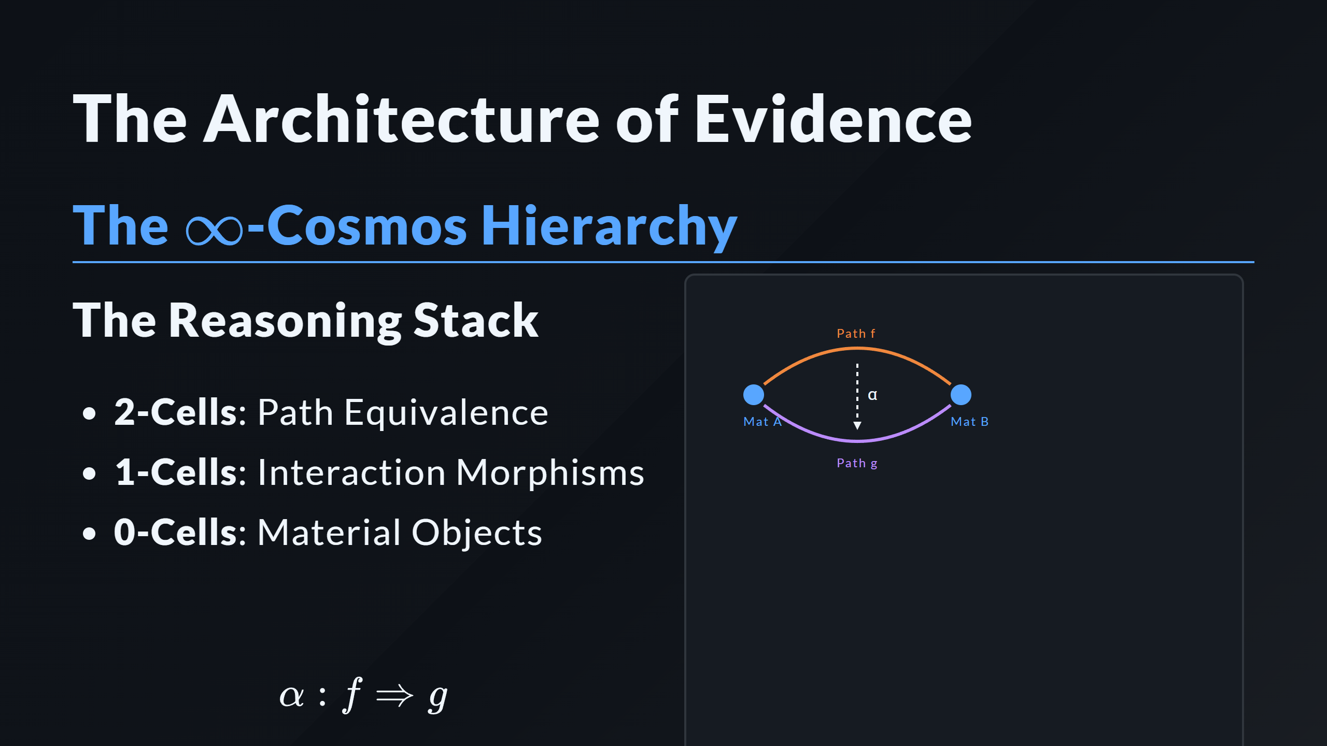
Notes:
INFINITY COSMOS SVG Path 1 Path 2 2-Cell Natural Transformation

