Slide 1


Slide 2
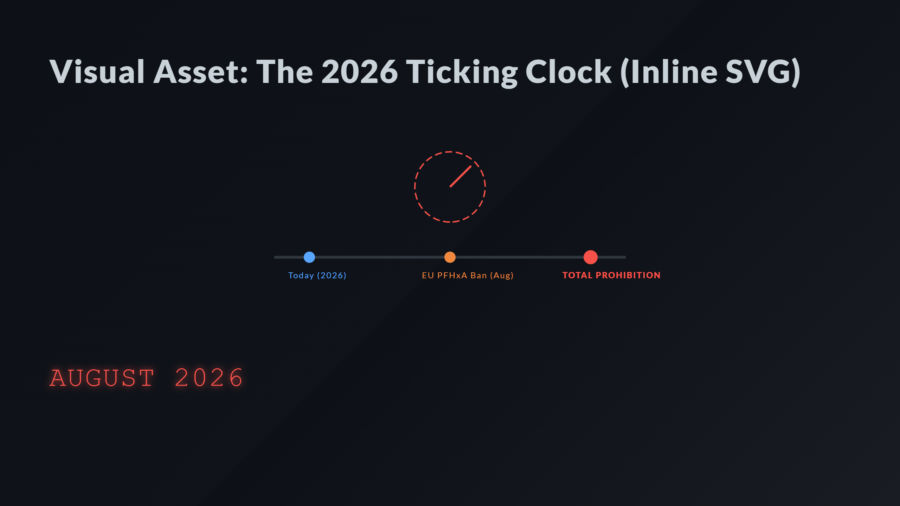
Notes:
Milestones The Ticking Arc

Slide 3
