Slide 1
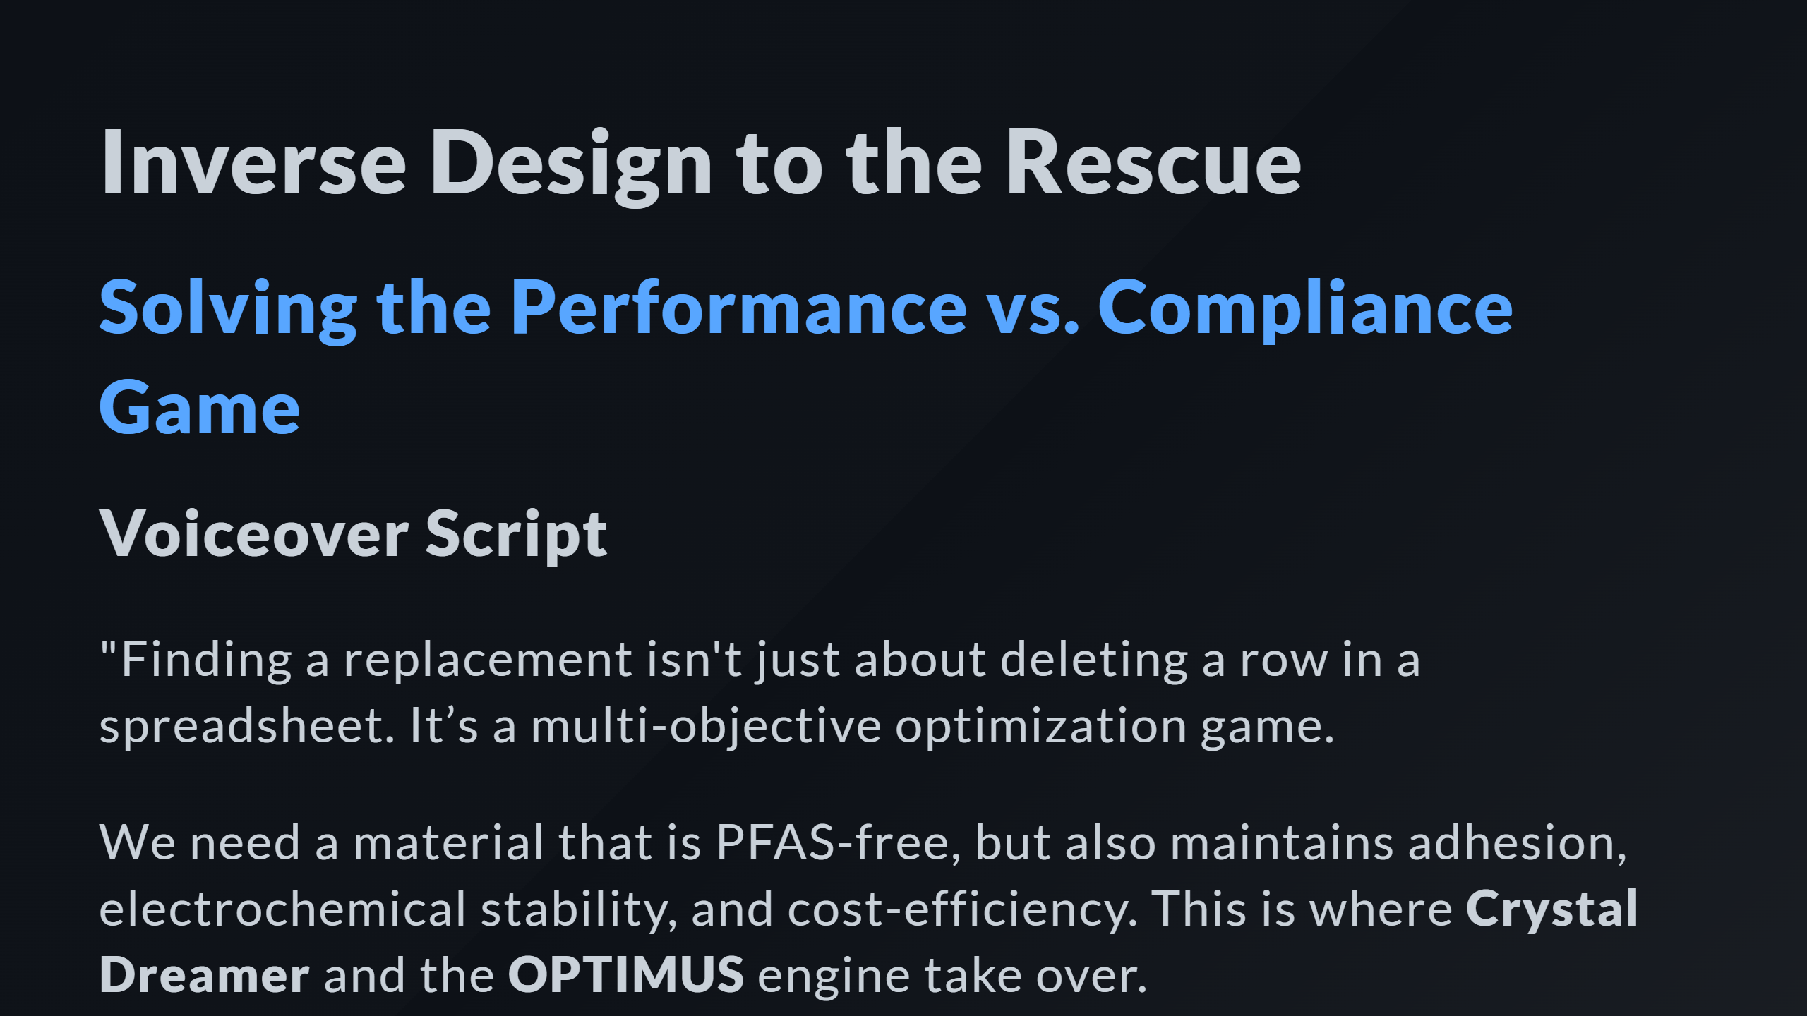

Slide 2
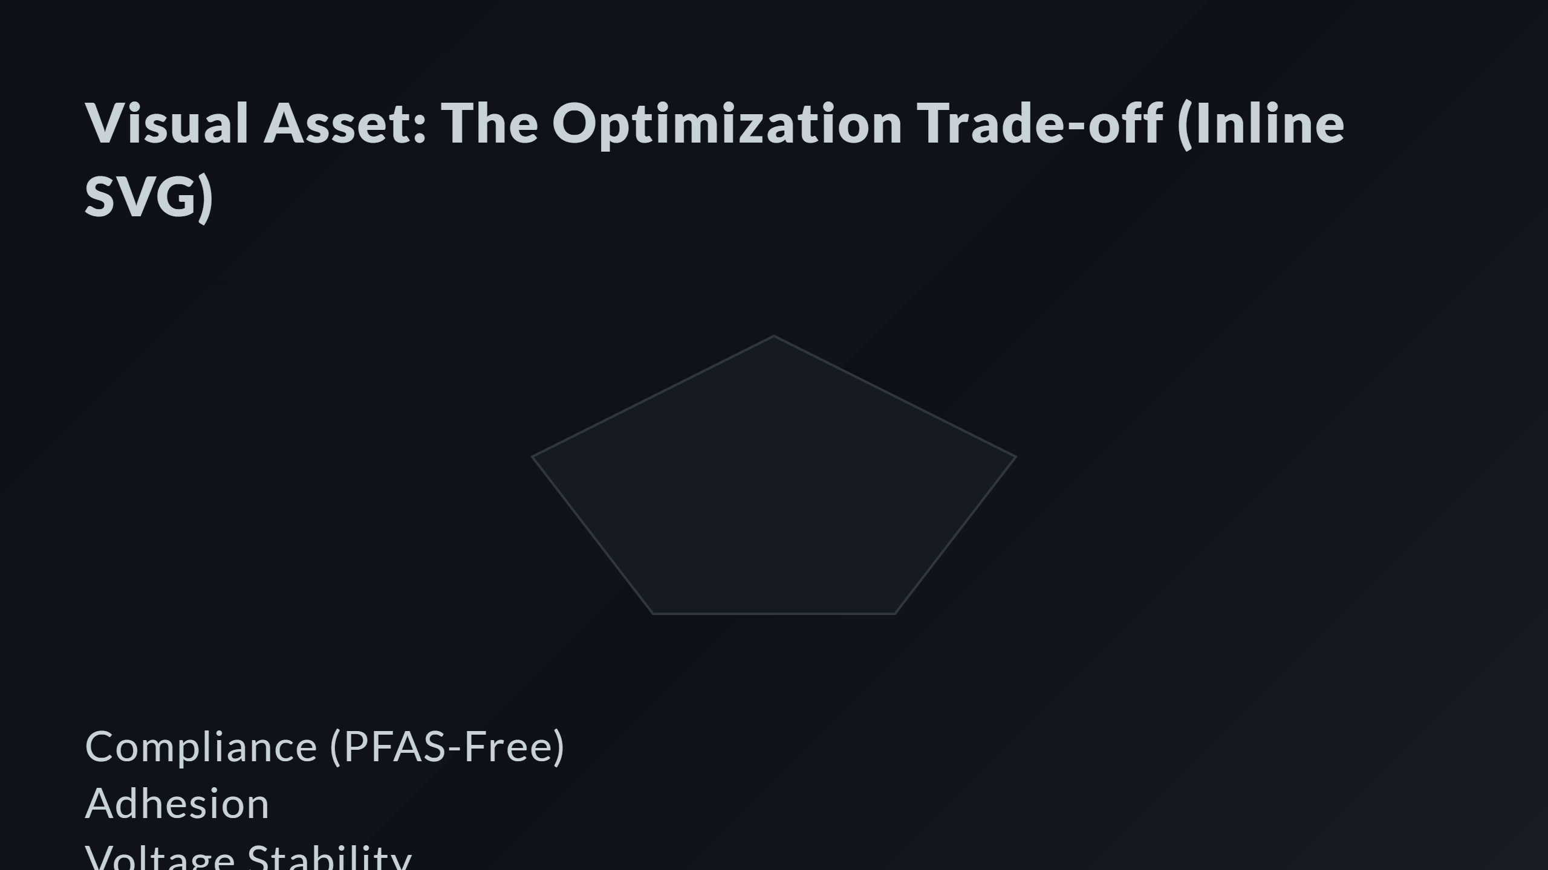
Notes:
Axis Labels PVDF Profile (Banned) CMC+SBR Profile (Selected) Optimization Marker

Slide 3
