Slide 1
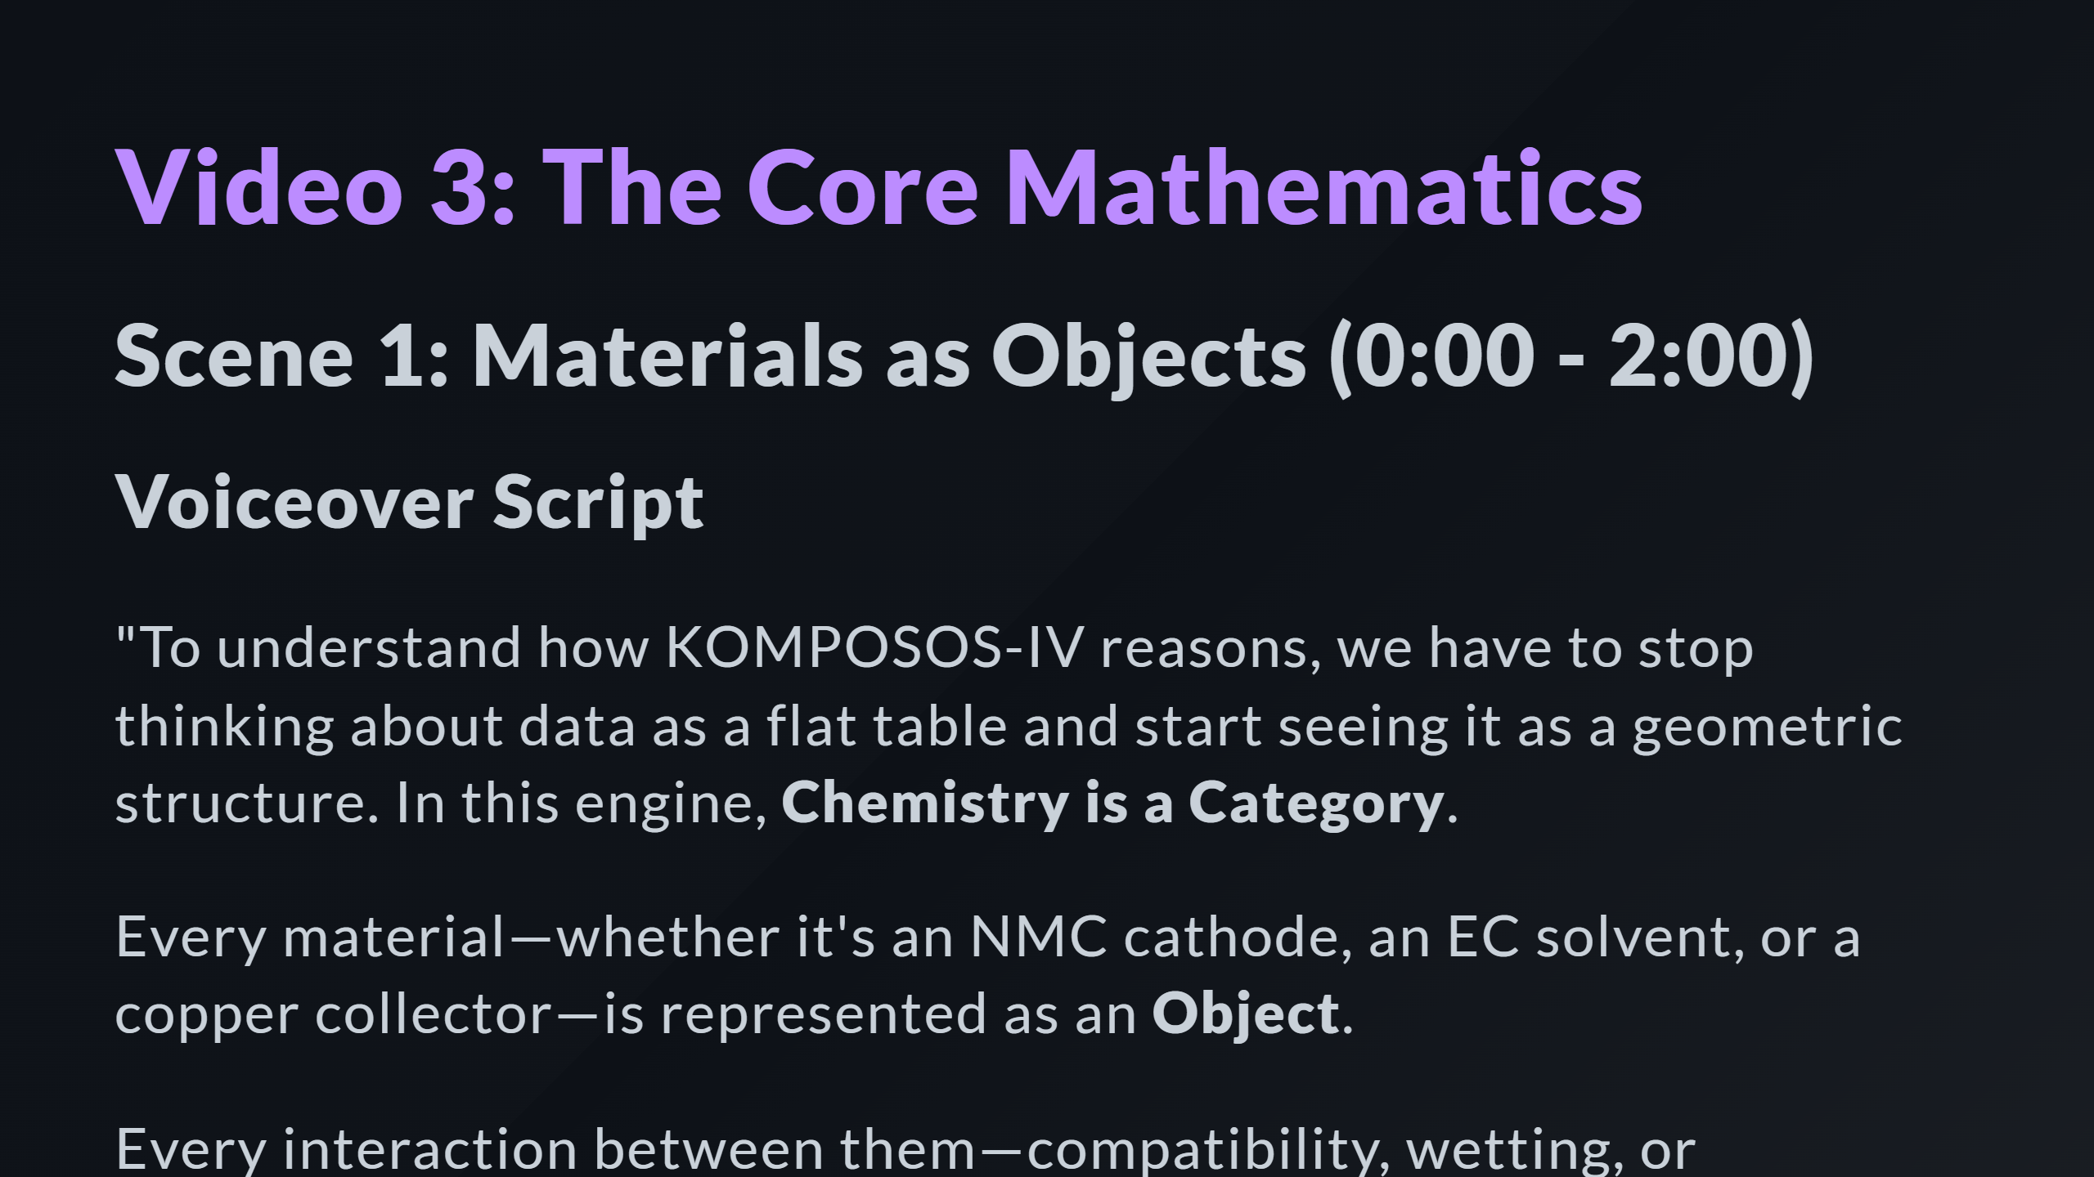

Slide 2
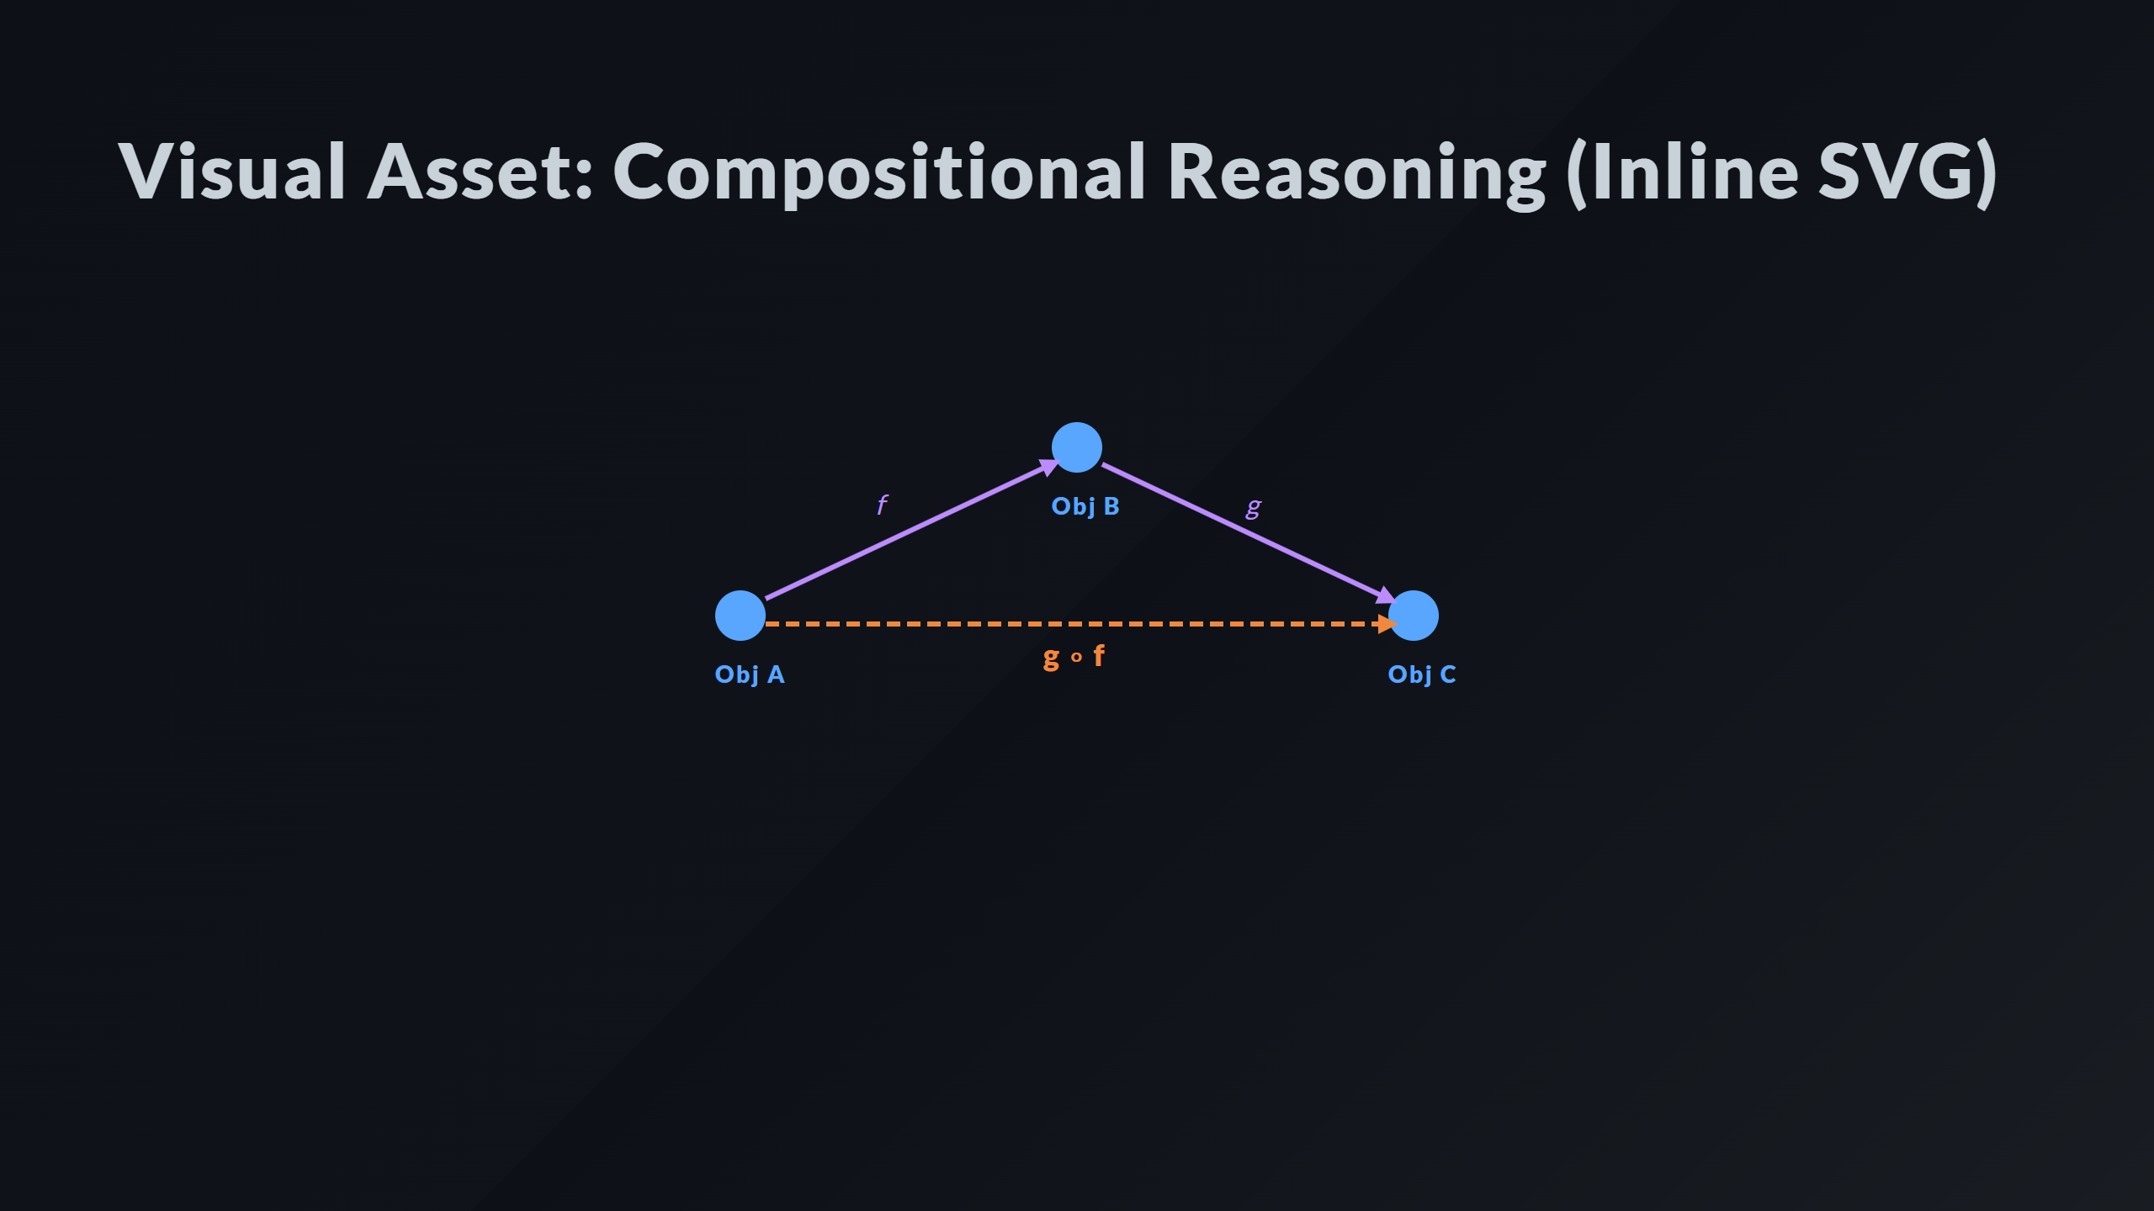
Notes:
Morphism f Morphism g Composition g ∘ f

Slide 3
