Slide 1
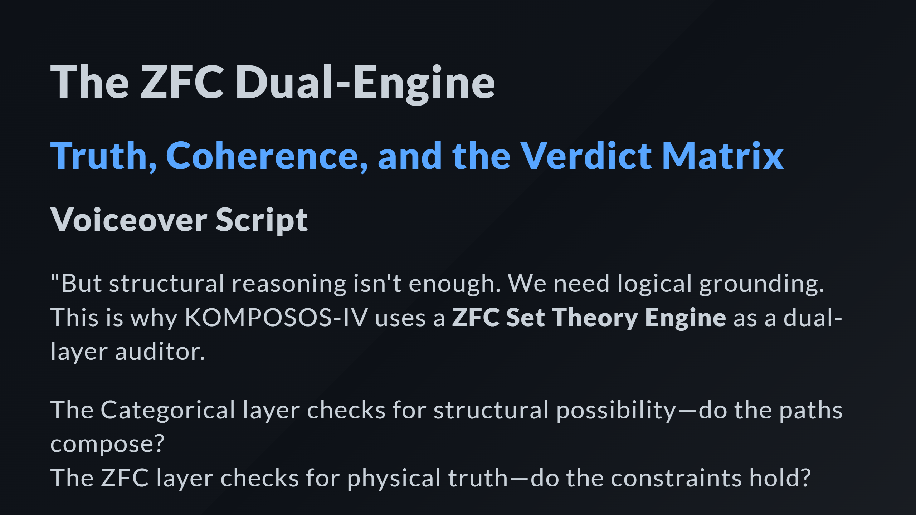

Slide 2
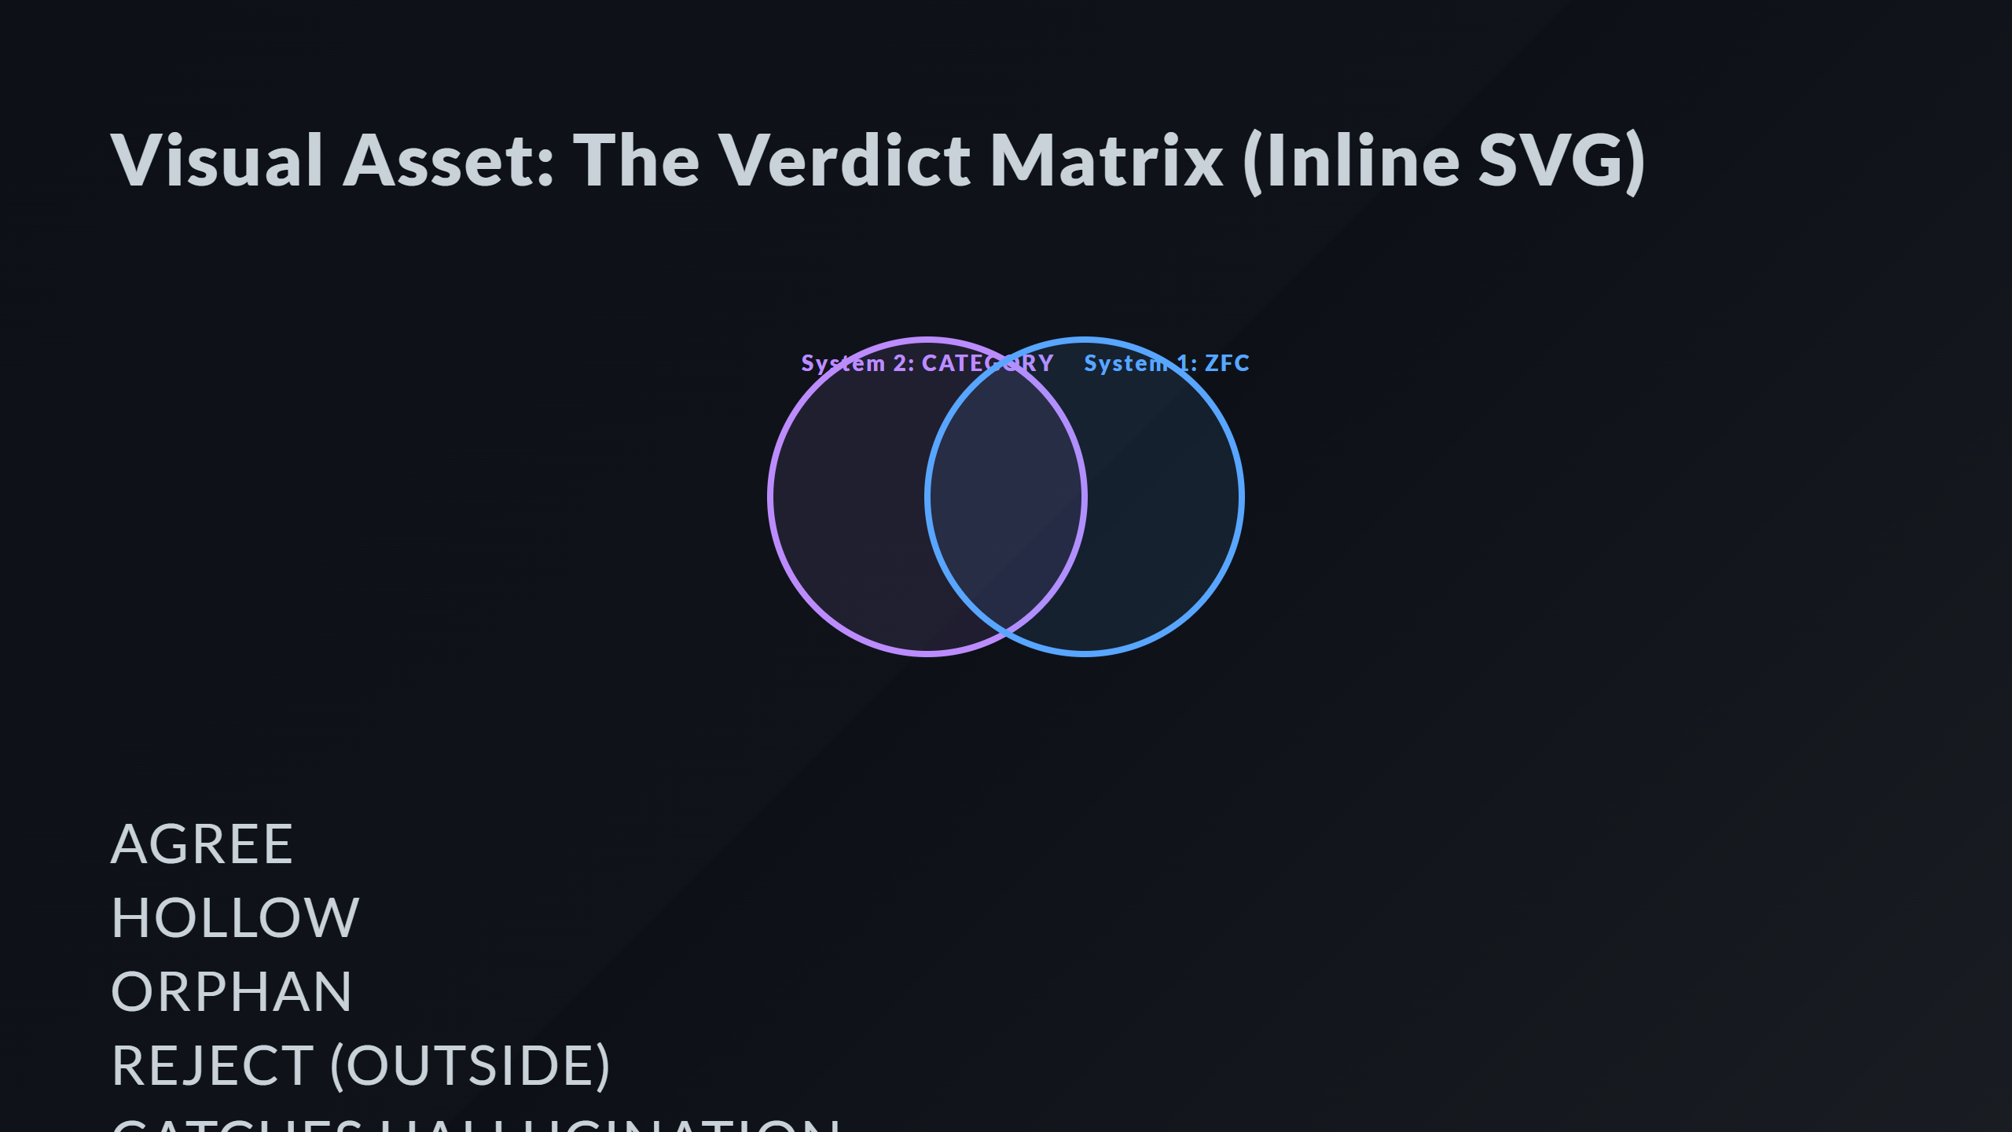
Notes:
Labels The Epiphany Moment (Hollow)

Slide 3
