Slide 1
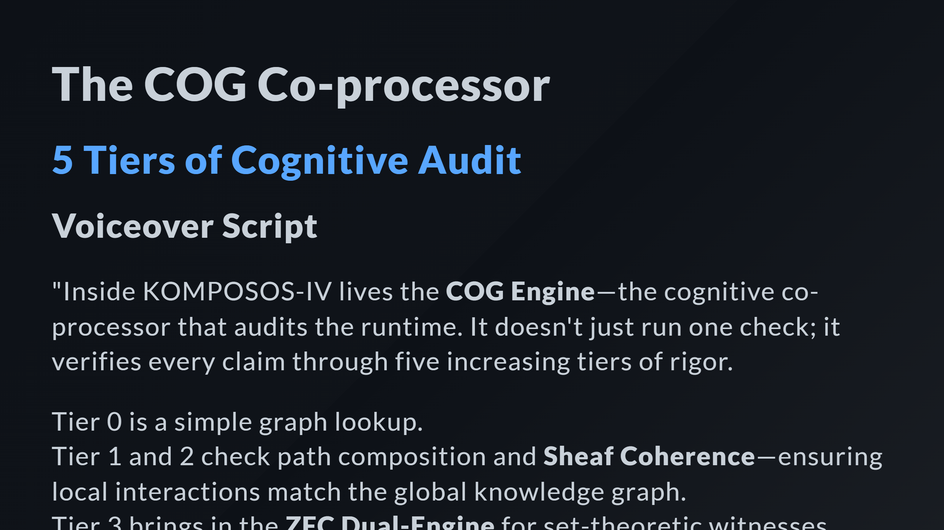

Slide 2
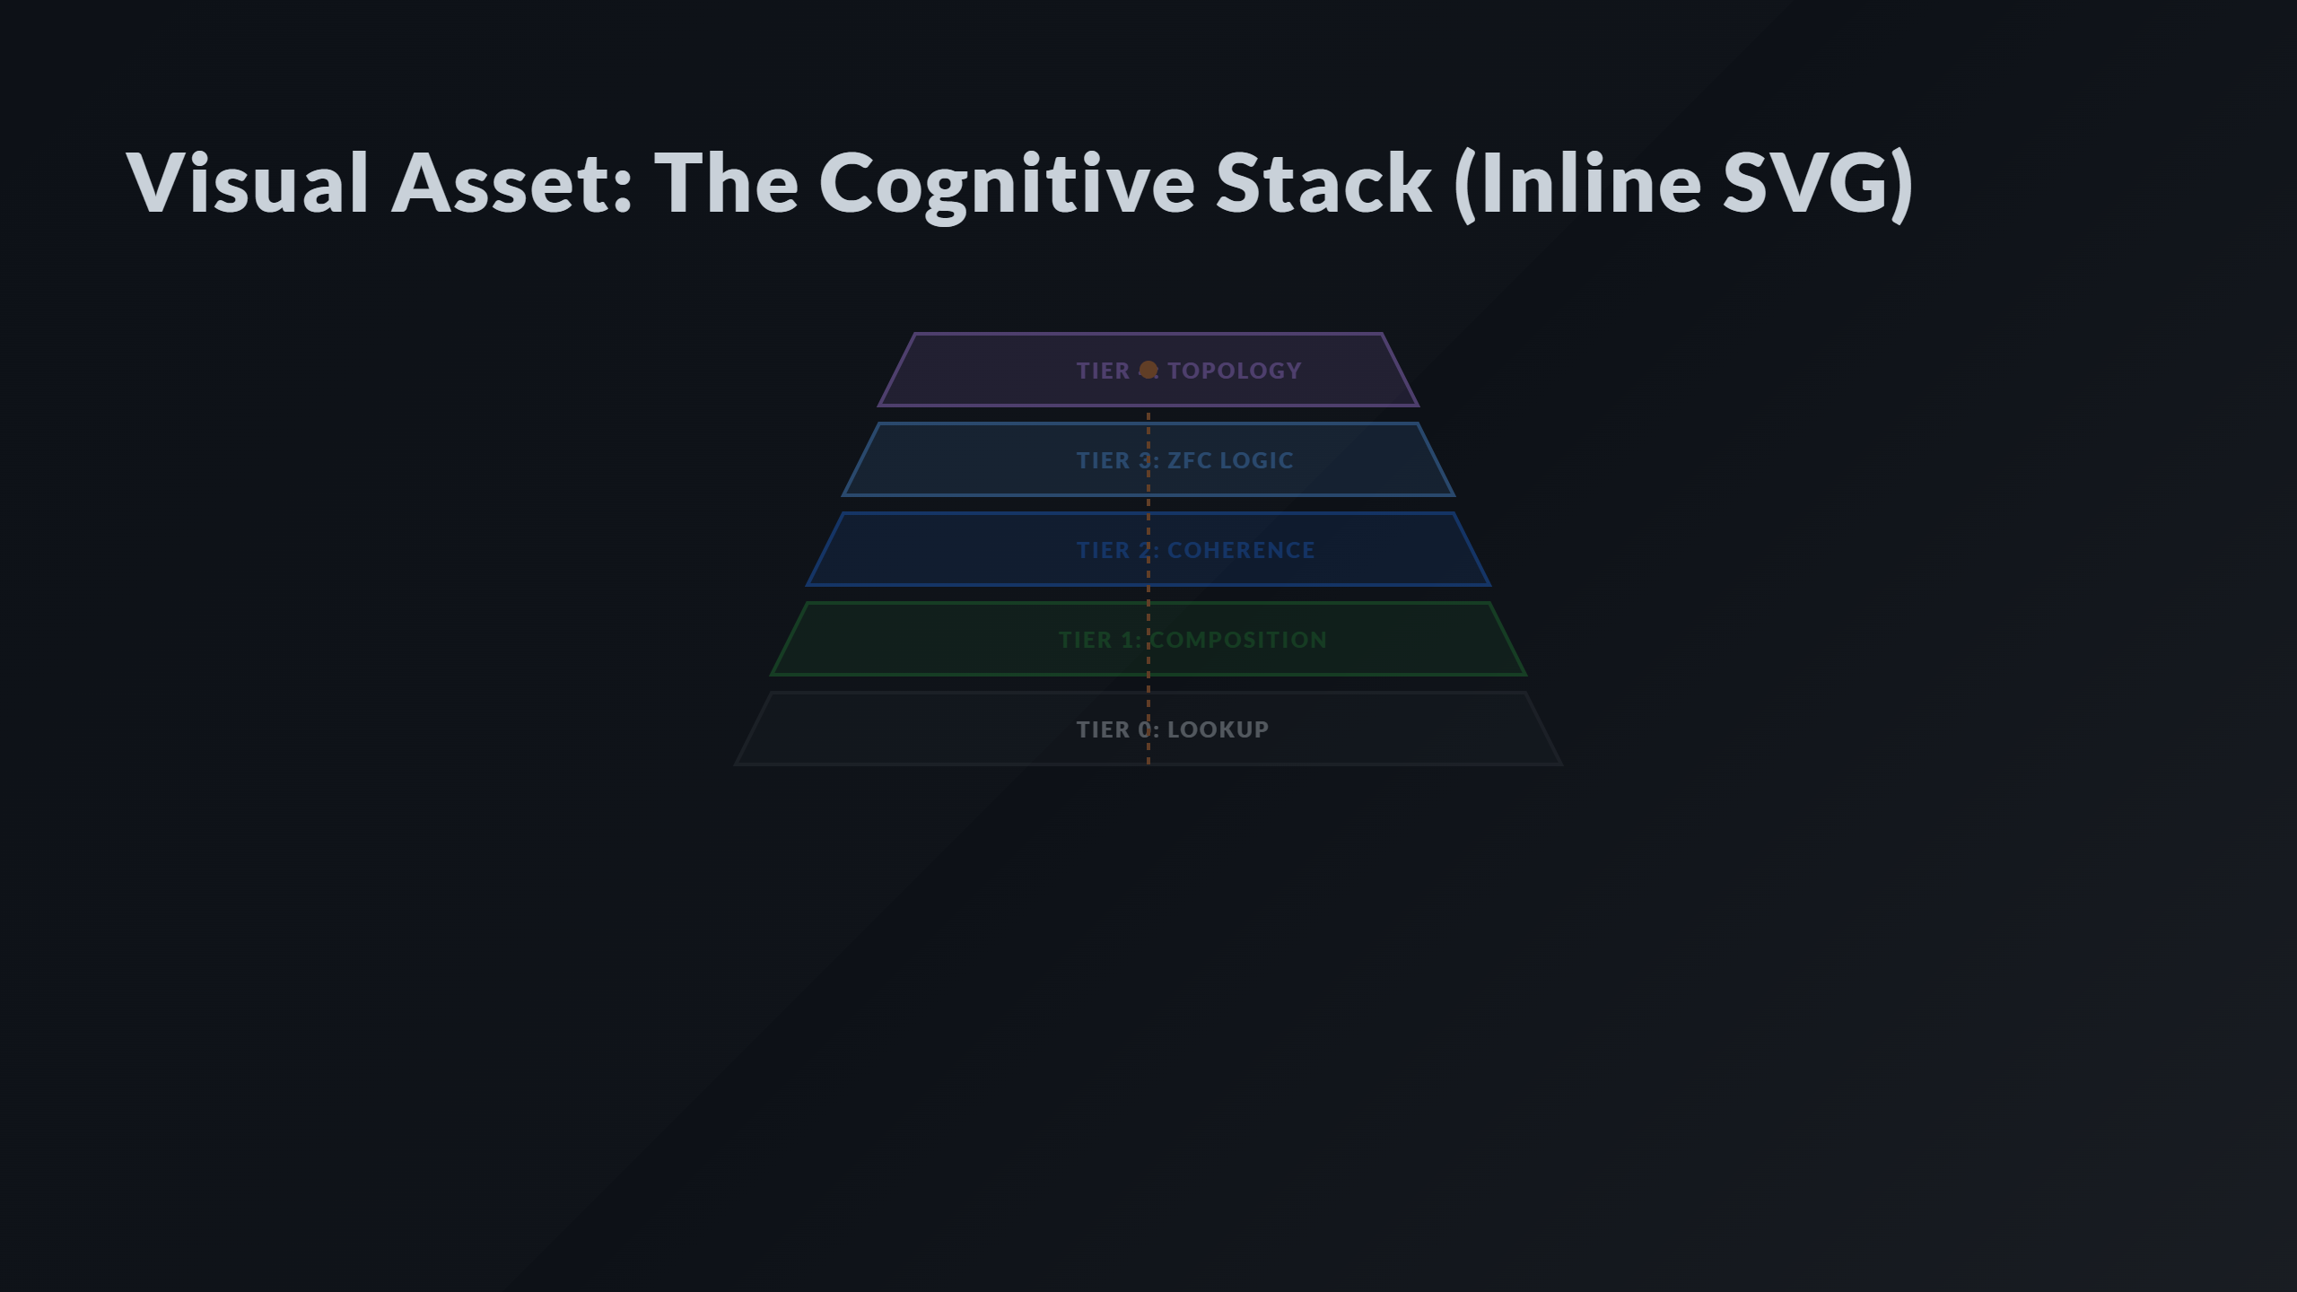
Notes:
Tier 3: ZFC Logic Tier 2: Sheaf/Kan Tier 1: Composition Tier 0: Graph The Coherence Signal

Slide 3
