Slide 1
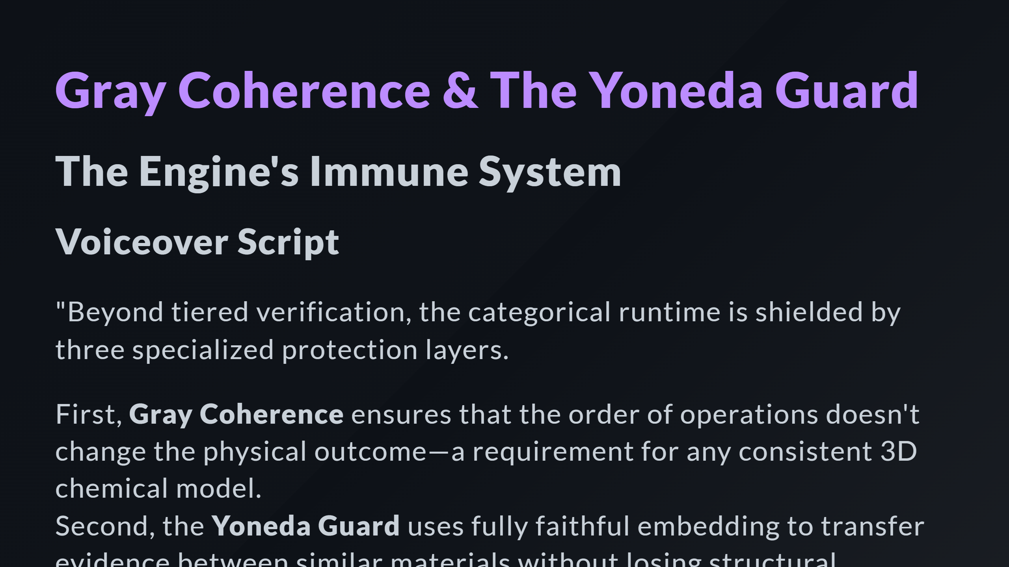

Slide 2
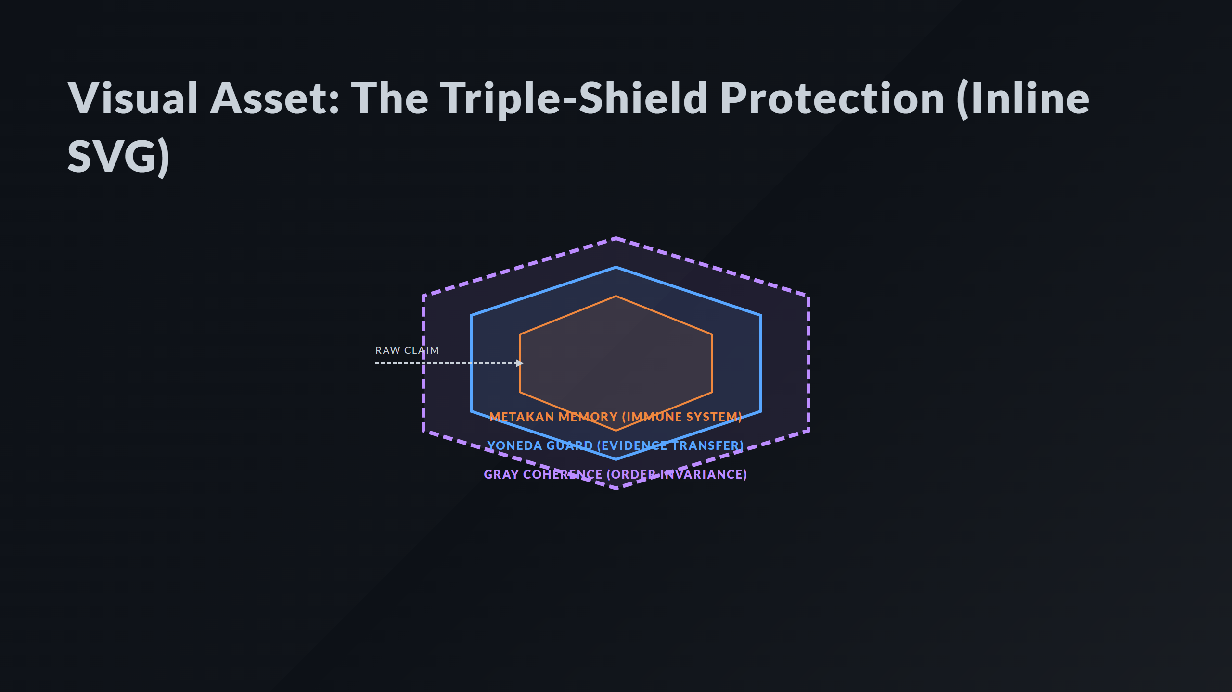
Notes:
Middle Shield: Yoneda Guard Inner Core: Failure Memory Data Flow

Slide 3
