Slide 1


Slide 2
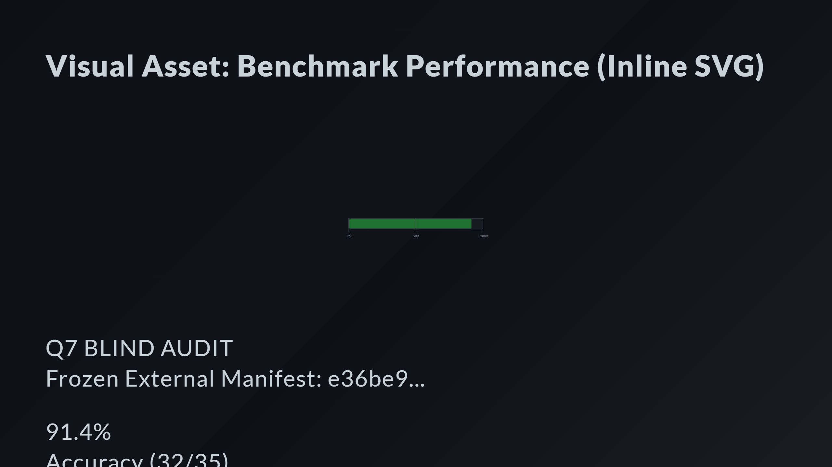
Notes:
Success Bar (91.4%) Milestone Markers Labels Big Numbers Status Badge

Slide 3
