Slide 1


Slide 2
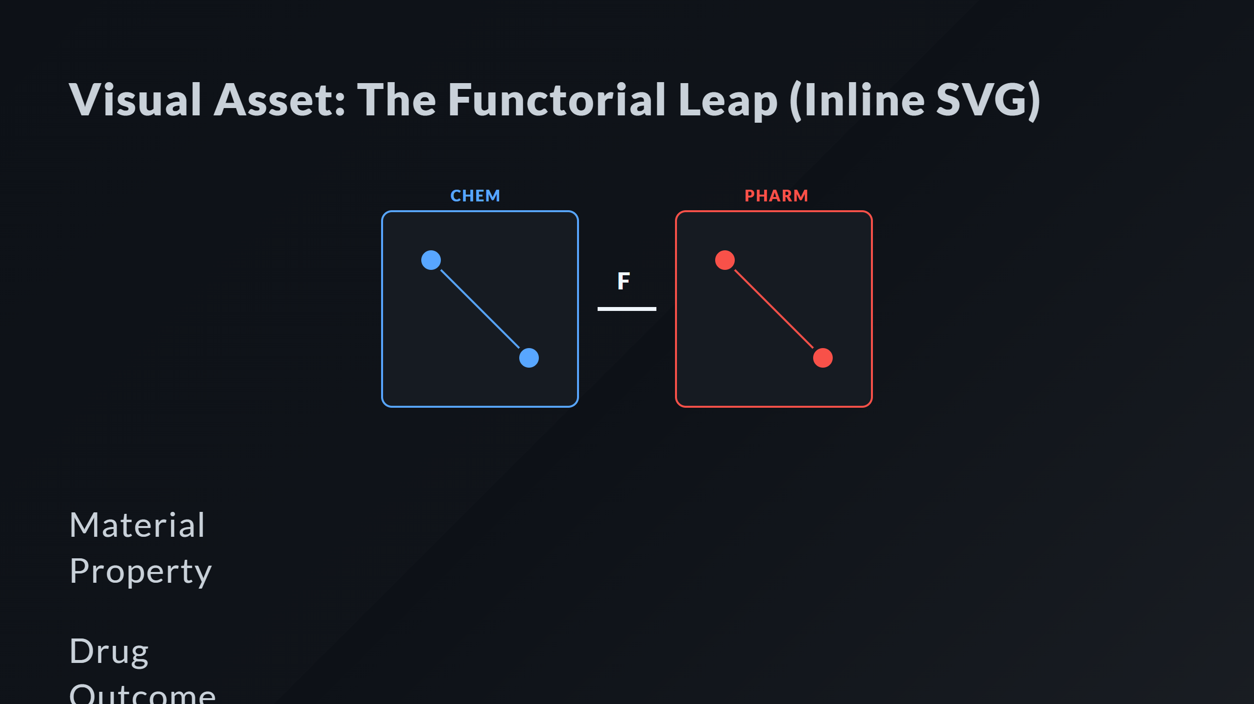
Notes:
The Functor F Domain: PHARM Labels

Slide 3
