Slide 1
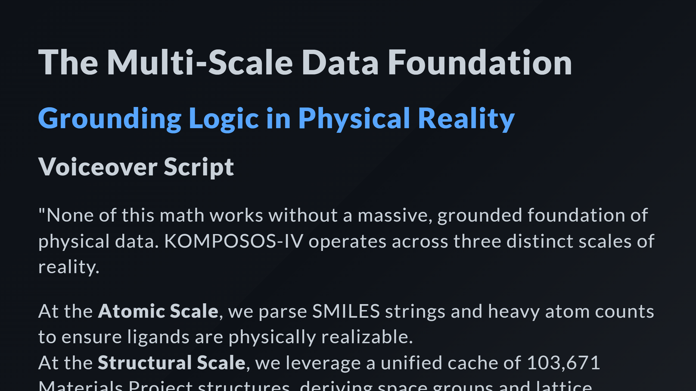

Slide 2
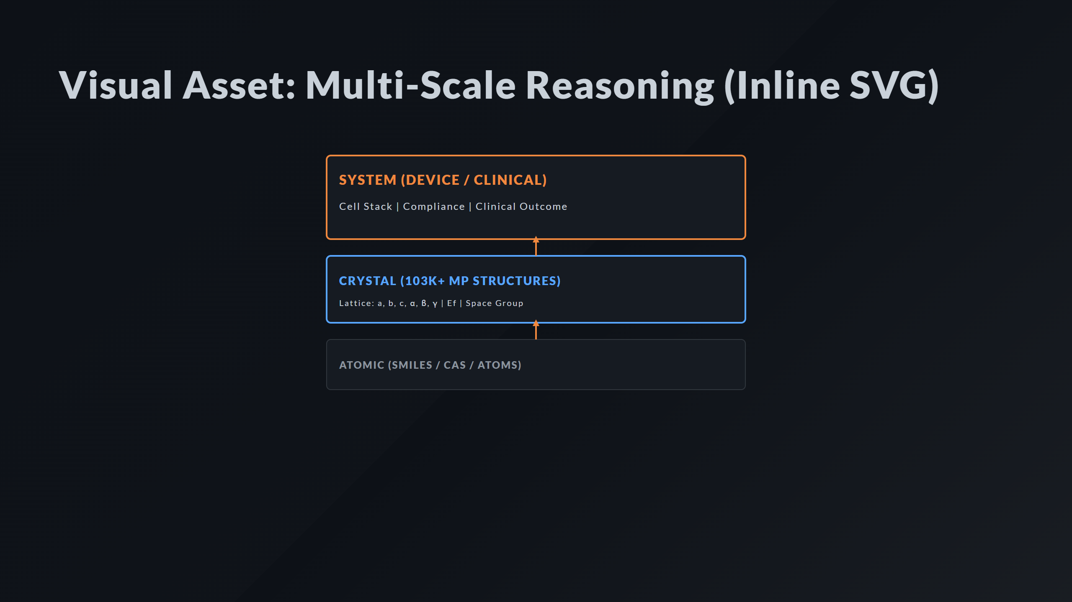
Notes:
Scale 2: Crystal Scale 3: System Relationships

Slide 3
